Slide 1
Water supply from NBS for irrigation & cropping
Pumping options

Slide 2
Definitions

Slide 3
Water pumping: what is it?
Definion: The action of pumping or circulating water in a system.¹
In practice: For irrigation it is used to bring water from a source (a well, a river, a pond, etc.) to the plants. Usually the water is both pumped:
Up (in elevation) because the water source is located lower than the plants.
Horizontally though the system to get from point A (the source), to point B (the plant).
1. Source: Merriam-Webster dictionnary, 2021.

Slide 4
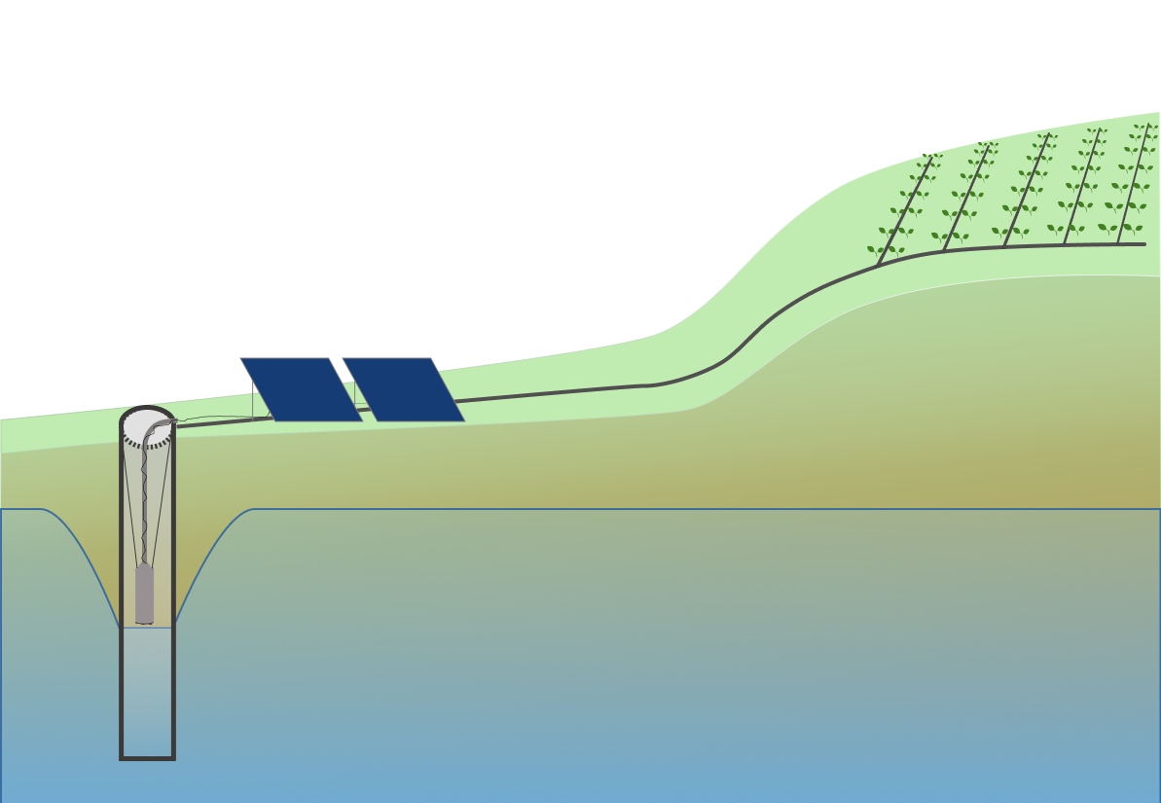
Irrigation system
An application system: it applies the water to the plant and distributes it amongst the plants in the plot. Here a drip system.
The irrigation system is the whole system that will allow to transport the water from the source, to the plant. It is composed of:
A conveyance system: its goal is to guide the water between the different components of the system
A pump: its purpose is to move the water through the system => It transforms energy into a movement. Here a submersible pump.
Solar panels are the generators which provide energy to the pump.
A water source: a well, a borehole, a river, a pond, etc. => A place where the water is available in a sufficient quantity to irrigate all the plants. Here a borehole.

Slide 5
The pump
Definition: a mechanical device using suction or pressure to raise or move liquids […].²
There are two types of pump:
Suction pumps
Lifting pumps
A submersible pump
2. Source: Oxford language, 2021

Slide 6
Suction / Lifting

Slide 7
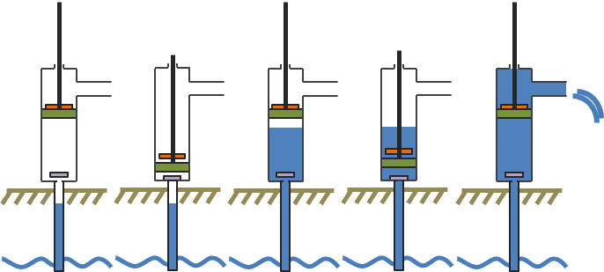
Suction pumps
They “suck” the water up.
The pumping mechanism is located outside of the water source.
The maximum pumping depth is generally around 7m (varies according to the atmospheric pressure)
/!\ With the drawdown depth, it generally means that it is only possible to use this type of pump when the static water level is 6m or less
1
2
3
4
5
Example with a piston pump
Notes:
This type of pump works by lowering the pressure in the suction hose/pipe by creating a vacuum. The pressure differential causes the water to move from the water source into the pipe and it initiates the water movement.

Slide 8
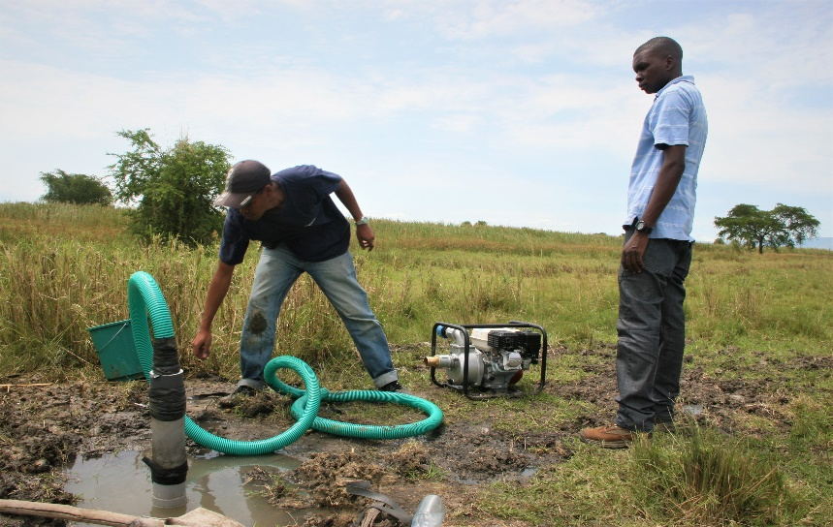
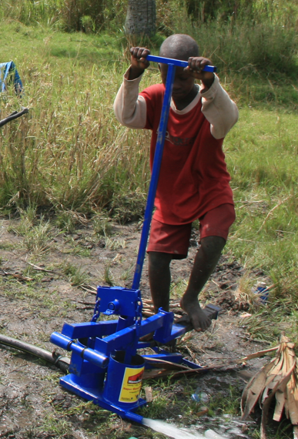
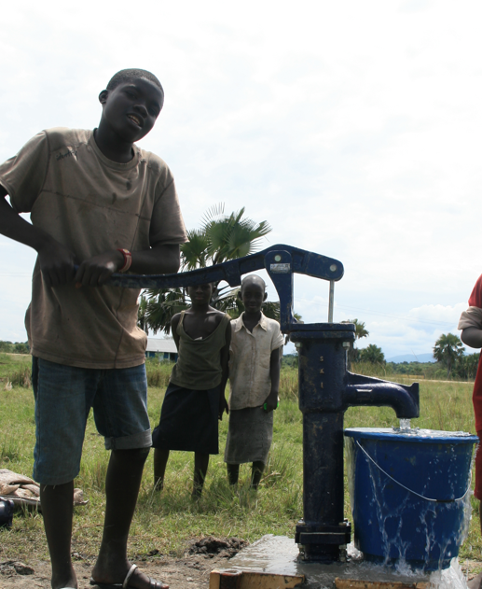
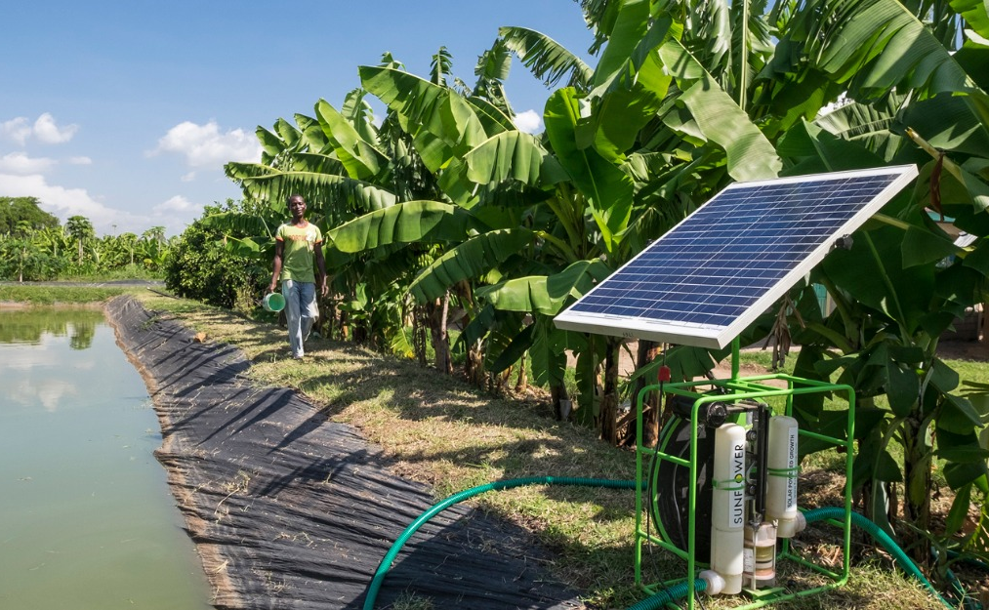
Suction pumps

Slide 9
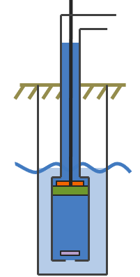
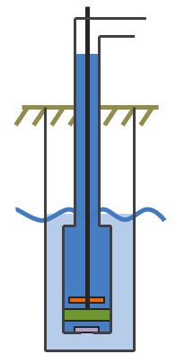
Lifting pump
They “push” the water up.
The pumping mechanism is located inside of the water source.
1
2
3
Example with a piston pump

Slide 10
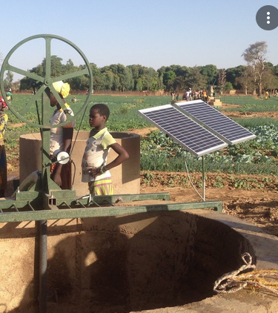
Lifting pumps

Slide 11
Pumping mechanisms
Most of the pumps for small-scale irrigation are centrifugal pumps (suction & submersible pumps)
E.g. Petrol pumps are all centrifugal
Some submersible pumps are helicoïdal
E.g. Some submersible pumps are helicoïdal
Piston or diagraphragm pumps ➔ much less common for agricultural purposes

Slide 12
Power generator

Slide 13
Types of energy source
For irrigation purposes, in sub-saharan Africa, pumps are powered mostly by:
Petrol/Diesel pumps = Petrol engines + diesel engines
Solar pumps = Electric motors powered by solar panels
Electric pumps = Electric motors powered by petrol/diesel generators or connected to the grid
Hand pumps = Human powered

Slide 14
Petrol pumps
Very frequent / most common => cheap & widely available
100% suction pumps
Powerful (in comparison to other types of pumps of similar prices) => high flow, high lift

Slide 15
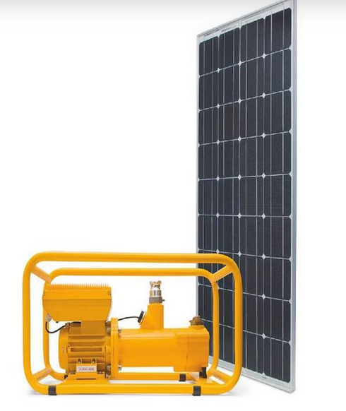
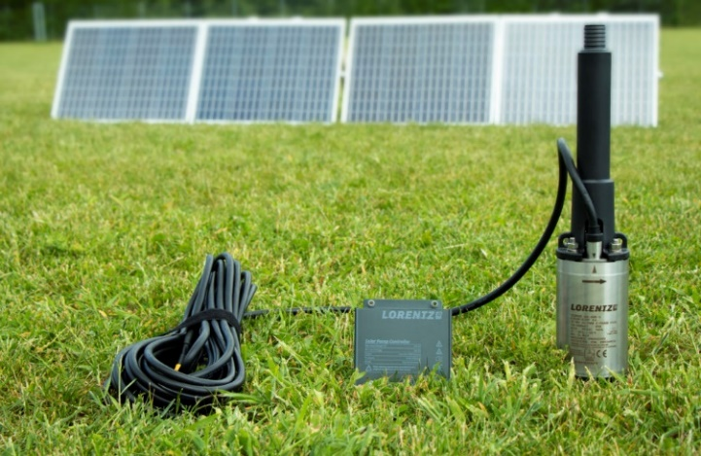
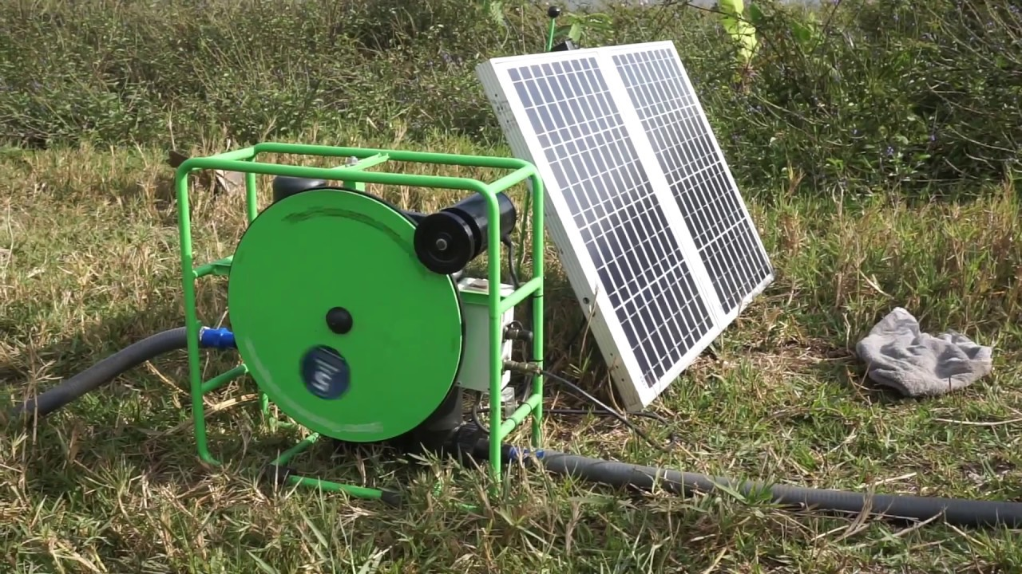
Solar pumps
More expensive than petrol pumps
Both suction & submersible types
Smaller pumps provide a low yield… but they can provide water throughout the day for free!
Emerging markets in sub-saharan Africa and Mozambique

Slide 16
Electric pumps
Both suction & submersible types

Slide 17
How to (technically) choose a pump?
Technical feasibility of the pump is not the only criteria to take into account. Commercial services associated with the pump and financial aspects should, of course, not be negleted.

Slide 18
Water source
Shalow VS deep water:
Shalow water ➔ suction OR submersible pumps are possible
Deep groundwater (> 6 m) ➔ submersible pumps only
Yield of the water source:
Measure the yield of the water source ➔ from this you know the volume that your water source is able to provide.
Water quality:
Determine the quality of your water source. Some pumps are more sensible to silk and sand than others

Slide 19
Water need & required pump yield
Reference evapo-transpiration in the area (Eto)*
X
Crop coefficient (Kc)**
Crop need
X
Area to irrigate
Water need of the farm
X
Efficiency of the application system***
Yield of the water source
Required pump yield
<
* https://aquastat.fao.org/climate-information-tool/
** https://www.fao.org/3/bc824f/bc824f.pdf
*** Part 2 of this course
Notes:
Required pump yield: the water that your pump should be able to provide at the head of your system.

Slide 20
Yield
How to make sure that the pump you have selected will provide enough water (= the required pump yield) when placed in your system ?
➔ Read the pump curve.
Make sure that at the head of your system, the yield of the pump is superior than your required pump yield.

Slide 21
Pump curve
The pump curve below is a way to present the characteristics of a pump and determining if it can be used in a specific situation. Each pump has its own curve.
The yield of the pump is correlated to the head of the system.
The higher the head, the more power is required to move the water, so the lower the yield is.
720Wp
Pump yield (L/s or m3/h)
360Wp
Total head (m)
Notes:
=> How to know if a pump is suitable for a specific situation? => One essential element is by knowing the head of the system and reading the pump curve to know how much water the pump can provide at this head.

Slide 22
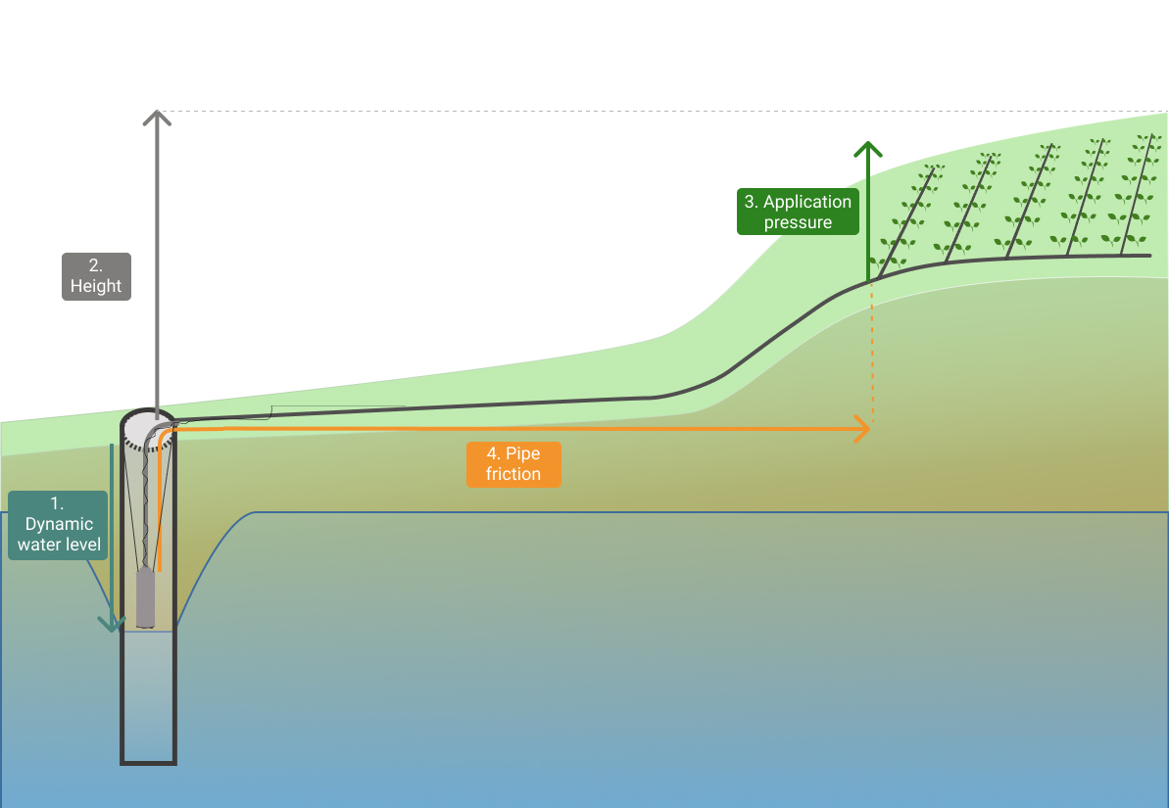
What is the head?
The application pressure: the force required to optimaly use the application system
To move the water in the system, the pump is confronted to different types of pressure that it needs to overcome:
The elevation (dynamic water depth + height)
The pipe friction
The application pressure
The elevation: (Water depth + height) the gravitational forces on the column of water between the lowest and the highest point in the system
The pipe friction: the frictional forces acting against the water’s movement in a container (e.g. pipes)

Slide 23
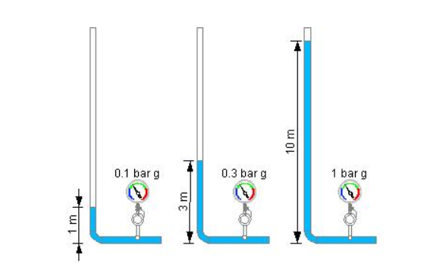
How do I know the head?
The head is expressed in meters.
The elevation: 10 meter water column = 1 bar = 10 meter head
Pipe friction depends on the pipe diameter, you can use this: https://www.nationalpump.com.au/calculators/friction-loss-calculator/
Each application system works with a specific water pressure which also varies depending on the number of units and their size.

Slide 24
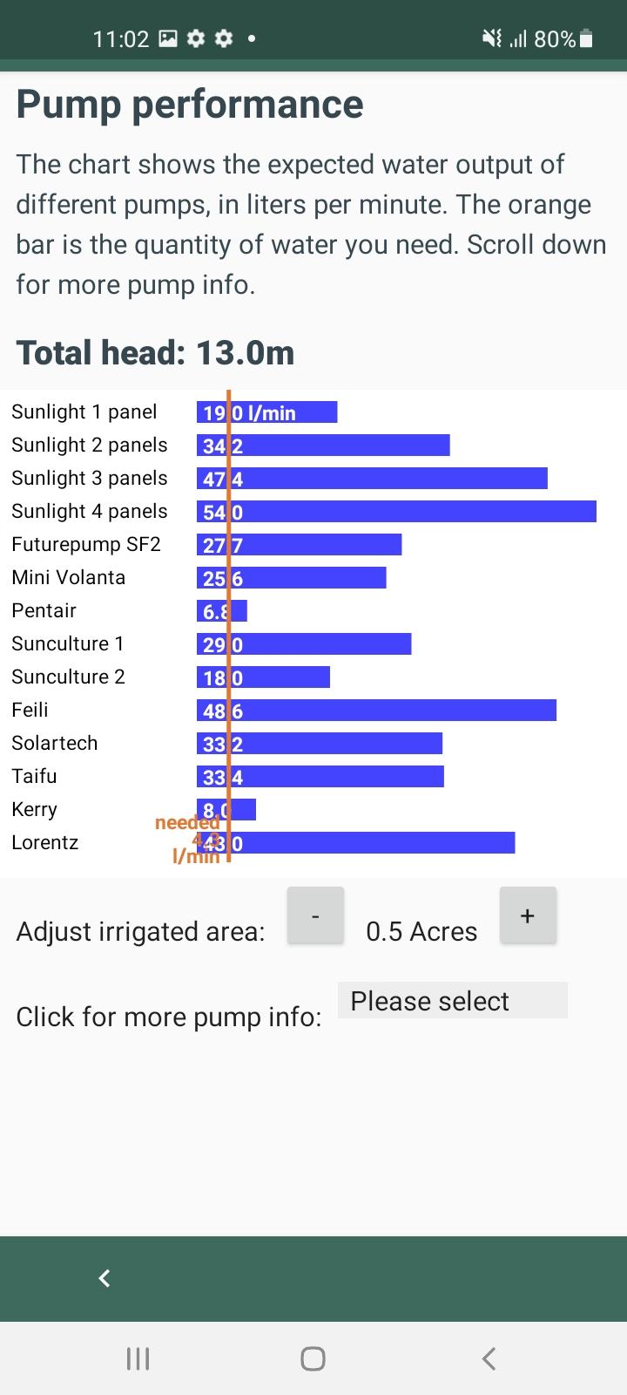
Practicing with the Sips app
Download the SIPS (Solar Irrigation Pump Selector) on your android phone, from the Google Store.
1. Enter the characteristics of your system
2. Choose amongst the pumps that are proposed to you

Slide 25
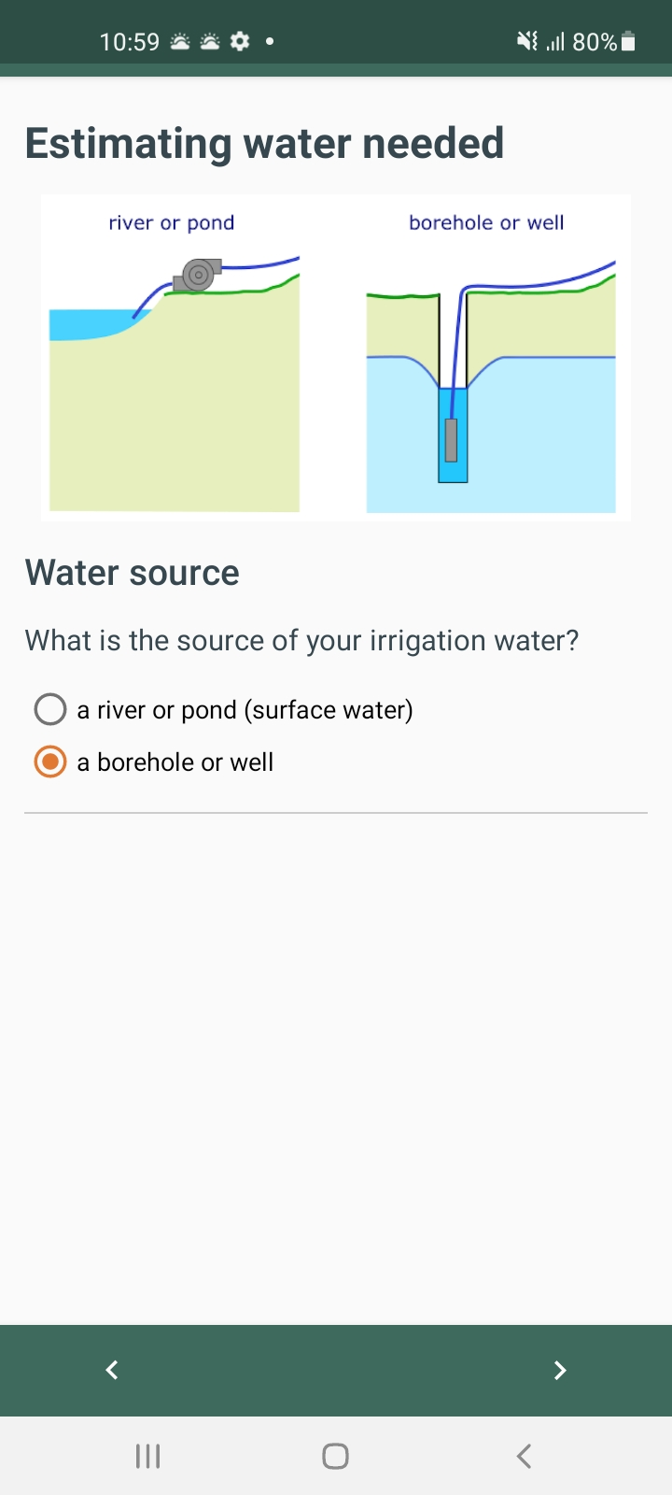
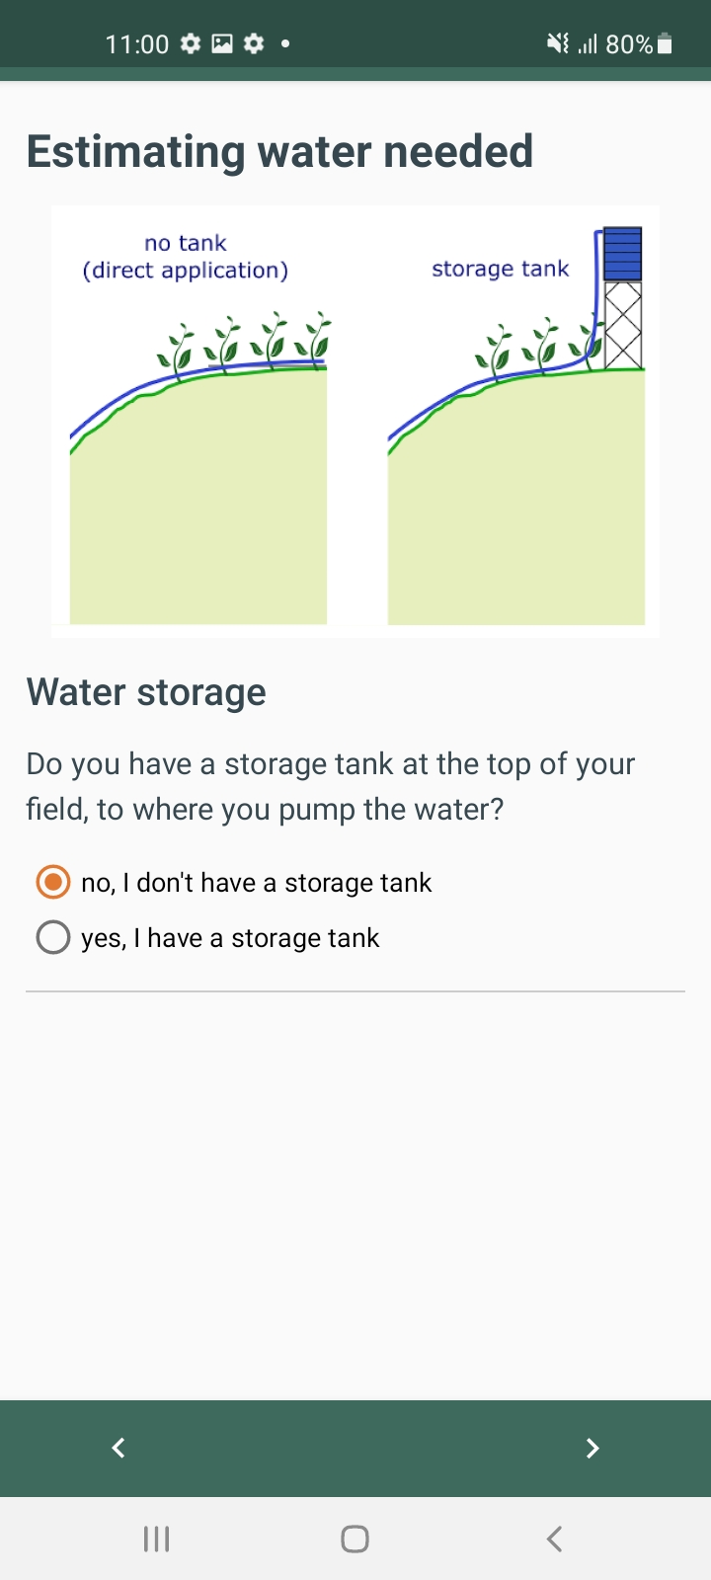
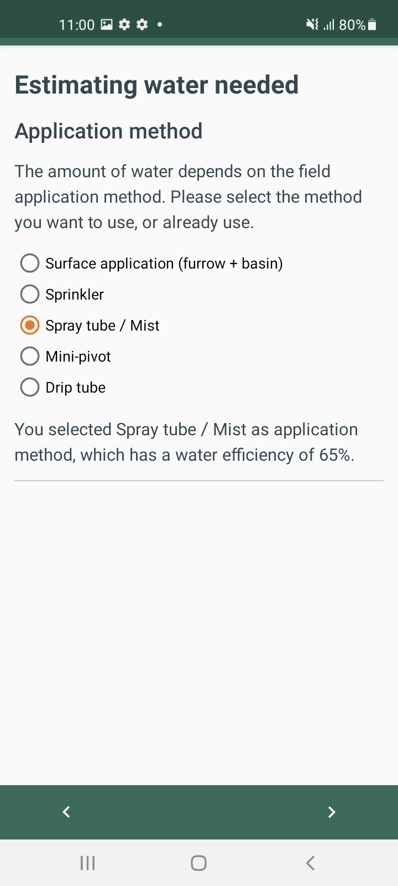
Why? To estimate whether a surface or a submersible pump can be used
Why? 1) To know whether the pump is connected to an application system and estimate the efficiency. 2) To estimate the height of the system.
Why? 1) To estimate the efficiency and caluate the required pump yield. 2) To estimate the application pressure for head calculation.

Slide 26
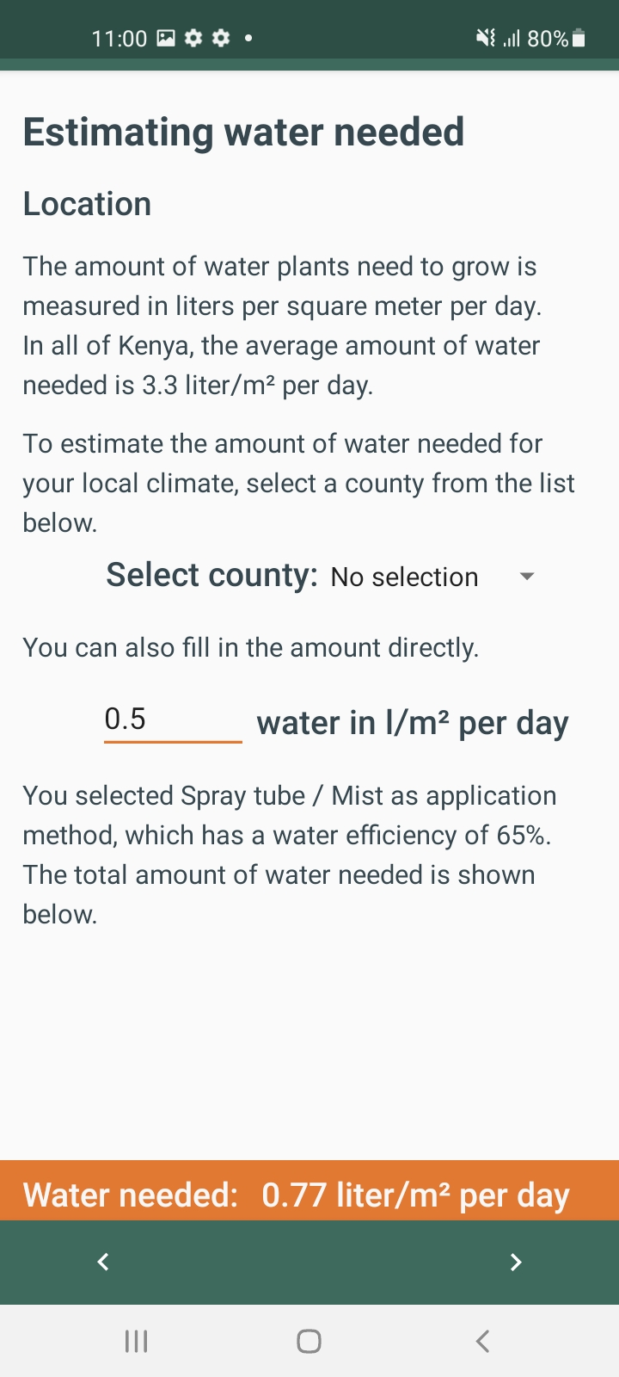
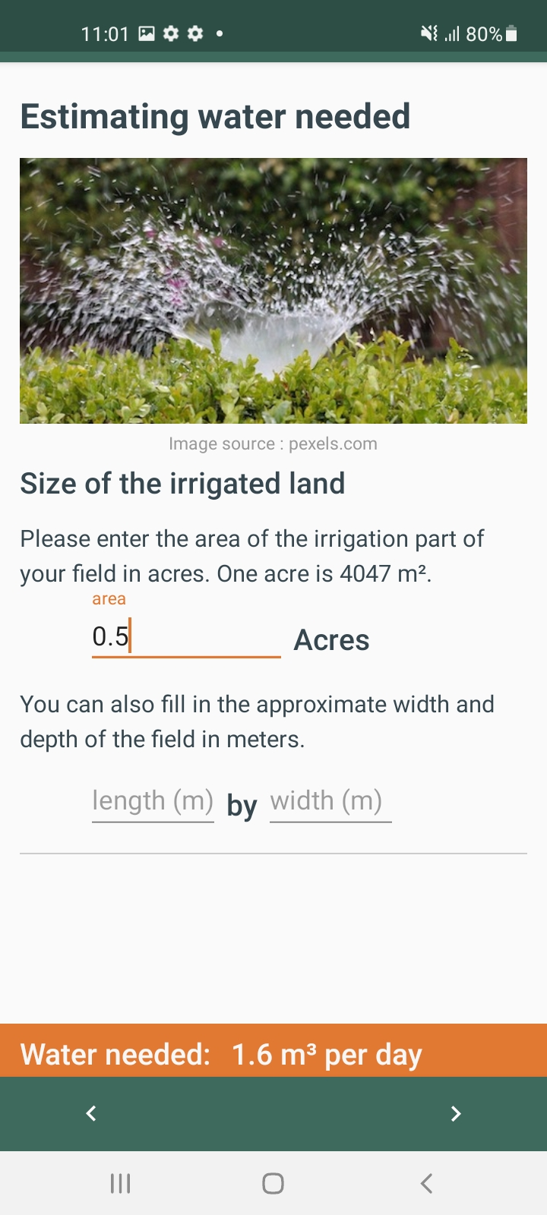
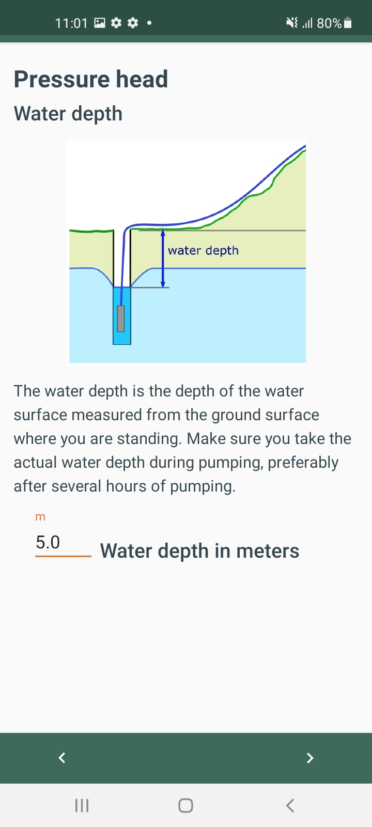
Why? To estimate the required pump yield
Why? To estimate the required pump yield
Why? To estimate the head of the system

Slide 27
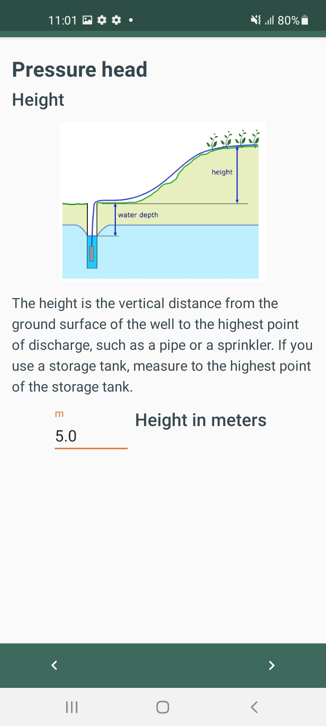
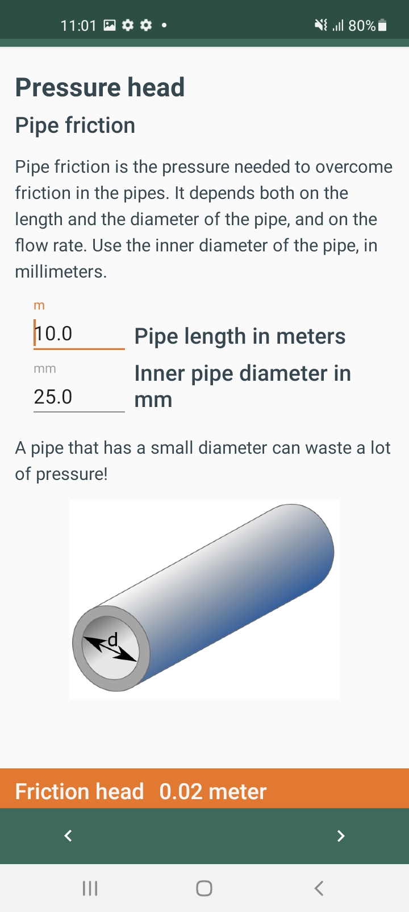
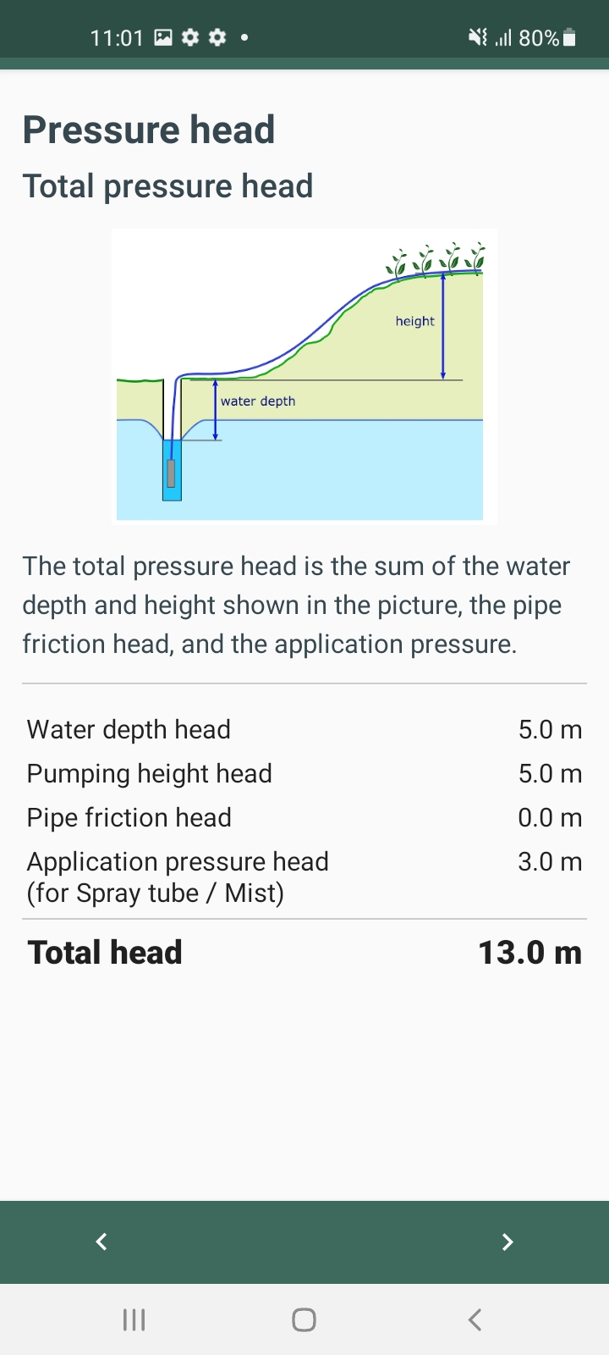
Why? To estimate the head of the system
Why? To estimate the head of the system
Why? To inform on the calculated head and the steps taken to reach the result.

Slide 28
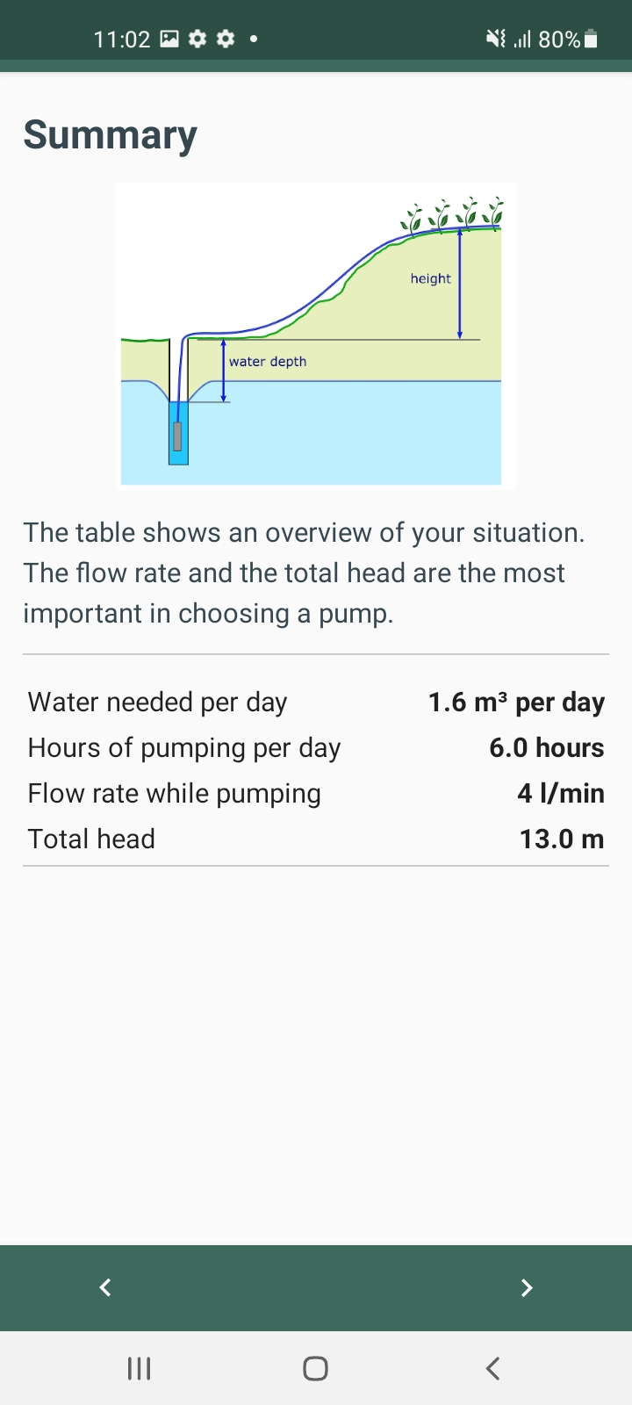
Why? To inform on the characteristics of the system that the pump needs to fit with
Why? To inform on the pumps that work for the system

