Slide 1
Water supply from NBS for irrigation & cropping
Application systems

Slide 2
Definitions

Slide 3
Application system: what is it?
Definion: The system (technology, practice or construction) that distribute the water coming from the system, to the plant.¹
In practice: Examples
Drip irrigation, sprinklers, spray tubes, etc.
Manual application with a hose or a watering can
Furrows digged in the field
Each type of system has a specific efficiency.
1. Source: Merriam-Webster dictionnary, 2021.

Slide 4
Efficiency: what is it?
Definition: it is the percentage of water that enters the application system and will actually reach the plant.
Even in a perfect condition, an application system is never 100% efficient, there are losses:
Losses in the air: by evaporation or splashing away from the plant
Losses in the soil: water infiltrates the deeper layers of the soil
Water distribution methods
[Leakage if the system is damaged]
=> Losses in the application need to be accounted for when calculating the required pump yield otherwise less water than expected will reach the plant.

Slide 5
Common types of application systems

Slide 6
Drip irrigation
Efficiency: Around 90% ➔ Very efficient
Application pressure: 1 to 5 m ➔ Works with very low pressure, but often requires a tank
Design & installation: difficult
Price: expensive
Lifespan: depends on quality/type
of materials.
Labour: very low

Slide 7
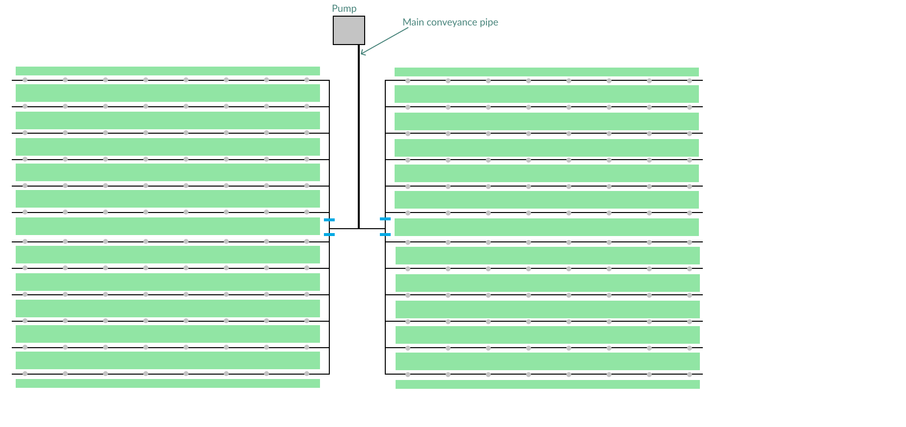
Drip irrigation layout
Sector (can be irrigated independently from the others)

Slide 8
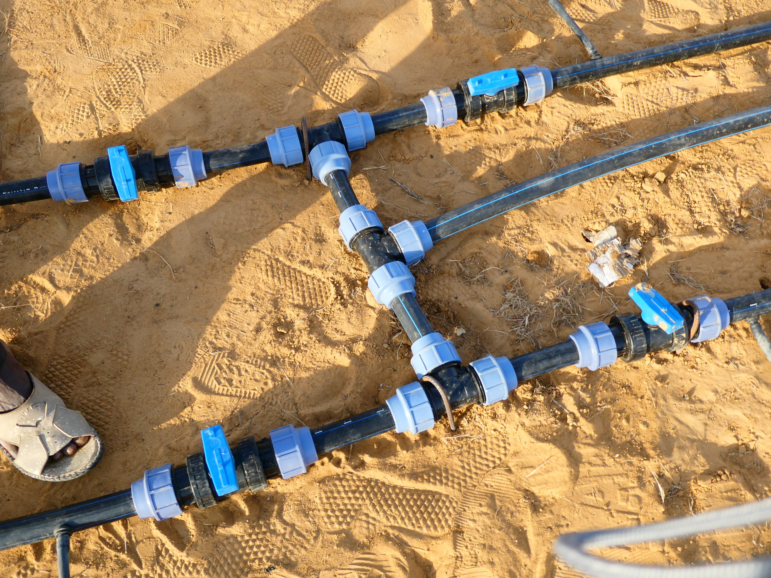
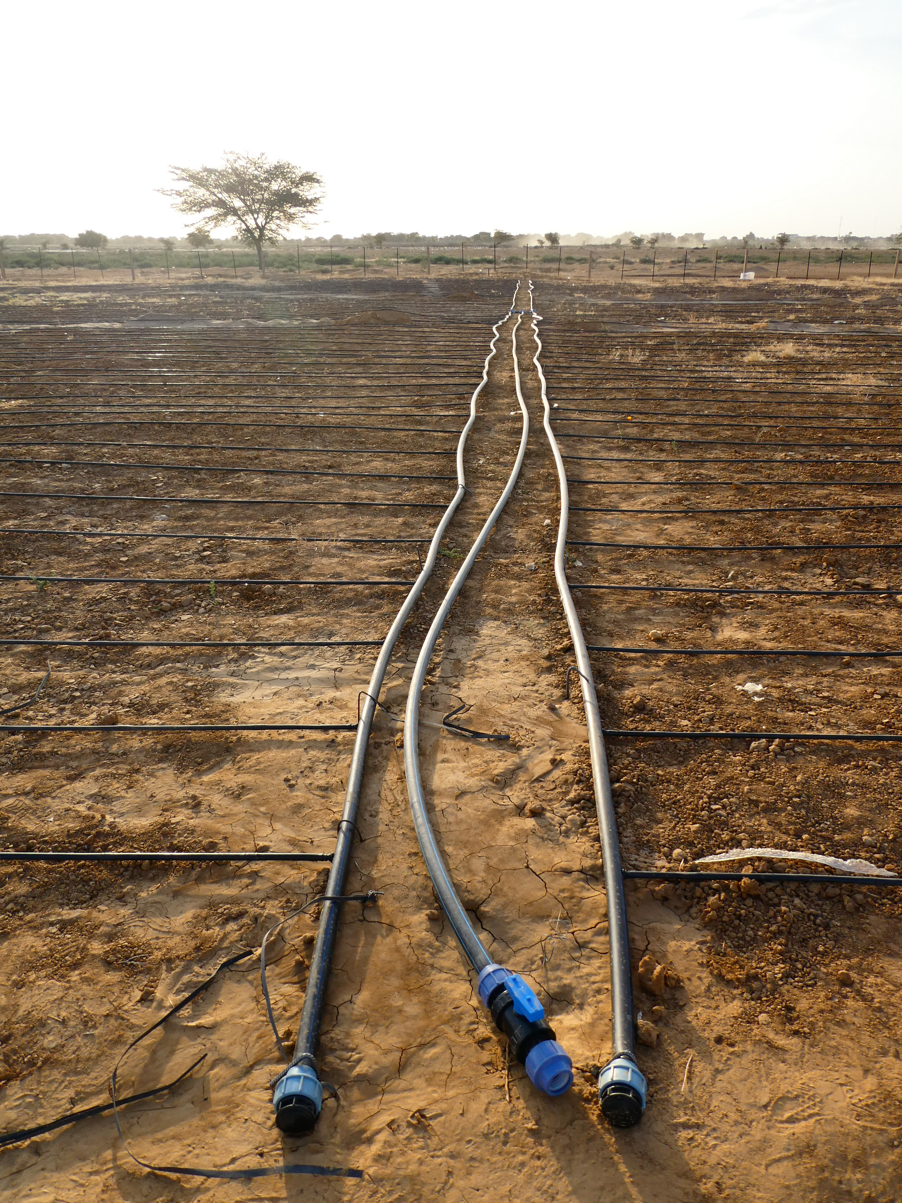
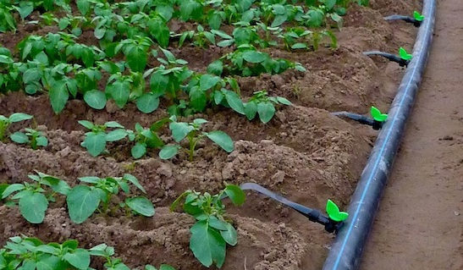
Open valve
Main conveyance pipe
Closed valve
Connections between the sectors
System being installed
Drip irrigation system

Slide 9
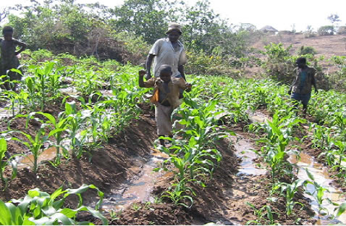
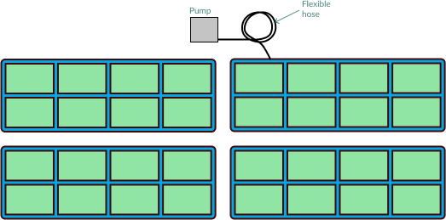
Furrows
Efficiency: Around 30-40% ➔ Not efficient (water losses in the soil)
Application pressure: 1 m ➔ Works with low pressure
Design & installation: easy
Price: cheap
Labour: moderated
Because of the very high water losses, furrows are NOT recommended with:
Solar pumps
Pumps of a low capacity
When water availability at the water source is limited

Slide 10
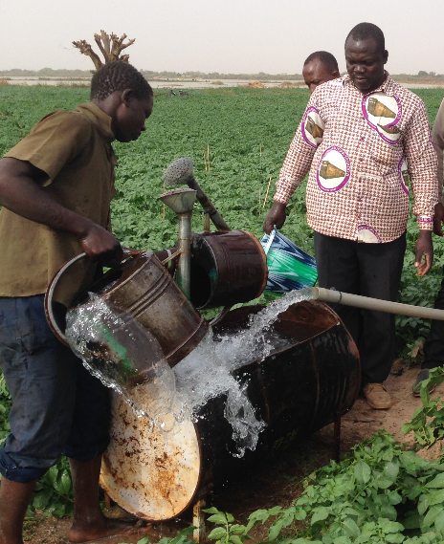
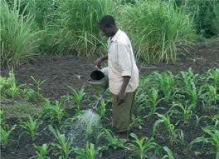
Watering can
Water efficiency: Around 90% ➔ Efficient
Application pressure: ~1 m ➔ Works with low pressure
Design & installation: easy ➔ Watering cans can be filled from a basin fed by the pump.
Price: cheap (labour costs)
Labour: intensive
Irrigation with watering cans is very time consuming.

Slide 11
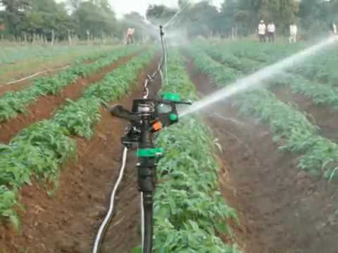
Sprinklers
Efficiency: Around 60% ➔ Low efficiency
Application pressure: 15 m ➔ Works with very high pressure
Design & installation: easy
Price: moderated
Labour: low

Slide 12
Spray tubes
Efficiency: Around 80% ➔ Efficient
Application pressure: 5 to 10 m ➔ Works with relatively low pressure
Design & installation: moderated
Price: Moderated
Labour: low

Slide 13
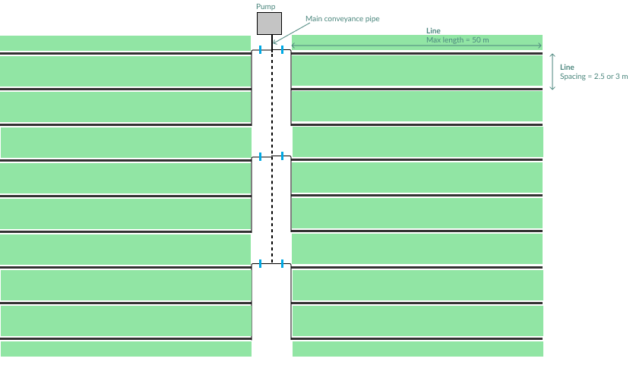
Spray tube layout
Sector (can be irrigated independently from the others)

Slide 14
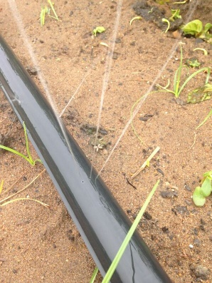
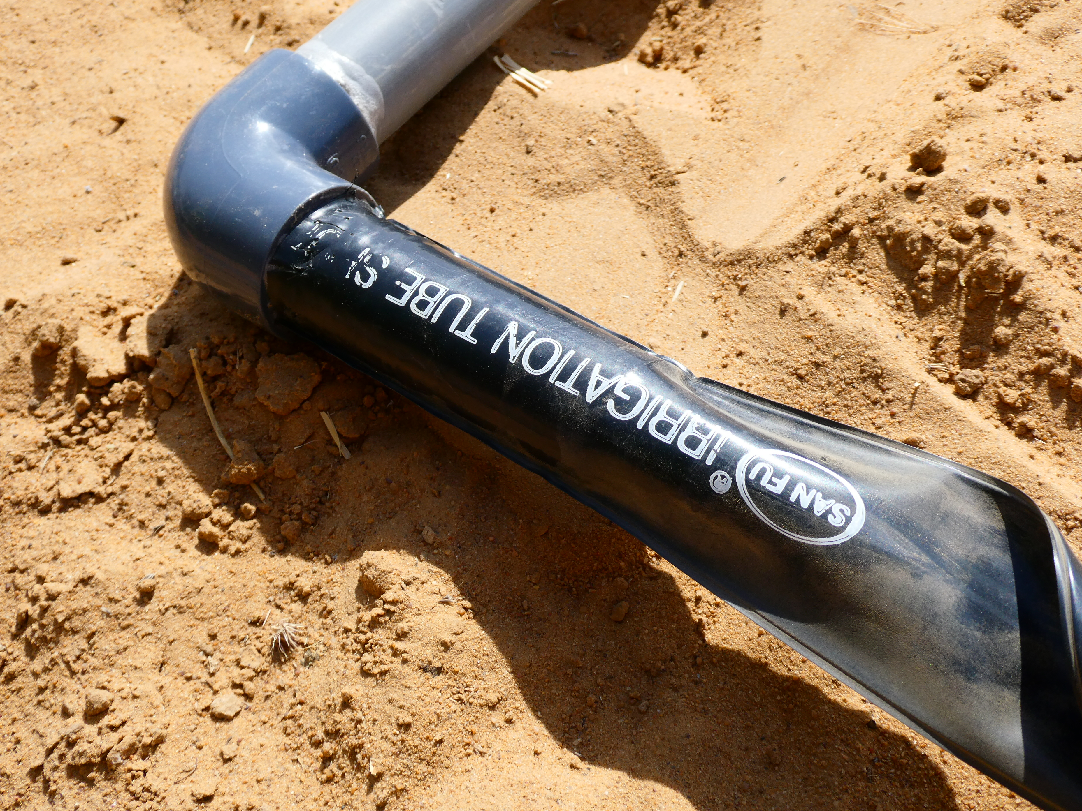
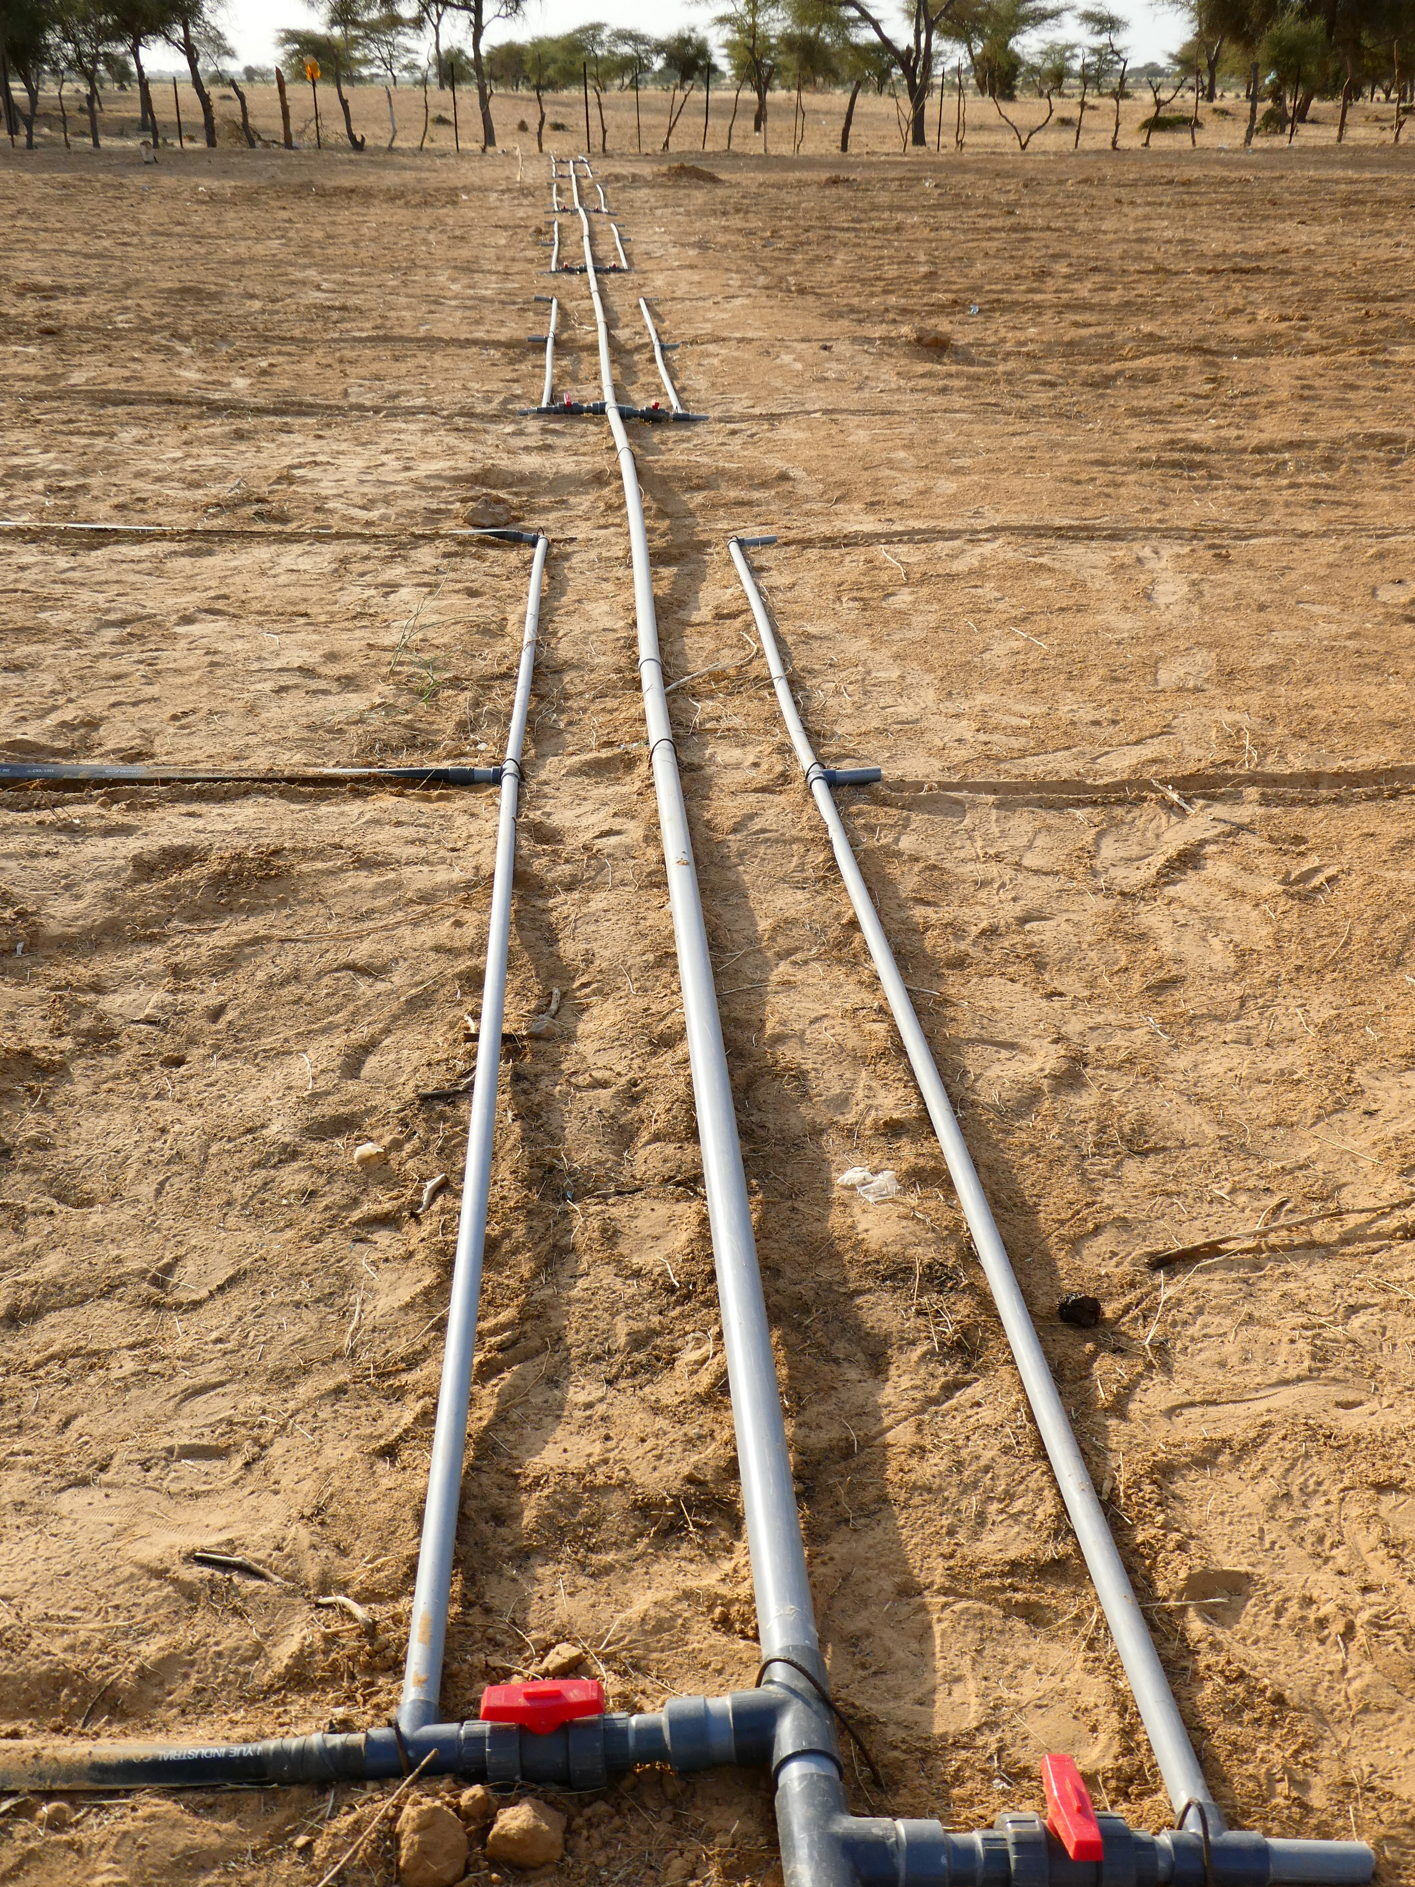
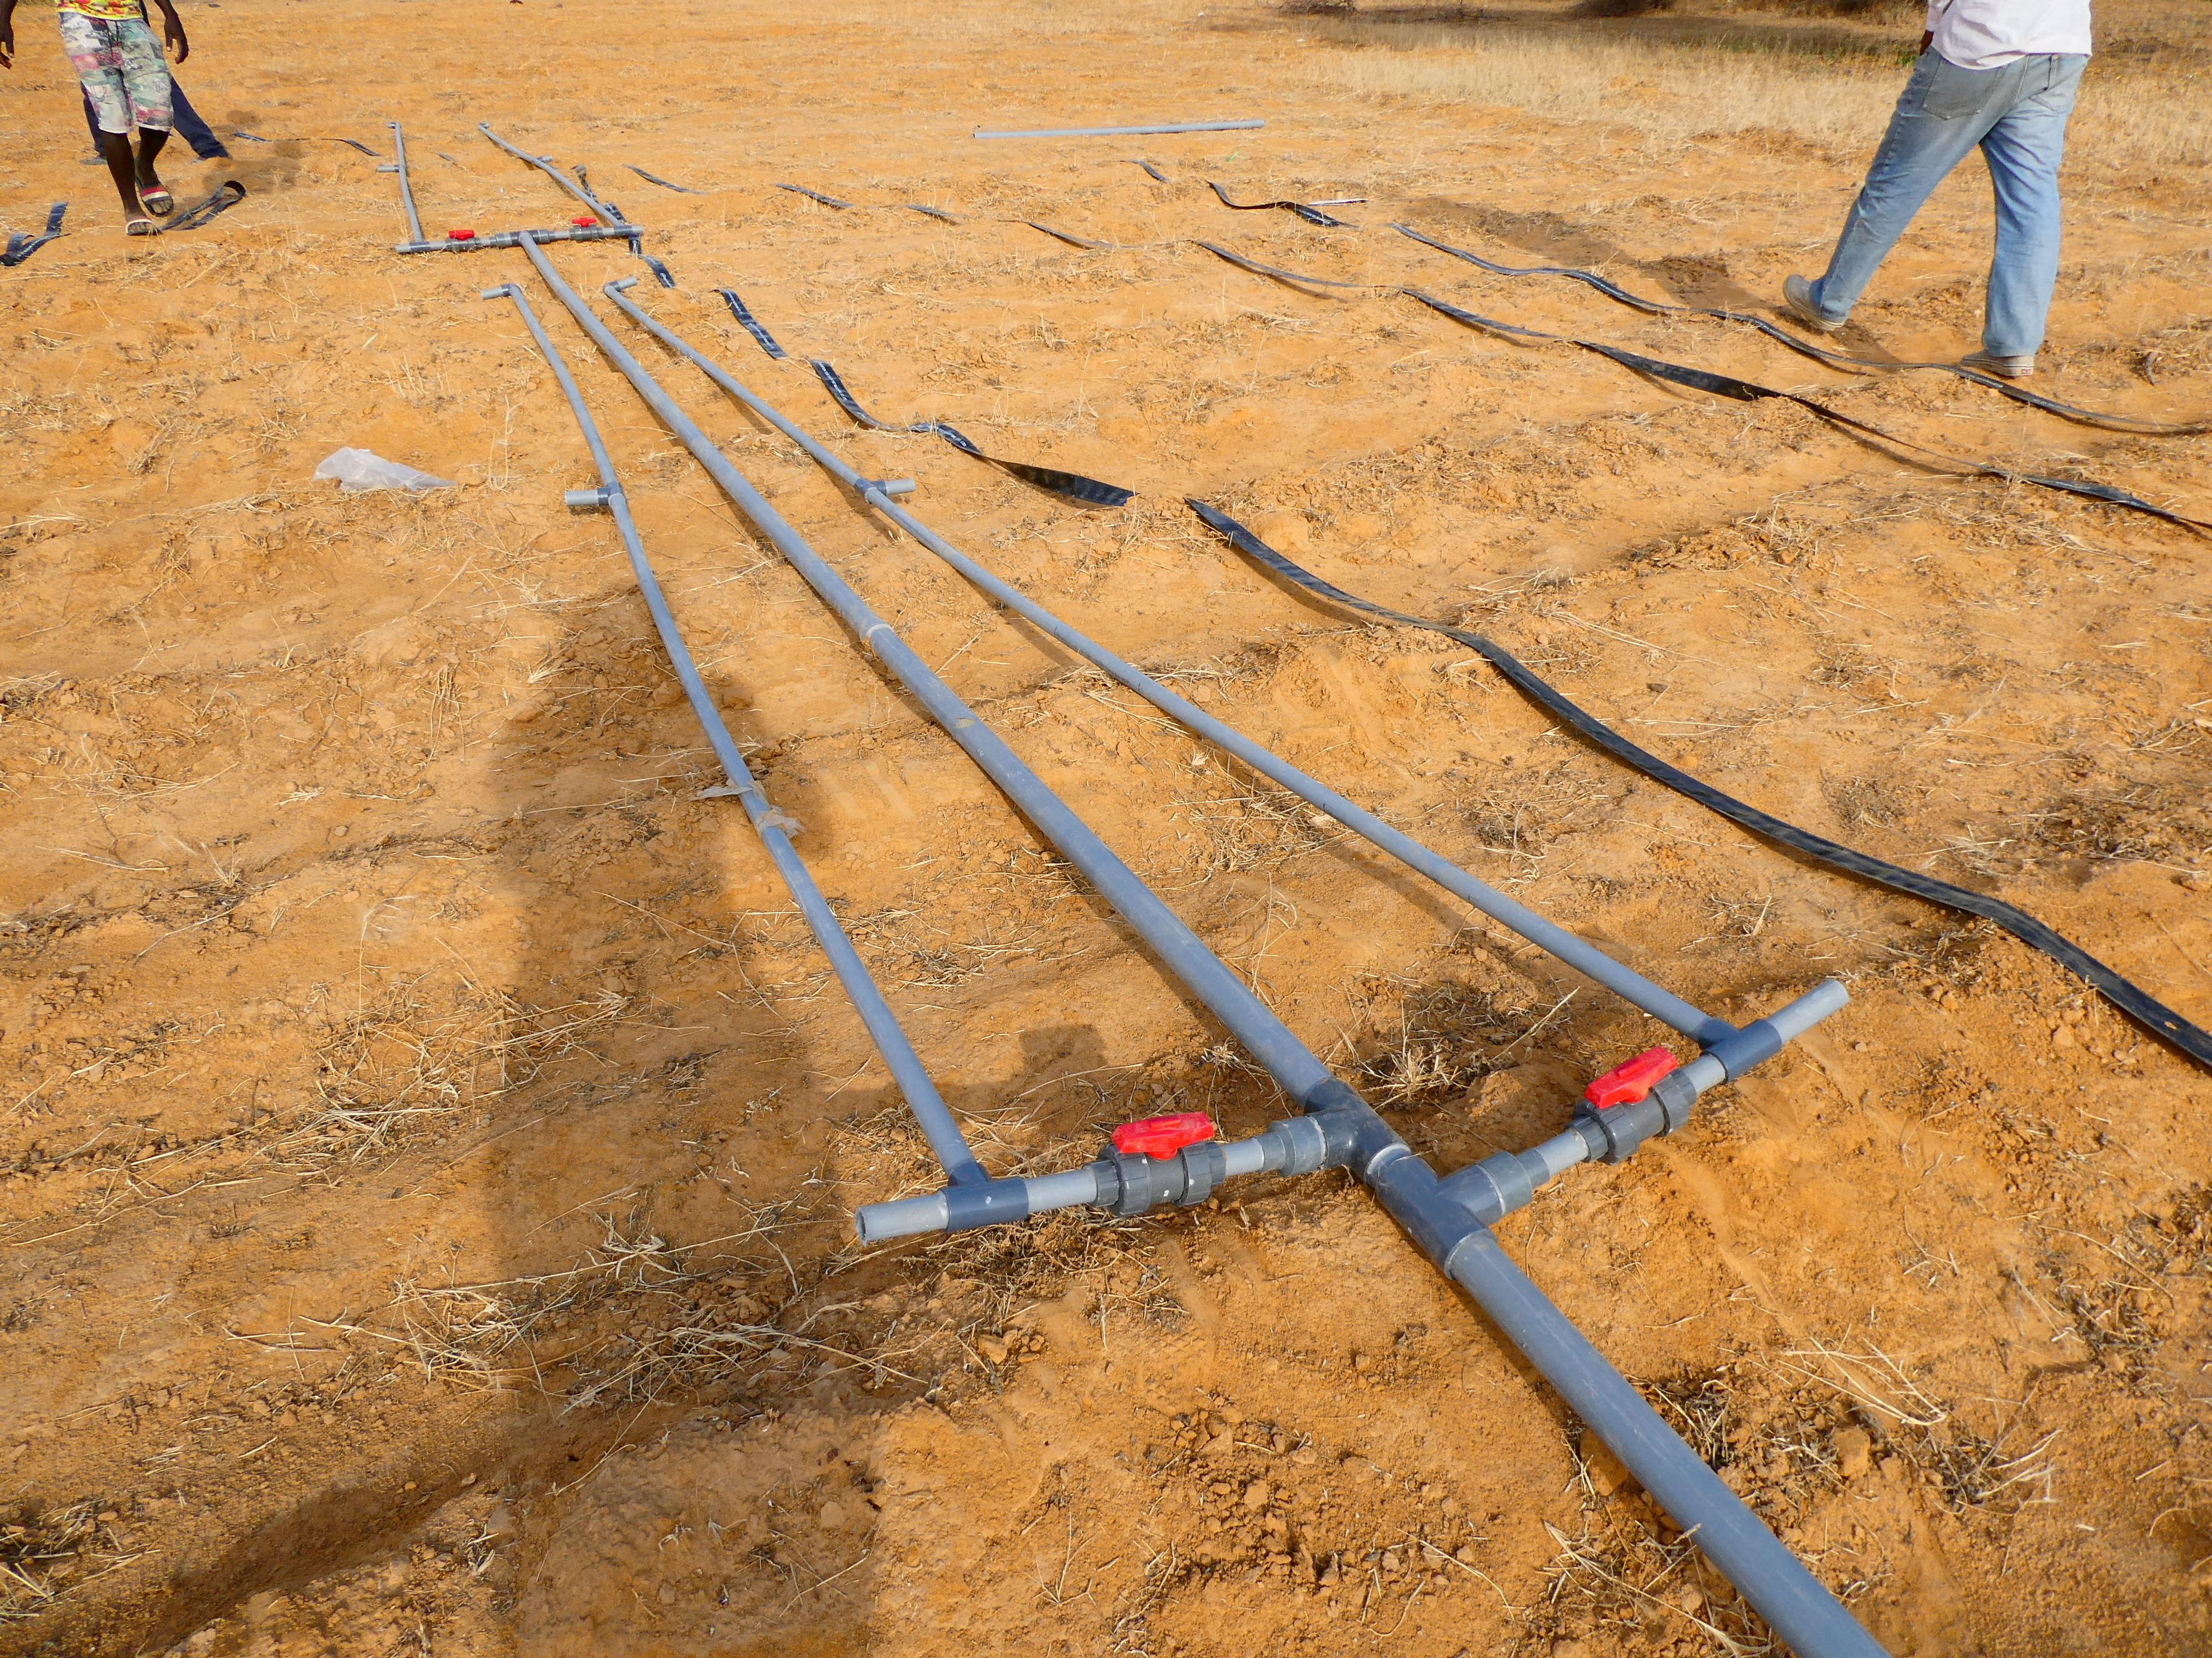
Sector

Slide 15
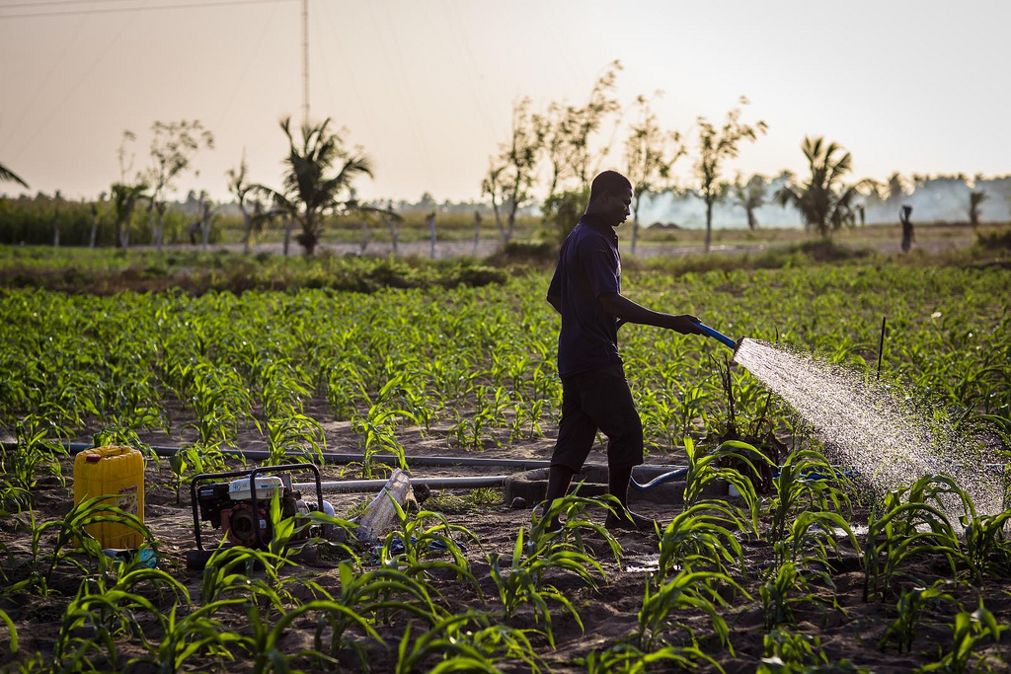
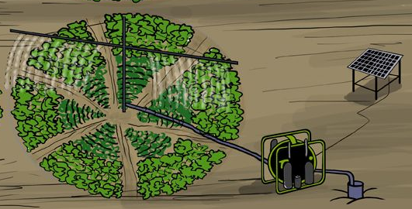
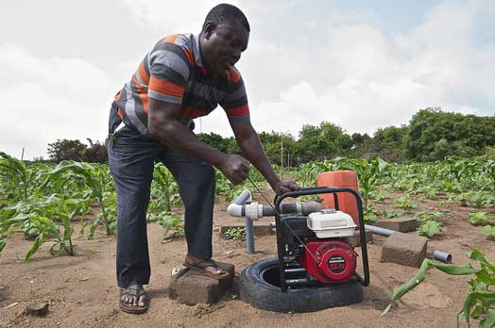
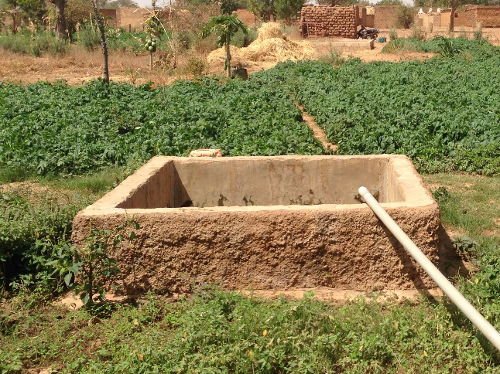
Others
Spray hose
Mini Pivot
Californian System
Low cost basins

