Slide 1





Water resources planning
Introduction to the course
Nora Van Cauwenbergh, PhD
Senior lecturer Water Resources Planning, module coordinator
25 April 2022

Slide 2
Water resources planning
serves Water Resources Management (WRM).
serves the manager to decide upon a number of investments for development of water management infrastructure,
also serves to analyse and formulate policies and strategies for the use of water and the delivery of water services
addresses the functioning of the Water Resources System (WRS) in its integrated whole, taking into consideration its social, economic and environmental functions.

Slide 3
The importance of water for our lives
Drinking water
Agriculture
Industries
Aesthetical value
Energy
Food
Ecosystems
Biodiversity
Recreation
Cultural value
Fisheries
Transportation

Slide 4
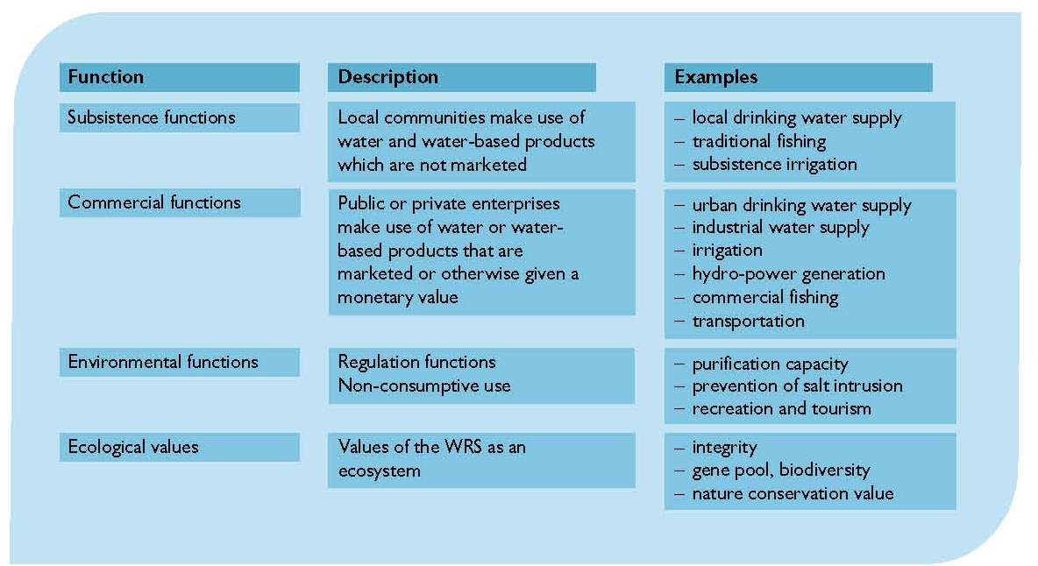
Multiple functions of water resources systems

Slide 5
Increased water use over time

Slide 6
Potential adverse impacts
Excessive withdrawals of river flows
Pollution from industrial and agricultural activities,
Eutrophication from excessive nutrient loads
Salinization from irrigation return flows
Excessive fish harvesting
Floodplain and habitat alteration from development activities
Changes in water and sediment flow regimes
Degraded infrastructures
Other issues…..

Slide 7
Triggers for water resources planning
problems have to be solved
an undesirable event
meet unsatisfied demands
develop under-utilized resources
achieve national development objectives
other (sectoral) planning efforts: energy, agriculture, fisheries, land use

Slide 8
So why plan? Why manage?
There are problems to solve and opportunities to obtain increased benefits from the use of water and related land resources
Benefits can be measured in many different ways. Agreement on best approach not easy, conflicts possible.
→ Need for careful study and research, as well as stakeholder involvement, in the search for a shared vision of the best compromised plan or management policy.

Slide 9
An example of planning procedure to address water scarcity
Issue: supplies are inadequate to meet demands
What are the causes? (increased water development, conflict over water rights and allocations (could be of transboundary nature), inefficient water use, high variability of water availability…..
What could be the measures to cope water scarcity? (water rationing in times of scarcity, conjunctive use of groundwater and surface supplies, equitable allocation to upstream and downstream users….. )
Do stakeholders agree on these measures?
Are these interventions sustainable (e.g. conjunctive groundwater use does not lead to over-exploitation)?

Slide 10
Water resources planning – multiple dimension of the water system

Slide 11
WRP – integration of knowledge and skills
Water legislation
Principles of IWRM
Mediation for Water Conflict Management
Water Resources System
Water Governance
Water Systems Modeling
Water Economics
Water Resources Assessment

Slide 12
Module for WMG students and short course participants
Target group:
Young and mid-career professionals, managers, engineers and technicians who have the ambition to judge, participate in and guide multi-disciplinary water resources planning studies.
Prerequisites
Understanding of the water resources physical system. Understanding of water use for agriculture, water supply, hydropower and environment. Understanding of water governance. Computer literacy. Good command of English.

Slide 13
Round of introduction
What is background, professional experience and particularly experiences with planning?
What is your interest in Water Resources Planning?

Slide 14




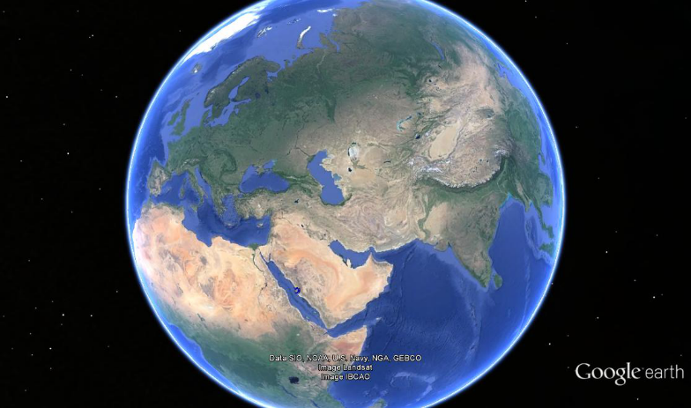
About me
Teaching/training
Water resources planning (WMG8b), Who and what makes water expertise (WMG2) WRMI-II at IUPWARE (VUB-KUL)
Capacity building through training and research
Research
Use of multiple knowledge in science-policy processes for natural resources management
System understanding; participatory integrated assessment using multiple-methods
Experience
EU (H2020) – NBS planning, Colombia - POMCA, Bolivia (VUB), Mexico, Myanmar - AIRBMP (CGIAR/WB),
Bangladesh Delta plan + NICHE, India (WB), Palestine (UN – planning under conflict), Chile, Saudi-Arabia (2nO), Algeria, Morocco

Slide 15
Learning objectives
Successful participants will be able to:
Describe concepts and major steps in water resources planning.
Identify, critically analyze and apply methods and tools, such as stakeholder integration, environmental impact assessment (EIA), decision support systems, role plays and water system models, while engaging in water resources planning activities.
Develop water management strategies and compare and evaluate them by applying multi-criteria analysis.
Discuss water resources planning and implementation in basins for specific context with special attention to basins in a developing country context.

Slide 16
WRP requires integration of knowledge and skills
Water legislation
Principles of IWRM
Mediation for Water Conflict Management
Water Resources System
Water Governance
Water Systems Modeling
Water Economics
Water Resources Assessment

Slide 17
Module content – 3 blocks
Framework for analysis and steps in the planning process
Approaches, models and tools in planning
  Role of models in planning
  Multi criteria analysis (MCA)
  Environmental Impact Assessment
Experiences from the Global South: plan implementation

Slide 18
Block 1: Framework for Analysis for water Resources Planning and planning steps
Introduction to Water Resources Planning and Framework for Analysis
  Analysis of Water resources plans
  Link to general theory and concepts
Key steps in a participatory integrated planning process
  Case study on participatory planning and exercises
  Highlighting stakeholder involvement in different steps of the planning process.
  Situation analysis, stakeholder involvement, criteria and objectives, action plans, evaluation, negotiation and decision making

Slide 19
Block 2: Methods, models and tools in water resources planning – 3 parts
Comprehensive overview of different types of models and when they are used in the planning process. Discussion of experiences, opportunities and limitations of modeling and their design.
Exercise on multi criteria analysis (MCA) of water management alternatives: construct a set of alternatives that will be evaluated using MCA, based on a set of predefined objectives and criteria of the plan.
Environmental Impact Assessment (EIA): Environmental impacts of water resources development projects, principles and methods of EIA, EIA and its application in water resources planning, case study and exercise on impact matrix

Slide 20
Block 3: Experiences from the Global South – planning implementation
Plan implementation and evaluation will be discussed based on case studies from the global south. Case studies and discussion on practices, challenges and opportunities for water resources planning in the global south
Case studies by experienced/senior lecturers
Assignment by participants

Slide 21

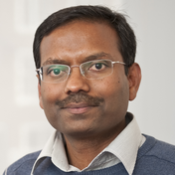

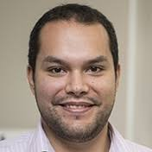

Staff – 3 lecturers and 2 guest lecturers
Van Cauwenbergh
Framework for Analysis
Module coordinator
Masih
Models, MCA
Mendoza
Environmental Impact Assessment
Godinez
Case study
Van Beek
Case study

Slide 22
Teaching modalities
The contact hours in the module will include BBB lectures, exercises and assignments, accompanied by PowerPoint presentations or videos with exercise guides
Part of the module will be asynchronous, with students doing self-paced learning and possibility for questions/discussion in BBB sessions
Interactive workshops and role plays will be organized (in BBB breakout sessions)
There will be no field trip
Overall module load has been reduced with around 20% given the specific circumstances of Covid19 lockdown, contact hours are generally limited to 2 periods per day

Slide 23
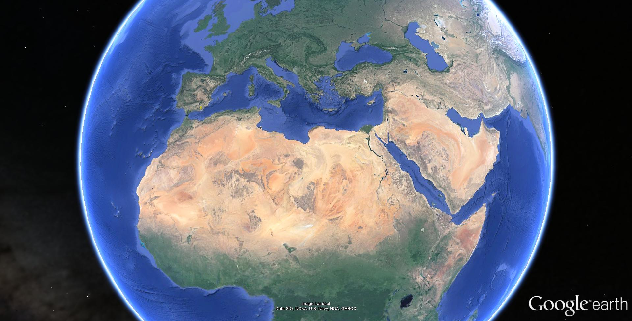
Module content – case studies
Andarax basin – participatory planning
Nile basin, NL barrier dam – MCA
Mekong basin – EIA

Slide 24
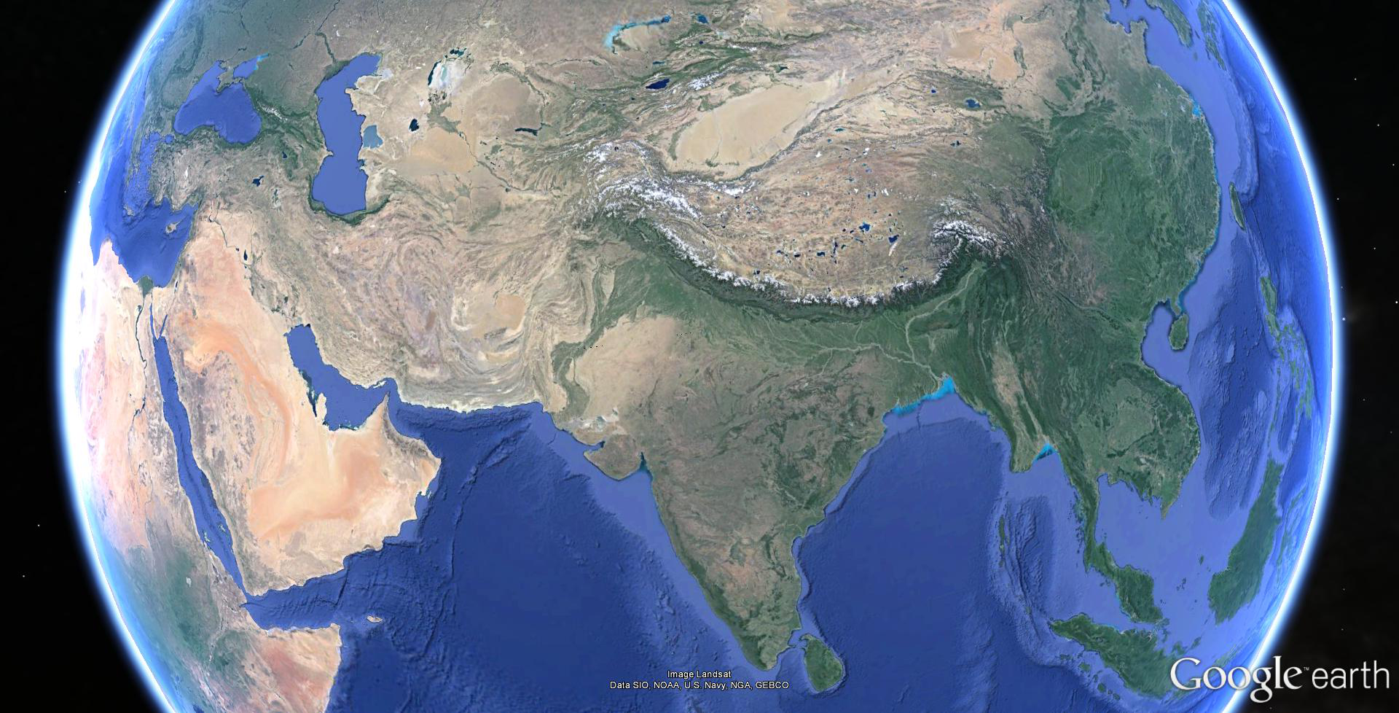
Module content – additional case studies + assignment cases
Implementation experiences in
Mekong basin
Mongolia
Mexico
Other

Slide 25
Water resources planning – the Matrix
BLOCK 1
Framework for analysis
Steps in planning process
Participatory techniques and experiences
BLOCK 2
Models and Tools
MCA
EIA
BLOCK 3
Experiences on planning and implementation
Participants Assignments
Global South
Nile basin
Andarax basin
Mekong basin
Global South

Slide 26
The matrix in the matrix
Linking WMG module activities to other modules in the program
In order to plan you need:
  Understand that planning is done by people and that differences exist in water management and governance expertise (WMG02)
  Understand the water resources system and governance (WMG03 and WMG04)
  Relate to a legal framework and institutions (WMG05o and WMG06o)
  Quantify impacts of actions on the system and its economics (WMG06o and WMG07o)
  To be able to manage differences in opinion and potential conflict (WMG07o)

Slide 27
Module assessment and examination
Oral exam (open book): 70%
Assignment: 30%
  Individual assignment week 1
  Participatory Integrated Planning assignment week 3

Slide 28
Module assessment vs study load

Slide 29
Module assessment - detail

Slide 30
Module assessment – 2 assignments
Individual assignment on analyzing the steps in a planning process in a case of own choice (10%)
Group assignment (3-4 per group) on designing a participatory planning process in a case of own choice (20%)

Slide 31
Lecturing materials
http://eCampus.un-ihe.org module 202122T08_M3549
J.C. Heun and N. Van Cauwenbergh, 2018 – Participatory Integrated Water Resources Planning: Framework for Analysis and Stakeholder integration, IHE Delft Lecture Notes.
Clouting H., Beevers L. and R. Vis, 2014 - Environmental Impact Assessment for water related projects, UNESCO-IHE Lecture Notes. (highlighted sections)
Loucks, D.P., van Beek, E. 2017. Water Resources Systems Planning and Management: An Introduction to Methods, Models and Applications. Springer. https://www.springer.com/gp/book/9783319442327
Other Handouts: Examples of case studies, Selected background reading.
Software: LIBRA River Basin Planning Simulation, Excel Spreadsheets, Altaguax DSS, Expert Choice (MCA).

Slide 32
Questions?

