Slide 1
Introduction to
Water Resources Plans and Framework for Analysis
Water Resources Planning
Dr. Nora Van Cauwenbergh, module coordinator
Senior lecturer Water Resources Planning, IHE Delft
May 2022

Slide 2
Learning objectives
Specific objectives of this lecture and exercise:
Get acquainted with a water resources plan from a country you know
Identify scope, objectives and boundaries of the plan and the drivers for the plan
Reflect on scale and link to water policy
Reflect on link to water resources system and its functions
Be exposed to the output of a planning process and methods as a preparation for the next lectures
Link to module learning objective:
Explain basic concepts and notions in water resources planning

Slide 3
Learning activities during this lecture
Exercise in pairs:
Analyse a water resources plan
Discussion:
What are the different scales and scopes, objective, etc.

Slide 4
Exercise: analyse a water resources plan
Select a case by 2 or 3 persons from the repository (links in PDF in Ecampus)
Scan through the plan and look for answers on the 7 questions in the exercise handout (use lecture note and ask questions to lecturer to clarify)
Write down your answers on max 2 pages
Prepare a presentation for the rest of the class where you highlight key elements from the answers (max 5’ including questions)
45’ group work + 45’ discussion

Slide 5
But first some general concepts and planning terminology

Slide 6
What is water resources planning (WRP)?
WRP is the creative and analytical process of
Hypothesizing sets of possible goals
Assembling needed information to develop and systematically analyze alternative courses of actions for attainment of such goals
Displaying the information and the consequences of alternative actions in an authoritative manner
Devising detailed procedures for carrying out the actions, and
Recommending courses of actions as an aid to decision-makers in deciding what set of goals and courses of action to pursue
(USA, National Water Committee, 1998)

Slide 7
What is water resources planning (WRP)?
Water Resources Planning (WRP) serves Water Resources Management (WRM).
WRP addresses the functioning of the Water Resources System (WRS) in its integrated whole, taking into consideration its social, economic and environmental functions.
The aims of WRP are: the planning of allocation and development of a scarce resource, matching water availability and demand, taking into account the physical boundaries, the full set of national objectives and constraints and interests of stakeholders

Slide 8
What is water resources planning (WRP)?
The main purpose is to ensure the sustainable exploitation of the water resources in support of the production of goods and services required to meet national and regional demand objectives
Systematic procedure to generate a synthesis of information in such a manner to gain insight into the nature and consequences of possible management strategies;
The analysis for planning aims to
identify and formulate feasible management actions;
generate and present quantitative information to enable better decisions on proposed actions for water resources development

Slide 9
Common goals of planning and management
Reducing the frequency and/or severity of the adverse consequences of droughts, floods and excessive pollution
Identification and evaluation of alternative measures that may increase the available water supplies or hydropower, improve recreation and/or navigation, and enhance the quality of water and aquatic ecosystems
Provide safe, reliable and affordable drinking water to people without causing damage to environment
Allocate scarce water resources among competing users in an equitable manner
Maximize net social and economic benefits from the operation of a multipurpose dam while minimizing the environmental damage
-----

Slide 10
An example of planning to address water scarcity
Issue: supplies are inadequate to meet demands
What are the causes? (increased water development, conflict over water rights and allocations (could be of transboundary nature), inefficient water use, high variability of water availability…..
What could be the measures to cope water scarcity? (water rationing in times of scarcity, conjunctive use of groundwater and surface supplies, equitable allocation to upstream and downstream users….. )
Do stakeholders agree on these measures?
Are these interventions sustainable (e.g. conjunctive groundwater use does not lead to over-exploitation)?

Slide 11
What is water resources planning (WRP)?
What is Planning is:
an art
science,
ingenuity
an exercise in politics
common sense
experience
systematic, methodical
listening,
coordinating
making compromises
avoiding mistakes

Slide 12
Scope and boundaries of WRP
Scope: what the plan covers conceptually, ‘the size of the box’
Activities (horizontal and vertical, e.g. focus on agriculture until farm level)
Issues (e.g. focus on floods)
Functions (e.g. focus on provisioning function)
Temporal boundary: Base year, looking ahead, 5, 10, 25 years

Slide 13
Spatial scales for WRP
River basin most suitable spatial scale (hydrological perspective)
Within a basin:
  Upstream-downstream impacts
  Up-scaling and downscaling issues (farmer field vs cropping system vs catchment vs basin)
  Administrative boundaries
Outside of a basin:
  National/country perspective
  Inter-basin transfers
  International context
  Virtual water

Slide 14
Temporal scales for WRP
Continuing sequential process
Need for periodical updates and adapting to new information, new objectives, and updated forecasts of future supplies.
→ planning for five years and then regularly updated.
Consider long term perspective (future needs growing population)
Consider expected impacts of climate change
Include the proper hydrological process scale
  Flood flows assessment: hourly or daily (or return period 10y-100 y)
  Surface supplies to farmers: weekly, monthly and seasonal
  Groundwater sustainability: seasonal, annual and decadal time scale

Slide 15
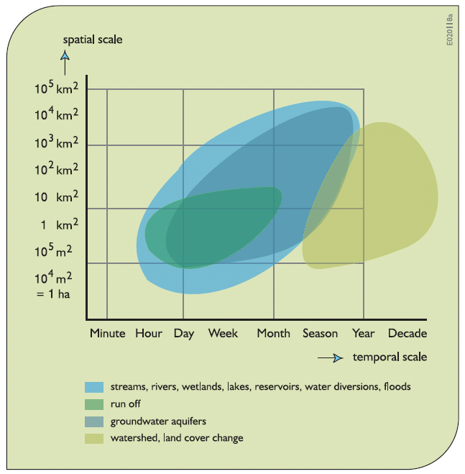
Spatial and temporal scales of physical processes
Source: Loucks & Van Beek, 2017

Slide 16
Boundaries and scales of activities
Source: Loucks & Van Beek, 2017

Slide 17


Planning approaches

Slide 18
Planning terminology
Scale
Scope
Action
Strategy
Measure
Scenario
Evaluation
Objectives
Criteria
Indicators
Monitoring
Implementation
Baseline

Slide 19
References / sources
Lecture note
Loucks and Van Beek (2017) – chapter 1 and 2
Ecampus repository

Slide 20
Exercise
Check materials and form the groups
Notes:
For online” Check materials and form the groups, possible to use breakout rooms

Slide 21
Exercise: analyse a water resources plan
Select a case by 2 or 3 persons from the repository (links in PDF in Ecampus)
Scan through the plan and look for answers on the 7 questions in the exercise handout (use lecture note and ask questions to lecturer to clarify)
Write down your answers on max 2 pages
Prepare a presentation for the rest of the class where you highlight key elements from the answers (max 5’ including questions)
45’ group work + 45’ discussion

Slide 22
Discussion

Slide 23
Discussion
Scope and scale
Objective
Link to water policy, legislation
Focus on certain elements of the water resources system? Functions of the WRS?
Detail of the plan
  Data
  Stakeholders involved
  Responsibilities
  Budget
General observations

Slide 24
How do you make a water resources plan?
Who?
When?
How?
Introduction to different steps in the process: Framework for analysis

Slide 25

Water resources planning steps
Introduction to Framework for Analysis
Dr. Nora Van Cauwenbergh
Senior lecturer Water Resources Planning, IHE Delft

Slide 26
The development of a water resources plan
How?
Analyses for WRP & WRM generally comprise several stages
The explicit description of these stages is referred to as the analytical (or conceptual) framework

Slide 27
Framework for analysis
A framework of analysis
  is meant to help to structure the planning process,
  is not unique per se to water resources planning (e.g. business strategy),
  common language amongst the plan stakeholders (glossary of terms)
WRP is a multi-facetted process
  not one generally accepted model of how to conduct it
  in practice the process will depend upon the circumstances and will be adapted while the planning proceeds, rather than following a clearly defined theoretical path

Slide 28
Framework for analysis – simple form
Understand situation, problems and opportunities
List a number of possible interventions
Check impact interventions on system
Evaluate interventions combined into strategies

Slide 29
Framework for analysis
Data
and
tools
Stakeholders
Analysis of problems and identification of possible measures
Specification of objectives and criteria
Delineation of analysis conditions and scenarios
Analysis of possible measures and promising strategies
Implementation assessment
Evaluation of selected strategies
Negotiation and decision making – presentation
Implementation, monitoring and evaluation
Objectives
Criteria
Conditions, scenarios
Implementation?
Negotiation and decision-making
Implementation
M&E

Slide 30
Framework for analysis
Loucks and van Beek, 2017 (chapter 13)
Used to understand planning process, however in practice
  Not a strict nor linear format
  Planning is circular and needs flexibility in process
5 phases

Slide 31
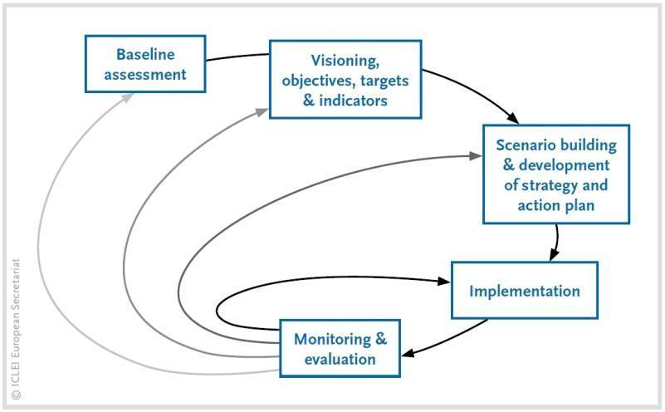
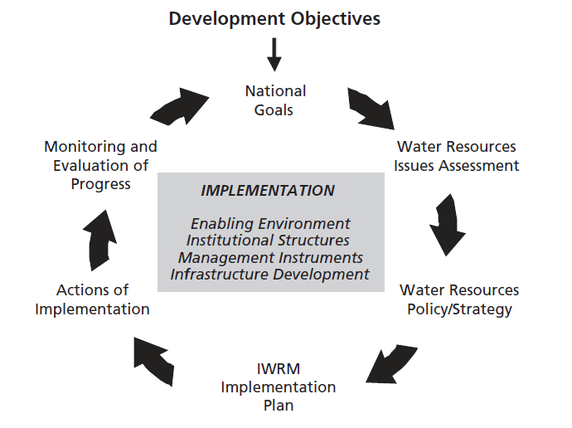
Circular, repetitive process
Source: Philip et al., 2011
Source: UN-Water, GDP, 2007

Slide 32
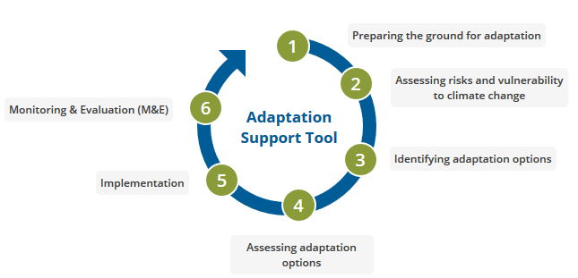
Circular, repetitive process
Source: Climate-ADAPT, 2020

Slide 33
Phase 1 - Inception
Setting up stakeholder process, defining analysis conditions, criteria & objectives

Slide 34
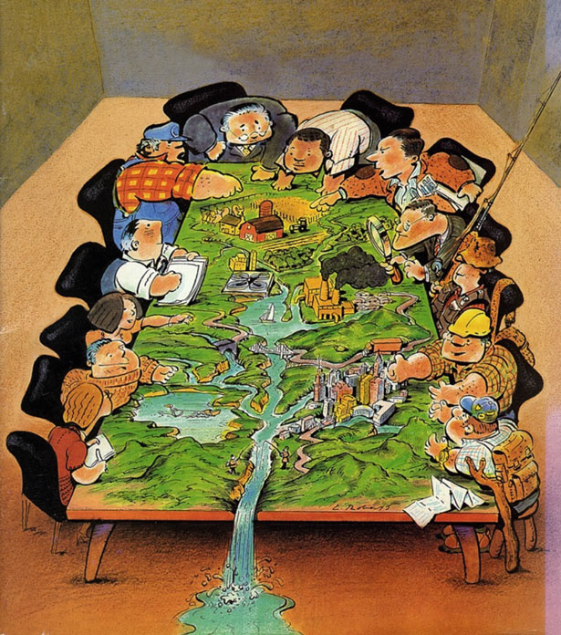
Setting up stakeholder process
Need for integration of issues/sectors/uses and users in WRP
Key points
Assure mandate of stakeholder process at highest possible level
Clarity on level of involvement
Feedback and communication plan
Resources and continuity
Strategy to get representative group of stakeholders
See videos on stakeholder analysis and methods/tools for stakeholder involvement

Slide 35
Analysis conditions
Complete set of conditions and assumptions under which an analysis is undertaken
  time horizon
  area boundaries
  discount rate and base year
  hydrologic and meteorological conditions
  projections of demand
  etc

Slide 36
System boundaries and scope
Temporal boundary:
Base year
Looking ahead, 5, 10, 25, 50 yrs
Scope: what the plan covers conceptually, ‘the size of the box’
Activities (horizontal and vertical, e.g. focus on agriculture until farm level)
Issues (e.g. focus on floods)
Functions (e.g. focus on provisioning function)

Slide 37
Objectives and criteria
Description of targeted outcome and how to assess it
  Resource development
  Triple bottom line (efficiency, equity, environmental integrity)
Objectives and criteria as guiding structure for analysis and evaluation of interventions
Plan/Policy
Objective
RD
Eff
EQ
EP
Criteria
Indicators

Slide 38
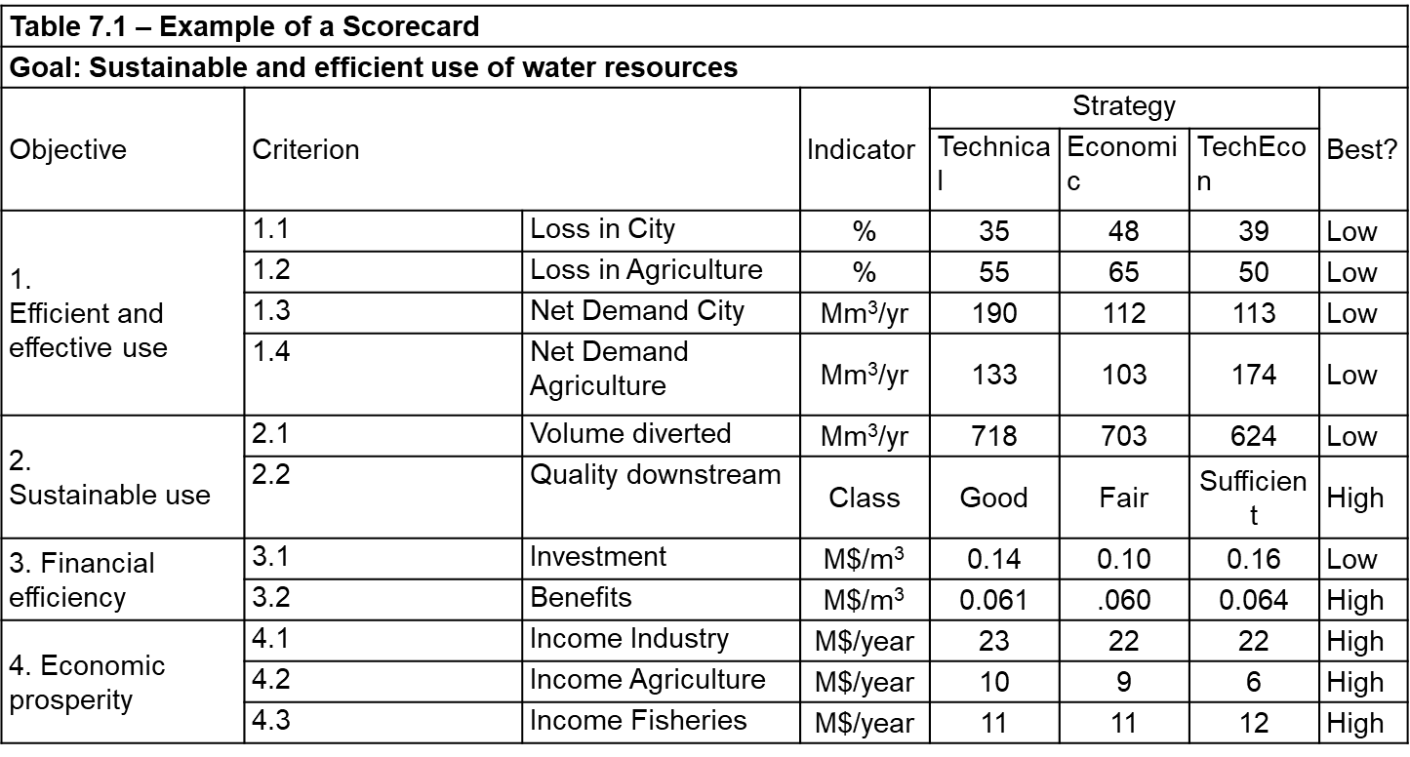
Objectives and criteria - example
Example of a Scorecard
Goal: Sustainable and efficient use of water resources
Objective | Criterion |  | Indicator | Strategy |  |  | Best?
 |  |  |  | Technical | Economic | TechEcon
1.Efficient and effective use | 1.1 | Loss in City | % | 35 | 48 | 39 | Low
 | 1.2 | Loss in Agriculture | % | 55 | 65 | 50 | Low
 | 1.3 | Net Demand City | Mm³/yr | 190 | 112 | 113 | Low
 | 1.4 | Net Demand Agriculture | Mm³/yr | 133 | 103 | 174 | Low
2. Sustainable use | 2.1 | Volume diverted | Mm³/yr | 718 | 703 | 624 | Low
 | 2.2 | Quality downstream | Class | Good | Fair | Sufficient | High
3. Financial efficiency | 3.1 | Investment | M$/m³ | 0.14 | 0.10 | 0.16 | Low
 | 3.2 | Benefits | M$/m³ | 0.061 | .060 | 0.064 | High
4. Economic prosperity | 4.1 | Income Industry | M$/year | 23 | 22 | 22 | High
 | 4.2 | Income Agriculture | M$/year | 10 | 9 | 6 | High
 | 4.3 | Income Fisheries | M$/year | 11 | 11 | 12 | High

Slide 39
Phase 2 - Situation analysis
Objective, triggers, levels, assessment and scenarios

Slide 40
Objectives of the situation analysis
identify all possible problems and issues
gain insight in the extent, cause and effects of the problems and issues
know the problem, before you try to solve it
gain insight in the user functions of the WRS
help identify all the interventions that possibly can be made
identify all stakeholders involved in and affected by the plan
help to rank problems
specify priority questions for analysis

Slide 41
Triggers for WRP and situation analysis
problems have to be solved
an undesirable event
meet unsatisfied demands
develop under-utilized resources
achieve national development objectives
other (sectoral) planning efforts: energy, agriculture, fisheries, land use

Slide 42
Levels of situation analysis (1/2)
Trigger is a specific problem:
“straight forward”, focus on cause and effects
analysis of effects of interventions still to be “holistic” (EIA)
Trigger is regular process of river basin planning:
analyse demand and supply (projections)
impact of (human) activities on resource functions
analyse (possible) conflicts between uses
link with sectoral plans (agriculture, energy, health, ……)

Slide 43
Levels of situation analysis (2/2)
Trigger is (WR) policy plan:
systematic review of the functions and role of water for the different human and environmental uses
Intensity of analysis depends upon
comparative importance of water resources functions
the scarcity of the resource (quantity + quality) and
the conflicts between uses

Slide 44
Issues and assessment
The issues can be divided into livelihood/demand issues (e.g. meeting the increasing/conflicting demands of different economic sectors) and resource-impact issues (e.g. impact of climate change, impact from human activities and land management)
Examples of assessment
  Social assessment (e.g. Budds / module institutional analysis)
  Socio-ecological systems assessment (e.g. Ostrom)
  Risk or vulnerability assessment (e.g. DRR, NAIAD, CRIDA)
  Demand management assessment
  Environmental Impact assessment
  Ecosystem services assessment (e.g. Diaz, MAES)
Notes:
Types of assessment (non-exhaustive list)
Social assessment examines how social and institutional structures affect water use and management, degree of equitable access to water such as by gender and how specific projects might affect the social structure.
Risk or vulnerability assessment analyses the likelihood of extreme events, such as flood assessment; the environmental implications of development programs and projects; management, or how a specific project might affect social structures; and droughts, and the vulnerability of society to them.
Demand management assessment assesses the potential for water savings through water conservation and demand management.
Unconventional sources assessment examines the potential for water reclamation, re-use, recycling and desalination.
EIA

Slide 45
Scenario analysis
Out of the sphere of influence, cannot change it, but have to adapt to it
Climate scenarios: taking into account variability and change of hydro-meteorological variables
Socio-economic scenario: population growth over time; energy prices over time; global transport of crude petroleum; technological changes of production processes/raw materials/types of products; amount of leisure time; and import/export policies.

Slide 46
Phase 3 - Strategy building

Slide 47
Interventions, alternatives and strategies
A strategy is a complete, consistent and coherent combination of measures that can be
  Technical (infrastructure (conventional and non-conventional), including operational rules and O&M
  Ecological (improving functioning of ecosystem, hydroforestry, enhancing recharge, minimum flow regimes)
  Implementation incentives (economic, pricing, legal)
  Institutional arrangements (responsibilities of agencies and modes of interaction)
After identification of the situation (problems and opportunities)
Allow reaching the objectives of the plan

Slide 48
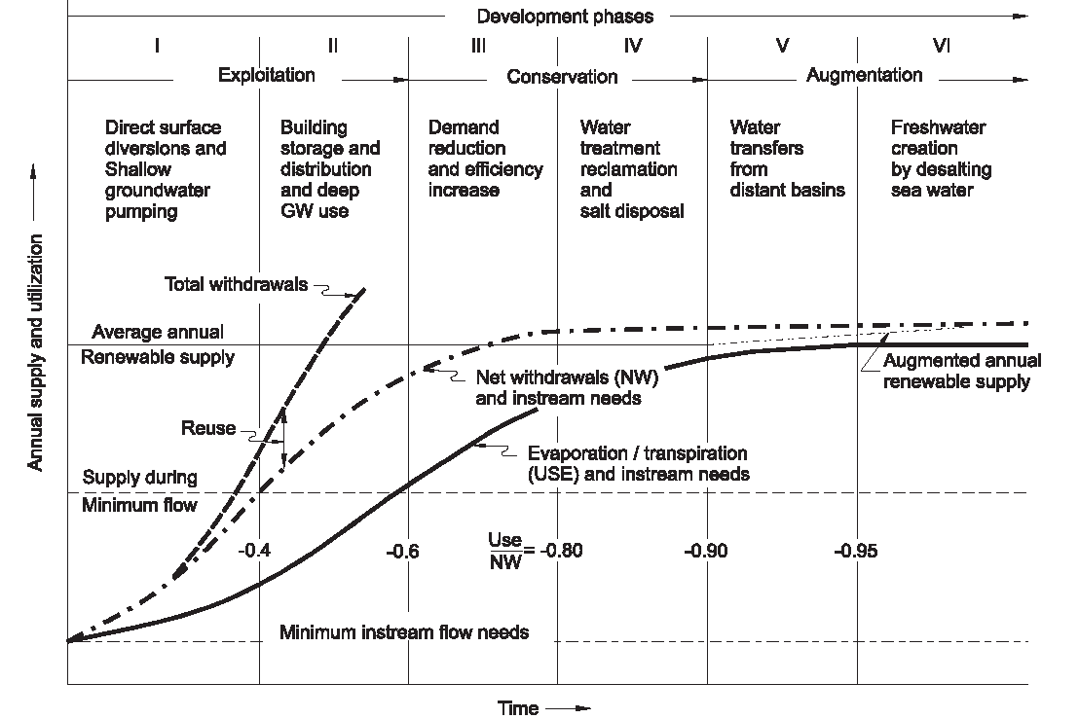
Phases of River Basin Development
“All river basins progress sequentially through the six development phases, from the undeveloped state to the fully developed, or closed, state.” Keller et al., 1998.

Slide 49
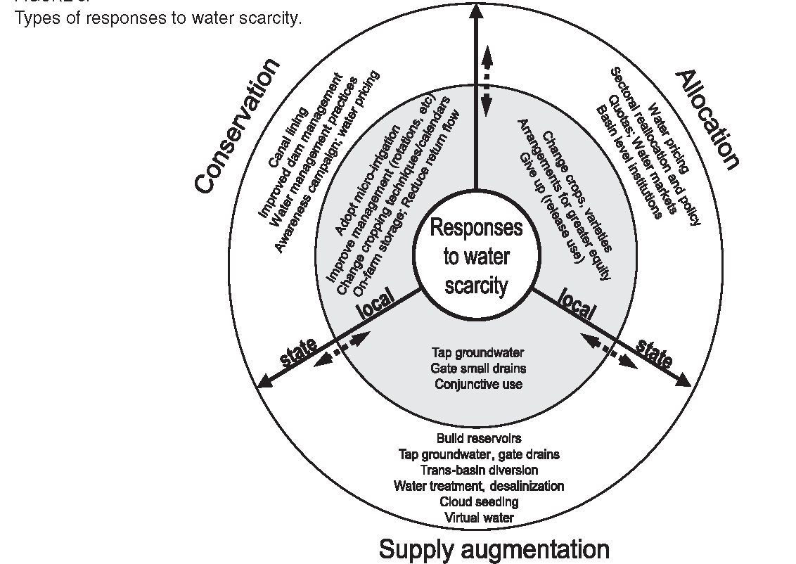
Strategies for water security
Types of responses to water scarcity (to achieve water security)
Conservation
Allocation
Supply augmentation
Source: Molle, 2003

Slide 50
Strategy evaluation
Once the alternatives are identified, the effects that each produces on the socio-hydrological system must be evaluated:
necessary to compute (potential) indicator values as a result of each of the alternatives being implemented.
Data collection and analysis and use of modelling/Decision support tools (e.g. optimization and/or simulation models) contribute in this process
Methods such as multi-criteria analysis and cost-benefit analysis contribute to the final recommendations
Choice is made by DM (not by models): involves politics, negotiation and potential compensation

Slide 51
Phase 4 - Action plan

Slide 52
Define action plan
Focuses on translation preferred strategy to concrete actions
  Responsibilities
  Liabilities
  Funding and finance
  Contracting
not intended to be static or prescriptive, leaving room for decision-makers to further discuss in relation to their own responsibilities
Uses, corrects or creates the necessary enabling environment for implementation

Slide 53
Phase 5 - Implementation

Slide 54
Implementation
Building infrastructure and implementing non-infrastructural measures
Monitoring and evaluation
  Based on the indicators linked to criteria and objectives defined earlier
  Informs adaptive management and potential contingency measures
  Informs compliance with performance levels (if specified in contract)
  Informs next planning cycle
  Important source of public (dis)trust

Slide 55
Check of learning objectives
Has this lecture facilitated to?:
Get acquainted with a water resources plan from a country you know
Identify scope, objectives and boundaries of the plan and the drivers for the plan
Reflect on scale and link to water policy
Reflect on link to water resources system and its functions
Be exposed to the output of a planning process and methods as a preparation for the next lectures
And are you now able to?:
Explain basic concepts and notions in water resources planning

Slide 56
References / sources
Lecture note– chapter 1 and 2
Loucks and Van Beek (2017) – chapter 13 (mandatory read)
Ecampus repository of plans

Slide 57
References / sources
Loucks and van Beek, 2017 – chapter 13 (mandatory read)
Philip, R., Anton, B. & van der Steen, P. 2011. SWITCH Training Kit. Integrated Urban Water Management in the City of the Future. Module 1. Strategic Planning. ICLEI, Freiburg, Germany. https://switchtraining.eu/home/
UN-Water, GWP. 2007. Roadmapping for Advancing Integrated Water Resources Management (IWRM) Processes. https://www.un.org/waterforlifedecade/iwrm.shtml
Linton, J., & Budds, J. (2014). The hydrosocial cycle: Defining and mobilizing a relational-dialectical approach to water. Geoforum. https://doi.org/10.1016/j.geoforum.2013.10.008
Ostrom, E. (2009). A general framework for analyzing sustainability of social-ecological systems. In Science. https://doi.org/10.1126/science.1172133
Keller, J., Keller, a, & Davids, G. (1998). River basin development phases and implications of closure. Journal of Applied Irrigation Science.
Molle, F. 2003. The closure of river basins: trajectories and societal responses. Conference paper 3rd conference of the International Water History Association. Alexandria, Egypt, 14 November 2003 http://dlc.dlib.indiana.edu/dlc/handle/10535/5064

Slide 58
Videos from the world on WRP - optional
Strategic Planning (SP) in business ( 5’ video by Erica Olson, check 3’51 on what SP is really about, check for analogies and differences between SP for organizations and water resources system) https://www.youtube.com/watch?v=s_OvXeUQV3o, https://www.youtube.com/watch?v=mLJ34L5UW4E
Global Water Partnership – (4:43 video sharing key insights on IWRM planning from 13 African countries during 2005-2010 period, lessons start at min 2:00) http://www.youtube.com/watch?v=tn4HyG9Q_N0
UC Davis lectures introducing water resources planning (lectures by dr. Sandoval, check min 18:35 to end for discussion of scales) https://www.youtube.com/watch?v=GQRXLJir9Po
Risk-based Water Resources planning under uncertainty (seminar by Dr. Jim Hall, check minutes 18:00 to 22:00 for explanation of risk-based planning) https://www.youtube.com/watch?v=xXXD5kaP78w
International, Example on IWRP for water utilities (2:32 video showing glossary, focus on need to look at scenarios for risk reduction and cost effectiveness) http://www.youtube.com/watch?v=q-yJE_gg_YA

Slide 59
Thank you
n.vancauwenbergh@un-ihe.org

