Slide 1





Water resources planning
Situation analysis - discussion
Nora Van Cauwenbergh, PhD
Senior lecturer Water Resources Planning, module coordinator
26 April 2022

Slide 2

Learning objectives
This courses will assist participants in:
Understand the rationale and objectives of a situation analysis
Apply techniques for situation analysis to a particular case study
Assess the functions and problems in the basin/area that is object of planning

Slide 3
Learning activities situation analysis
Create an understanding of the Andarax river basin
Exercise on situation analysis
  Problem/issue cloud (individual while listening to presentation+ plenary discussion)
  Problem tree exercise (in groups)
  Stakeholder analysis matrix (in groups)
Discussions on situation analysis

Slide 4
Learning activities 26 April 2022
8h45: Feedback day 1 and introduction to situation analysis, orientation toward materials
09h00 Create an understanding of the Andarax river basin and make problem cloud (active listening to presentation)
09h45: Introduction to problem tree / stakeholder analysis (watch videos, scan through references, self-paced)
10h45: Q&A and discuss who will make which exercise and group creation
11h00: Exercise on situation analysis in groups (session in groups)
  Bring your notes on problem/issue cloud
  Problem tree exercise or stakeholder analysis exercise
  Prepare output to present in plenary
12h00: Present and discuss problem trees and stakeholder matrix
Thursday 10h45: Q&A situation analysis

Slide 5
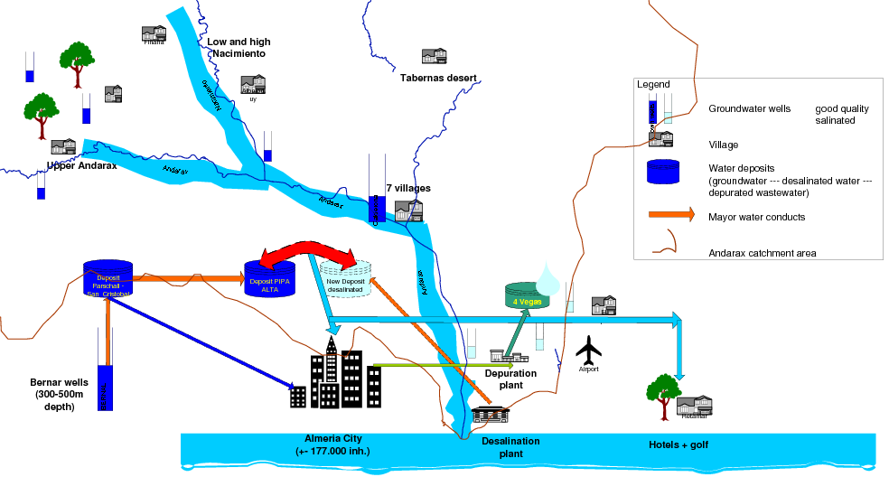
Exercise - the Andarax river basin brainstorm
Exercise in active listening
While the presentation is on-going make (mental) notes of
  What are potential problems in the basin?
  What are main drivers for changes in the basin?
  What is the status of the water bodies?
  Who is using water and for what?
  What are other actors?
Make notes of questions

Slide 6
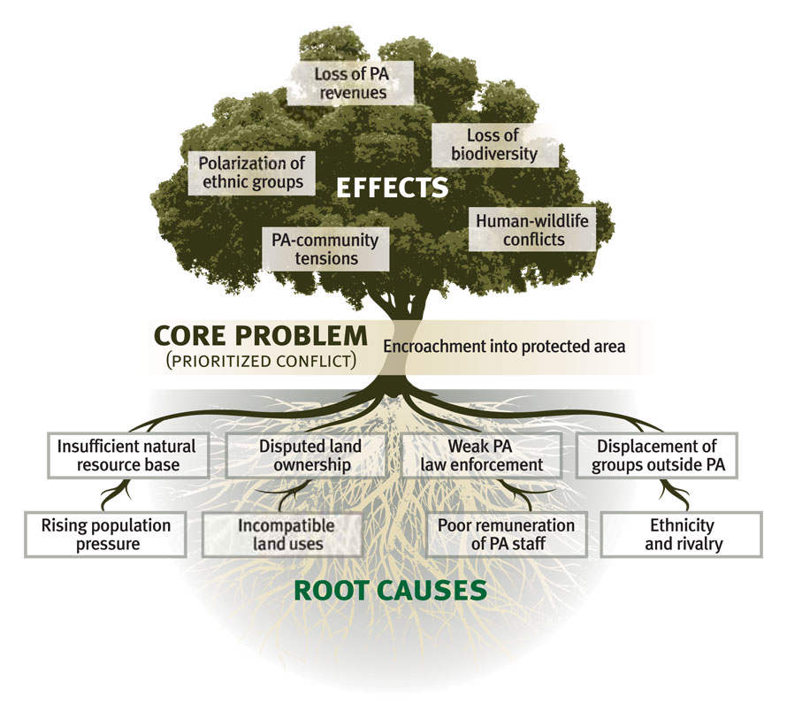
Exercise – problem tree
Select one problem and in groups of 2-3 prepare a problem tree as explained in video (consult practitioners guide for more information)
Bring your tree (on paper) and be ready to present/argue

Slide 7
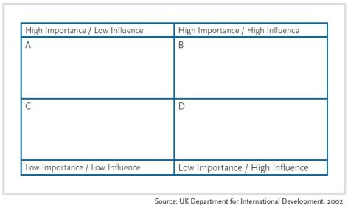
Exercise – stakeholder analysis
Select one problem and in groups of 2-3 prepare a problem tree as explained in video (consult practitioners guide for more information)
Bring your matrix (on paper) and be ready to present/argue

Slide 8
Andarax basin
An introduction to the case study
Dr. Nora Van Cauwenbergh
Senior lecturer Water Resources Planning, IHE Delft

Slide 9
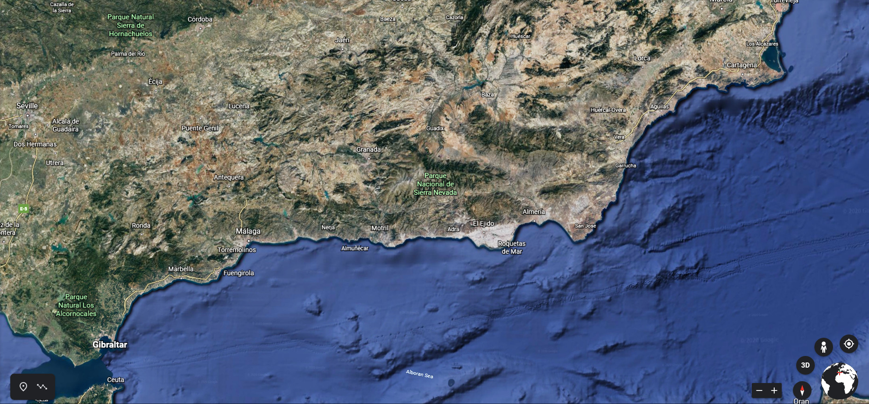
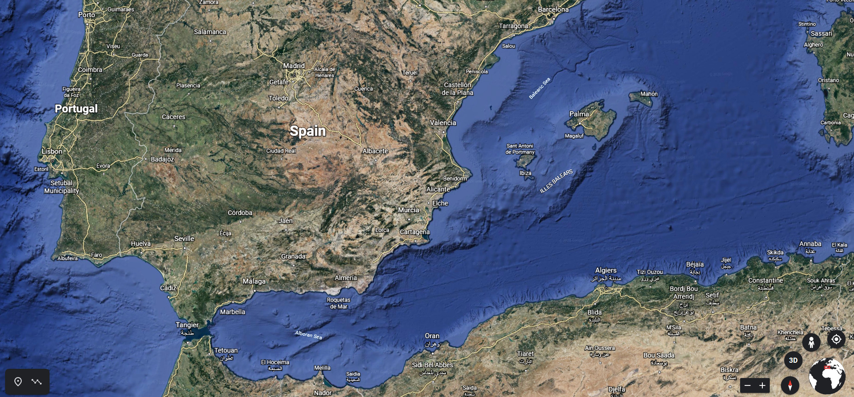
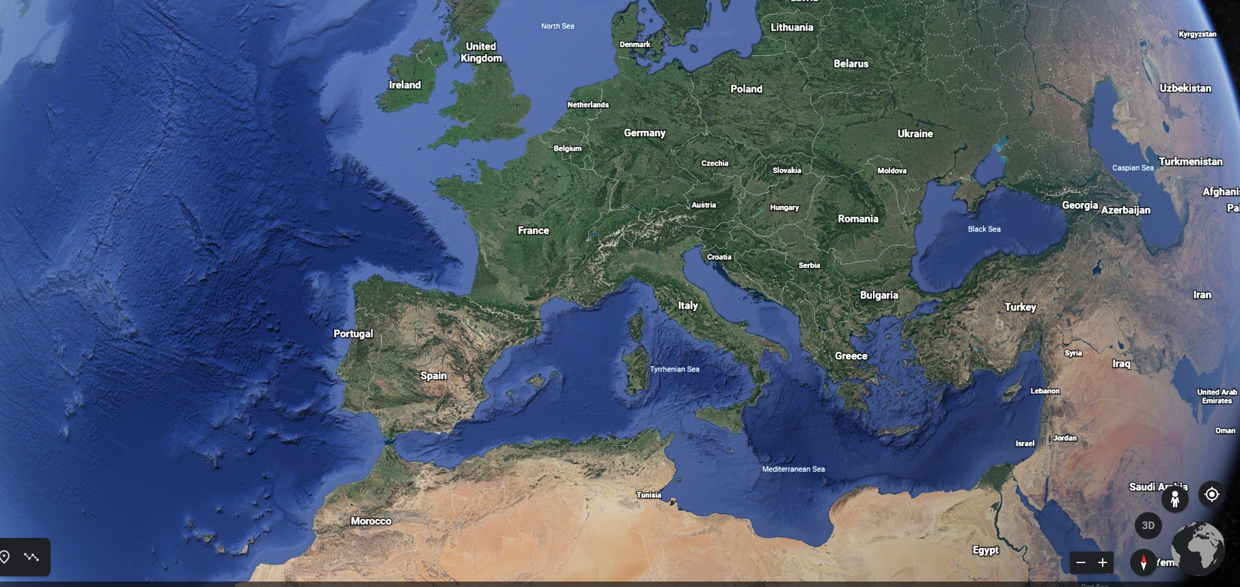
Andalusian Mediterranean basin - Almeria

Slide 10
Exercise – active listening / situation analysis
While the presentation is on-going make (mental) notes of
  What are potential problems in the basin?
  What are main drivers for changes in the basin?
  What is the status of the water bodies?
  Who is using water and for what?
  What are other actors?
Make notes of questions

Slide 11
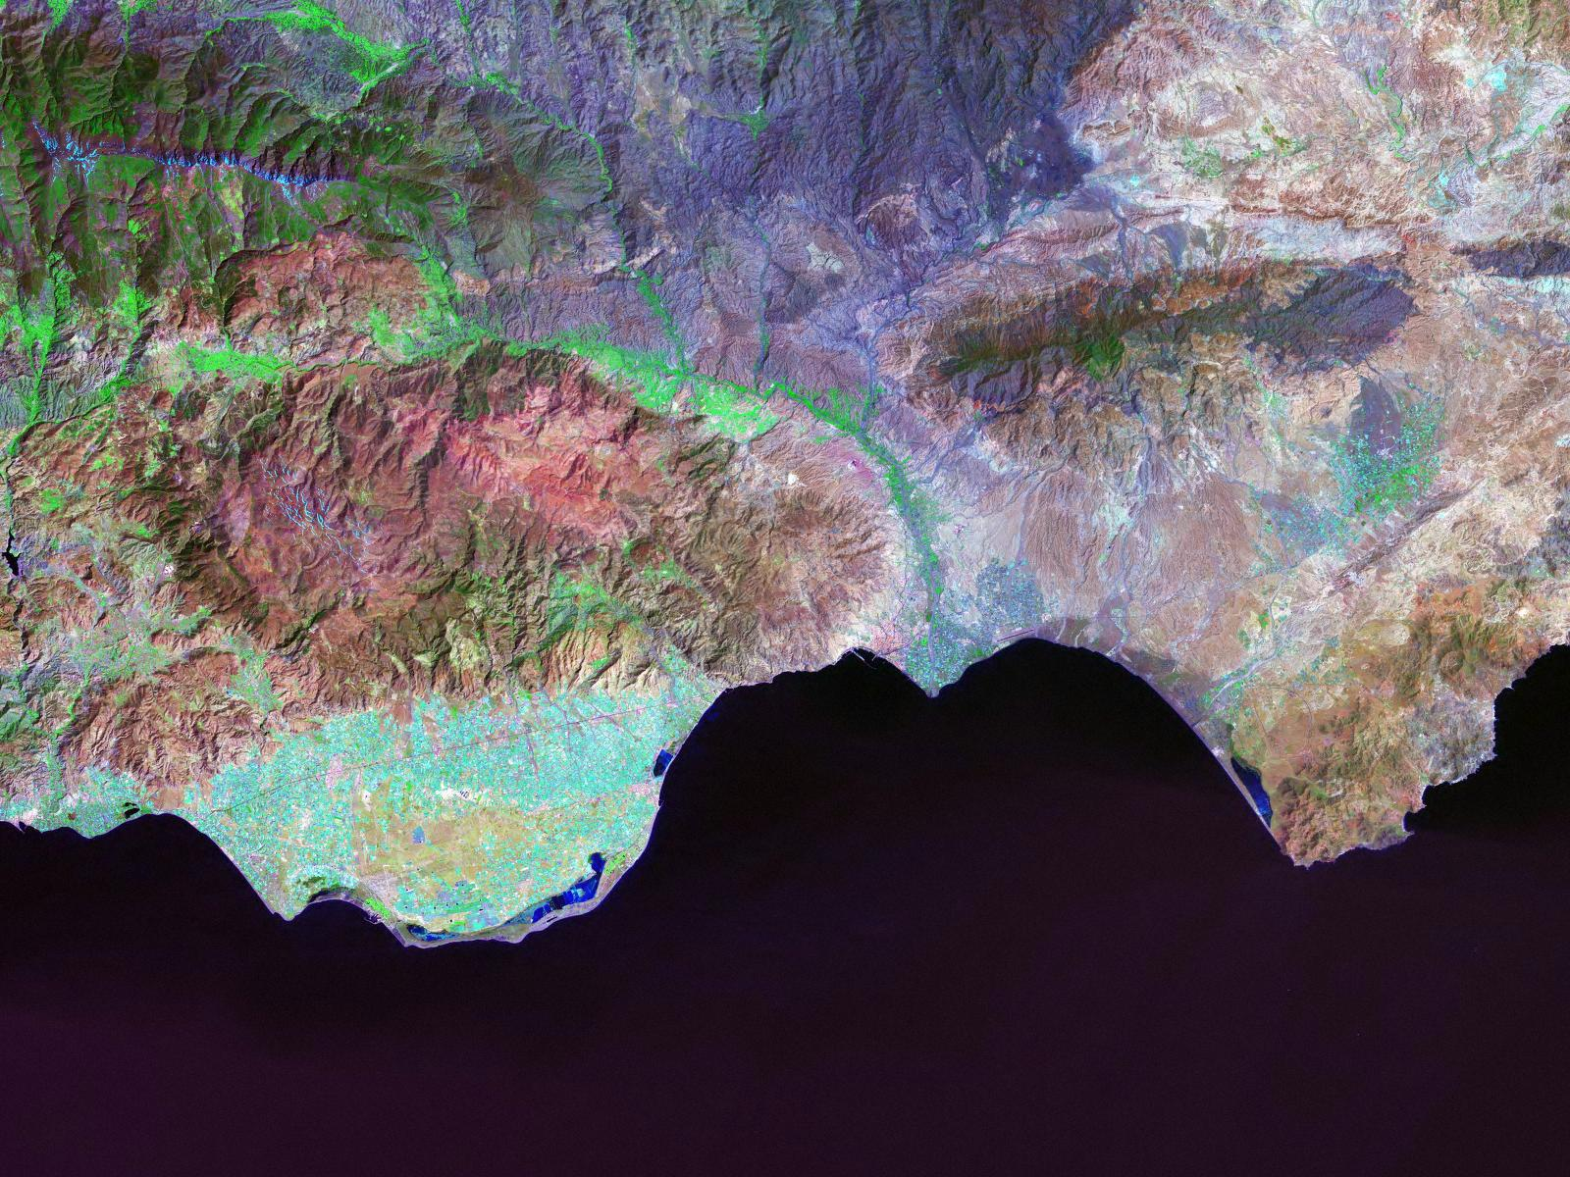
Sierra de Filabres
Sierra Nevada
Desierto de Tabernas
Sierra Alhamilla
Andarax river
Campo de Níjar
Sierra de Gádor
Almería
Cabo de Gata
Campo de
Dalías

Slide 12
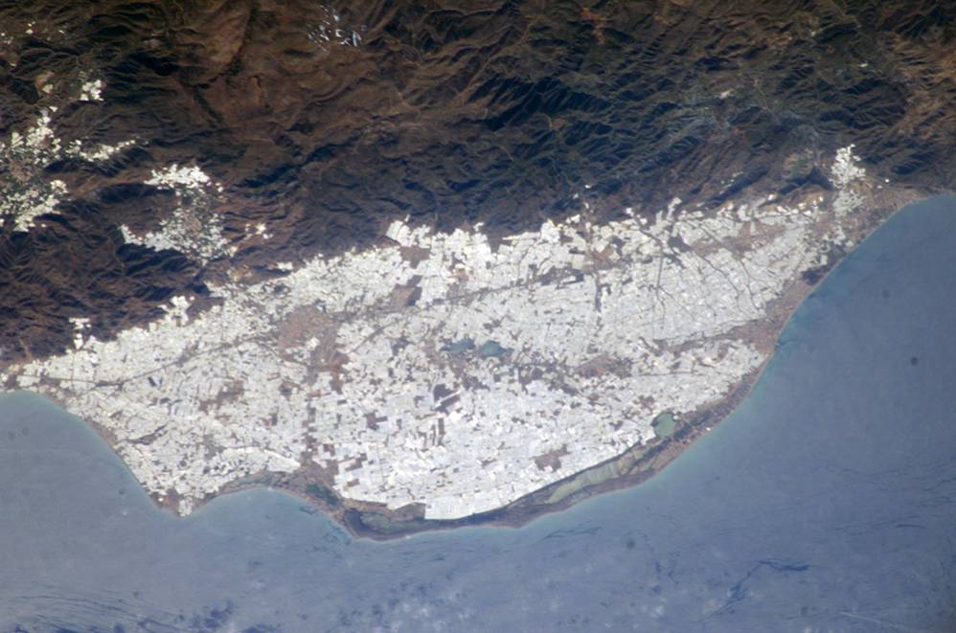
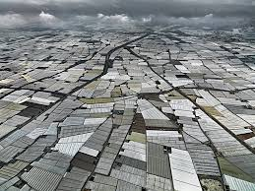
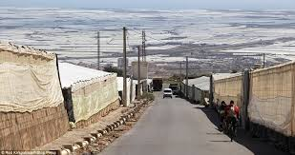

Slide 13
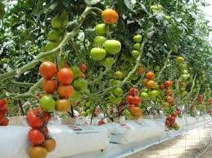
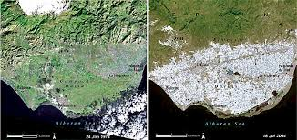
Economy – agricultural boom

Slide 14
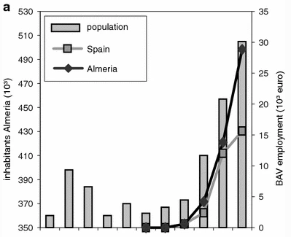
Socio-economy of Almeria province
Activity
BAV (10⁶ euro)‏
% GDP
Employment (unities)‏
%Employment
Almeria
Direct
Indirect
Total
Direct
Indirect
Total
Intensive agriculture
695
447
1.142
25,7
55.000
14.314
69.314
41,3
Other irrigation
445
-
445
1
2.524
-
2.524
1,5
Industrial activities
128
-
128
2,9
2.790
-
2.790
1,7
Tourism
237
89
326
7,3
10.855
3.512
14.367
8,6
Total
1.105
536
1.641
36,9
71.169
17.826
88.995
53,1
Source: Van Cauwenbergh et al., 2008

Slide 15
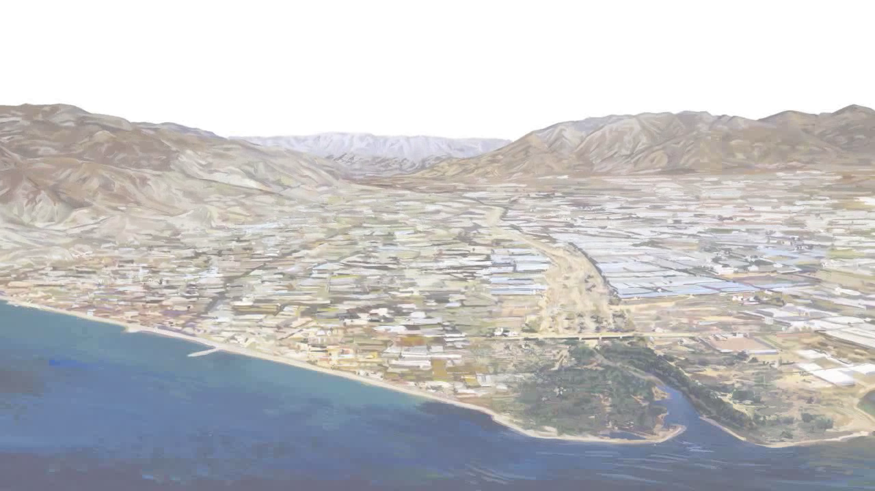
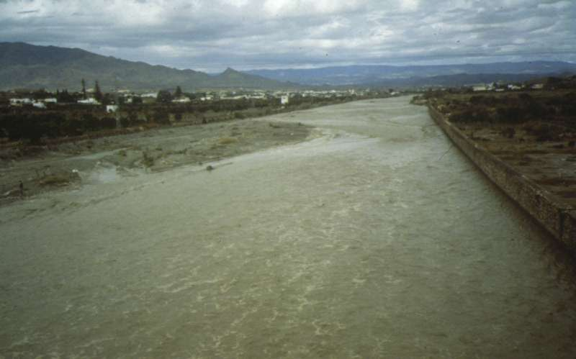
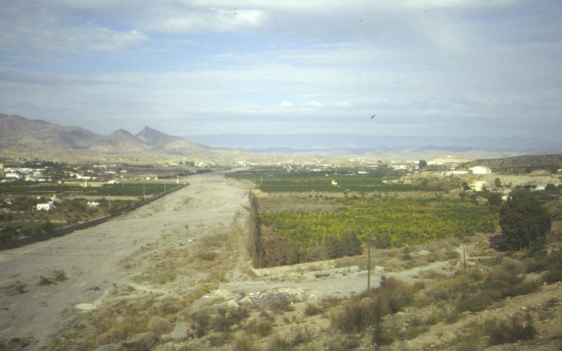
Semi-arid region with high rainfall variability

Slide 16
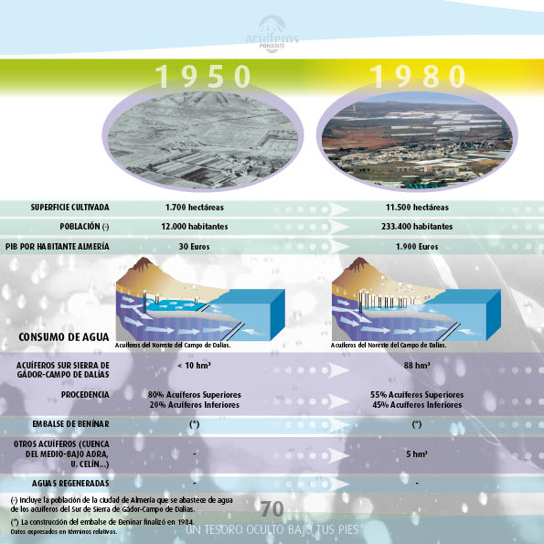
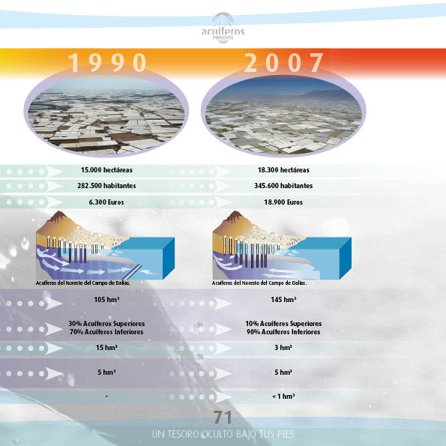

Slide 17
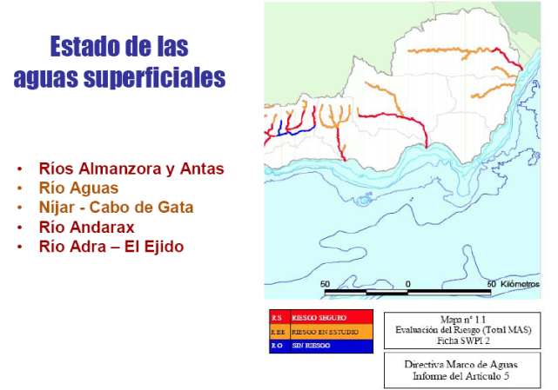
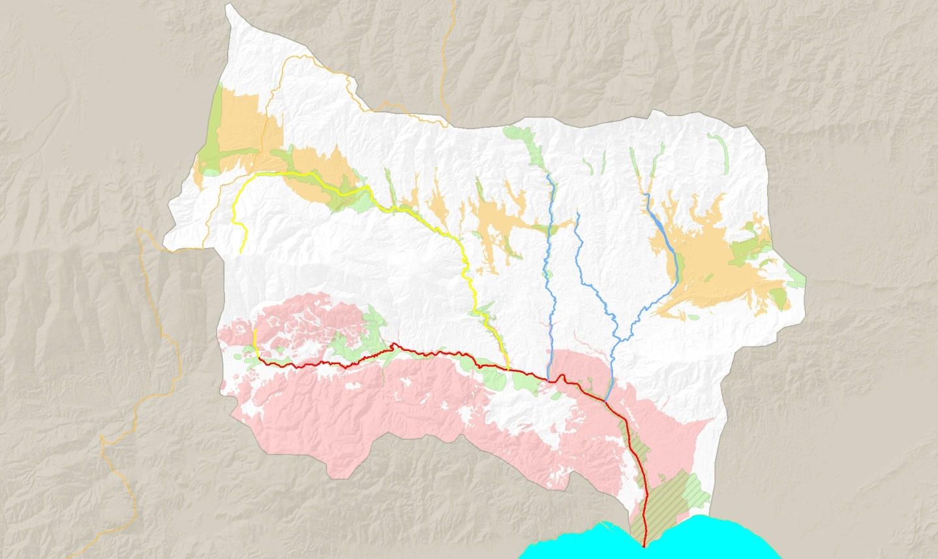
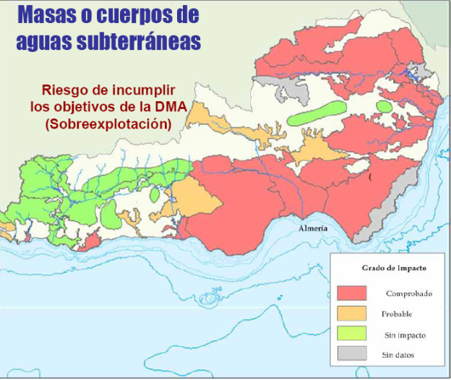
Limited resources under high pressure

Slide 18
Water scheme

Slide 19
Institutional setting

Slide 20
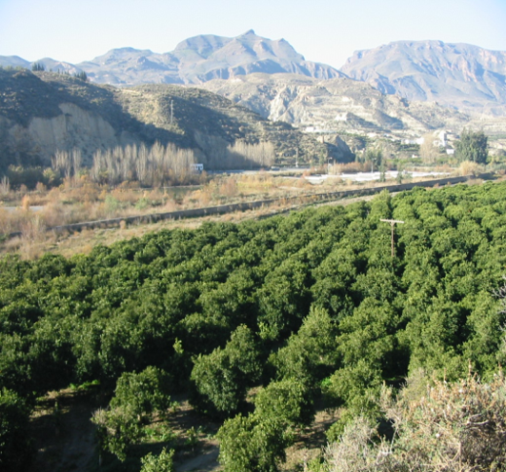
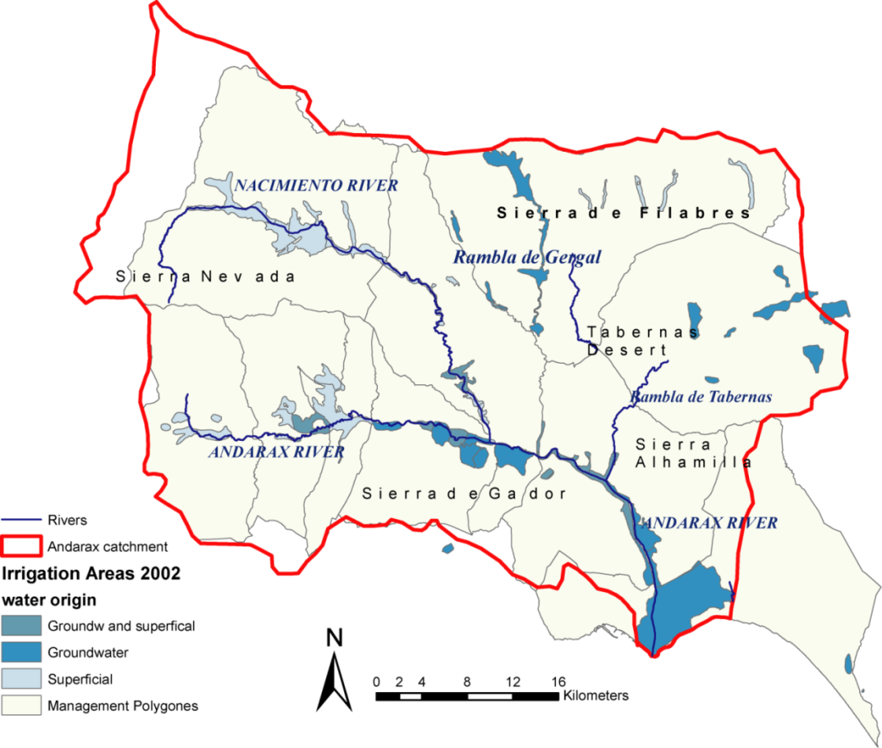
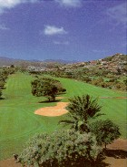
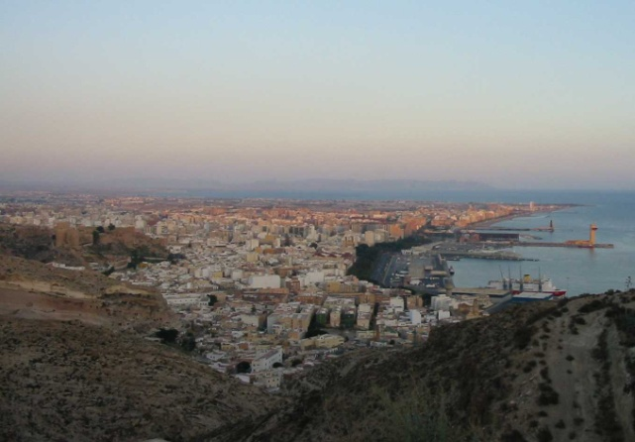
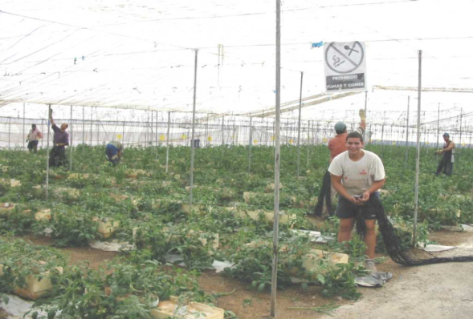
Uses, economy and stakeholders
GOLF COURSE
4.000 - 15.000 m³/ha – 4€/m³
CITRICS
5000 m³/ha – 0,75€/m³
City of Almeria
180.000 inhab 15 Hm³/y
GREENHOUSE IN ALMERIA
5.500 to 8.000m³/ha – 10€/m³

Slide 21
High pressure on limited resources
Overexploitation, environmental degradation,
Unsustainable production model
Need for alternative management strategies

Slide 22
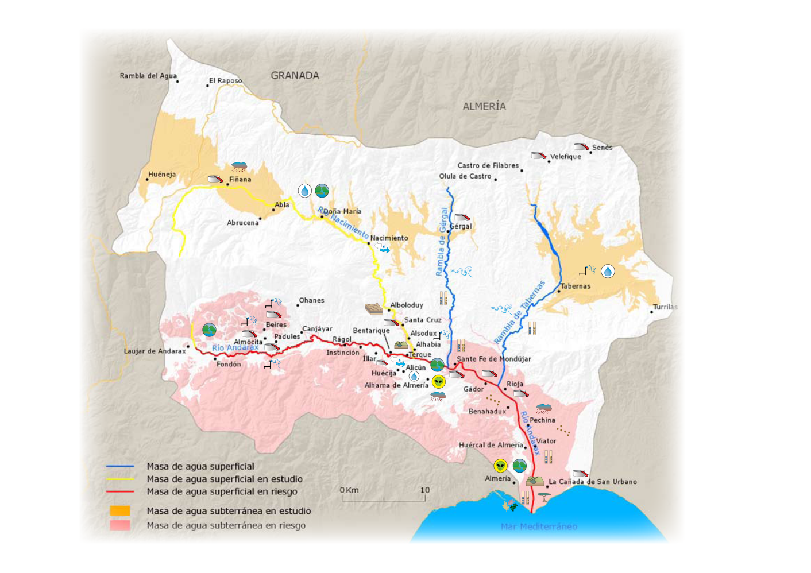
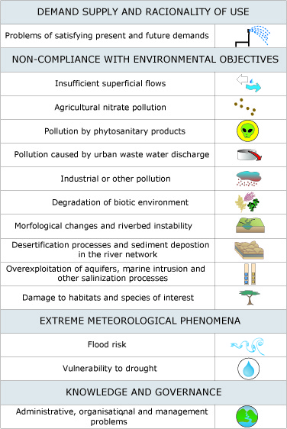
Water issues
Overexploitation, environmental degradation,
Unsustainable production model
Need for alternative management strategies

Slide 23

Water management alternatives
River basin plan

Slide 24
References / sources
Van Cauwenbergh, N., Pinte, D., Tilmant, A., Frances, I., Pulido-Bosch, A., & Vanclooster, M. (2008). Multi-objective, multiple participant decision support for water management in the Andarax catchment, Almeria. Environmental Geology, 54(3). https://doi.org/10.1007/s00254-007-0847-y
ALERT report on institutional and stakeholder context (available on eCampus)
ALTAGUAX report on participatory situation analysis (2010, available on eCampus)
Additional reading on Andarax related issues
On non-conventional resources as ‘fix’ for water scarcity: Swyngedouw, E. (2013). Into the Sea: Desalination as Hydro-Social Fix in Spain. Annals of the Association of American Geographers. https://doi.org/10.1080/00045608.2013.754688
On role of pricing and subsidies in irrigation: Toan, T.D. Water Pricing Policy and Subsidies to Irrigation: a Review. Environ. Process. 3, 1081–1098 (2016). https://doi.org/10.1007/s40710-016-0187-6
El Ayni, F., Manoli, E., Cherif, S., Jrad, A., Assimacopoulos, D., & Trabelsi-Ayadi, M. (2013). Deterioration of a Tunisian coastal aquifer due to agricultural activities and possible approaches for better water management. Water and Environment Journal. https://doi.org/10.1111/j.1747-6593.2012.00354.x
MacDonald, D., Crabtree, J. R., Wiesinger, G., Dax, T., Stamou, N., Fleury, P., Gutierrez Lazpita, J., & Gibon, A. (2000). Agricultural abandonment in mountain areas of Europe: Environmental consequences and policy response. Journal of Environmental Management. https://doi.org/10.1006/jema.1999.0335

Slide 25

Videos to watch
  Introduction to the Andarax river basin – by yours truly (16’ video presenting the area, its biophysical and socio-economic characteristics and part of the historical water related historical development, this is the start of the situation analysis)
  Almeria Spain - World's Largest Concentration of Greenhouses (4’ video of panoramic views and drive/walk by to get a sense of the area today) https://www.youtube.com/watch?v=MNVLW5EzTDA
  50 years of greenhouses in Almeria – on history of agriculture and greenhouses in the region of Almeria, Spain – subtitles in English can be activated (video in 2 parts developed by Caja Rural which is a farmers bank and interviewing several experts in the region, focus on part 1 to understand the agricultural transformation and relation to water availability and government aid vs private initiative in general, part 2 explains the development of greenhouse technology as well as financing/commercialization in more detail and is optional to watch) https://www.youtube.com/watch?v=wLaPGsBa130 (part 1 19:19’ video) , https://www.youtube.com/watch?v=LcyrqsBDUc8) (part 2 16:34’)
  Salad Slaves: Who really provides our vegetables (12:59’ video by the Guardian on the dire labor conditions for migrant workers in the greenhouse industry in Almeria. While this doesn’t happen in all greenhouses, it is an enormous problem) https://www.youtube.com/watch?v=oZl1eBU4Qx0
  Organic farming supersized – An imperfect solution for the planet (6:02’ video by France24 on the environmental consequences of industrial greenhouse farming in Almeria, even if organic) https://www.youtube.com/watch?v=VYiQ-kgZHjA (interviews with organic farmer, legal expert and environmental NGO representative)

Slide 26
References / sources – optional
OPTIONAL – references to discuss stakeholder involvement and planning in the Andarax basin
Cabello, V., Kovacic, Z., & Van Cauwenbergh, N. (2018). Unravelling narratives of water management: Reflections on epistemic uncertainty in the first cycle of implementation of the Water Framework Directive in southern Spain. Environmental Science and Policy, 85. https://doi.org/10.1016/j.envsci.2018.03.019
Van Cauwenbergh, N., Ballester Ciuró, A., & Ahlers, R. (2018). Participatory processes and support tools for planning in complex dynamic environments: A case study on web-GIS based participatory water resources planning in Almeria, Spain. Ecology and Society, 23(2). https://doi.org/10.5751/ES-09987-230202

Slide 27
Exercise in groups
9h45 - Check videos and materials of stakeholder analysis AND problem tree
10h45 – Divide in groups and work on the exercise
11h45 – Plenary presentation (1 group presents, 2 groups discussant)

Slide 28
Exercise – problem tree
Select one problem and in groups of 2-3 prepare a problem tree as explained in video (consult practitioners guide for more information)
Bring your tree (on paper) and be ready to present/argue

Slide 29
Exercise – stakeholder analysis
Select one problem and in groups of 2-3 prepare a problem tree as explained in video (consult practitioners guide for more information)
Bring your matrix (on paper) and be ready to present/argue

Slide 30
Discussion
Reflecting back on exercises and general principles of situation analysis
Introduction to the individual assignment

Slide 31
Trigger for WRP and situation analysis
problems have to be solved
an undesirable event
meet unsatisfied demands
develop under-utilized resources
achieve national development objectives
other (sectoral) planning efforts: energy, agriculture, fisheries, land use

Slide 32
Levels of situation analysis
Water policy
Systematic review of functions WRS
All benefits and issues
Regular planning
Analyse demand-supply
Link to other sectoral plans
Specific problem
Straight-forward, focused
Analysis still holistic (e.g. EIA)
Impact activities on resources
Analyse potential conflicts

Slide 33
Intensity of situation analysis
Intensity of analysis depends upon
comparative importance of water resources functions
the scarcity of the resource (quantity + quality) and
the conflicts between uses

Slide 34
Objectives of situation analysis
identify all possible problems and issues
gain insight in the extent, cause and effects of the problems and issues
know the problem, before you try to solve it
gain insight in the user functions of the WRS
help identify all the interventions that possibly can be made
identify all stakeholders involved in and affected by the plan
help to rank problems
specify priority questions for analysis

Slide 35
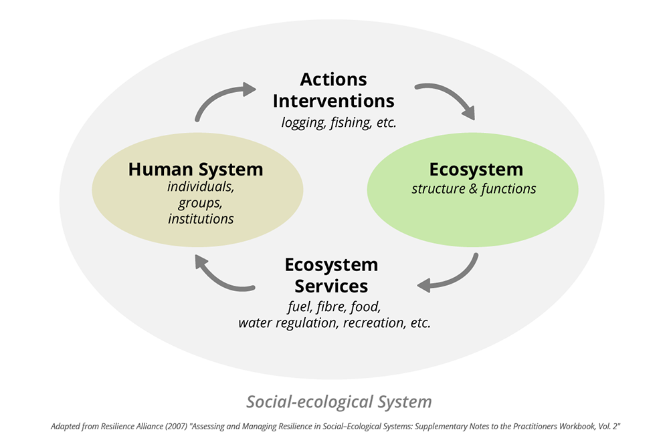
Issues and assessment
Based on understanding of processes in socio-ecological systems:
Relation between human and natural system through actions/ interventions and changes in ecosystem services (benefits from nature)
Human system includes SES and AIS
Include livelihood-demand and resource-impact issues
Needs interdisciplinary knowledge, different knowledge systems
Visualizes “why and how”

Slide 36
Issues and assessment
Based on understanding of processes in socio-ecological systems:
Relation between human and natural system through actions/ interventions and changes in ecosystem services (benefits from nature)
Human system includes SES and AIS
Include livelihood-demand and resource-impact issues
Needs interdisciplinary knowledge, different knowledge systems
Visualizes “why and how”

Slide 37
Techniques for situation analysis
no described format
tables, diagrams, matrices, trees; highlighting
  relations,
  interactions
  cause-effect relationships
  gaps in analysis
  good for communication / presentation
  bring hierarchy / prioritization
dissect (decompose) the problem

Slide 38
Techniques / tools for situation analysis
WWWWW Questions
Problem Tree; Cause - Effect Table
Matrix of Activities
Function Analysis
Resource Function Table; Resource Use Table
Describe factors: Physical, Demographic, Socio-economic, Political / Institutional
Stakeholder Analysis Tools
EIA, SEA
Objective Analysis
Design Tree = Analysis of Measures

Slide 39
Output of the situation analysis
report elaborating the progress with implementing improved management of water resources, the outstanding issues, the problems and some of the solutions
Prioritising these problems, issues and solutions in terms of social, economic, environmental and political priorities is an important aspect.
examines the key factors of influence in a given situation.
Especially important to view the situation first from the perspective of those directly affected. Awareness of the problems and the motivation to seek solutions are a function of the condition experienced by the stakeholders.

Slide 40
Coordination of multiple knowledge
Coordination of knowledge transfer between more technical/analytical and more experience-based knowledge
Emphasis on the participation of stakeholders, however not to the extent of ignoring the statistical aspects and quality of data. Balance = challenge (cf Role of Models, Masih week 2)
Combination of stakeholder involvement techniques and methods
Specialist expertise has an important role in conducting the analysis when highly technical skills are required, large baseline surveys need to be done when there is particular need for an independent viewpoint.
Presence of technical experts in the stakeholder forums!

Slide 41
Knowledge and stakeholders
Source: adapted from Reed et al., 2009

Slide 42
Knowledge and stakeholders – level/mode
Informal and formal modes
Level of involvement
  Link to planning approach and democratic context
  Transparency
  Needs to be backed by a consistent communication strategy and feedback
Source: own elaboration after Arnstein, 1969, Sadoff and Grey, 2005 &

Slide 43
Coordinate collection of knowledge
Multi-stakeholder groups should design the information gathering, analysis and research process themselves, to ensure ownership of the strategy and its results.
All the ‘analysis’ tasks are best implemented by bringing together, and supporting, existing centers of technical expertise, learning and research.
Since analysis is central to strategy development, it should be commissioned, agreed and endorsed at the highest level

Slide 44
Situation analysis and AIS
SA links back to the existing water resources management system and its effectiveness in reaching the goal of sustainable management and development.
Weaknesses, problems and issues identified ~ :
  Water resources policy
  Water (resources) legislation
  Water Management institutions, and
  Water (resources) management practices.
Causes of the problems may not lie in the same area.
→ identify gaps in the management framework and allow a prioritisation of action.

Slide 45
Institutional analysis
Looking behind the scenes of power relationships
Understanding the reality – rather than the rules
Can lead to politically sensitive results
Should be undertaken by researchers or consultants

Slide 46
Notes on situation analysis (1/3)
Identify existing and future known problems, but not potential, imagined ones (impact analysis)
Problems to be analyzed in terms of the interaction between human activities, natural systems and management options
A problem is not the occurrence of a physical phenomenon; the phenomenon becomes a problem:
  if it has adverse social and economic consequences
  if remedial measures are difficult to take

Slide 47
Notes on situation analysis (2/3)
Problems may be a function of time, space
Focus on extreme event, while regular event may be much more worrisome (but may not reach the headlines)
Constraints limit alternatives. Do not worry too much about them in the process, be creative
What does each stakeholder think of other stakeholders situation

Slide 48
Notes on situation analysis (3/3)
Rounds of problem analysis:
  1) identification and classification + quantification and prioritization
  2) screening possible measures + formulation of specified questions

Slide 49
Useful resources and tools from the web
OECD: http://www.oecd.org (topics/working papers,i-Library)
WB: http://worldbank.org
CAPNET: http://www.cap-net.org
Water Resources Assessment. WMO UNESCO. Handbook for review of National Capabilities http://www.wmo.ch/web/homs/documents/english/handbook.pdf
California Watershed Assessment Manual http://cwam.ucdavis.edu/Manual_chapters.htm
Practitioner’s guide. Data and Information Assessment Matrix. http://www.methodfinder.net/pdfmethods/methodfinder/methodfinder_method67.pdf
Practitioner’s guide. Problem tree. http://www.methodfinder.net/pdfmethods/methodfinder/methodfinder_method1.pdf
WB. Participation and Social Assessment: Tools and Techniques. http://www-wds.worldbank.org/servlet/WDSContentServer/WDSP/IB/1996/04/01/000009265_3980624143608/Rendered/PDF/multi0page.pdf

Slide 50
Checking the learning objectives
Do you?
Understand the rationale and objectives of a situation analysis?
Know which techniques you can apply for situation analysis to a particular case study?
Know how to assess the functions and problems in the basin/area that is object of planning?

Slide 51
Assignment
Learning objectives:
Identify boundaries and objectives for water resources planning in a specific context
Be able to design a problem tree for a specific problem and link potential measures to it
Reflect on the actors involved in the case you are experienced with.
Description:
You are asked to perform a situation analysis on a case that you are (well) experienced with.

Slide 52
Assignment – output and timing
Output: word document of 1000 to 1500 words presenting:
Brief description of the area, main uses and users
Identify the objectives and boundaries for WRP
Overview of the main problems
Selection of 1 specific problem and design of a problem tree clarifying underlying causes.
Potential measures for that specific problem
Identification of the actors involved
Timing:
Wednesday May 4, no later than 9h on eCampus under 2MB with title “Your name_SA assignment”
Assessment:
10% of the final exam score. The study load is of 5 hours total

Slide 53
References / sources
See references in individual presentations on
  Planning process steps
  Problem tree
  Stakeholder analysis

Slide 54
Questions?

Slide 55
Thank you
n.vancauwenbergh@un-ihe.org

Slide 56
Water resources planning
Situation analysis - problem tree
Nora Van Cauwenbergh, PhD
Senior lecturer Water Resources Planning, module coordinator

Slide 57
Situation analysis and problem tree
Reminder
Objective of a situation analysis
Different triggers and intensity of analysis
Type of knowledge involved and how to coordinate it
Methods and techniques
Communication
Water policy
Regular planning
Specific problem

Slide 58
Why a problem tree?
Helps to define the problems in an area under planning
Provides a rational guidance to order these problems into cause-effect relationships
Indicates interrelations between problems and how certain issues underlie several later problems (root cause)
Provides an objective basis for monitoring and evaluating changes at later stages
In WRP it can help people to uncover and analyze underlying causes of a particular problem
Helps to assess what efforts/measures are needed to overcome problems

Slide 59
How?
Visual tool to narrow down and prioritize problems (but also objectives or decisions)
Main issue represented by tree trunk
Relevant factors, influences and outcomes show up as tree roots or branches/leaves
source: www.iisd.org/csconservation/conflict_tree.aspx

Slide 60
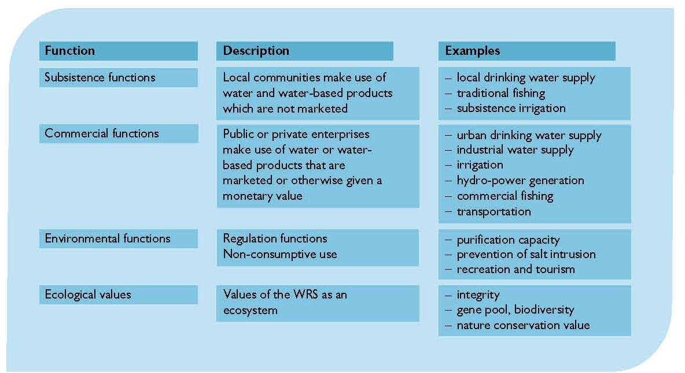
Step 1 – Define the problem
Clearly define the problem by 5W1H approach (what, where, when, who, why, how)
Specific, water related problem - or directly impacted by or impacting on water
  Too much, little, polluted, degraded, expensive
  Or compromising objectives of the plan
  Or compromising functions of the water resources system
Temporal and spatially explicit
Who is it a problem for?
Note: what is a problem for one, is a cause or an effect for someone else. Avoid arbitrary choice by consulting and agreeing with actors in the planning process
Source: Loucks and van Beek, 2017 p569

Slide 61
Step 2 – Identify causes and effects
Based on understanding of processes in socio-ecological systems:
Relation between human and natural system through actions/ interventions and changes in ecosystem services (benefits from nature)
Human system includes SES and AIS
Include livelihood-demand and resource-impact issues
Needs interdisciplinary knowledge, different knowledge systems
Visualizes “why and how”
Source: Loucks and van Beek, 2017 p573

Slide 62
Step 3 – Structure causes and effects, identify root causes and feedback loops
Within the boundaries of the system
Based on understanding of socio-ecological processes
What are drivers of change? Will they worsen or improve situation?
Identify the sphere of influence?
Which causes can you treat? Which are within mandate of organization and scope of plan, which are based on cooperation, and which are to be considered as uncertainties in the system

Slide 63
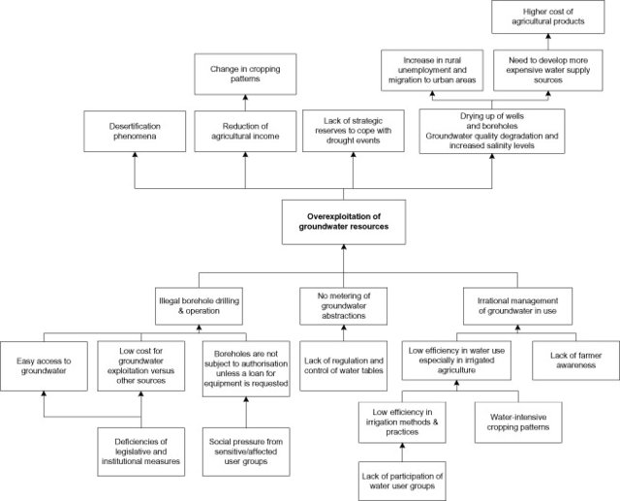
Example
source: El Ayni et al., 2013
Notes:
Create example of overexploitation in Andarax
Highlight
Has NRS and SES causes
Feedback loop
Combination needed to have a certain effect
What happens if you have a box double

Slide 64
Notes
Importance of well defining the core problem (be specific, also problems have to be existing ones, not potential future ones, also not lack of solution)
When building up the tree in different levels of causes and effects, do the “leads to” test to check position of boxes
A certain issue can only appear once (if you see it appearing more than one time, you need to reshuffle the boxes)
Check what are issues inside and outside the boundaries of the situation analysis
Reflect on the mandate of the water resources plan and the type of issues it is responsible for

Slide 65
Exercise – Problem tree for Andarax
The objective of this exercise is to create a problem tree for a problem of choice in the Andarax river basin
Instructions
  Look at the videos introducing the Andarax river basin and make notes (individual) of the following:
    What are potential problems in the basin?
    What are main drivers for changes in the basin?
    What are actors and potential solutions?
    OUTPUT: PROBLEM CLOUD
  In the problem cloud, define 2-3 key problems
  Select one problem and in groups of 2-3 prepare a problem tree as explained above (consult practitioners guide for more information)
  Prepare your paper and argumentation for the plenary presentation

Slide 66
Discussion and Q&A
Issues are multi-facetted
What is the mandate (what can you change)…cf boundaries
Advantages and disadvantages of problem tree in situation analysis

Slide 67
References / sources
References and sources
On problem tree technique; GMBH practitioner guidelines (available on eCampus)
Mapping and Assessment of Ecosystem Services (MAES): https://biodiversity.europa.eu/maes
Additional reading on Andarax related issues - optional
El Ayni, F et al. (2013). Deterioration of a Tunisian coastal aquifer due to agricultural activities and possible approaches for better water management. Water and Environment Journal. https://doi.org/10.1111/j.1747-6593.2012.00354.x
MacDonald et al. (2000). Agricultural abandonment in mountain areas of Europe: Environmental consequences and policy response. Journal of Environmental Management. https://doi.org/10.1006/jema.1999.0335
Lafuente et al. (2018). The role played by environmental concern and institutional trust in changing public preferences for water management. Environmental Policy and Governance. https://doi.org/10.1002/eet.1808
Additional reading on understanding interactions in the natural-human system (SES and IPBES) - optional
McGinnis, M. D., & Ostrom, E. (2014). Social-ecological system framework: Initial changes and continuing challenges. Ecology and Society. https://doi.org/10.5751/ES-06387-190230
Díaz, S. et al. (2015). The IPBES Conceptual Framework - connecting nature and people. In Current Opinion in Environmental Sustainability. https://doi.org/10.1016/j.cosust.2014.11.002

Slide 68
Videos to watch (optional)
General on problem tree methods and socio-ecological system understanding
General purpose and method of problem tree (1:59 video by TolaData company to introduce general principles of problem tree, not specific for water systems) https://www.youtube.com/watch?v=-j-_Y7D35H4
For an introduction to ecosystem services and its relation to biodiversity (5:36 video from EU environment, after 1:36 it introduces the valuation techniques reflecting on monetizing and CBA https://www.youtube.com/watch?time_continue=27&v=D6luBEJfi3s&feature=emb_title )
Use of ecosystem service approach in defining human interventions (9:02 video by California Academy of Sciences with an example on the function of mangrove swamps for coastal areas 2:33 and wetlands for cities 4:14 https://www.youtube.com/watch?v=BCH1Gre3Mg0 )
On the Andarax case and its specific problems: check link to videos in PowerPoint introducing Andarax PIP
Notes:
The future of farming – Hydroponic tomatoes (4’39 video on the high-tech, highly intensive production system used to different degrees in Almeria – video is from California, but essentially this technology was invented in Almeria and then exported and further perfected all over the world. Reflect on the input/output of this system, advantages and challenges) https://www.youtube.com/watch?v=bRyBKWqLzI8
Water mismanagement in Spain - the Economist (3’22 video on management for water in Spain, good overview, then focuses on example of Guadiana river) https://www.youtube.com/watch?v=MxGKKgax1RA
Senderismo, Laujar de Andarax, Almeria – by Canal de Turismo (1:29 video to see the spring of the river Andarax, no English subtitles available) https://www.youtube.com/watch?v=CZ5lS7HU4dg
Las Canales de Padules, rio Andarax – by Altos vuelos (2:59 video flyover of some villages in the medium-upper Andarax (old grapevine area) and in the Padules channels – just to get an image of the area https://www.youtube.com/watch?v=bYOUHfgR_Kw)
.

Slide 69
Questions?

Slide 70
Water resources planning
Situation analysis - stakeholder analysis
Nora Van Cauwenbergh, PhD
Senior lecturer Water Resources Planning, module coordinator

Slide 71
Stakeholder analysis
Theory and exercise
Dr. Nora Van Cauwenbergh
Senior lecturer Water Resources Planning, IHE Delft

Slide 72
Why and who - stakeholder involvement?
In water resources planning, decisions on water allocation and management are made: affect a large number of people and involve multiple parties.
Different levels of government, water users across sectors, civil society, experts, environmental and other NGOs, media etc.
Consensus on importance of democratizing decisions on allocation and management of water
  Efficiency argument
  Social inequity argument
Notes:
Why are we talking about stakeholder involvement for TB water security?
Well, to achieve this TB water security a number of decisions on water allocation and management have to be made that will affect a large number of people and involve multiple parties.
These parties are: different levels of government, to water users in different sectors, water utilities and service companies, research experts and media but also the civil society and NGOs representing environmental and other interests.
The consensus is that we need to involve these stakeholders when making decisions on water management and allocation, be it transboundary or not.
The idea is that through involving stakeholders, the understanding of the water issue will improve as well as which solutions and projects are possible. On top of that you can anticipate resistance to certain projects by discussing with stakeholders and assure buy-in from stakeholders on the final decisions made. This will make their implementation smoother and more efficient. And through also involving those stakeholders that do not normally have access to centres of decision making and power, you can avoid propagating or aggravating social inequity.

Slide 73
How to start? Identification methods and tools
Importance of representative sample (need for validation)
Know them before you involve them
Source: adapted from Reed et al., 2009
Notes:
So if you want to start with involving stakeholders, the first thing to do is to set up the stakeholder group
And to do so you need to identify and select stakeholders
This is a key step and the care with which this is done will determine to large extent the success of your involvement, as the latter will strongly depend of the legitimacy and representativeness of your stakeholder group.
What it comes down to is that you have to know your stakeholders before you involve them
Reed provides good information on methods for stakeholder identification in 3 steps:
from identification with interviews, snowball sampling and focus groups
to Differentiation of stakeholders (either top down with methods such as influence – importance matrices) or bottom-up, led by the stakeholders themselves.
Finally it is also wise to look into the relations between stakeholders before starting the involvement. This can be done using methods such as social network analysis, knowledge mapping etc.
These steps are important, not only to assure a representative and legitimate group of stakeholders, but also to adapt your involvement methods and techniques based on the categories of stakeholders and for example the degree of cooperation that exists between them

Slide 74
Step 1 – stakeholder identification
Long list of stakeholders via categories
Snowball sampling
Importance of validation (representativeness)
Understanding of roles (formal/informal)
different spheres of government: regional, national, sub-national, local
water utilities and companies
farmers
businesses
community-based organizations
universities and research institutions
schools
media ...

Slide 75
Step 2 – stakeholder differentiation (matrix)
In general, stakeholders can be described based on following characteristics (cf Water Governance module):
Degree of economic, social or cultural reliance on the system
Degree of effort and interest in the management of the system
Historical and cultural relationship with the system
Unique knowledge or skills for the management of the system or resources at stake
Present or potential impact of the activities of the stakeholder on the system
Existing rights to land or other natural resources
Importance
Influence

Slide 76
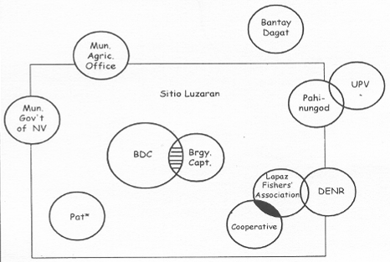
Step 3 – stakeholder relations
Venn diagram
Social network analysis
Source: Kemerink, 2012
Source: IDS, 2011

Slide 77
Discussion
Importance of knowing stakeholders before you involve them
Roles (formal/informal) and link to institutional analysis
Analysis informs different strategies to engage, based on
  Stakeholder characteristics
  Argument for engagement (efficiency and/or equity)
Identify existing centers of knowledge/power/influence/cooperation and conflict → adapt methods/tools for engagement

Slide 78
Exercise – stakeholder analysis Andarax
The objective of this exercise is to identify key/primary/secondary stakeholders and create a stakeholder matrix for the Andarax
Instructions
  Check the description of stakeholders and institutional analysis provided in folder exercises/stakeholder analysis
  In groups of 2-3:
    EX 1: list the stakeholders according to affected or affecting and formulate the rationale
    EX 2: create a stakeholder matrix and prepare an argumentation for the position of each of the stakeholders
  Reflect on what the information of influence/importance means for water resources planning process

Slide 79
Exercise 1 – stakeholder analysis Andarax
List the stakeholders as affected/affecting
Instructions
  List the affected and affecting stakeholders on a separate paper (make 2 columns, left affected, right affecting and position stakeholders in ‘their’ column)
    Which are the stakeholders in the river basin that depend on good water management (affected)
    Which are the stakeholders in the river basin that influence water management (affecting)
  Prepare your paper (take a picture or scan) and group discussion for the plenary session

Slide 80
Exercise 2 – stakeholder matrix Andarax
Create an influence/ importance matrix
Instructions
  Read through the description of institutions and stakeholders
  Indicate the key stakeholders on your list
  Indicate their relative importance and influence (locating in matrix)
  Prepare your paper and discussion for the plenary session

Slide 81
Discussion and Q&A
Role of farmers/NGOs/…
What are different channels of influence/power?
The power of irrigation sector
Vested interests and large scale infrastructure (in Andarax desal/ protection of water rights (for who) / introduction to Mexico case)

Slide 82
More information - practitioners
General on stakeholder involvement methods and tools (comprehensive toolkit on stakeholder involvement methods in different moments of planning and management; not specific to water management) www.mspguide.org/tools-and-methods
Stakeholder involvement in urban water management (training kit for practitioners focusing on increasing sustainability of urban water management, contains different modules, module 2 focuses on stakeholder involvement) https://switchtraining.eu/home/
INBO, 2018. The handbook for the participation of stakeholders and the civil society in the basins of rivers, lakes and aquifers https://www.riob.org/pub/HandBook-participation-en/2/
IDS,2011. Learning about Analysing Networks to Support Development Work? (Practice paper with information on the SNA method as well as reflection on some applications)
Notes:
More information on the methods and tools for stakeholder involvement in TB water security can be found in the links and references here.

Slide 83
References and reading
Reed, M. et al. (2009). Who’s in and why? A typology of stakeholder analysis methods for natural resource management. Journal of Environmental Management. https://doi.org/10.1016/j.jenvman.2009.01.001
Arnstein, S. R. (1969). A Ladder Of Citizen Participation. Journal of the American Planning Association. https://doi.org/10.1080/01944366908977225
Kemerink, 2012. Water Governance Module. UNESCO-IHE. Lecture Note (check updated version)
Additional reading on stakeholder lobbying (optional)
Esteban, E., Dinar, A., & Albiac, J. (2019). Determinants of water lobbying: Irrigators’ behavior in a water-stressed basin. Water Policy. https://doi.org/10.2166/wp.2019.148

Slide 84
Questions?
n.vancauwenbergh@un-ihe.org

