Slide 1





Water resources planning
Stakeholder involvement- discussion
Nora Van Cauwenbergh, PhD
Senior lecturer Water Resources Planning, module coordinator
28 April 2022

Slide 2

Learning objectives
This courses will assist participants in:
Understanding different modalities of involvement and its relation to engagement objectives, steps in the planning process and context;
becoming aware about the costs and other challenges of planning and coordinating stakeholder involvement; and
Critically analyze the stakeholder process and its outcomes through a case study

Slide 3
Learning activities stakeholder involvement
Theory on methods and tools for stakeholder involvement
Stakeholder involvement in the Andarax basin – a comparative analysis across scales
  AAA planning process at regional scale
  PIP at basin scale
  Operational agreement on aquifer exploitation at water body scale
Discussions on stakeholder involvement

Slide 4
Why and who - stakeholder involvement?
To achieve water security, decisions on water allocation and management: affect a large number of people and involve multiple parties.
Different levels of government, water users across sectors, civil society, experts, environmental and other NGOs, media etc.
Consensus on importance of democratizing decisions on allocation and management of water
  Efficiency argument
  Social inequity argument
Notes:
Why are we talking about stakeholder involvement for TB water security?
Well, to achieve this TB water security a number of decisions on water allocation and management have to be made that will affect a large number of people and involve multiple parties.
These parties are: different levels of government, to water users in different sectors, water utilities and service companies, research experts and media but also the civil society and NGOs representing environmental and other interests.
The consensus is that we need to involve these stakeholders when making decisions on water management and allocation, be it transboundary or not.
The idea is that through involving stakeholders, the understanding of the water issue will improve as well as which solutions and projects are possible. On top of that you can anticipate resistance to certain projects by discussing with stakeholders and assure buy-in from stakeholders on the final decisions made. This will make their implementation smoother and more efficient. And through also involving those stakeholders that do not normally have access to centres of decision making and power, you can avoid propagating or aggravating social inequity.

Slide 5
How to start? Identification methods and tools
Importance of representative sample (need for validation)
Know them before you involve them
Source: adapted from Reed et al., 2009
Notes:
So if you want to start with involving stakeholders, the first thing to do is to set up the stakeholder group
And to do so you need to identify and select stakeholders
This is a key step and the care with which this is done will determine to large extent the success of your involvement, as the latter will strongly depend of the legitimacy and representativeness of your stakeholder group.
What it comes down to is that you have to know your stakeholders before you involve them
Reed provides good information on methods for stakeholder identification in 3 steps:
from identification with interviews, snowball sampling and focus groups
to Differentiation of stakeholders (either top down with methods such as influence – importance matrices) or bottom-up, led by the stakeholders themselves.
Finally it is also wise to look into the relations between stakeholders before starting the involvement. This can be done using methods such as social network analysis, knowledge mapping etc.
These steps are important, not only to assure a representative and legitimate group of stakeholders, but also to adapt your involvement methods and techniques based on the categories of stakeholders and for example the degree of cooperation that exists between them

Slide 6
SI methods and tools in different moments of decision making
Understanding the problem
  problem tree, maps/rich pictures, joint fact finding – but also understanding different interests, positions and frames
  E.g. Transboundary Diagnostic analysis (Danube), UNECE joint fact finding
  Visioning exercise
Defining alternative solutions
  Modelling
  Scenario assessment
  E.g. collaborative modelling Mexico between states, NBI, shared models between countries
Comparing/expressing preference for solutions, negotiation
  Priorities, citizen jury
  Voting in MCA, e.g. Jordan river
Monitoring and evaluation (citizen based monitoring)
Source: own elaboration
Notes:
When this preparatory step is done, we can talk about a number of methods and tools that are used at various steps of decision making in transboundary water security
I divide the decision making into 4 key steps: from understanding the situation and problems, to identifying alternative actions (solutions and developments), to choice between these alternatives and negotiation toward a common strategic action plan and finally the implementation and monitoring and evaluation of the implemented actions.
In all these steps methods and tools can be used, either supported by models and DSS with different degrees of sophistication or working with more so-called analog methods such as surveys, interviews and workshops. What is important is that all the methods and tools require capacity building (translation and facilitation) for them to facilitate effective involvement and a constructive dialogue.
Now let’s look into the steps and a few of the examples>
In the first step, typical methods that can be used is the generation of a problem tree, maps, rich pictures
Examples are the TBA in Danube and the joint fact finding as prescribed by the UNECE convention
In the second step, stakeholders can be involved in defining which are possible course of actions by using either models in which they can see the result of interventions, or organize scenario exercises and brainstorming with more or less sophisticated assessment related to it. Many examples exist with different degrees of interaction between stakeholders and models/DSS tools, for example in Mexico a WEAP tool with interactive interface was used to support stakeholder debate, the NBI has a history of sharing models on the Nile etc.
Then comes the key step in the DM, the one in which choices are made and negotiation is happening. The expressing of prefernces for certain solutions to end up in the common strategic action plan, again, can be supported by simple voting exercises (where stakeholders indicate priorities with stickers) or more sophisticated DSS based multi-ctieria or cost benefit analysis tools that allow for elicitation of preferences and votes. Examples of participatory MCA can be found in Spain and the Jordan river basin amongst others.
In the last step, the one where the decision is implemented and subsequently monitored and evaluated, stakeholders can be involved. For example through citizen science, or at higher levels of government, through sharing monitoring data and protocols.

Slide 7
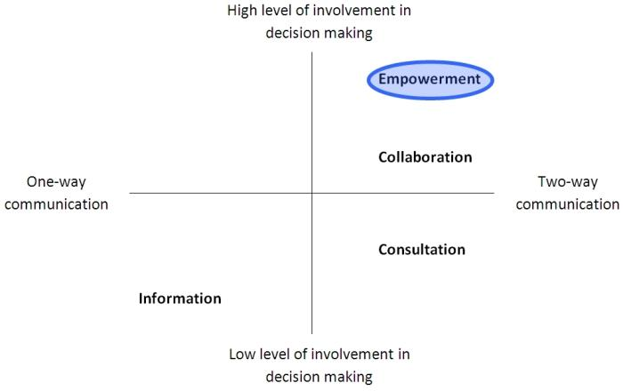
Levels and modes of stakeholder involvement
One way 2way communication, level of power
Source: own elaboration after Arnstein, 1969, Sadoff and Grey, 2005 &
Notes:
One important thing to consider when selecting and using the methods and tools that I have mentioned, is the different levels and modes of stakeholder involvement.
Starting with the level, one key reference here is the one of Arnstein of in 1969 who describes the ladder of participation.
Depending on the level of power, and intensity of participation, stakeholder involvement ranges from manipulation to citizen control. The higher you go up the ladder, the more there is actually potential to influence decisions. We can therefore see that lower levels will lead to unilateral actions whereas higher levels have more coordination and potential joint action.
Whereas you definitely want to stay away from organizing the lower levels of involvement, and potentially counterproductive as it can be a source of conflict, there is a careful choice to be made in defining the level between informing stakeholders to giving actual citizen control. This choice will depend on a number of factors such as capacity, legal constraints and political preferences and has implications for the type of methods and tools one will use, but also for the way in which a given method is used.
What is important to realize is that the level of power and 2-way communication, the more one moves toward cooperation and joint action on the cooperation spectrum
Secondly, the mode of participation is important. Here we distinguish formal and informal approaches, and we can link this to some degree to the multiple tracks of diplomacy. We are then mainly thinking about track 2 and 3. In track 2 it is about sharing ideas that inform official processes in track 1 (such as peace talks). In track 3 the involvement aims to empower individuals or communities to participate in the negotiation process. Depending on the track you are in, both the methods and tools as well as what is considered to be a representative and legitimate stakeholder group, will differ.

Slide 8
Levels and modes of stakeholder involvement
Informal
+ Good for thinking outside the box
- Lack of formal mandate means decision making is not influenced / Unstable group
Formal/Informal, diplomacy track and scale
( ~ 4 tracks of TB water diplomacy)
  Official (Track I) vs. unofficial dialogue (Track II);
  High-level political and military leaders (Track I) vs. individuals and private groups (Track III);
  Peace talks (Track I), sharing of ideas that inform the official process (Track II), empowerment of individuals and communities to participate in the negotiation process (Track III)
  CSO-led dialogues supporting locally-led governance processes (Track IV), more activist
Formal
+ Recognized status / Binding character
- Participants act within the mandate of their institutions: less innovation
Source: SWITCH guide
Source: US Institute of Peace, online glossary & Warner, 2018
Notes:
(Module 2, p 24)
Informal:
Informal processes typically provide for an open space for everybody to speak her or his mind without facing any threats of being sanctioned for controversial opinions. The resulting atmosphere is a fertile ground for ‘thinking outside the box’ and for more radical ambitions to be pursued.
The lack of a formal mandate from the participants’ institutions usually implies that the results of the discussions and activities in the stakeholder process have little impact in the decision making of the official water bodies. Another disadvantage is that the group might be rather unstable.
Formal:
Stakeholders are invited in their official capacity to represent their institution. Decisions taken in the stakeholder process have a binding character and are communicated back to the participating institutions to be taken up in their internal discussions or procedures.
The main shortcoming here is that the participants will be more ‘careful’ in how they contribute to the process, trying to avoid any undesired implications for their institutions.
One important thing to consider when selecting and using the methods and tools that I have mentioned, is the different levels and modes of stakeholder involvement.
Starting with the level, one key reference here is the one of Arnstein of in 1969 who describes the ladder of participation.
Depending on the level of power, and intensity of participation, stakeholder involvement ranges from manipulation to citizen control. The higher you go up the ladder, the more there is actually potential to influence decisions. We can therefore see that lower levels will lead to unilateral actions whereas higher levels have more coordination and potential joint action.
Whereas you definitely want to stay away from organizing the lower levels of involvement, and potentially counterproductive as it can be a source of conflict, there is a careful choice to be made in defining the level between informing stakeholders to giving actual citizen control. This choice will depend on a number of factors such as capacity, legal constraints and political preferences and has implications for the type of methods and tools one will use, but also for the way in which a given method is used.
What is important to realize is that the level of power and 2-way communication, the more one moves toward cooperation and joint action on the cooperation spectrum
Secondly, the mode of participation is important. Here we distinguish formal and informal approaches, and we can link this to some degree to the multiple tracks of diplomacy. We are then mainly thinking about track 2 and 3. In track 2 it is about sharing ideas that inform official processes in track 1 (such as peace talks). In track 3 the involvement aims to empower individuals or communities to participate in the negotiation process. Depending on the track you are in, both the methods and tools as well as what is considered to be a representative and legitimate stakeholder group, will differ.

Slide 9
Levels and modes of stakeholder involvement
Source: Ruiz-Villaverde, A. & Garcia-Rubio, M., 2017
Notes:
One important thing to consider when selecting and using the methods and tools that I have mentioned, is the different levels and modes of stakeholder involvement.
Starting with the level, one key reference here is the one of Arnstein of in 1969 who describes the ladder of participation.
Depending on the level of power, and intensity of participation, stakeholder involvement ranges from manipulation to citizen control. The higher you go up the ladder, the more there is actually potential to influence decisions. We can therefore see that lower levels will lead to unilateral actions whereas higher levels have more coordination and potential joint action.
Whereas you definitely want to stay away from organizing the lower levels of involvement, and potentially counterproductive as it can be a source of conflict, there is a careful choice to be made in defining the level between informing stakeholders to giving actual citizen control. This choice will depend on a number of factors such as capacity, legal constraints and political preferences and has implications for the type of methods and tools one will use, but also for the way in which a given method is used.
What is important to realize is that the level of power and 2-way communication, the more one moves toward cooperation and joint action on the cooperation spectrum
Secondly, the mode of participation is important. Here we distinguish formal and informal approaches, and we can link this to some degree to the multiple tracks of diplomacy. We are then mainly thinking about track 2 and 3. In track 2 it is about sharing ideas that inform official processes in track 1 (such as peace talks). In track 3 the involvement aims to empower individuals or communities to participate in the negotiation process. Depending on the track you are in, both the methods and tools as well as what is considered to be a representative and legitimate stakeholder group, will differ.

Slide 10
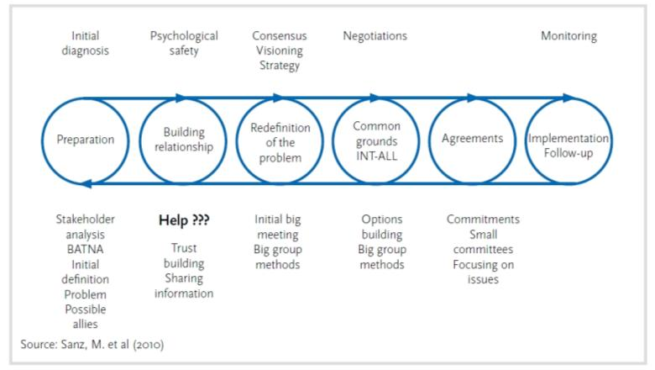
Levels and modes of stakeholder involvement
Why social inclusion?
Fair access to water
Basic needs of all water users to be met
Disadvantaged groups of society must have their say, too
SASI or Systematic Approach for Social Inclusion is based on five principles:
People support initiatives that they help
A focus on building common ground and respect for each other
Negotiation based on interests and not on positions
A system is better understood when changing it
Trial-and-error is the best learning process
Source: Sanz, M. et al. (2015)
Notes:
One important thing to consider when selecting and using the methods and tools that I have mentioned, is the different levels and modes of stakeholder involvement.
Starting with the level, one key reference here is the one of Arnstein of in 1969 who describes the ladder of participation.
Depending on the level of power, and intensity of participation, stakeholder involvement ranges from manipulation to citizen control. The higher you go up the ladder, the more there is actually potential to influence decisions. We can therefore see that lower levels will lead to unilateral actions whereas higher levels have more coordination and potential joint action.
Whereas you definitely want to stay away from organizing the lower levels of involvement, and potentially counterproductive as it can be a source of conflict, there is a careful choice to be made in defining the level between informing stakeholders to giving actual citizen control. This choice will depend on a number of factors such as capacity, legal constraints and political preferences and has implications for the type of methods and tools one will use, but also for the way in which a given method is used.
What is important to realize is that the level of power and 2-way communication, the more one moves toward cooperation and joint action on the cooperation spectrum
Secondly, the mode of participation is important. Here we distinguish formal and informal approaches, and we can link this to some degree to the multiple tracks of diplomacy. We are then mainly thinking about track 2 and 3. In track 2 it is about sharing ideas that inform official processes in track 1 (such as peace talks). In track 3 the involvement aims to empower individuals or communities to participate in the negotiation process. Depending on the track you are in, both the methods and tools as well as what is considered to be a representative and legitimate stakeholder group, will differ.

Slide 11
Pitfalls of stakeholder involvement and how to avoid them
Motivation, trust, legitimacy
What can you do?
  Seek endorsement at highest possible level (mandate), legitimate representation
  Transparency on level of influence
  Build capacity and use translation (language and discipline barrier)
  Feedback and tangible results
  Continuity, facilitation and resources
Notes:
Finally, and in spite of the consensus on the need for stakeholder involvement and the decades of experience with applying different methods and tools to improve water decision making, there is extensive evidence of a number of pitfalls encountered in stakeholder involvement.
The key ones are related to the stakeholders’ motivation for and trust in the involvement process. The motivation is strongly related to the level of power in the participation. We can see that the higher up the ladder, the more motivated or committed stakeholders are. There are many cases as well where stakeholders don’t trust the process, feeling that they are being taken advantage of. And serious issues are encountered with the legitimacy. All of this jeopardizes the outcomes of any method and tool that is used.
So what can you do to avoid that?

Slide 12
Key points
Importance of stakeholder involvement for just and legitimate actions for water management and security
Know the stakeholders before involving them, representation, legitimacy
Different methods and tools can be used at different steps of DM, they can be supported by models or not, important is to build capacity in the methods used, adapted to the needs of stakeholders
Level and mode of stakeholder involvement have to be clear, as they will define the type or variation of method/tool used, but also be essential to motivation and commitment of stakeholders
Pitfalls can be overcome by having a transparent, well organized process, with a representative group of stakeholders, feedback and continued efforts to engage the different types of stakeholders in water management talks

Slide 13
Establishing a stakeholder involvement process – practitioner recommendations
Clarify the stakeholder process goals and expectations
Maintain transparency regarding roles and interests
Focus on the needs of the rive basin as a whole (clear link to situation/problem analysis)
Try to create win-win situations
Strive for early tangible results

Slide 14
Establishing a stakeholder involvement process – practitioner recommendations
Financing
Staff
Communication costs
Print materials
Moderator for meetings
Cost for meeting venues, equipment, materials and catering
Expert advice and training
Focal point for collaboration
Managing internal collaboration
Ensuring coherence with other strategies and policies
Linking internal and external stakeholders
Development of ToR
Hiring facilitator and moderator
Planning and administering budget

Slide 15
Establishing a stakeholder involvement process – practitioner recommendations
Getting stakeholders on board
Understand different interests/ agendas of stakeholders
Speak their language
Highlight benefits, provide incentives
Create space for those less familiar with participation
Aim for ownership through development of common vision
Effective information flow
Ensuring early outputs
Highlighting success
Raising profile of stakeholders engaged

Slide 16
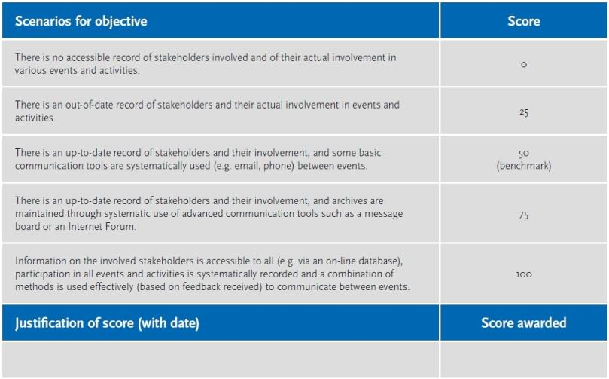
Establishing a stakeholder involvement process

Slide 17
More information
General on stakeholder involvement methods and tools
  www.mspguide.org/tools-and-methods
Reflection on methods and tools for participatory river basin planning
  On (participatory) river basin planning as source for conflict or cooperation: Van Cauwenbergh, 2019
  On participatory or collaborative modelling: Basco et al. 2017 https://10.1016/j.envsoft.2017.01.014
Specific for transboundary
  On stakeholder identification: www.abn.ne (Niger Basin Authority)
  On transboundary diagnostic analysis (TDA): Pernetta & Bewers, 2012 https://10.1016/j.ocecoaman.2011.09.008
  On Nile basin Initiative: www.nbi.org
  On methods and tools that promote TB cooperation: “Leb et al. 2018. Promoting Development in Shared River Basins : Tools for Enhancing Transboundary Basin Management. World Bank, Washington, DC. © World Bank. https://openknowledge.worldbank.org/handle/10986/29462 License: CC BY 3.0 IGO .”
Notes:
More information on the methods and tools for stakeholder involvement in TB water security can be found in the links and references here.

Slide 18
More information - practitioners
General on stakeholder involvement methods and tools (comprehensive toolkit on stakeholder involvement methods in different moments of planning and management; not specific to water management) www.mspguide.org/tools-and-methods
Stakeholder involvement in urban water management (training kit for practitioners focusing on increasing sustainability of urban water management, contains different modules, module 2 focuses on stakeholder involvement) https://switchtraining.eu/home/
INBO, 2018. The handbook for the participation of stakeholders and the civil society in the basins of rivers, lakes and aquifers https://www.riob.org/pub/HandBook-participation-en/2/
IDS,2011. Learning about Analysing Networks to Support Development Work? (Practice paper with information on the SNA method as well as reflection on some applications)
Notes:
More information on the methods and tools for stakeholder involvement in TB water security can be found in the links and references here.

Slide 19
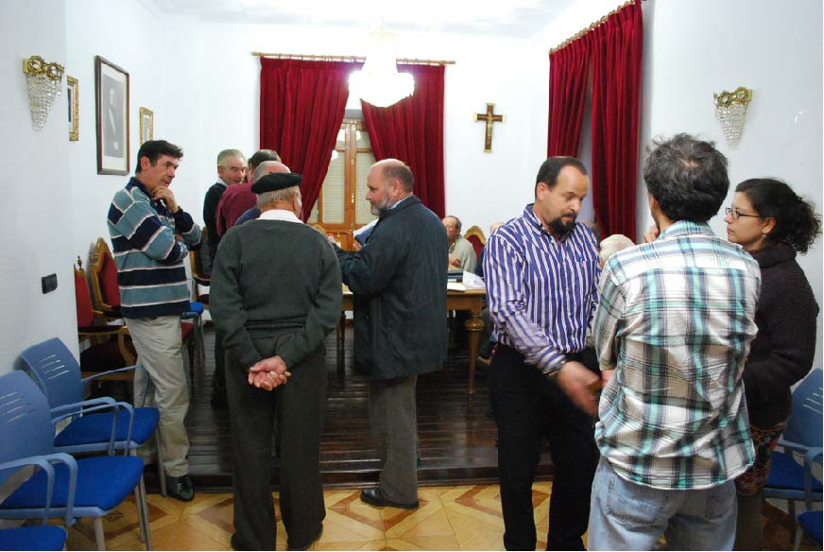
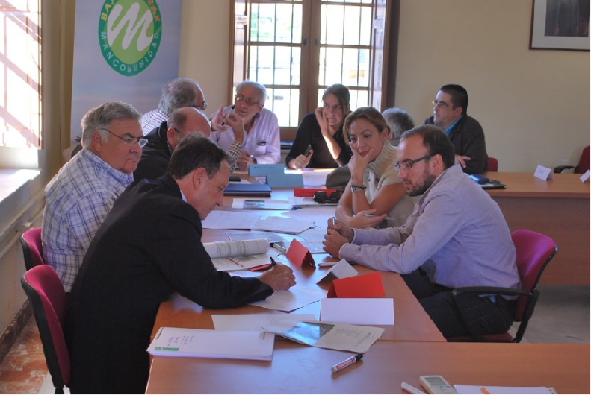
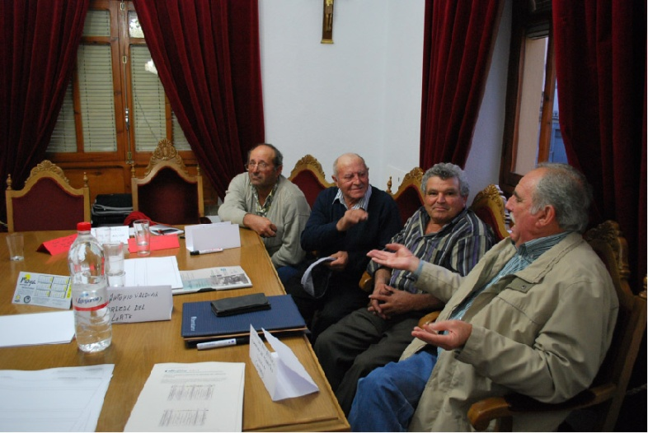
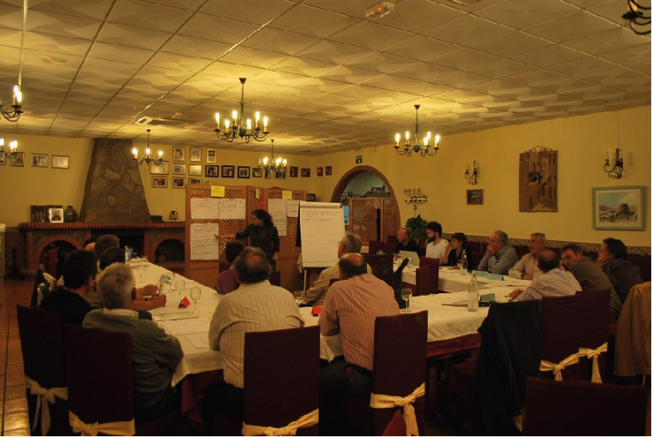
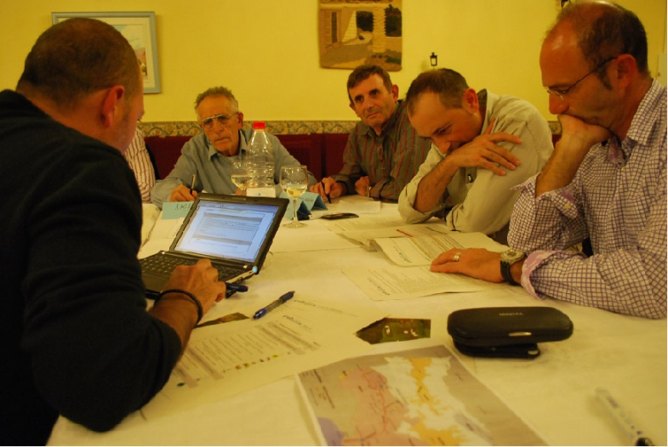
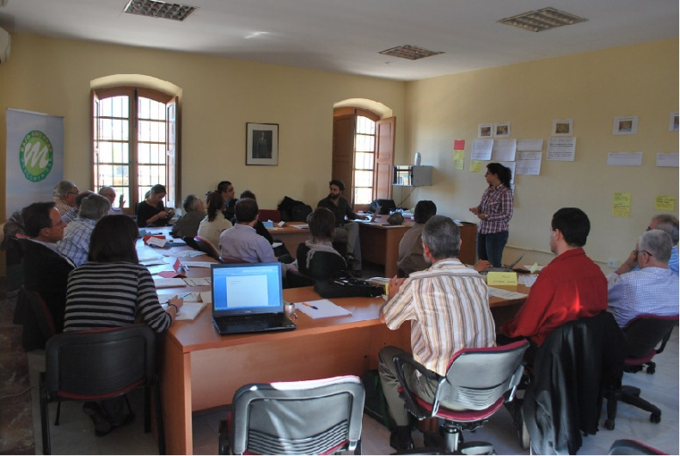
Part 2 - Stakeholder involvement in the Andarax river basin
Analysis of outcomes in 3 parallel stakeholder involvement initiatives

Slide 20
Assessing participatory water resources planning
Multi-level governance initiatives to improve WRM for colletive and adaptive groundwater management through participatory processes or organs
Case studies linking to debates of
  Participatory WRP ~ adaptive management and IWRM
  Collective management and groundwater resources
Assessing stakeholder processes and outcomes
  Who particpates and why: motivation, power → equity?
  How do we participate: Information presentation, digestion and follow up → efficiency and social learning?
  Implementation of the outcomes + monitoring (~operational capacity) → adaptation?

Slide 21
Participatory processes and outcomes
Source: Newig J., 2007

Slide 22
Participatory processes and outcomes
Source: Newig J., 2007

Slide 23
Participatory processes and outcomes
PROCESS
Stakeholders
Information
Tools
Information flow
Capacitation/mediation
Motivation
Fairness/Inclusiveness
Transparany
Accountability
OUTCOME
Decisions, Implementation,
Status of wáter bodies
Trust
Empowerment
Ownership
Knowledge generation
Social learning
Source: own elaboration after Newig, J., 2007

Slide 24
Improving water management through participatory processes – towards collective groundwater management
Regional level
Multiple basins
Water Agency
Information and consultation on draft basin plan
Basin scale
Andarax basin
Water Agency in collaboration with IHE and UAL, UGR
Multi-stakeholder platform and DSS for participatory planning
Water body scale
Lower Andarax Aquifer
Tragsatec
Establishing water user board and regulation plan - POMBA (regulating water resources of middle lower Andarax)
for participation, integration and implementation
Source: ALTAGUAX material (eCampus), Van Cauwenbergh et al. (2018), Rica et al. (2012), Lopez-Gunn et al. (2010)

Slide 25
Active listening to prepare debate
While listening to 3 stories, you are asked to chose a best and worst participatory process
  Which process assures more equity, which one least (related to who particpates and why: motivation, power)
  Which process is more efficient and provides more social learning (related to how we participate: Information presentation, digestion and follow up)
  Which process do you expect to get the best outcomes (related to Implementation of the outcomes + monitoring (~operational capacity))
Fill in the form and write a short justification –use the elements mentioned in Newig’s scheme + add your own
Prepare your arguments for debate

Slide 26
1. Official planning process by water agency (AAA)
– introducing new content and actors
Internal changes + EU Water Framework Directive
  Environmental uses and good status of water bodies
  Public participation (article 14)
  Principle of Cost recovery
Changes in planning process: Integrated Water Managament
Changing institutions and tasks
  Water council now integrates different voices
  Organization of « Participation days » - Different publications and sensibilization campaigns
  Environmental Impact Assessment, Economic Analysis, Action Plans
  = a different table
ASSURED

Slide 27
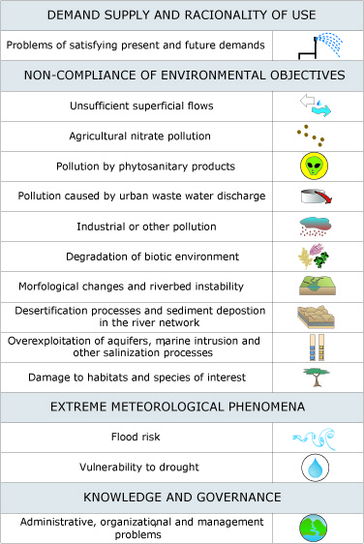
New content on table = Scheme of Important Themes
Start of HP process
Structuring SA in themes (SIT)
Linked to strategies/actions
Public consultation per sector + experts + web consult
Once approved, translation into action plan + draft HP + EA
After consultation, approval of HP basin and inclusion in NHP

Slide 28
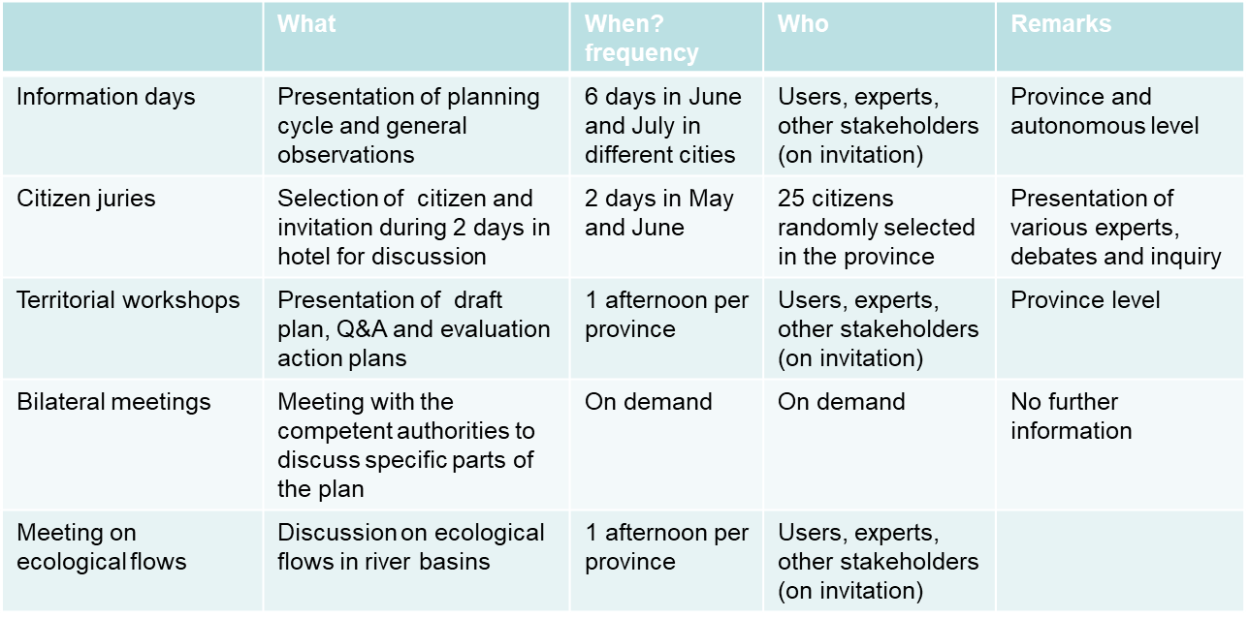
Participation events in planning cycle: what? who? when?
  Scale = province or larger scale
  Frequency
  Feedback

Slide 29
Who participates? Interest groups → regional water council

Slide 30
Observations AAA participatory planning process
On composition of work group and motivation
  Focus on users (sectoral and territorial) + compensation by citizen juries
  Frequency and scale is far from sufficient (no common ground)
  No clear feedback, some actors not invited (ecologists)
On work plan and information flow
  Public information improved, but lack of detail and coordination
  Vast amounts of information (draft plan = 327p + 9 annexes of +- 200p)
  Use of SIT improves the process
  Need for technical people

Slide 31
Observations AAA participatory planning outcome
On capacity for social learning and implementation
  Cyclic process with PoM evaluation- but jeopardized social learning
  Absence of economic valuation of action plans
    no implementation strategy
    no cost-efficiency
  Implementation at various ministries, lack coordination
  Political processes and economic crisis heavily way on the process

Slide 32
2. Multi-stakeholder platform at basin scale (Altaguax)

Slide 33
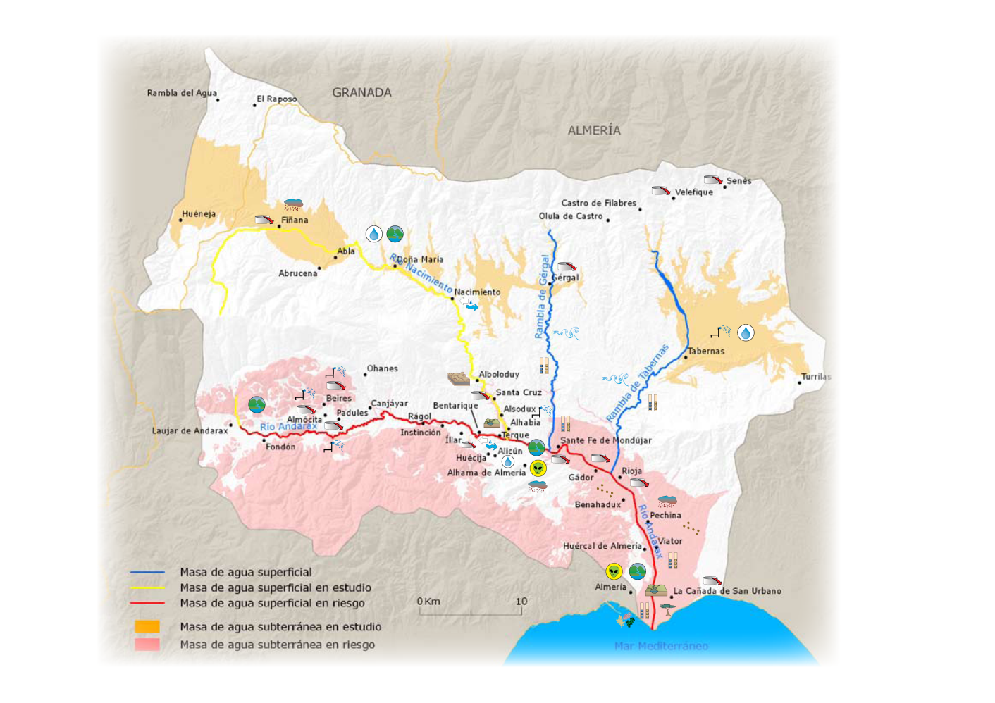
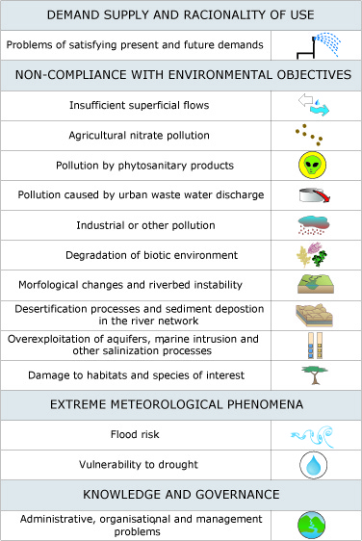
Workshops on validation of situation analysis and proposition of action plans

Slide 34
Who participates? Multi-stakeholder platform

Slide 35
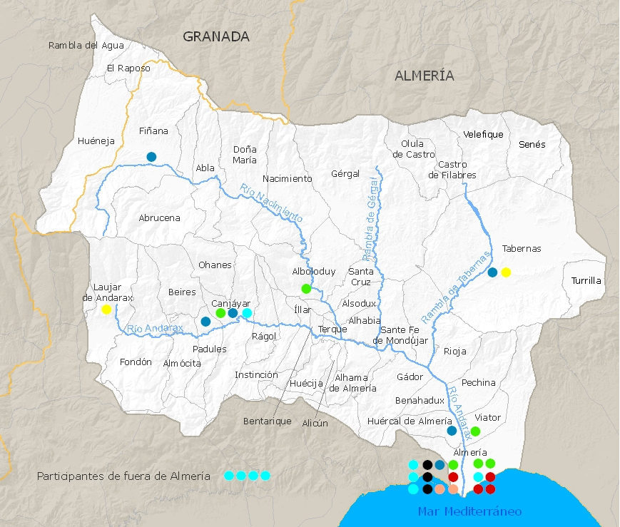
Who participates? Multi-stakeholder platform
Irrigation associations / Farmer organizations
Municipalities
Rural development agents
Administration
Other (private, neigbourhood)
Experts (scientific, technical)
Ecologists
→ covering different
  interests
  sectors
  locations

Slide 36
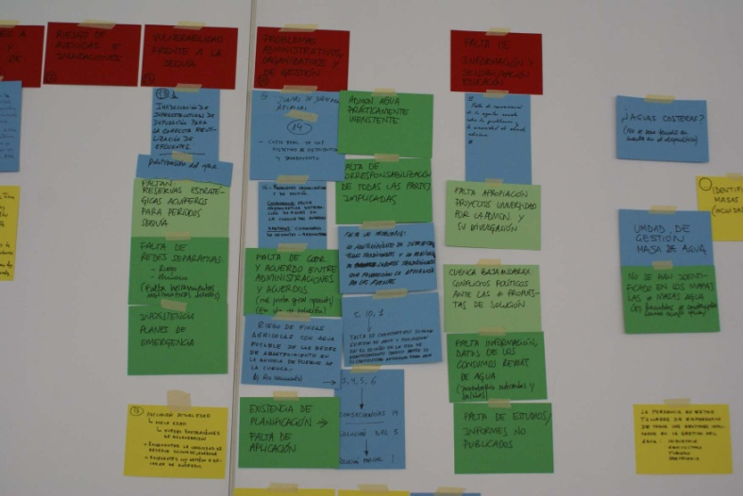
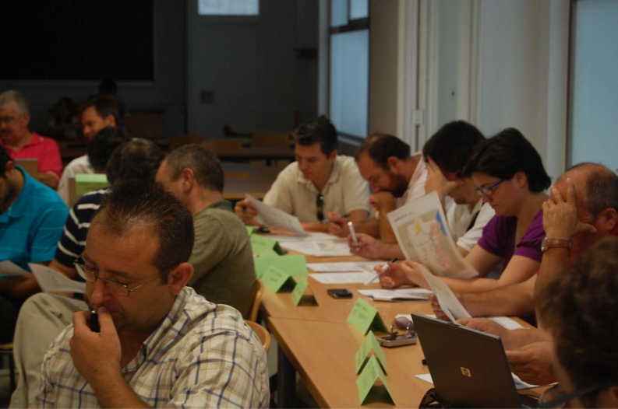
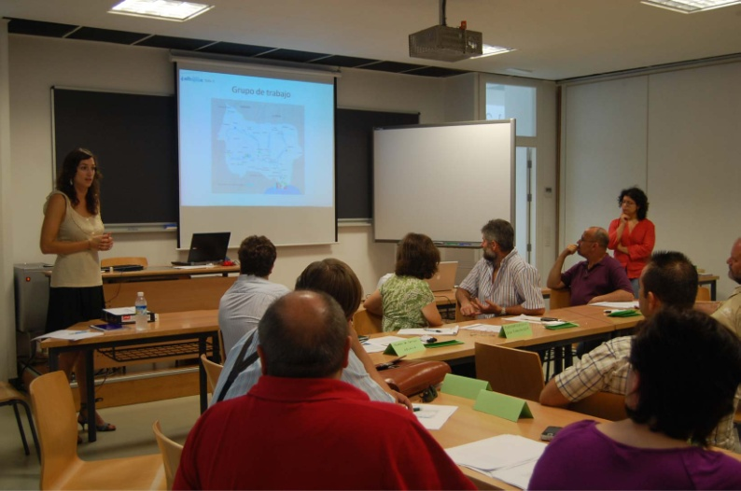
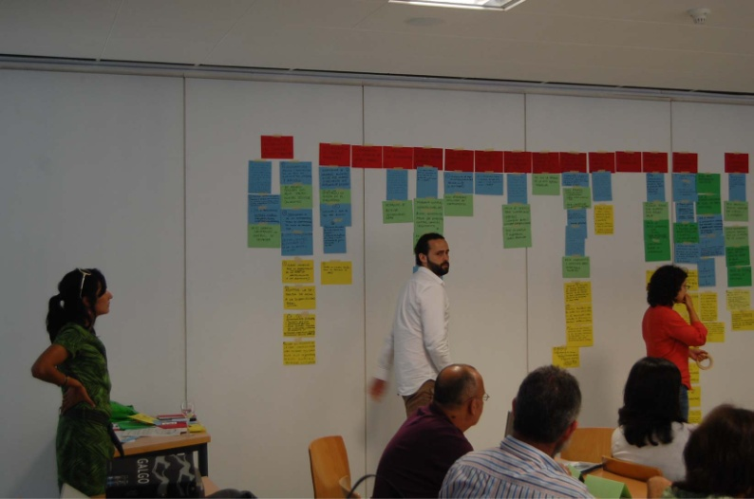
Workflow: workshops on validation of situation analysis (1) and proposition of action plans (2)

Slide 37
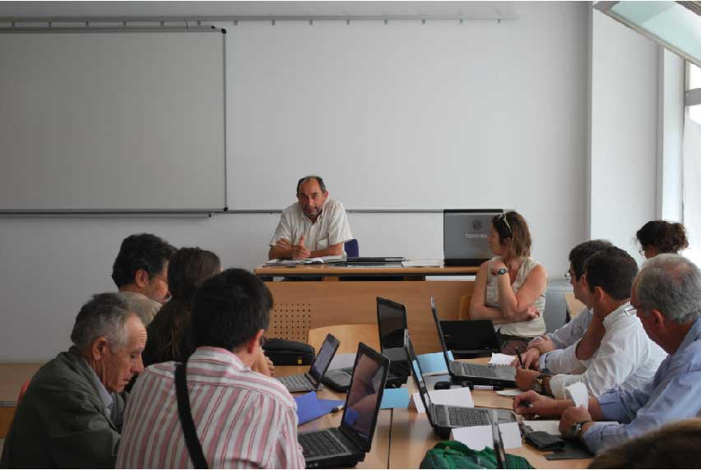
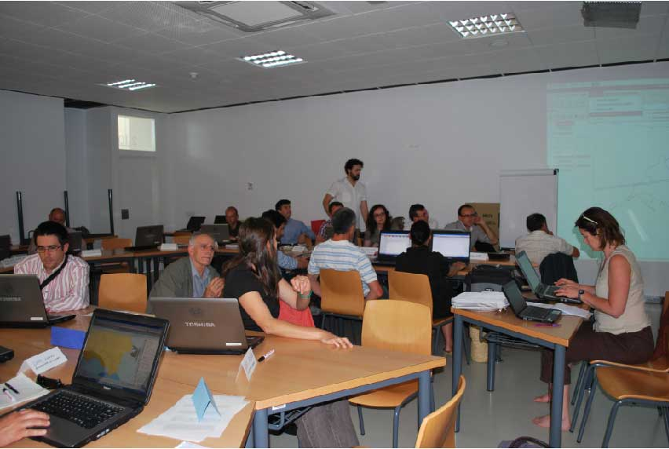
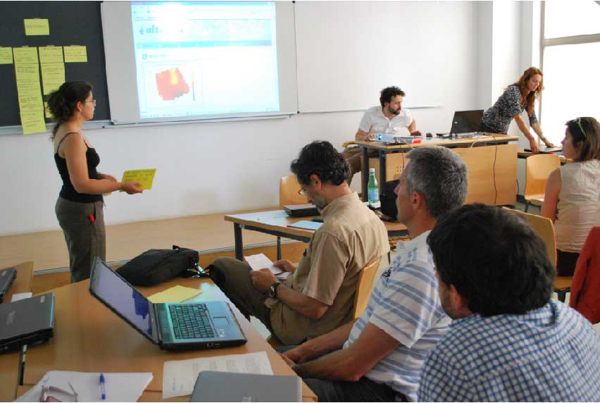
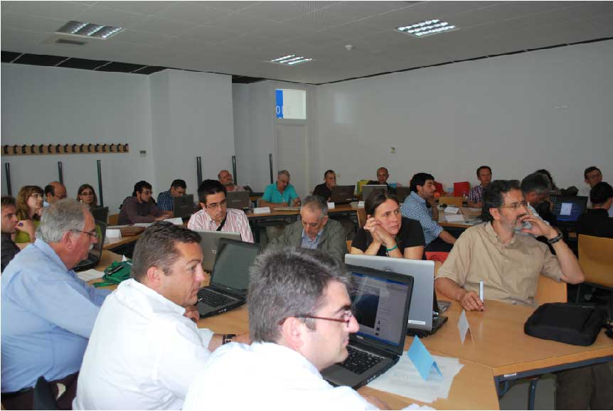
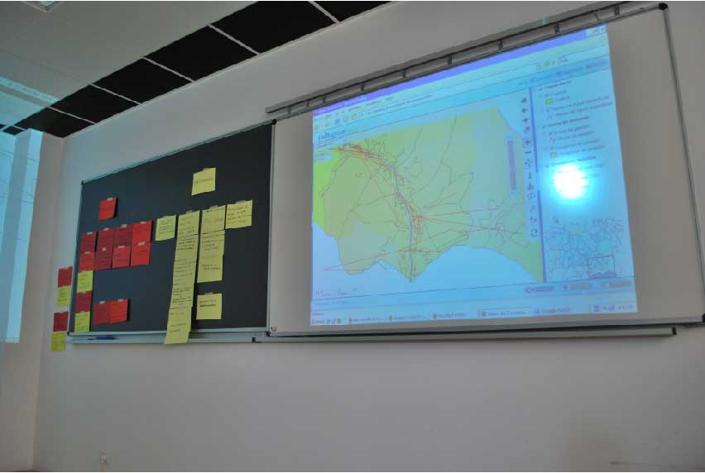
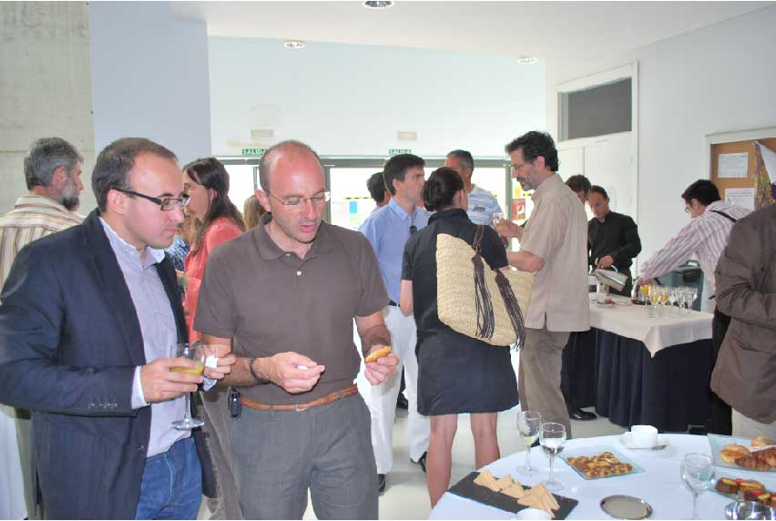
Workflow: workshops on decision support system (3) and allegations to draft plan (5) + final tests DSS (5)

Slide 38
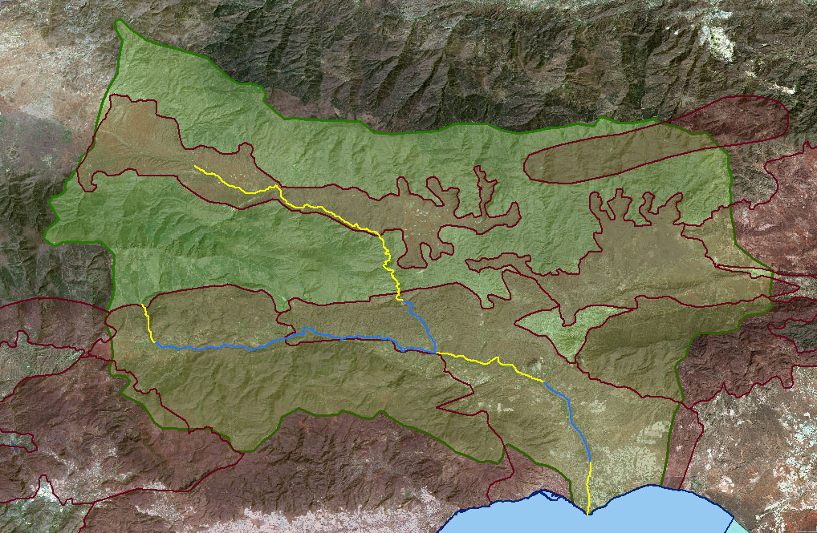
Workshop 4 targeting social inclusion
Get closer to stakeholders: 3 days at different locations upstream
Formulation of petitions against draft hydrological plan = direct benefit
Formulation of alternative management strategies to be discussed during workshop 5

Slide 39
Workshop 4 – comparing situation analysis Altaguax vs PH and petitions

Slide 40
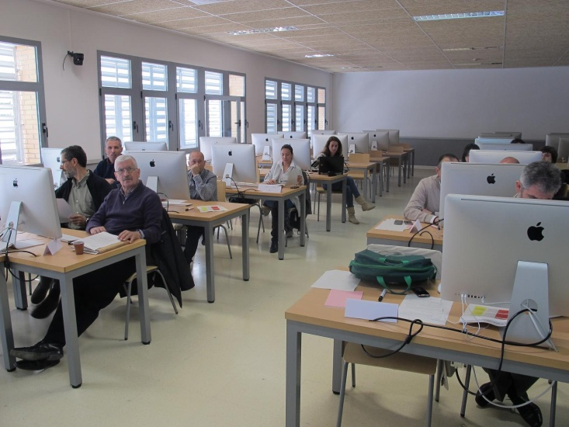
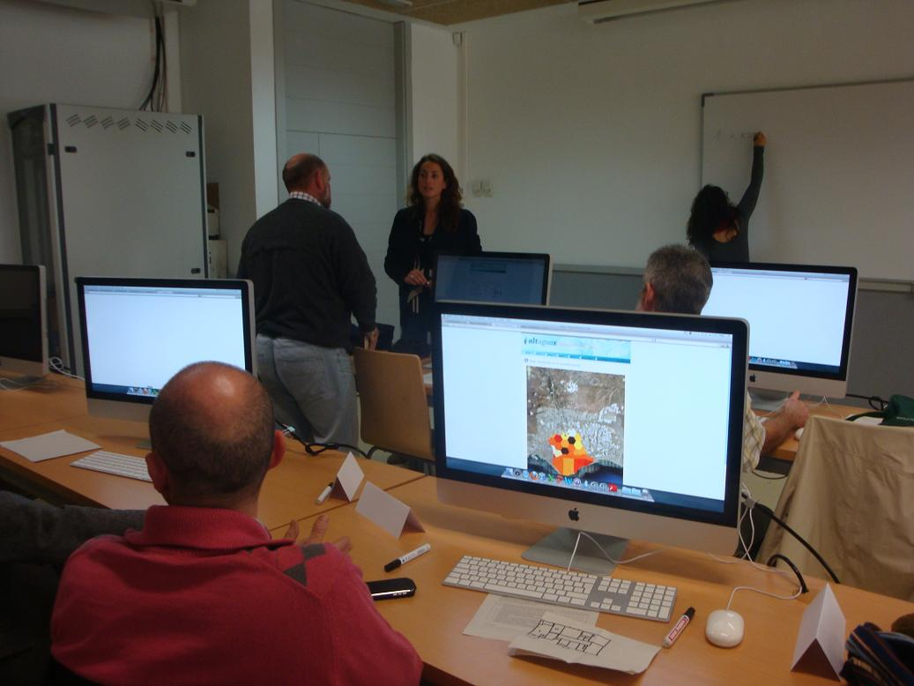
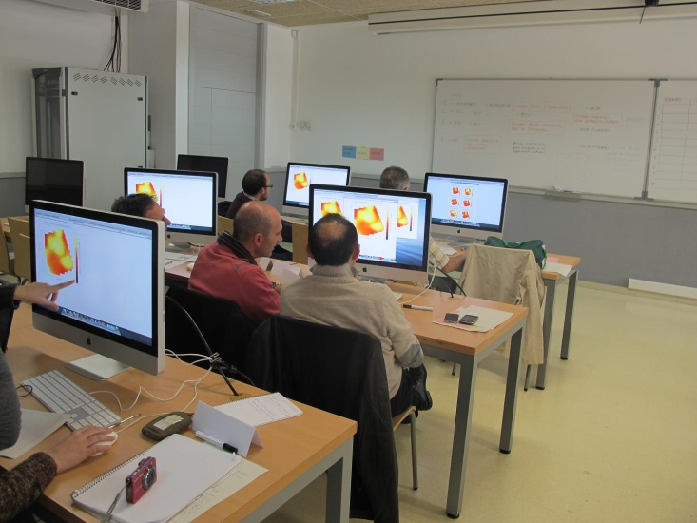
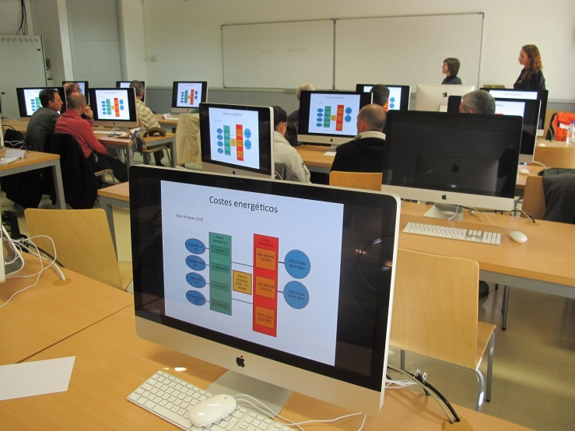
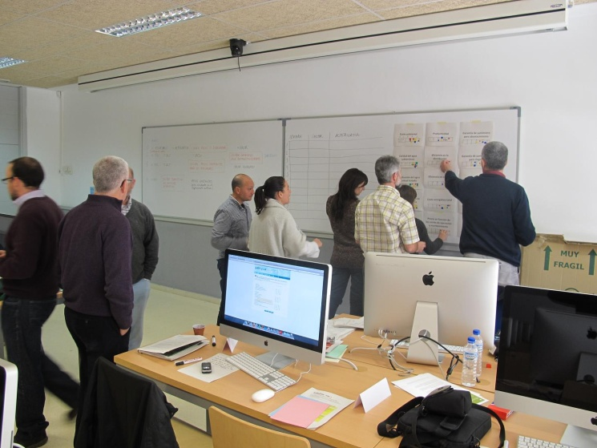
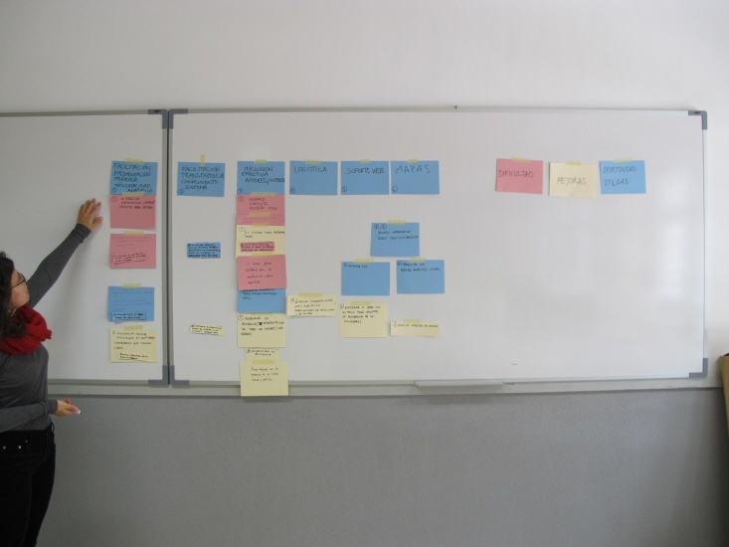
Workshop 5 (after almost 2 year break) – DSS tests + feedback to petitions on hydrological plan

Slide 41
Stakeholder attendance and motivation

Slide 42
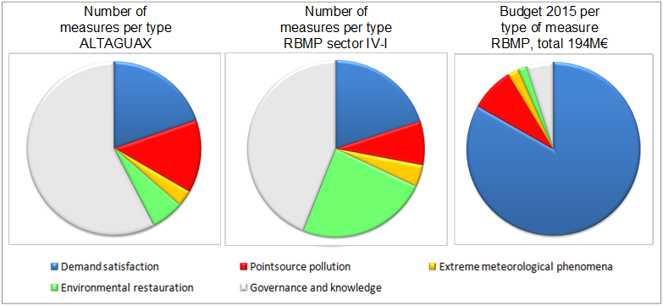
Decision on program of measures and budget allocation

Slide 43
Observations on multi-stakeholder platform - process
On composition of work group and motivation
Creation of a solid working group (experience, trust, motivation, knowledge)
  Representation through concerted stakeholder analysis
  From ‘shame’ to talk to confidence and transparency
  Importance relations, face to face, investment during several years in MSP
  Feed back sessions needed for motivation (importance of scale)
  DM presence to assure participants are heard
  Technicians and experts presence to clarify and ‘equalize’ the debate
  Importance of facilitation and mediation!
Who participates and who doesn’t? What strategies to motivate?
  Majors difficult (not operational level)
  Scale and stakes of high basin (w4 in 3 areas)

Slide 44
Observations on multi-stakeholder platform - process
On work plan and information flow
  Clear objectives, calendar and time frame make the process more robust
  Inclusiveness - composition and facilitation!
  Fundamental to have an extended debate on the diagnostics – issues of scale
  Repetition on diagnostics helps to create collective identity, common ground
  Sufficient time needed for consultation of previous documents
  Web motivates, collective assisted memory
On capacity for social learning and implementation
  Process of gradual capacitation, generation of transparency and system knowledge
  Large emphasis on diagnosis → creation of common ground
  Increased understanding of actors’ operation and help for implementation
  Supporting tools important yet hardly used outside facilitated environment

Slide 45
Observations on multi-stakeholder platform - outcome
On capacity for social learning and implementation
  Process of gradual capacitation, generation of transparency and system knowledge
  Large emphasis on diagnosis → creation of common ground
  Increased understanding of actors’ operation and help for implementation
  Supporting tools important yet hardly used outside facilitated environment
On decisions and implementation

Slide 46

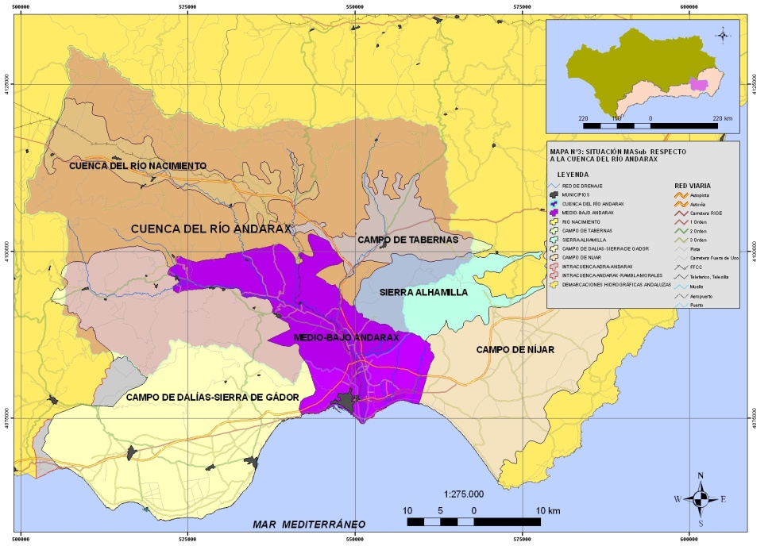
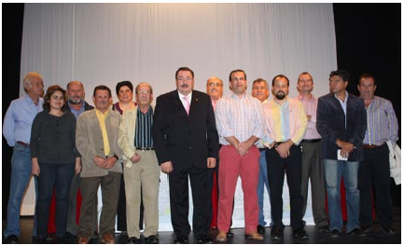
3. Establishing water user board at aquifer scale – POMBA

Slide 47
Workflow – discuss and define competences for operational management of groundwater body
To attain a sustainable use of the available water resources in groundwater body 060.012, solving problems of overexploitation and pollution, both from GW as from existing non conventional resources that can supply to members of the Central Users Board in the future
Establish necessary actions and measures towards rational water use, monitoring of status (qn, ql), pollution control, and improved artificial recharge of the groundwater bodies where viable.
Comply with hydrological plan + enhance members on savings, rationing, optimization

Slide 48
Workflow – discuss and define competences for operational management of groundwater body (contn.)
Control of uses and abstraction rates
Collaboration and dialogue with Andalusian Water Agency, collective defense of interests
Inform on all proceedings for granting, modification or extinction of user rights of the water resources
Guarantee the availability of sufficient water resources, through incorporation of non-conventional resources for all uses

Slide 49
Composition Central Water User Board at aquifer scale

Slide 50
Observations Water User Board - process
On composition of work group and motivation
  Invitation of water users in the area, based on registered uses
  Virtually limited to urban and agricultural water use
  Direct motivation as this is going to be the regulatory authority
On work plan and information flow
  Revision and update of registered water rights (private and public)
  Interviews in the field and control of boreholes
  Discussion of legal framework and ‘estatutos’, composition and competences of the Water User Board
  Creation of water balance at the aquifer scale + estimation of available resources and allocation plan (not completed)

Slide 51
Observations Water User Board - outcome
On capacity for social learning and implementation
  Outsourcing to public company(Tragsatec), technocratic approach
  Limited consideration for alternative approaches (cf composition work group), no info on revision of the established ‘Plan de Ordenación’
  Direct link to implementation in the competences in estatutos
  Political processes and economic crisis heavily way on the process (water balance and plan de ordenación not completed) - funding problems

Slide 52
What were the strong/weak points? Opportunities and challenges?
Regional level
Multiple basins
Water Agency
Information and consultation on draft basin plan
Basin scale
Andarax basin
Water Agency in collaboration with IHE and UAL, UGR
Multi-stakeholder platform and DSS for participatory planning
Water body scale
Lower Andarax Aquifer
Tragsatec
Establishing water user board and regulation plan - POMBA (regulating water resources of middle lower Andarax)

Slide 53
Strong points
Efficiency arguments
  Improved public information
  Scheme of Important Themes → more credibility
  Participation administration technicians → more effective process
  Flexible rules → improved process (suggestions possible)
  Clearly explained calendar and methodology → more robust process
Equity and empowerment arguments
  Raise profile of less powerful in facilitated debates
  Reduced hijacking in presence of experts
  Opportunity to inform and educate citizens on new policy/management objectives and have them participate in DM
  Condition: adequate organization

Slide 54
Weak points
Effiency arguments
  Lack of clear objectives, need to explain goal = compliance WFD
  Facilitation and mediation often lacking
  Time schedules → no indepth discussion and satisfactory solution to problems, too much unmediated information
  Disconnect between scale of participation and management unit
Equity and empowerment arguments
  Focus on vested interest groups (new voices difficult to reach table)
  Unclear future of pp: need to integrate with future planning
  Parallel comm. channels (back doors to adming for vested interest)
  Relevance and utility of pp not fully acknowledged by WM

Slide 55
Participatory processes and outcomes
PROCESS
Stakeholders
Information
Tools
Information flow
Capacitation/mediation
Motivation
Fairness/Inclusiveness
Transparany
Accountability
OUTCOME
Decisions, Implementation,
Status of water bodies
Trust
Empowerment
Ownership
Knowledge generation
Social learning

Slide 56
Revisiting the relation of context, process and outcome
CONTEXT
Policy priorities
Resources
Social capital
Interest/Concern
Complexity of issues
Power relations
Transparancy & Accountability
PROCESS
Stakeholders
Information
Tools (DSS)
Information flow
Capacity/mediation
Motivation
Fairness/Inclusiveness
Transparany
Accountability
MANDATE
OUTCOME
Decisions, Implementation, Status of WB
Trust
Empowerment
Ownership
Knowledge generation
Social learning
Source: Van Cauwenbergh et al. (2018) after Newig, J. (2007)

Slide 57
Conclusions (1/2)
  Limited institutional capacity to implement new planning processes (~historical context)
  Limited society capacity to participate → importance of the process as gradual social learning, need to include different expert voices at the table
  Scale issue, RBO is not implementing the participation process ←→ motivation (need to create a direct interest for stakeholders important for creation of trust and active motivation)
  Empowerment and equity vs context and mediation

Slide 58
Conclusions (2/2)
  Implementation needs clear competences, realistic cost estimations and subsequent funding
  → need for vertical integration of different initiatives, polycentric governance needs integration to be set as a goal from the beginning
  Role of ICT and web tools: support, not leading → need for interplay with dynamic and reactivating process, need for agile tools
  Importance of mandate

Slide 59
Checking the learning objectives
Did the course help you to:
Understanding different modalities of involvement and its relation to engagement objectives, steps in the planning process and context;
becoming aware about the costs and other challenges of planning and coordinating stakeholder involvement; and
Critically analyze the stakeholder process and its outcomes through a case study

Slide 60
References and reading (optional)
Arnstein, S. R. (1969). A Ladder Of Citizen Participation. Journal of the American Planning Association. https://doi.org/10.1080/01944366908977225
Lopez-Gunn E., M. Rica, and N. Van Cauwenbergh. (2012). Taming the groundwater chaos. Pages 227–239 in L. De Stefano and M. R. Llamas, editors. Water, agriculture and the environment in Spain: can we square the circle? CRC Press/Balkema, Leiden, The Netherlands. Online URL
Newig, J. (2007) Does public participation in environmental decisions lead to improved environmental quality?: towards an analytical framework. In: International Journal of Sustainability Communication 1, pp. 51-71. http://nbn-resolving.de/urn:nbn:de:0168-ssoar-431965
Reed, M. et al. (2009). Who’s in and why? A typology of stakeholder analysis methods for natural resource management. Journal of Environmental Management. https://doi.org/10.1016/j.jenvman.2009.01.001
Rica, M., Lopez-Gunn, E., Llamas (2012). Analysis of the emergence and evolution of collective action: an emprirical case of of Spanish groundwater user association. Irrigation and Drainage 61(S1): 115-125. https://doi.org/10.1002/ird.1663
Ruiz-Villaverde, A. & Garcia-Rubio, M. (2017) Public participation in European Water Management: from theory to practice. In Water Resources Management 31: 2479-2495 https://doi.org/10.1007/s11269-016-1355-1
Sadoff, C. W., & Grey, D. (2005). Cooperation on international rivers: A continuum for securing and sharing benefits. In Water International 30 (4): 420-427. https://doi.org/10.1080/02508060508691886
Sanz, M. et al. (2015) New approaches to cleaner production: applying the SASI method to micro-tanneries in Colombia. In Journal of Cleaner Prduction 112: 963-971. https://doi.org/10.1016/j.jclepro.2015.08.090
Van Cauwenbergh, N., A. Ballester Ciuró, and R. Ahlers (2018). Participatory processes and support tools for planning in complex dynamic environments: a case study on web-GIS based participatory water resources planning in Almeria, Spain. Ecology and Society 23(2):2. https://www.ecologyandsociety.org/vol23/iss2/art2/
Additional reading on stakeholder lobbying
Esteban, E., Dinar, A., & Albiac, J. (2019). Determinants of water lobbying: Irrigators’ behavior in a water-stressed basin. Water Policy. https://doi.org/10.2166/wp.2019.148
Hernandez-Medina, E. (2010). Social inclusion through participation: the case of the participatory budget in Sao Paulo. In International Journal of Urban and Regional Research https://doi.org/10.1111/j.1468-2427.2010.00966.x

Slide 61
Questions?
n.vancauwenbergh@un-ihe.org

