Slide 1

Water resources planning
Strategy building
Theory and exercise
Dr. Nora Van Cauwenbergh
Senior lecturer Water Resources Planning, IHE Delft

Slide 2
Learning objectives
This lecture will assist participants to
Understand methods to define strategies and scenarios, understand the importance of scenarios and uncertainty
Familiarize with the participatory definition of strategies, the information need and considerations on implementation and cost analysis
Familiarize with the participatory evaluation of strategies, with and without indicators
Understand the underlying information need for interpretation of preferred strategies

Slide 3
Contents
Part 1 – Recap completed situation analysis
Part 2 – Exercise on proposal of alternatives + links to institutions and implementation – towards analysis matrix
Part 3 – Exercise on sustainability of options ifo different scenarios – towards evaluation matrix
Part 4 – Theoretical considerations and final discussion

Slide 4
Learning activities
10h15: Introduction exercise and creation of group
10h30: Recap completed situation analysis – self paced check material in folder exercises/strategy building on eCampus
  SA problem map
  Workshop report
  Feedback on problem trees
11h30: Exercise in groups on proposal of alternatives (2 per groups, prepare slides and discussion)
12h30: Lunch break
13h45: Presentation by groups and Q&A (make sure to understand the different plans as you will have to score them)
14h15: Overview of all strategies and scoring by groups (Exercise on sustainability of options ifo different scenarios – towards evaluation matrix)
14h45: Discussion, theoretical considerations and final discussion

Slide 5
Strategy proposals vs problems and criteria
Situation analysis
Strategy portofolio: list of possible measures combined into strategies as alternative options (aim = reach objectives)
problems
stakeholders
scenarios
Resources / Uses
institutions

Slide 6
Measures composing management strategies
A management strategy is composed of a series of measures/interventions
Combination of measures on
  Infrastructure development
  Demand management
  Institutional arrangements
  Eco-hydrological measures
  Pricing and cost recovery
  Awareness
Need to be detailed in terms of
  Location and time
  Actors involved (institutions and other stakeholders)
  Budget, financing and cost-effectivenestiat

Slide 7
Evaluation of measures and strategies in WRP
QUALITATIVE QUANTITATIVE

Slide 8
Relation to problems & objectives/criteria
Will the measure allow to reach my objectives?
Objectives and criteria as guiding structure for creation of analysis and evaluation matrix
Importance of priorization
Importance of boundaries (spatial, temporal and of competences)
Plan/Policy
Objective
RD
Eff
EQ
EP
Criteria
Indicators

Slide 9
Consideration of cost-effectiveness
Cost Effectiveness Analysis (CEA) is closely related to Cost Benefit Analysis (CBA).
CBA
  one of the methods of appraising policies and projects which impact on the environment
  useful economics tool aid for rational budget allocation decisions in water resources projects
  but not sufficient as a “stand alone” criterion

Slide 10
Steps to define cost-effectiveness
1. Defining the strategy
2. Identifying strategy impacts
3. Identifying strategy impacts which are economically relevant
4. Physically identifying impacts
5. Calculating a monetary valuation of relevant effects
6. Discounting of cost and benefit flows

Slide 11
Consideration of roles and responsibilities
Link to governance structure and institutional analysis
Different types of roles
  Design and procurement
  Implementer
  Monitoring
  Evaluation

Slide 12
Exercises
Connect to Teams for the exercise part

Slide 13
Groups
Group 1: Kartik, Sajib, Karen, Waliuddin
Group 2: Oclaya, Priscilla, Eman, Daniel, Safaa
Group 3: Rad, Abed, Muhammad, Claudio , Mounia
Group 4: Carlon, Sharif, Ivonne, Haneen, Janani
Group 5 : Deepti, Bernice, Obrike, Johane, Suzan

Slide 14
Exercise 1: Definition of a structured strategy
(Re-) constructed problem tree as starting point
Division in groups ( 3-5) / check materials
Discuss and select strategy proposal / alternative management options for the Andarax basin from the list or add new ones that address problems
Discuss objectives, problems addressed and relation to stakeholders in the catchment (responsibilities and co-opting)
Discuss and motivate cost-effectiveness on short and long term
Prepare presentation in group and discussion (2 strategies per group)
Notes:
Note for next sessions: don’t do plenary presentation of the measures but a poster pitch carroussel…nobody is listening to the presentations

Slide 15
Exercise 2: sustainability of options (evaluation matrix)
ANALYSIS MATRIX EVALUATION MATRIX
Each group gets a set of action plans that are prepared in exercise 1
You are asked to score the action for its “sustainability” (considering environmental, economic and social impact)
The score is from 1 to 10 (1 being the least sustainable)
Motivate your score, assumptions made + information lacks identified

Slide 16
Discussion
Plenary discussion of scores and motivation

Slide 17
Results from exercise – evaluation matrix
 | Wealth from waste | Need no education | Demad mngt | Aquifer knowledge | Build 2 Treat Supra | Nitrate gone | Policy over politics | Decentralize 2 expedize | Control balance
G1
G2
G3
G4
G5
Total

Slide 18
Comparing sustainability of strategies
Rainwater Harvesting
CHOICE
Building of a reservoir
Strategy 1
Capacity building
Strategy 2
Strategy 3
Notes:
Comparing sustainability of management strategies and choice.........can we create consensus on score?

Slide 19
What would happen under diff. scenarios?
Climate change
Energy prices
Market changes (e.g. Production in Morocco)
Would your action be more/less sustainable??
QUALITATIVE QUANTITATIVE

Slide 20
Scenarios – general concepts
Considering factors
  External to system (driving forces):
    climate change
    market change (macro-economic)‏ - energy
  Internal to system (responses/measures):
    Offer/Demand oriented
    Water pricing
    ...
  Variables (related to all functions of WRS):
    Biophysical
    Socio-economic
    Administrative/legal
    Operational

Slide 21
Methods for scenario development
Surveys
Interviews
Envisioning workshops

Slide 22
Evaluating actions and strategies in planning
QUALITATIVE QUANTITATIVE

Slide 23
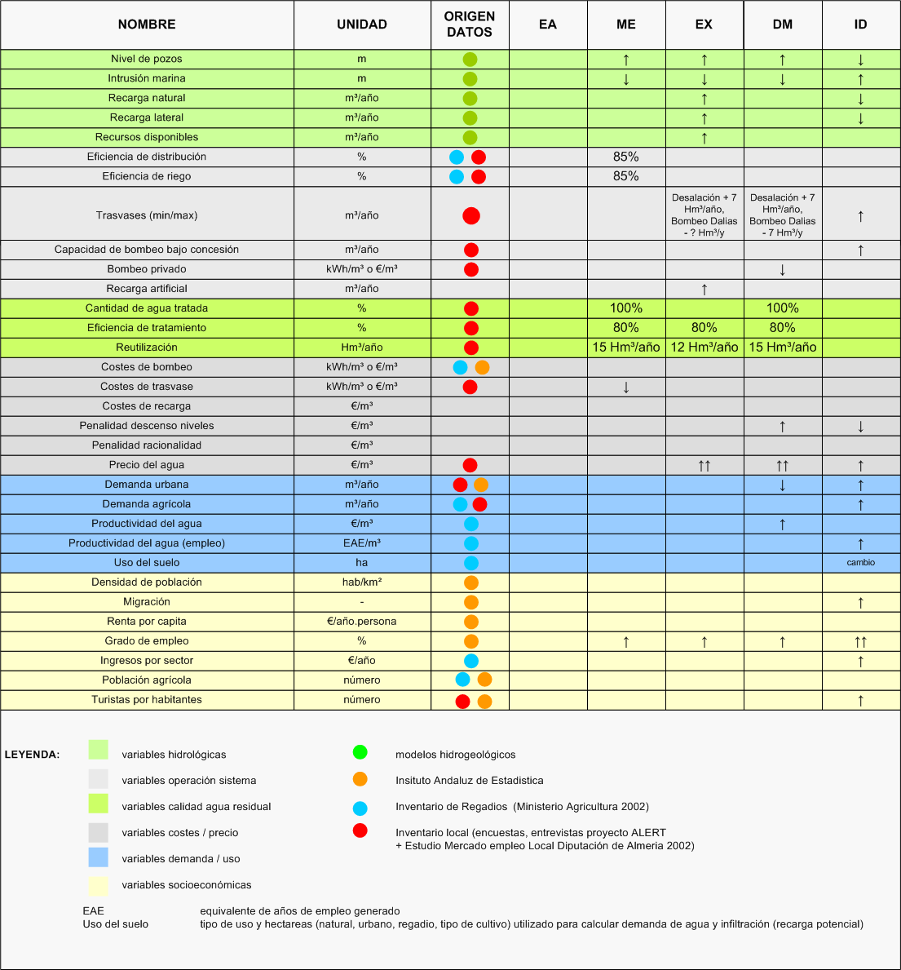
Information need
Types of information:
Hydrological
Other environmental
Economic
Social
Sources:
Reports
Statistics
Interviews
Multi stakeholder platform

Slide 24
Selection of the models/quantification tools
Available tools and databases (link to week 2)
Importance of well defined boundary conditions
Depending on the type of data available you can use more or less advanced models to quantify the impact of alternative strategies
Introduction of lay knowledge as complementary to modeling and technical analysis
  Balance!
  Need to facilitate introduction of lay knowledge

Slide 25
Scenarios and robustness of decision-making
Climate scenarios
Socio-economic scenarios
  Pricing scenarios
  Energy scenarios
  Demographic scenarios
Projections need to be made to be able to select robust management alternatives

Slide 26
Check the learning objectives
?? Did the lecture help you to:
Understand the need to define objectives and criteria for the planning exercise linking to existing policies and issues raised in the situation analysis?
Familiarize with the participatory definition of action plans, the information need and considerations on implementation and cost analysis?
Familiarize with the participatory evaluation of action plans, with and without indicators?
Understand the underlying information need for interpretation of preferred action plans?

