Slide 1





Water resources planning
Wrap up and Q&A
Nora Van Cauwenbergh, PhD
Senior lecturer Water Resources Planning, module coordinator
13 May 2022

Slide 2
Learning objectives
Successful participants will be able to:
Describe concepts and major steps in water resources planning.
Identify, critically analyze and apply methods and tools, such as stakeholder integration, environmental impact assessment (EIA), decision support systems, role plays and water system models, while engaging in water resources planning activities.
Develop water management strategies and compare and evaluate them by applying multi-criteria analysis.
Discuss water resources planning and implementation in basins for specific context with special attention to basins in a developing country context.

Slide 3
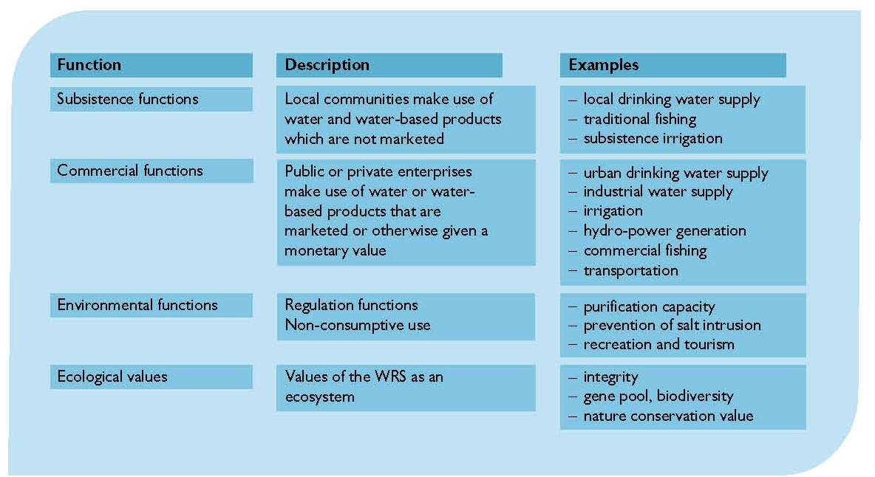
Multiple functions of water resources systems

Slide 4
Water resources planning – multiple dimension of the water system

Slide 5
WRP – integration of knowledge and skills
Water legislation
Principles of IWRM
Mediation for Water Conflict Management
Water Resources System
Water Governance
Water Systems Modeling
Water Economics
Water Resources Assessment

Slide 6
Module assessment and examination
Oral exam (open book): 70%
Assignment: 30%
  Individual assignment week 1
  Participatory Integrated Planning assignment week 3

Slide 7
Module assessment - detail

Slide 8
Oral exam on Thursday May 19
Open book, 25’ per student, no preparation time
Total of 3-4 questions covering the 3 blocks of the module
  1-2 questions by Nora (max 10’ counting for 30% of total mark)
  1 question by Ilyas (max 7’ counting for 20% of total mark)
  1 question on EIA assignment by Angeles (max 5’ counting for 20% of total mark)
Lecturers will deliberate for some minutes after all questions have been answered and student will be informed of pass/fail (indicative mark)

Slide 9
Lecturing materials
http://eCampus.un-ihe.org module 201920T08_M3549
J.C. Heun and N. Van Cauwenbergh, 2018 – Participatory Integrated Water Resources Planning: Framework for Analysis and Stakeholder integration, IHE Delft Lecture Notes.
Loucks, D.P., van Beek, E. 2017. Water Resources Systems Planning and Management: An Introduction to Methods, Models and Applications. Springer. https://www.springer.com/gp/book/9783319442327
Other Handouts: Examples of case studies, Selected background reading.
Software: LIBRA River Basin Planning Simulation, Excel Spreadsheets, Altaguax DSS, Expert Choice (MCA).

Slide 10
Questions?

Slide 11
Module content – 3 blocks
Framework for analysis and steps in the planning process
Approaches, models and tools in planning
  Role of models in planning
  Multi criteria analysis (MCA)
  Environmental Impact Assessment
Experiences from the Global South: plan implementation

Slide 12
Block 1: Framework for Analysis for water Resources Planning and planning steps
Introduction to Water Resources Planning and Framework for Analysis
  Analysis of Water resources plans
  Link to general theory and concepts
Key steps in a participatory integrated planning process
  Case study on participatory planning and exercises
  Highlighting stakeholder involvement in different steps of the planning process.
  Situation analysis, stakeholder involvement, criteria and objectives, action plans, evaluation, negotiation and decision making

Slide 13
Block 2: Methods, models and tools in water resources planning – 3 parts
Comprehensive overview of different types of models and when they are used in the planning process. Discussion of experiences, opportunities and limitations of modeling and their design.
Exercise on multi criteria analysis (MCA) of water management alternatives: construct a set of alternatives that will be evaluated using MCA, based on a set of predefined objectives and criteria of the plan.
Environmental Impact Assessment (EIA): Environmental impacts of water resources development projects, principles and methods of EIA, EIA and its application in water resources planning, case study and exercise on impact matrix

Slide 14
Block 3: Experiences from the Global South – planning implementation
Plan implementation and evaluation will be discussed based on case studies from the global south. Case studies and discussion on practices, challenges and opportunities for water resources planning in the global south
Case studies by experienced/senior lecturers
Assignment by participants

