Slide 1





Water resources planning
Planning as controversial science-policy process
Nora Van Cauwenbergh, PhD
Senior lecturer Water Resources Planning, module coordinator
11 May 2022

Slide 2
Learning objectives and activities
At the end of the lectures on planning and conflict, participants will be able to:
Critically analyze how decision making in WRP leads to the emergence of conflict or cooperation
Sub-objectives:
Analyse socio-environmental problems in planning processes with the perspective of complex systems.
Critically analyse water resources planning models and tools and their role in generating conflict or cooperation
Understand what is the decision space, and how to fight to broaden it up
To facilitate these learning objectives, participants are handed material and tools that enable them to
Understand the mutual influence of science and politics and how they determine the decision space.
Identify methods and tools to re-open the decision space as a practice to balance power asymmetries.
Reflect on how these tools can be used in practice.

Slide 3
From Subject Received Size Categories
Leon Hermans LWM message 08:52 22 KB
Learning activities
Day 1 - Jonatan
  Introduction to the role of knowledge production in socio-environmental change
  Introduction to the Zapotillo case study
  Exercise on analysing a water resources planning tool
Day 2 - Jonatan
  Discussion post normal science
  Introduction to the serious game (WEAP model and role play)
  Role play and discussion
Day 3 - Nora
  Discussion and linking to the overall learning objectives and activities

Slide 4
Link to overall learning objectives WRP
Successful participants will be able to:
Describe concepts and major steps in water resources planning.
Identify, critically analyze and apply methods and tools, such as stakeholder integration, environmental impact assessment (EIA), decision support systems, role plays and water system models, while engaging in water resources planning activities.
Develop water management strategies and compare and evaluate them by applying multi-criteria analysis.
Discuss water resources planning and implementation in basins for specific context with special attention to basins in a developing country context.

Slide 5
Discussion
What did you learn from the work on the Zapotillo case study?
How does it relate to the planning process discussed in week 1 and the models/tools in week 2? And what about the implementation reflections of prof. Van Beek?
  What was the objective and scope of the official WEAP – planning and how did this change through the participatory modelling?
  Which stakeholders were involved in the initial planning process (high/low importance/influence?) – How did this change?
  Can you reflect on the presence (or not) of comparing different alternatives/scenarios and using multi-criteria analysis?
  How does this case and the process of planning link to an implementation outcome
  Other questions…

Slide 6
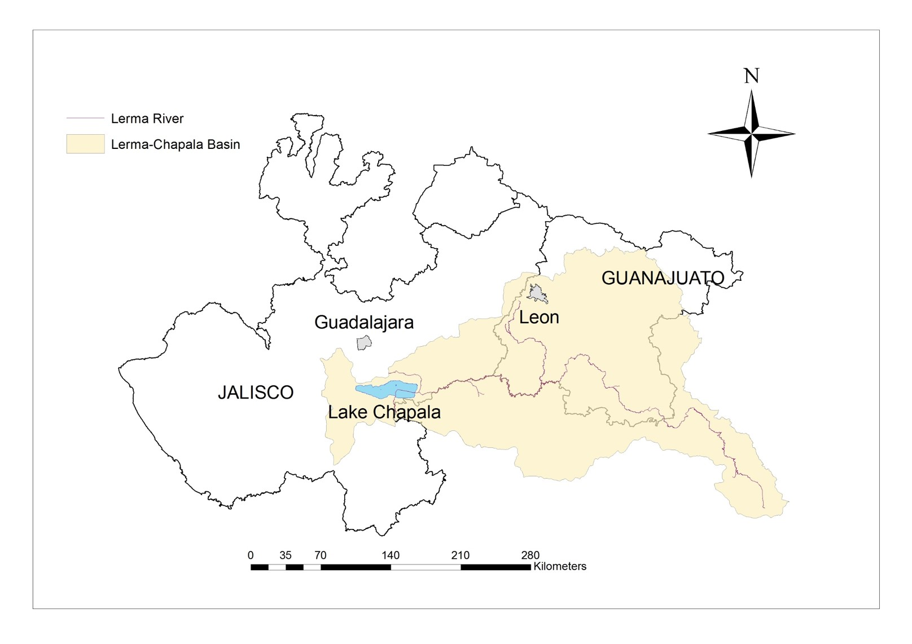
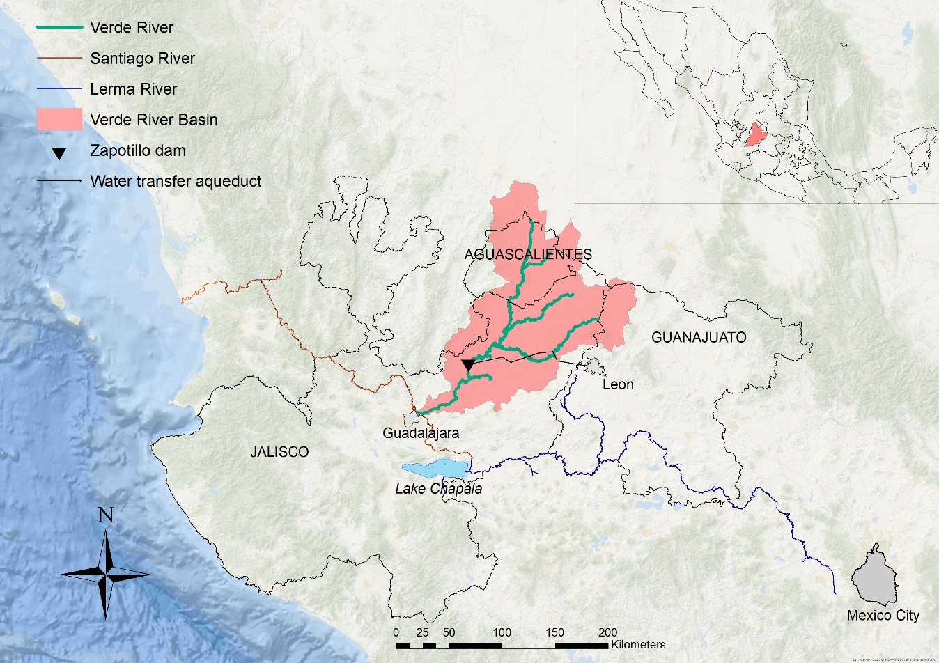
Case study – Water security in Guadalajara and Leon, Mexico

Slide 7
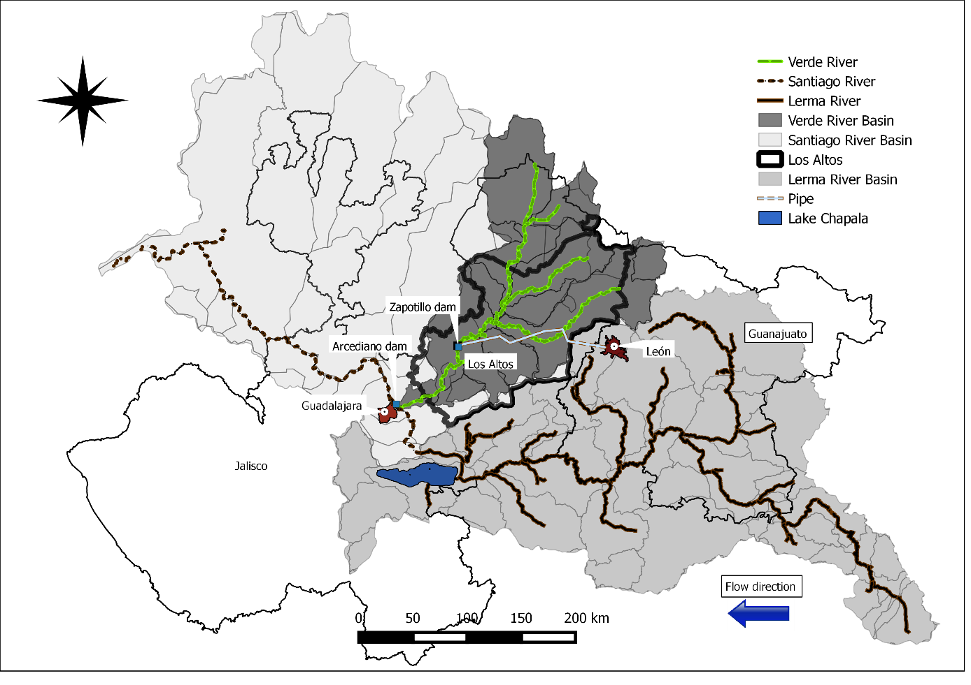
Case study – Water security in Guadalajara and Leon, Mexico

Slide 8
Analysis – role of planning process in fostering cooperation in contentious WM decisions
Source: adapted from Newig, 2007
Methods: analysis of interplay context-process-outcomes, analytical power tools, transformative analysis, scenario modelling, ethnography and Q-method
Role of stakeholders, level of involvement, models/tools, values, political context
Approach: action research between institutionalism and critical theory

Slide 9
Water resources planning as an arena for water diplomacy – WHY?
Outcome perspective: planning as political process that accentuates water governance and management choices
  Process of allocation and development of a scarce resource, matching availability and demand, considering physical boundaries, (national) objectives and constraints and interests of stakeholders
  Structured, based on rational problem understanding, solution definition and choice
  Political exercise
  Channel important public investment, long-ranging impacts, including on conflict
Process perspective: steps in planning link to water conflict management
  Joint fact finding
  Negotiation of trade-offs and compensation
  Adaptive governance
  E.g. steps in mutual gains approach

Slide 10
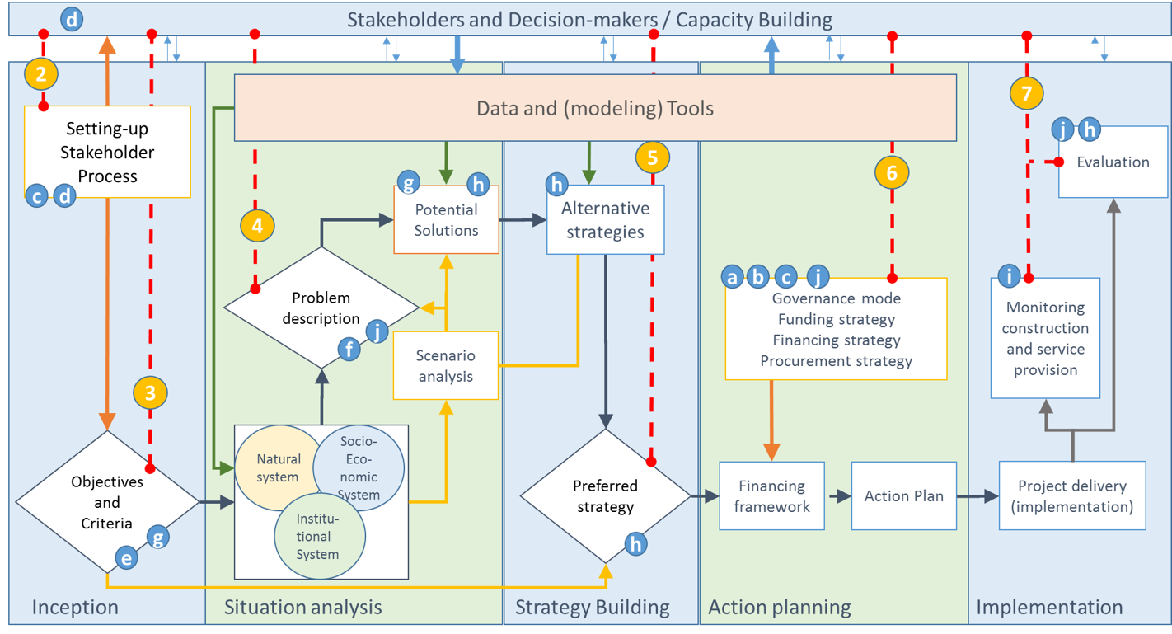
Stepwise framework - water planning process
Adapted from FFA, Loucks and Van Beek, 2017

Slide 11
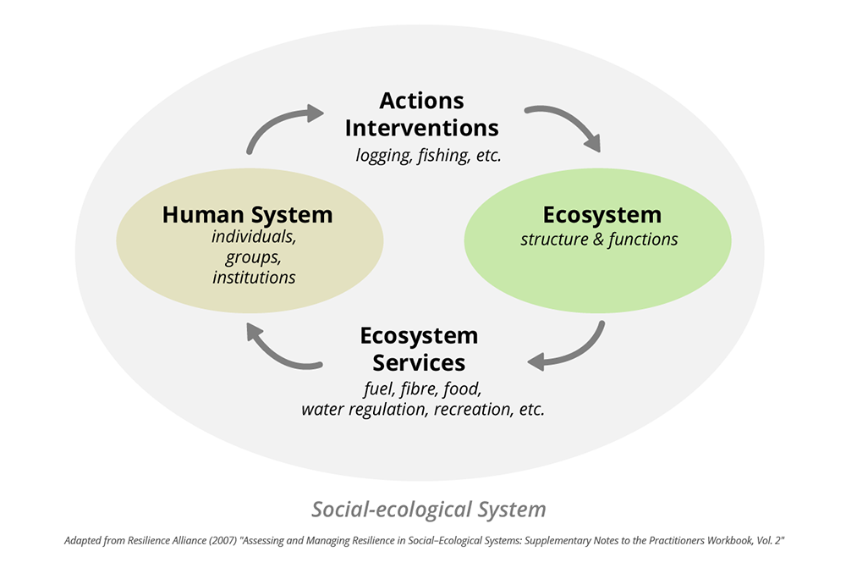
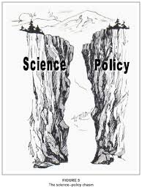
“Internal” influence on policy effectiveness
Understanding complex dynamics of water issues and interventions (multiple actors, multiple knowledge, multiple cause-effect relations)
How to translate knowledge into action? Science-Policy-Interface

Slide 12
From science to action – science policy interface

Slide 13
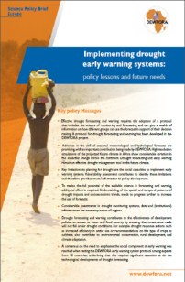

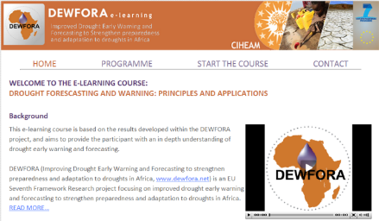
Linking science to policy
How we are we supposed to do it?
Science, Research & development
Policy & policy
implementation
Solutions
outputs
Outcomes
Universities, research institutes,
Companies,
Research consortia
National, regional, local government
Agencies
NGO’s
Communities
Policy briefs, Websites
Tweets, Blogs, Podcasts, etc

Slide 14
Uptake of “new” science may in reality be a bit more complex…
Communication
Leadership
Outcomes
Research outputs
Learning
Trust

Slide 15
The science-policy interface
Although the SPI is an ideal working framework between scientists and policy makers, it implies more than good intentions: creation of spaces and training of specialists to make the SPI effective
Source: Villada Canela, 2017

Slide 16
The science-policy interface
3 key elements
Links in the chain: Motivated and capable individuals, able to utilise and exchange evidence and expertise to influence decision outcomes
The right evidence: Availability of the appropriate data and expertise
Productive exchange: of this evidence between individuals in the pathways
Source: UN, 2017

Slide 17
Gap analysis – frequently observed gaps
In the scientific evidence
Gaps in monitoring data
Gaps in production of statistics
Missing lay, local and traditional knowledge
In the effective exchange of experiences
Knowledge is not picked up: problems with timing and messengers
Knowledge is not accepted: problems managing different viewpoints
Knowledge does not fit needs: problems with relevance, content and the form of outputs
Capacities, motivation and resources (scientists, politicians, implementation officials and managers of SPI organizations)

Slide 18
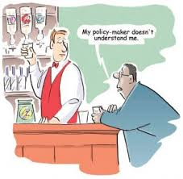
Strategies to manage the science-policy interface
Step 1: Build your own understanding of gaps and capacities
Step 2: Build partnerships to grow your capacity to act
Step 3 and 4: Fill gaps in available evidence
Steps 5, 6, 7: Build the capacities of other participants (for links in the chain of outcomes)
Steps 8, 9, 10: Create practices for the effective exchange of experiences
Source: UN, 2017 and adapted from DFID, 2013

Slide 19







“External” factors of influence in policy and planning effectiveness

Slide 20
Checking the learning objectives
At the end of the lectures on planning and conflict, participants will be able to:
Critically analyze how decision making in WRP leads to the emergence of conflict or cooperation
Sub-objectives:
Analyse socio-environmental problems in planning processes with the perspective of complex systems.
Critically analyse water resources planning models and tools and their role in generating conflict or cooperation
Understand what is the decision space, and how to fight to broaden it up

Slide 21
References / sources
Godinez-Madrigal, J., Van Cauwenbergh, N., & van der Zaag, P. (2019). Production of competing water knowledge in the face of water crises: Revisiting the IWRM success story of the Lerma-Chapala Basin, Mexico. Geoforum. https://doi.org/10.1016/j.geoforum.2019.02.002
Newig, J. (2007). Does public participation in environmental decisions lead to improved environmental quality?: towards an analytical framework. Communication, Cooperation, Participation (International Journal of Sustainability Communication), 1(1), 51-71. https://nbn-resolving.org/urn:nbn:de:0168-ssoar-431965
Molle, F. 2003. The closure of river basins: trajectories and societal responses. Conference paper 3rd conference of the International Water History Association. Alexandria, Egypt, 14 November 2003 http://dlc.dlib.indiana.edu/dlc/handle/10535/5064
﻿Hidalgo, J., Peña, H., 2009. Turning water stress into water management success: experiences in the Lerma-Chapala river basin. In: Lenton, R., Muller, M. (Eds.), Integrated Water Resources Management in Practice: Better Water Management for Development. ﻿Development. Earthscan, London, pp. 107–148 (available on eCampus)
Wester, P., Mollard, E., Silva-Ochoa, P., Vargas-Velázquez, S., 2009b. From half-full to half-empty: the hydraulic mission and water overexploitation in the Lerma-Chapala Basin, Mexico. In: Molle, F., Wester, P. (Eds.), River Basin Trajectories: Societies, Environments and Development. CABI, Wallingford, UK, pp. 75–99.

Slide 22
Questions?
n.vancauwenbergh@un-ihe.org
j.godinezmadrigal@un-ihe.org

Slide 23
Questions on the PIP assignment
Groups
Barbados groundwater for drinking water supply
  Deepitika Chand, Johane Dorcena, Carlon Worrell, Mounia El Azhari, Muhammad Eleiwi, Ivonne Liere, Sharif Mujadedi
Cali, Colombia, Lili river basin
  Safaa Aldirawi, Haneen Muhammad, Eman Hamada, Daniel Ascuntar Rios, Oclaya Verwey, Priscilla Crisis
Kaliwa River Watershed, Philippines
  Sajib Mahanta, Kartik Kamath, Claudio Moreira, Waliuddin Ansari, Karen Garcia
India, recurring floods
  Obrike Chinyelu, Abed Tobey, Suzan Dehati, Janani Ravindran, Bernice Ephraim, Radhakrishna Govindarajulu

Slide 24
PIP assignment
Output:
Powerpoint presentation of 15 slides maximum, including:
  Short description of the case and current (lack of) participation in river basin planning.
  Actors to be involved and strategy to assure participation in a kick-off meeting
Timing:
Tue 10/05 (by 10am – email): presentation of groups and selected case + questions on the assignment Wed 11/05 (period 3): analysis of draft presentation outline + Q&A (Nora available, max 20’ per group).
Fri 13/05: period 1, send presentations all groups by 10h30 / period 2+3, presentations (20' + 10' Q&A).
Assessment: 20% of the final exam score, study load of 16 hours pp incl. presentations

Slide 25
PIP assignment - assessment
You will be assessed during the oral presentation and Q&A and receive a group grade based on 10 assessment criteria (6 on content and 4 on format, all equally important):
Content:
Case study description: Context of biophysical and socio-economic and political system
Presentation of issues: what are the problems in the basin, what are impacts on the water system and beyond, any causes, drivers etc.
Current (lack of) participation: analysis of who is participating and link to institutional setup
Stakeholder analysis: what are the relative roles of stakeholders, what are power balances and interest? (Use of influence/importance matrix or other e.g. Venn diagram or SNA)
Selection of working group: how do you select the group of stakeholders you will work with in your planning process, is it linked to the analysis?
Strategy for motivation: how will you invite stakeholders and ensure they participate in a meaningful way? Do you have separate strategies for different (types of) stakeholders?
Format
PowerPoint clarity: structure, balanced use of text and images, amount of text on slides, font sizes, color use etc
Oral presentation quality: narrative over slides, highlighting images/tables etc, contact with room, one or more speakers
Time management: oral presentation should be no longer than 15 minutes
Question and answers: how is the group responding to answers, are all members represented?

Slide 26
Questions on indivudal SA assignment

Slide 27
Thank you!
n.vancauwenbergh@un-ihe.org

