Slide 1





Water resources planning
Introduction – Why do we plan
Nora Van Cauwenbergh, PhD
Associate Professor Water and Societal Transitions
Oct 2025

Slide 2
Water resources planning
serves Water Resources Management (WRM).
serves the manager to decide upon a number of investments for development of water management infrastructure,
also serves to analyse and formulate policies and strategies for the use of water and the delivery of water services
addresses the functioning of the Water Resources System (WRS) in its integrated whole, taking into consideration its social, economic and environmental functions.

Slide 3
The importance of water for our lives
Drinking water
Agriculture
Industries
Aesthetical value
Energy
Food
Ecosystems
Biodiversity
Recreation
Cultural value
Fisheries
Transportation

Slide 4
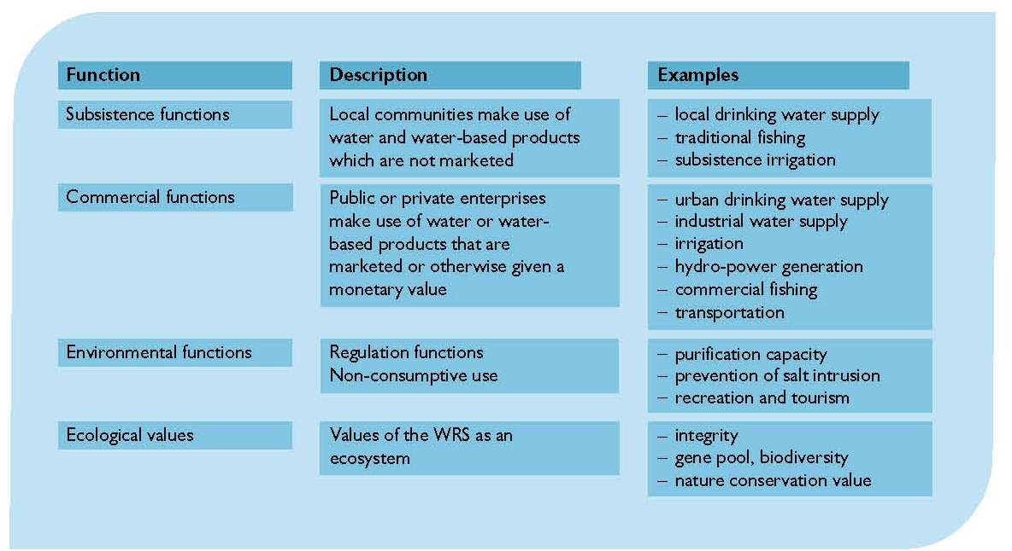
Multiple functions of water resources systems

Slide 5
Increased water use over time

Slide 6
Potential adverse impacts
Excessive withdrawals of river flows
Pollution from industrial and agricultural activities,
Eutrophication from excessive nutrient loads
Salinization from irrigation return flows
Excessive fish harvesting
Floodplain and habitat alteration from development activities
Changes in water and sediment flow regimes
Degraded infrastructures
Other issues…..

Slide 7
Triggers for water resources planning
problems have to be solved
an undesirable event
meet unsatisfied demands
develop under-utilized resources
achieve national development objectives
other (sectoral) planning efforts: energy, agriculture, fisheries, land use

Slide 8
So why plan? Why manage?
There are problems to solve and opportunities to obtain increased benefits from the use of water and related land resources
Benefits can be measured in many different ways. Agreement on best approach not easy, conflicts possible.
→ Need for careful study and research, as well as stakeholder involvement, in the search for a shared vision of the best compromised plan or management policy.

Slide 9
An example of planning procedure to address water scarcity
Issue: supplies are inadequate to meet demands
What are the causes? (increased water development, conflict over water rights and allocations (could be of transboundary nature), inefficient water use, high variability of water availability…..
What could be the measures to cope water scarcity? (water rationing in times of scarcity, conjunctive use of groundwater and surface supplies, equitable allocation to upstream and downstream users….. )
Do stakeholders agree on these measures?
Are these interventions sustainable (e.g. conjunctive groundwater use does not lead to over-exploitation)?

Slide 10
Water resources planning – multiple dimension of the water system

Slide 11
WRP – integration of knowledge and skills
Water legislation
Principles of IWRM
Mediation for Water Conflict Management
Water Resources System
Water Governance
Water Systems Modeling
Water Economics
Water Resources Assessment

Slide 12
Module for WMG students and short course participants
Target group:
Young and mid-career professionals, managers, engineers and technicians who have the ambition to judge, participate in and guide multi-disciplinary water resources planning studies.
Prerequisites
Understanding of the water resources physical system. Understanding of water use for agriculture, water supply, hydropower and environment. Understanding of water governance. Computer literacy. Good command of English.

Slide 13
Experience with planning so far
What have you learned about the plans in your basins so far?
How can you link your recent MSc experience to river basin planning?

Slide 14
Learning objectives
Successful participants will be able to:
Describe concepts and major steps in water resources planning.
Identify, critically analyze and apply methods and tools, such as stakeholder integration, environmental impact assessment (EIA), decision support systems, role plays and water system models, while engaging in water resources planning activities.
Develop water management strategies and compare and evaluate them by applying multi-criteria analysis.
Discuss water resources planning and implementation in basins for specific context with special attention to basins in a developing country context.

Slide 15
WRP requires integration of knowledge and skills
Water legislation
Principles of IWRM
Mediation for Water Conflict Management
Water Resources System
Water Governance
Water Systems Modeling
Water Economics
Water Resources Assessment

Slide 16
Module content – 3 blocks
Framework for analysis and steps in the planning process
Approaches, models and tools in planning
  Role of models in planning
  Multi criteria analysis (MCA)
  Environmental Impact Assessment
Global experiences and their relevance for Ethiopia: plan implementation

Slide 17
Block 1: Framework for Analysis for water Resources Planning and planning steps
Introduction to Water Resources Planning and Framework for Analysis
  Analysis of Water resources plans
  Link to general theory and concepts
Key steps in a participatory integrated planning process
  Case study on participatory planning and exercises
  Highlighting stakeholder involvement in different steps of the planning process.
  Situation analysis, stakeholder involvement, criteria and objectives, action plans, evaluation, negotiation and decision making

Slide 18
Block 2: Methods, models and tools in water resources planning – 3 parts
Comprehensive overview of different types of models and when they are used in the planning process. Discussion of experiences, opportunities and limitations of modeling and their design.
Exercise on multi criteria analysis (MCA) of water management alternatives: construct a set of alternatives that will be evaluated using MCA, based on a set of predefined objectives and criteria of the plan.
Environmental Impact Assessment (EIA): Environmental impacts of water resources development projects, principles and methods of EIA, EIA and its application in water resources planning, case study and exercise on impact matrix

Slide 19
Block 3: Experiences from the Global South – planning implementation
Plan implementation and evaluation will be discussed based on case studies from the global south. Case studies and discussion on practices, challenges and opportunities for water resources planning in the global south
Case studies by experienced/senior lecturers
Assignment by participants

Slide 20
Lecturing materials
OCW
Loucks, D.P., van Beek, E. 2017. Water Resources Systems Planning and Management: An Introduction to Methods, Models and Applications. Springer. https://www.springer.com/gp/book/9783319442327
Other Handouts: Examples of case studies, Selected background reading.
Software: link to MSc where relevant

Slide 21
Questions?

