Slide 1





Situation and problem analysis
Jaap Evers

Slide 2
Today’s programme
Discussing the terms
Rich picture approach for situation analysis
Presenting rich pictures
Break
We start at 14.00hr
Developing a problem tree and means-ends diagram
Exercise for homework (presentation Monday afternoon period 3)

Slide 3
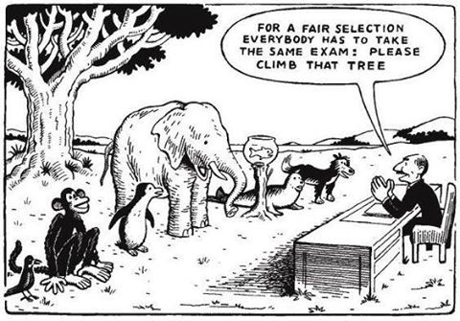
A flood is coming! The plan is to climb that tree!

Slide 4
Getting to terms?
where you are now
This is the current situation
A situation includes social, environmental, technical, economical, cultural/spiritual, and institutional aspects.
In the current situation you might already recognize challenges or issues.
the situation as it is or expected

Slide 5
Getting to terms?
This is the desired situation. It describes norms, criteria and values.
Social (e.g. well-being)
Economic (e.g. employment)
Environmental (e.g. biodiversity)
Technical (e.g. state of infrastructure)
Institutional (rights, regulations, norms)
Spiritual (e.g. safe water rituals, river rights)
where you want to be
the situation as desired (objective)

Slide 6
Getting to terms?
A problem is the difference between the current (or expected future) situation and the desired (future) situation
where you are now
where you want to be
problem
the situation as it is or expected
the situation as desired (objective)

Slide 7
Getting to terms?
Situation analysis
where you are now
where you want to be
problem
the situation as it is or expected
the situation as desired (objective)

Slide 8
Getting to terms?
Problem analysis
Situation analysis
where you are now
where you want to be
problem
the situation as it is or expected
the situation as desired (objective)

Slide 9
Getting to terms?
A plan describes the current situation, the desired situation (the objectives and monitoring criteria), and the strategy on how to get there (what, why, who, where, when, and how)
Problem analysis
Situation analysis
where you are now
where you want to be
plan
the situation as it is or expected
the situation as desired (objective)

Slide 10
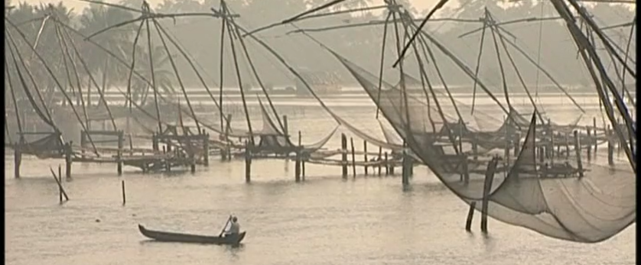
Video Kerala
Give a situational analysis
Social,
Cultural
Environmental
Economic
Technological
Institutional

Slide 11
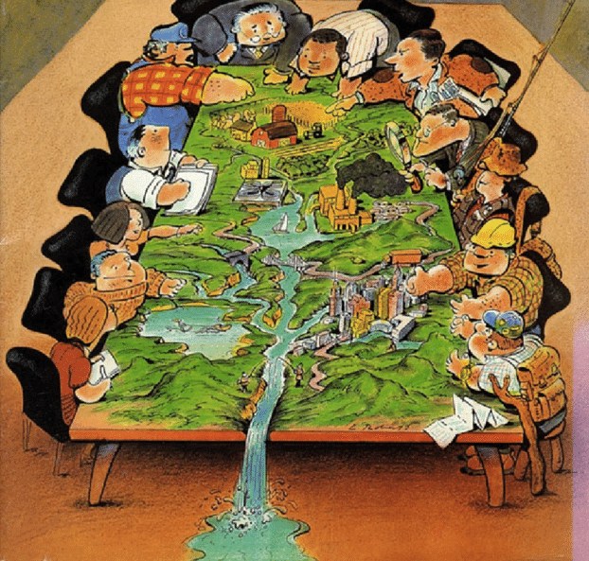
What is planning?
Planning is an analytical process
Understanding problems and solutions relations
Planning is a political process
Competition of ideas and interests, priorities, and trade-offs
(Van Beek, 2017)

Slide 12
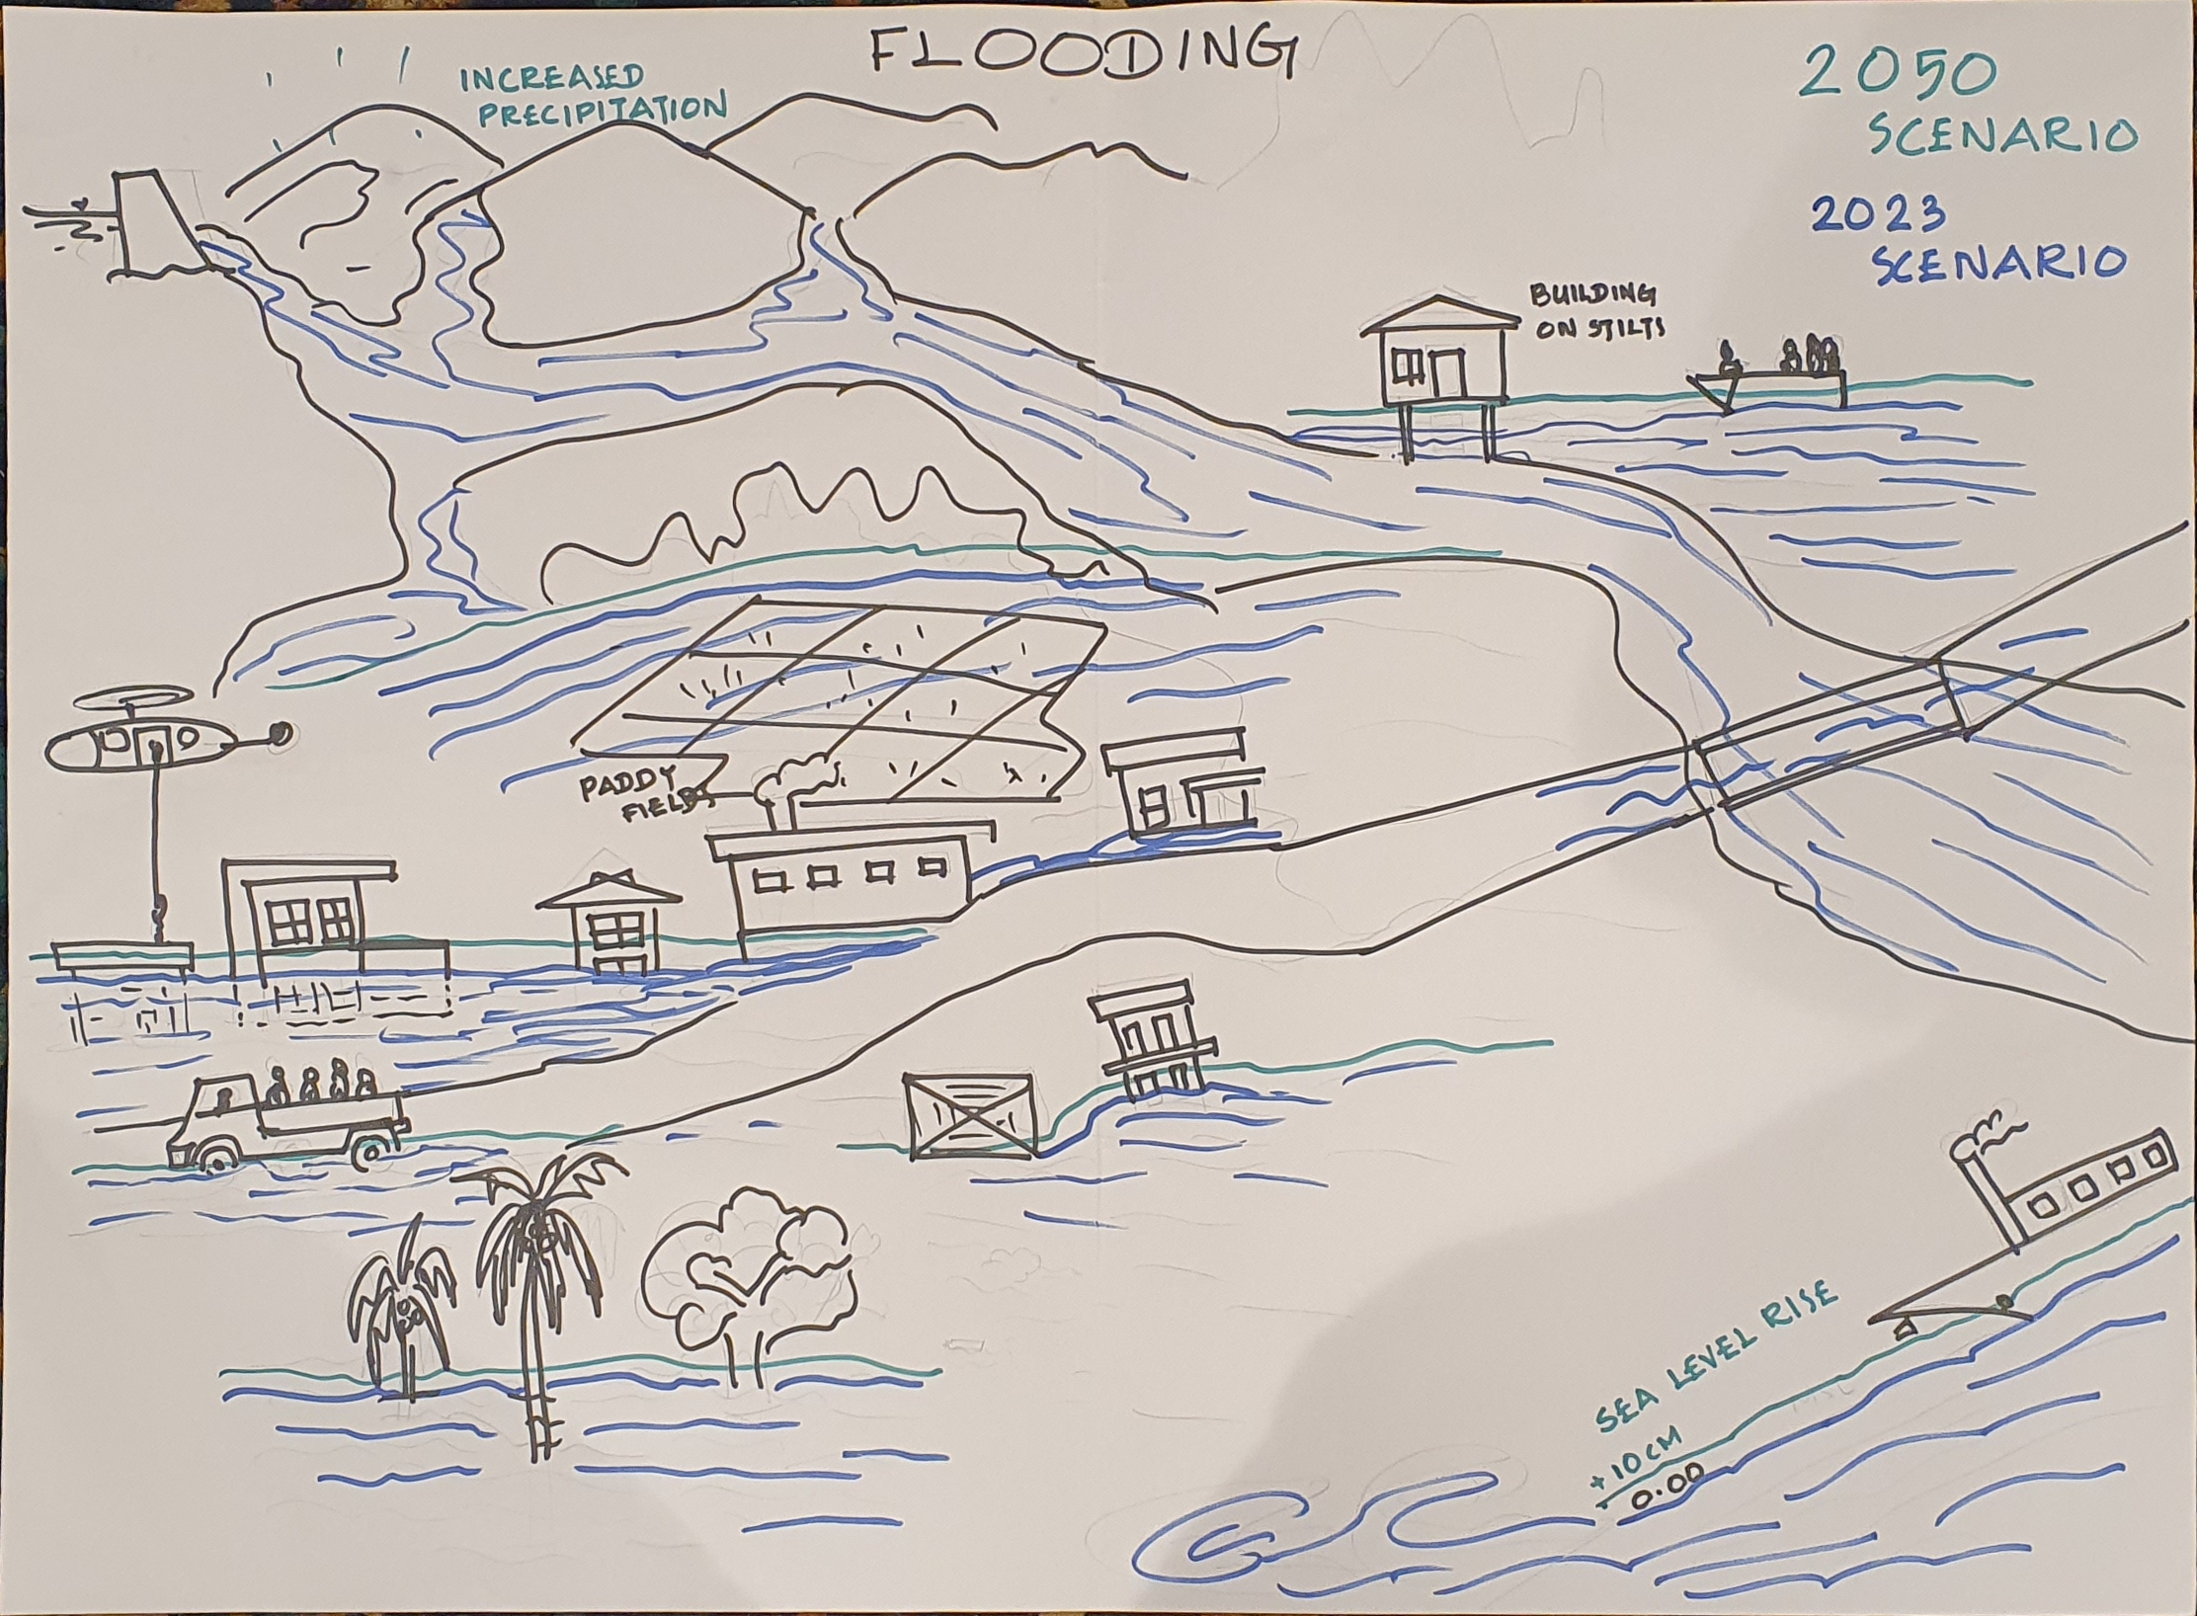

Slide 13
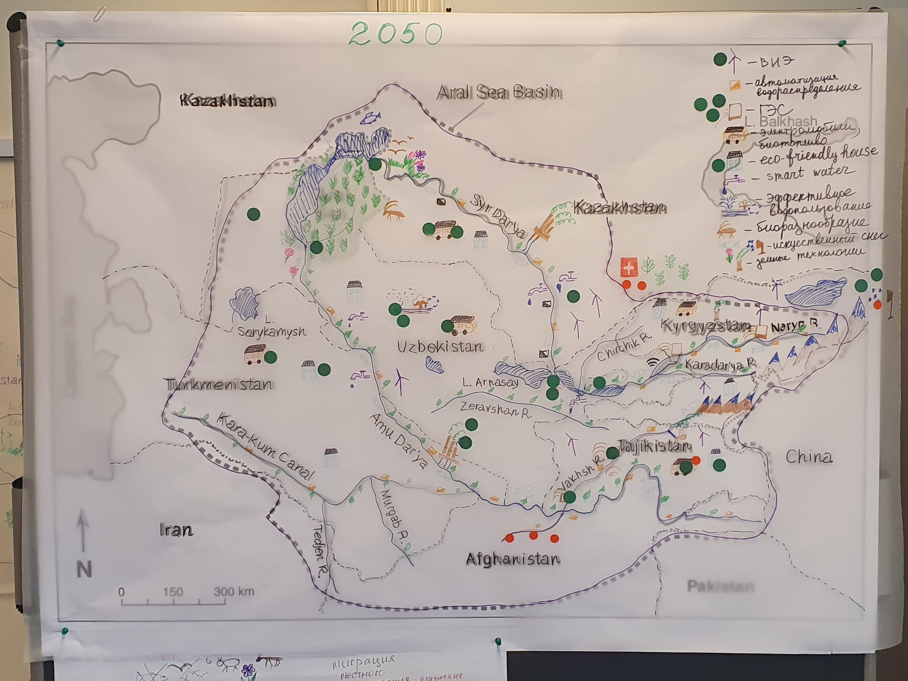
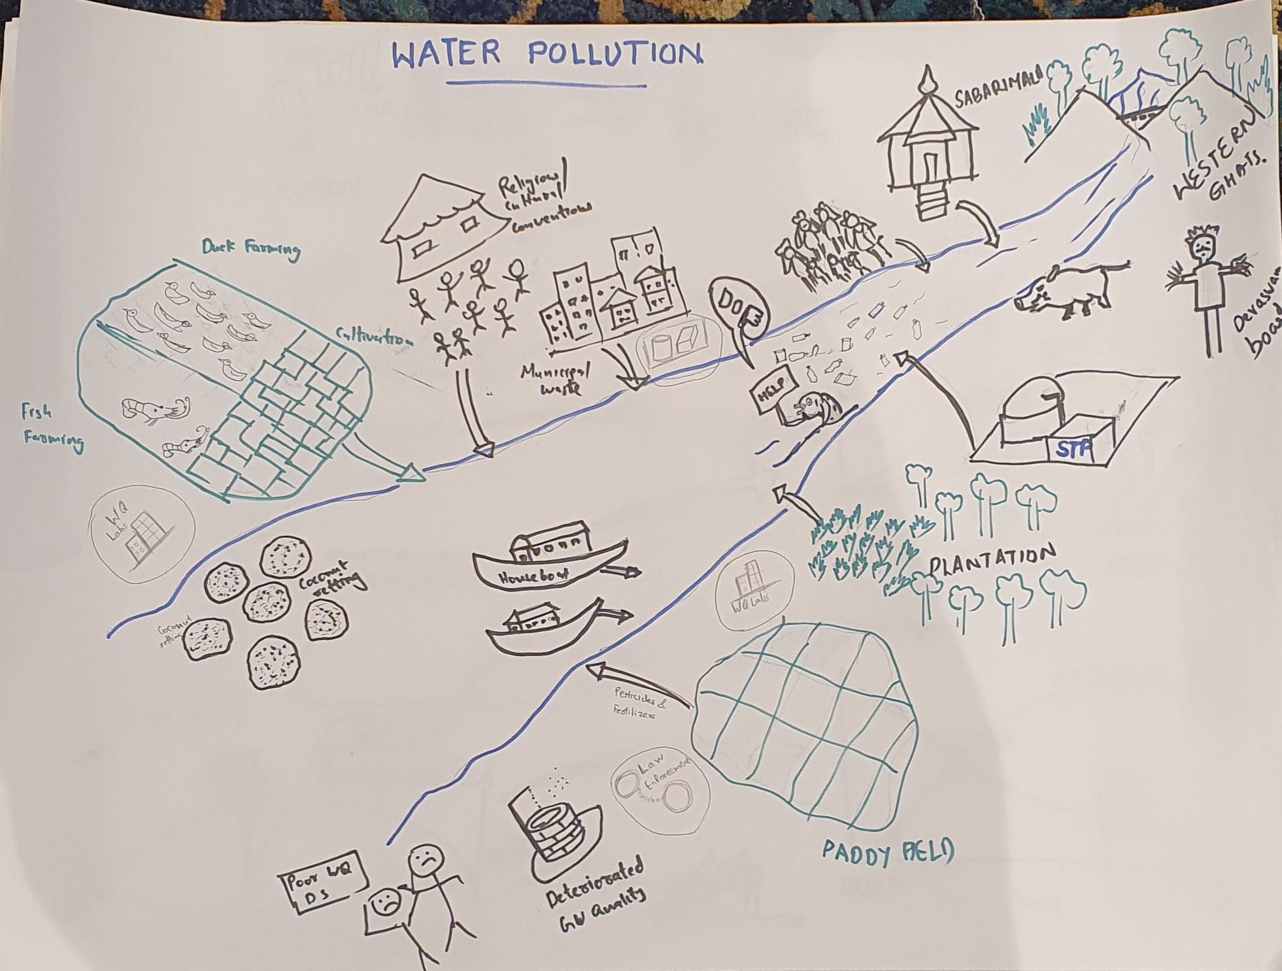
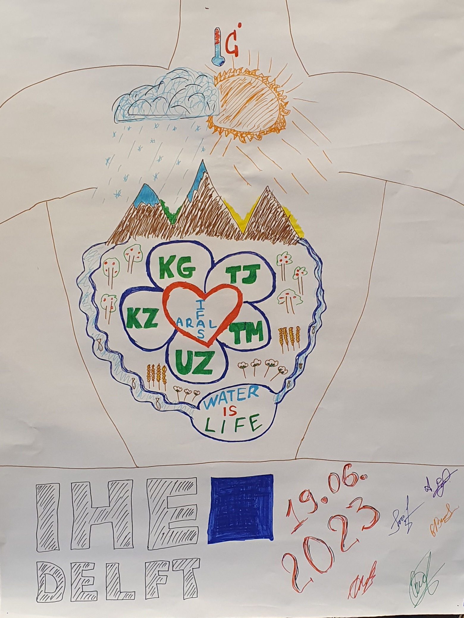
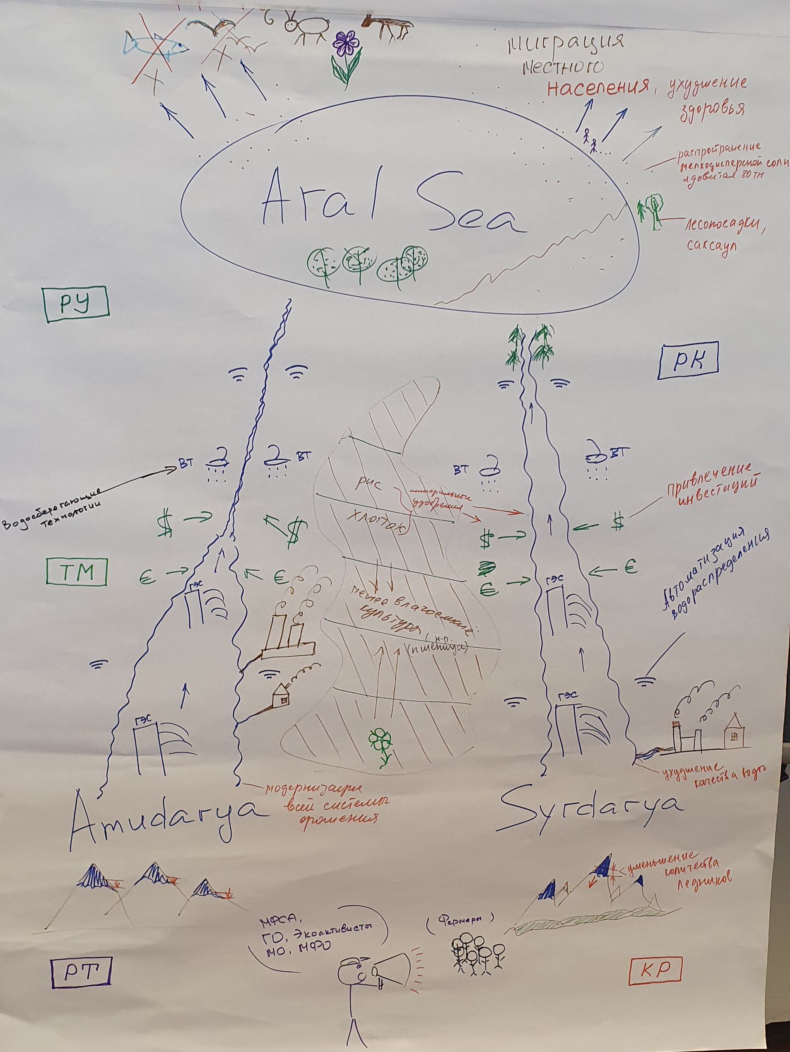
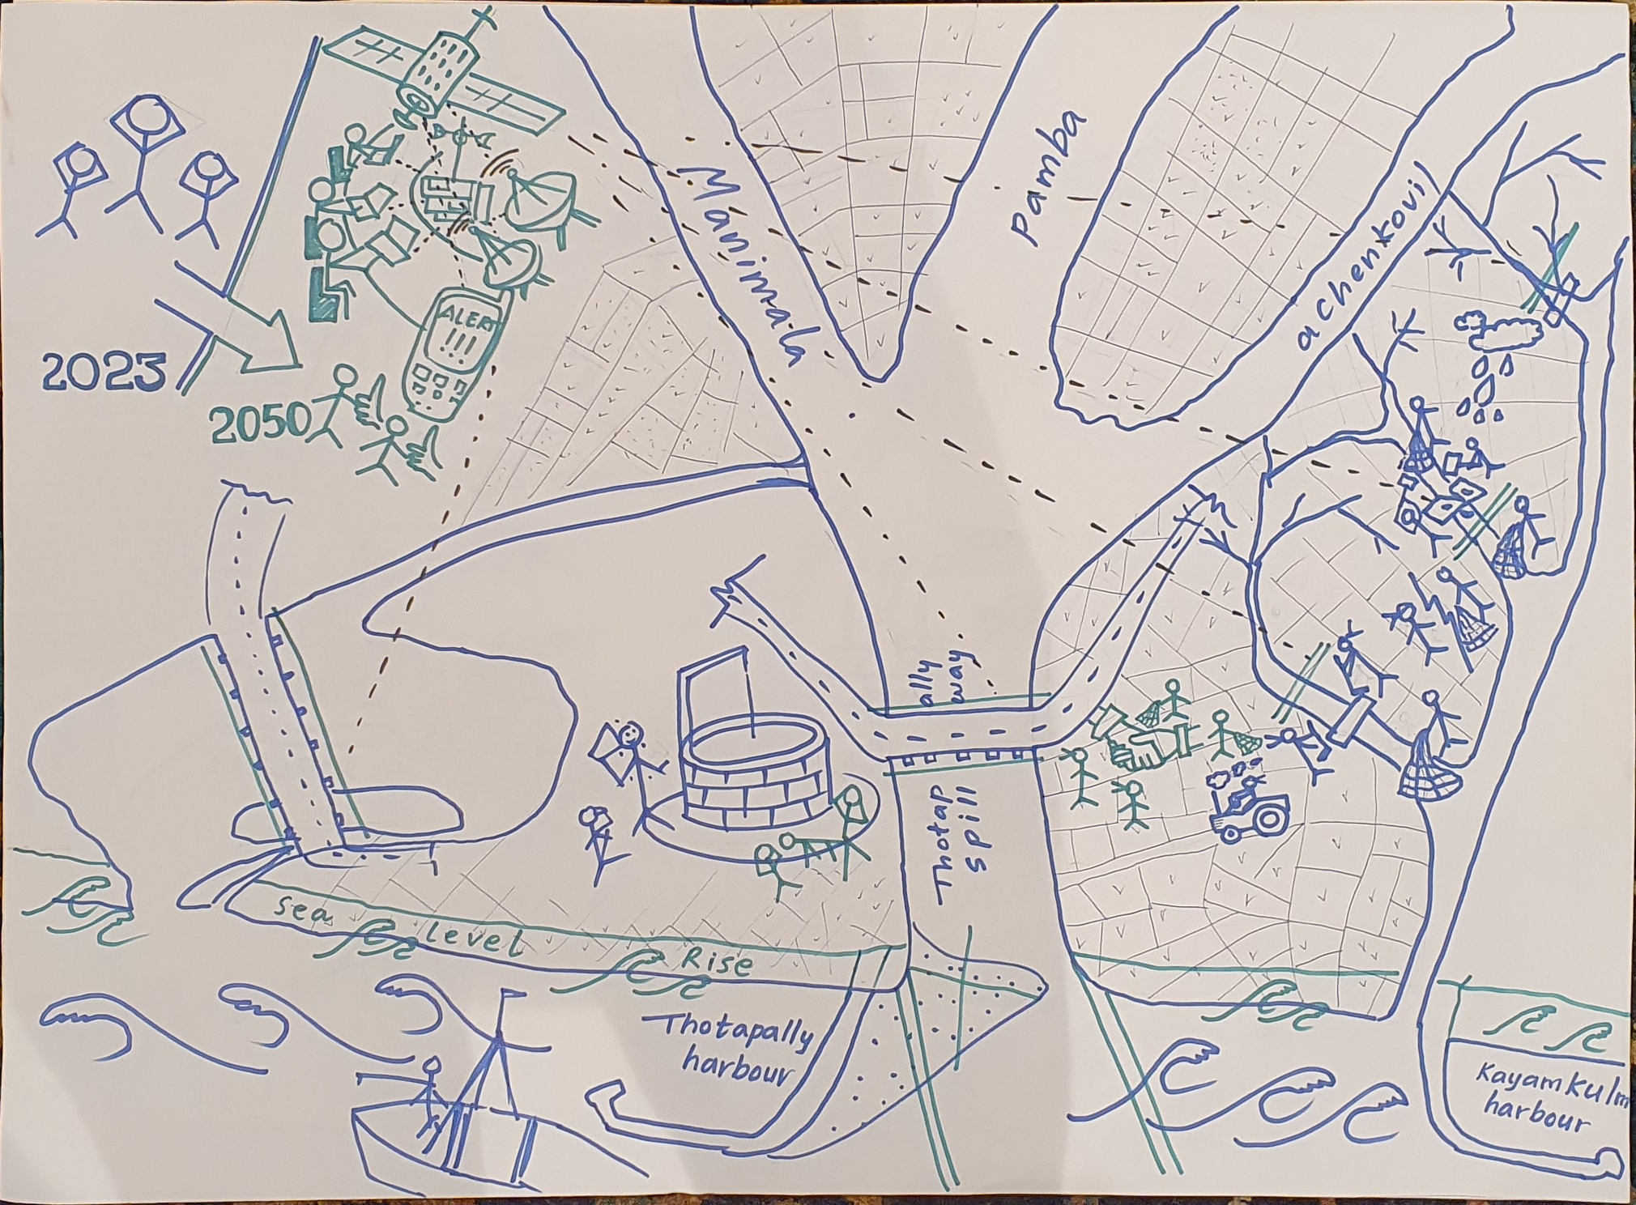
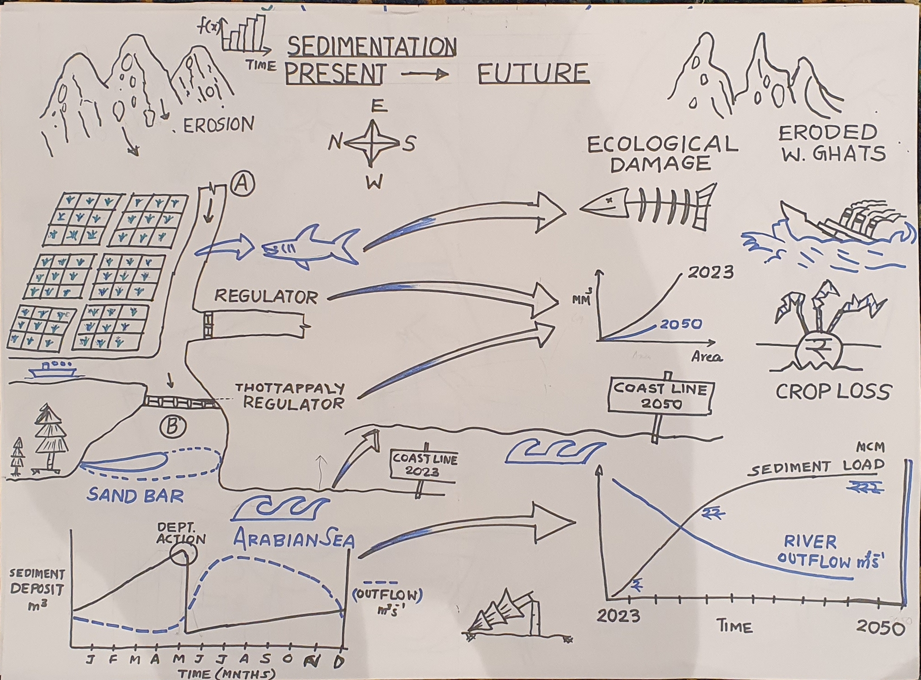
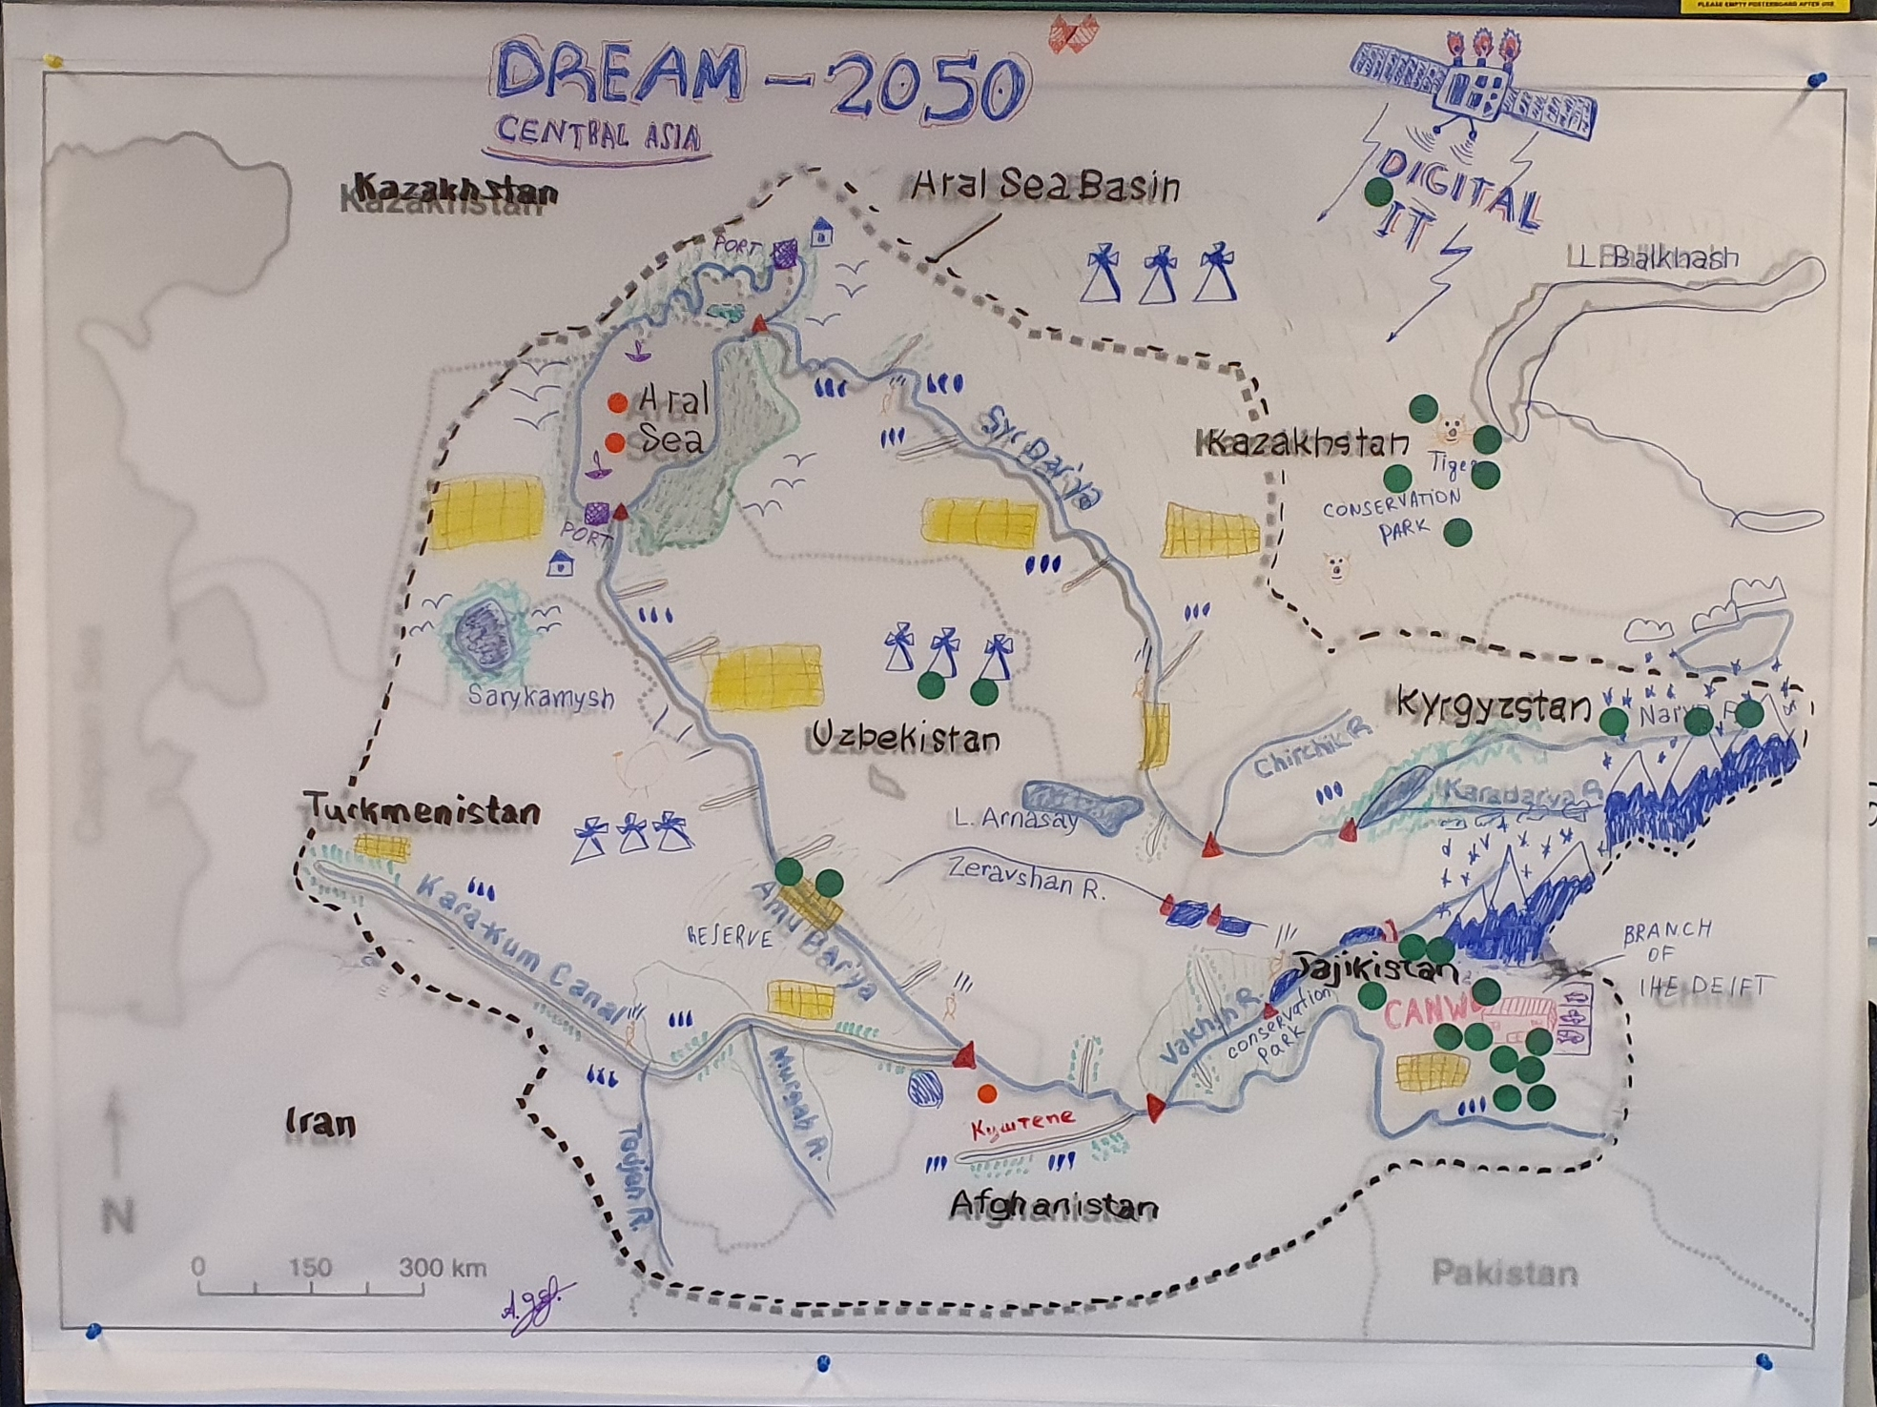
Rich pictures – a participatory approach to understanding and describing complex situations

Slide 14
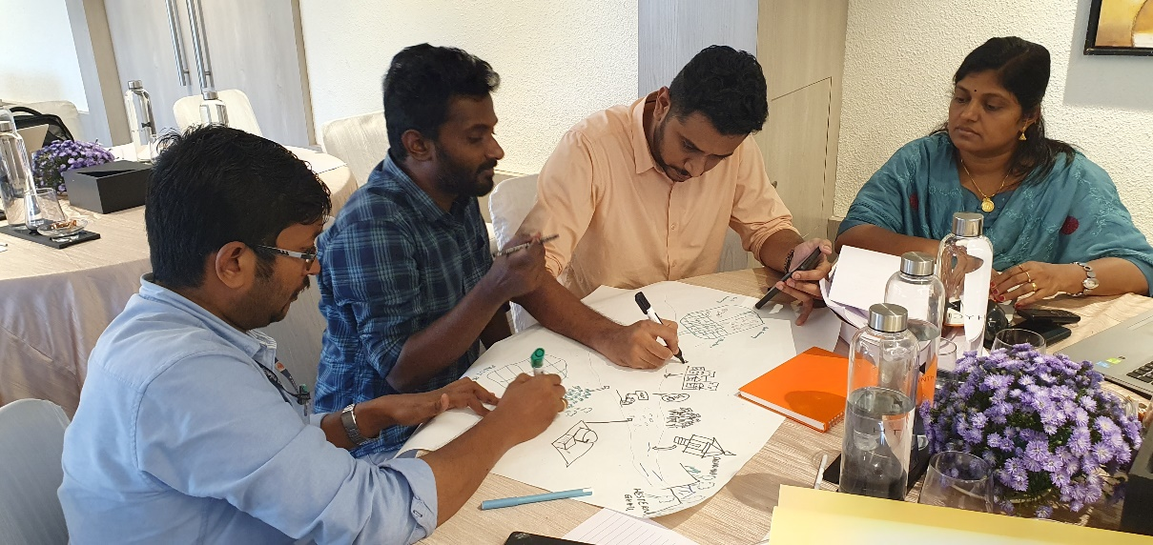
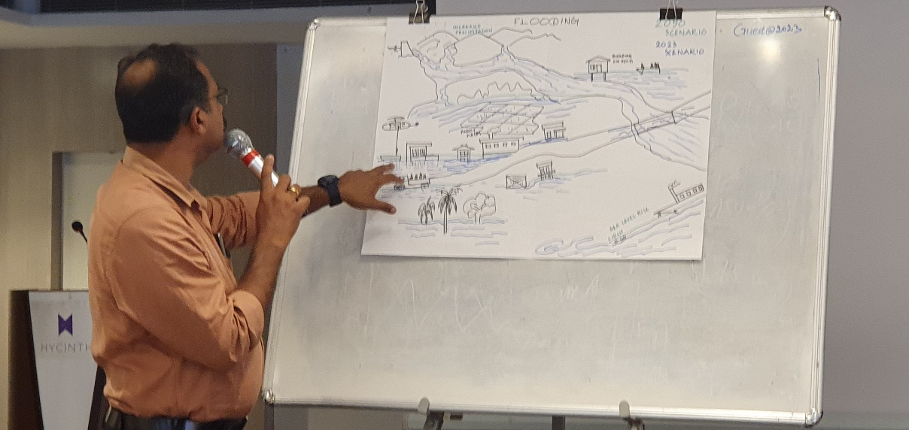
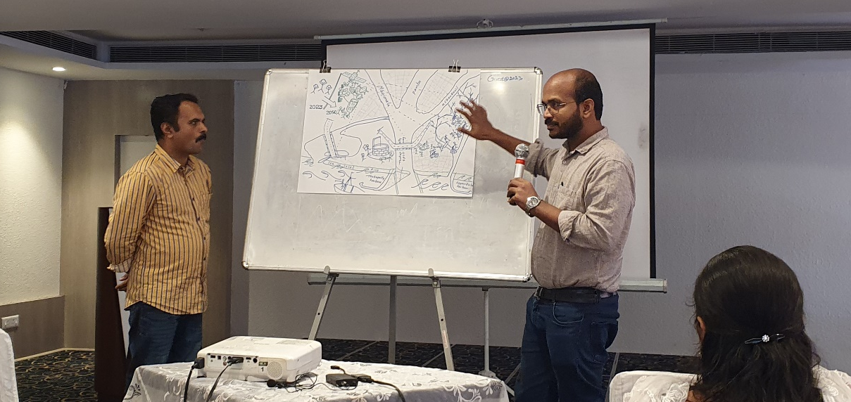
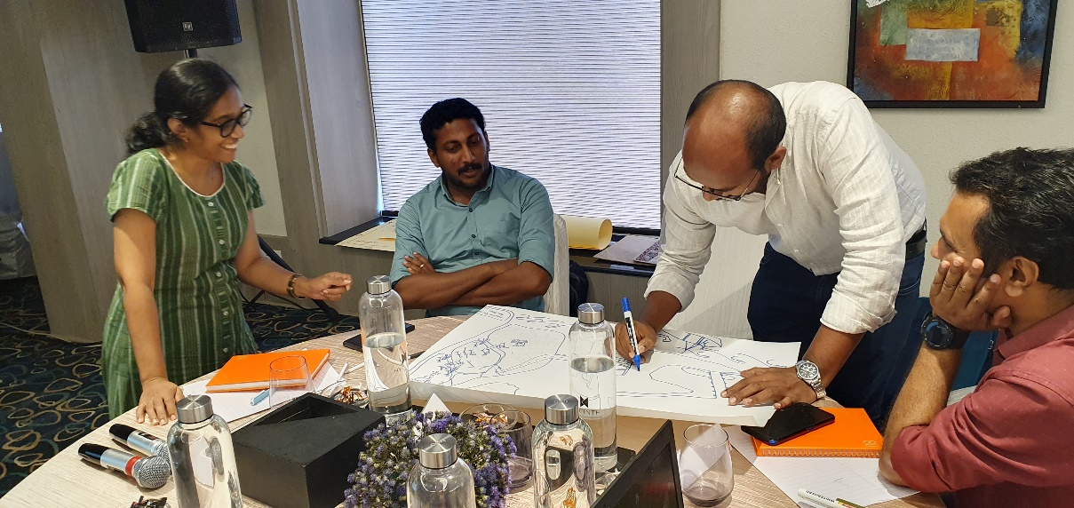
Rich pictures approach: creating system understanding

Slide 15
Exercise
Develop a rich picture of your basin and focus on (shared ) water values
A value is something that is important and meaningful (of value) to someone. A shared water value means that a specific value has been identified by more than one individual or organisation. They can include environmental, cultural, economic and/or social aspects. A shared water challenge arises when more than one stakeholder identifies that a value is being threatened, or that a stakeholder’s activities is seen to be in competition with the protection of a value.

Slide 16
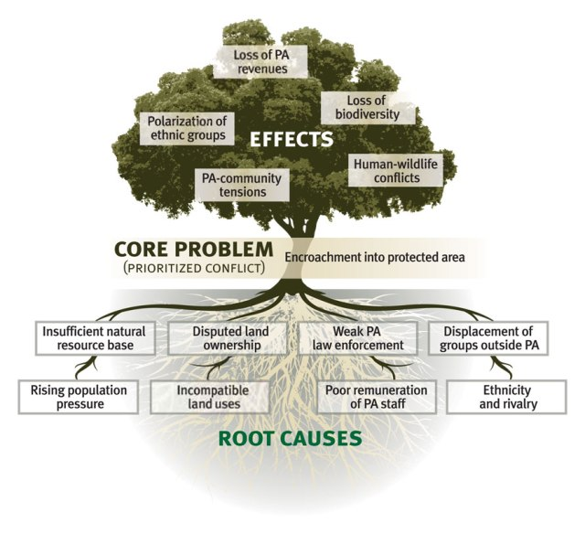

Slide 17
Case: Rotam bus action plan
In the city of Rotam, the last two decades the frequency of bus accidents has increased significantly. This causes much delay and inconvenience for the passengers but also causes traffic jams. There have also been several accidents in which the bus driver, passengers or other traffic participants were killed. The city of Rotam has public transport contracts with several private public transport companies (operating local and regional bus lines), and due to bad publicity in the media they have registered a reduction in the number of bus passengers. The city council of Rotam, would like to see more people to use the bus again for their transportation within the city and its surrounding region.
The city public transport department (responsible for the control of the public transport companies) aims to develop a plan of action to increase the usage of buses for local transportation by its inhabitants. At the same time the plan is used by the city council to promote public transportation over the use of cars to improve the air quality of the city.

Slide 18
Analyzing problems (cause – effect)
Problem tree

Slide 19
Analyzing solutions (means – ends)
Solution tree
(a mirror of the problem tree)

Slide 20
Exercise
Select one issue in your river basin
  Develop a problem tree
  Develop a means-ends diagram

Slide 21
Exercise and homework
Get inspiration from the situation analyses on the OCW site
Develop a situation analysis presenting 3 water challenges and the related:
Social,
Cultural,
Environmental,
Economic,
Technical, and or
Institutional aspects and values

Slide 22
“Title of the shared challenge”
Short description of the problem (difference between the situation and the desired situation)
Causes (of the situation)
X
Y
Z
Effects (consequences)
x
y
z
Relevant stakeholders
A
B
C

Slide 23
Thank you
Jaap Evers
j.evers@un-ihe.org
www.un-ihe.org/jaap-evers

