Slide 1





Implementation based planning:
MOTA analysis

Slide 2
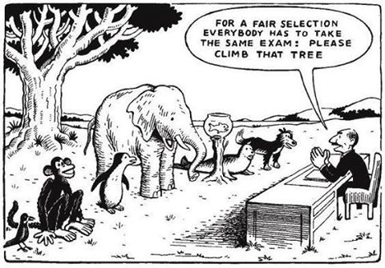
A flood is coming! The plan is to climb that tree.

Slide 3
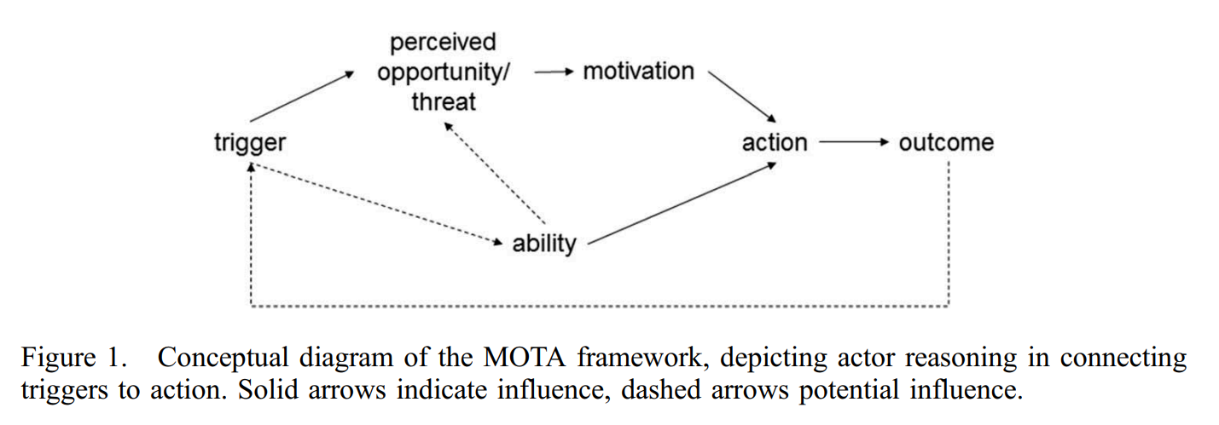
MOTA framework (Phi et al. 2015)

Slide 4
MOTA analysis
Oppor-tunity Threat
Policy
Climate change
Population
Environment
…
Land use
Infrastructure
…
Knowledge
Capital
Institutional Capacity
Stakeholder’s perception
Management/Governance
…
Change
Safety
Benefit
…
Moti-vation
Ability

Slide 5
MOTA analysis
What you know
Action
What you want
What you can

Slide 6
MOTA analysis
What othersknow
Action
What others want
What others can

Slide 7
MOTA analysis
Motivations
Goals and ambitions
Tasks and responsibilities
Abilities
Financial
Institutional
Technical
Social

Slide 8
MOTA analysis
Motivations
Abilities
Despite of what you WANT, the feasibility of plan depends on what you CAN

Slide 9
MOTA analysis
Motivations
Abilities
Despite of what others WANT, the feasibility of plan depends on what others CAN

Slide 10
MOTA analysis
Motivations
Abilities
Despite of what you WANT, the feasibility of plan depends on what others CAN

Slide 11
MOTA analysis
Motivations
Abilities
Affordability
Feasibility

Slide 12
MOTA analysis
What one wants
What one can
The Perceptions of Opportunities and Threats define how much one wants it and how many resources one makes available

Slide 13
MOTA role play

Slide 14
MOTA role play
1 person = 1 stakeholder
MoWE
Others are based on your stakeholder analysis
3 Rounds of play
MOTA assessment per stakeholder group
Top-down presentation of proposed actions by government
Bottom-up response and coming to consent

