Slide 1

BRIGHT - IHE
Basin Management Planning training plan
Pieter van der Zaag
Professor of Water Resources Management
20 November 2025
Notes:
The lecture on Water Resources Management, Concepts and Tools is a compulsory subject of the Water and Environmental Resources Management (WERM) Course (both for WQM and WRM branches). It is meant to give an introduction to present-day views and techniques regarding the sustainable management of water resources as an integrated part of the national policy framework. For the Water Resources Management (WRM) branch of the WERM Course it is the basic lecture which is the start of a sequence of key lectures on planning, analysis, management and decision making.

Slide 2
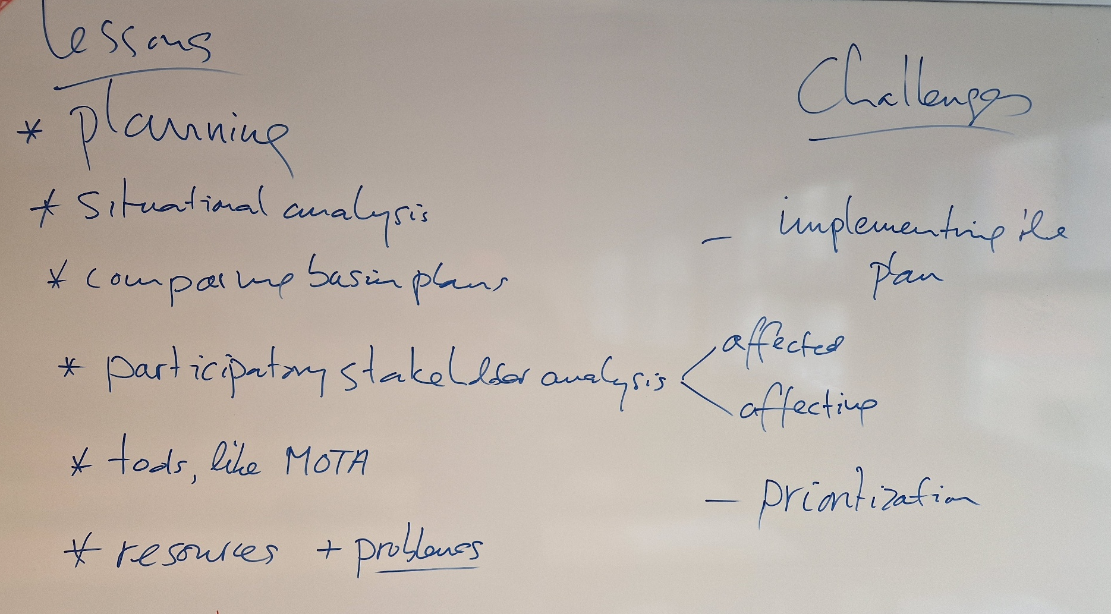
Evaluation
9 -17 October 2026
What did you like most in learning in the past week?

Slide 3
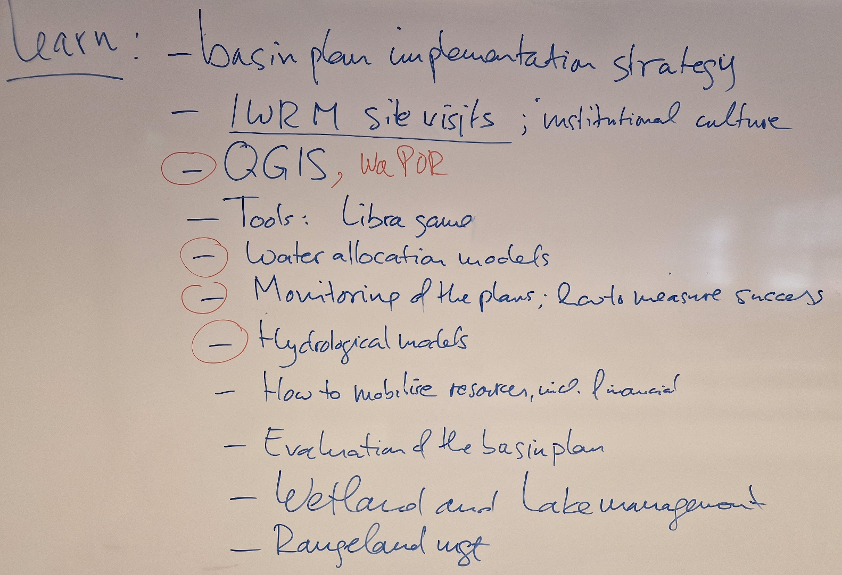
Evaluation
9 -17 October 2026
What would you still like to learn or focus on in the coming weeks?

Slide 4
Training plan
9 October – 19 December 2026
9/10 – 14/11: - Master classes for all graduates, with IHE staff and guest lecturers, on cross-cutting and specialist thematic topics
- Excursions and site visits in NL (throughout the entire period)
17/11 – 5/12: - 6(?) Specialist thematic topics – studied in small groups,
leading to (6?) thematic reports,
presented on 4 and 5 December
8/12 – 19/12 - Capstone project for all 5 basins separately,
leading to 5 basin reports,
presented during closing seminar on 18 and 19 December

Slide 5
Training plan
9 October – 19 December 2026
Cross cutting:
C0. Overall introduction to Basin Management Planning (Nora, Pieter)
C1. Institutional embedding (admin and local) the basin plan (Jaap)
C2. Stakeholder engagement and Governance (Nora, Wim)
C3. Technological Innovations and Data for Basin Information Management (Seleshi, Solomon)
C4. Climate Change and River Basins (Pieter, Seleshi)
Specialist thematic topics (for small group work for thematic review):

Slide 6
Training plan
9 October – 19 December 2026
Specialist thematic topics (thematic review for small group work):
S1. Basin Restoration and Management (Pieter, Abebe)
S2. Water-Energy-Food-Ecosystem Nexus Aspects in Basin Management (Seleshi)
S3. Geospatial data and remote sensing for river basin planning and management (Solomon, Abebe)
S4. Groundwater development and management in basin plan (Solomon,
Tibor Stigter (tbc))
S5. Water pollution (Konstantina Velkushanova (tbc))
S6. Special case: large cities and their hinterlands (including peri urban fringes) (Nora, William Veerbeek (tbc), Pieter)

Slide 7
Training plan
9 October – 19 December 2026
Specialist thematic topic | Participants
S1. Basin restoration | Temesgen (Awash), Abrha (Ome-G), Yibeltal (Abbay), Zelalem (Abbay), Molla (Abbay)
S2. WEFE nexus | Asmare (Tekeze), Zemenay (Omo-G)
S3. Geospatial data and RS | Ayalneh (Tekeze), Merhawit (Tekeze), Tesfaye D. (Omo), Samson (Omo), Haymanot Z. (Awash),
S4. Groundwater | Degefom (Tekeze), Fisiha (Awash), Tolesa (Awash), Adula (RVL), Getahun (Omo)
S5. Water pollution | Gecho (Awash), Meron (RVL), Abebe (RVL), Andualem (RVL), [Haymanot T. (Abbay)]
S6. Large cities | Haymanot T. (Abbay), [Fisiha (Awash)]
Absent | Melaku (Abbay), Tesfaye A. (RVL)

Slide 8
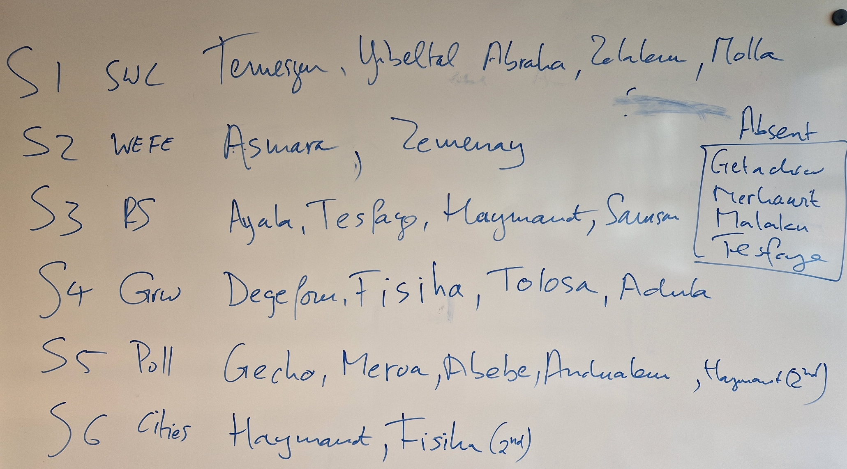
Training plan
9 October – 19 December 2026

