Slide 1
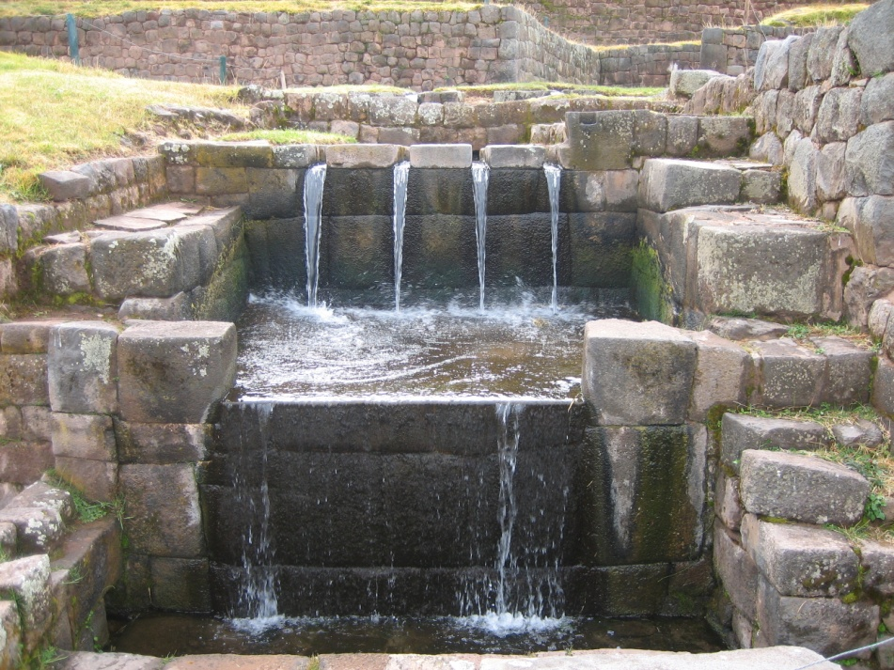
BRIGHT
Large cities – some exercises
Pieter van der Zaag
Professor of Water Resources Management
November 2025

Slide 2
Large cities – the case of Addis
1. Assess the current situation
urban area, population and industry served
current water sources and water supply
apparent per capita gross water use
return flows, wastewater etc.
current water losses: unaccounted-for, non-revenue etc.
who has access to WASH, coverage; who not?
which institution(s) are involved
financial situation: cost, revenue, tariff system
2. Assess the growth of Addis and its water use, 2015-2025
3. Assess projections of Addis population and water demand, 2025-2035
4. Draw some lessons

Slide 3
Large cities – the case of Addis
1. Assess the current situation
urban area, population and industry served
current water sources and water supply
apparent per capita gross water use
return flows, wastewater etc.
current water losses: unaccounted-for, non-revenue etc.
Coverage; who has access to WASH, who not?
which institution(s) are involved
financial situation: cost, revenue, tariff system
2. Assess the growth of Addis and its water use, 2015-2025
3. Assess projections of Addis population and water demand, 2025-2035
4. Draw some lessons

Slide 4
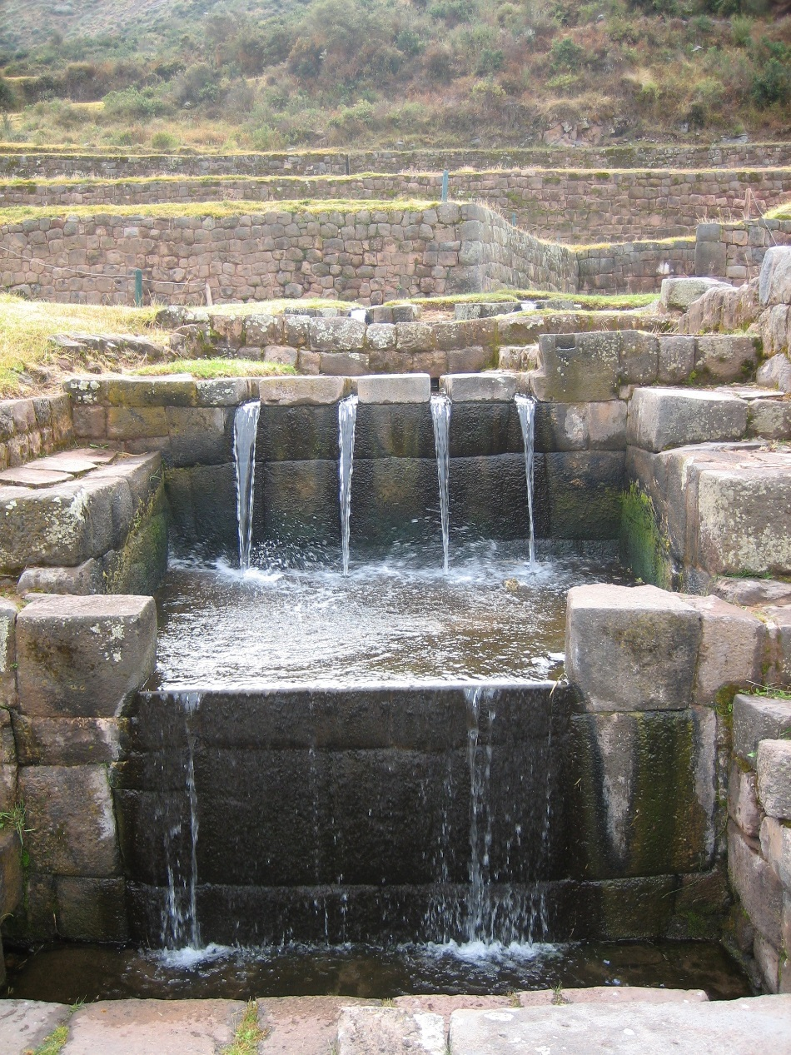
p.vanderzaag@un-ihe.org

