Slide 1
Deriving high-resolution evapotranspiration products using a data fusion method
Haneen Muhammad Hussein Muhammad
MSc Thesis Identifier WMG.23-23
April 2023

Slide 2
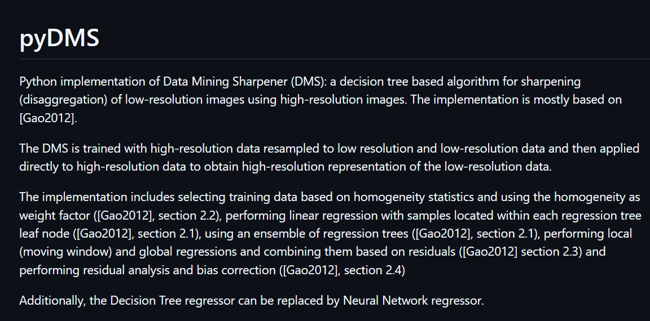
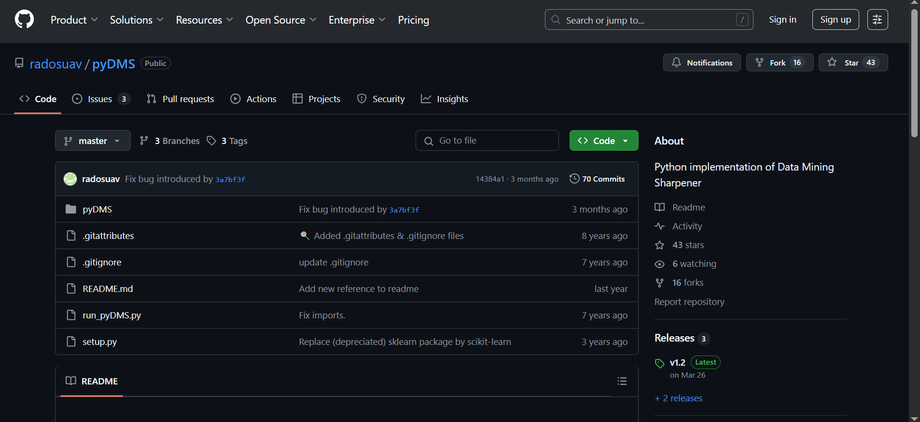
Github repository of PyDMS
https://github.com/radosuav/pyDMS

Slide 3
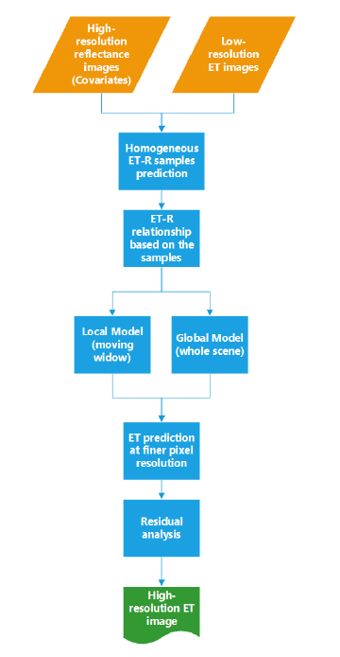
Method
Input
Python tool for sharpening low-resolution images using high-resolution data
Based on the method from Gao et al. (2012)
Trains on:
- High-res data resampled to low-res
- Actual low-res data
Especially useful for remote sensing / satellite imagery
Data needed:
WaPOR L1/L2 as “Low resolution image”
- Download from WaPORDL
Sentinel-2 NDVI (or other indices) as “High-resolution image”
- Download from GEE
Output

Slide 4
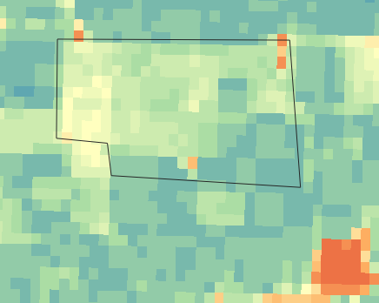
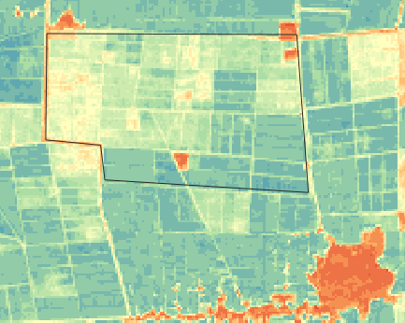
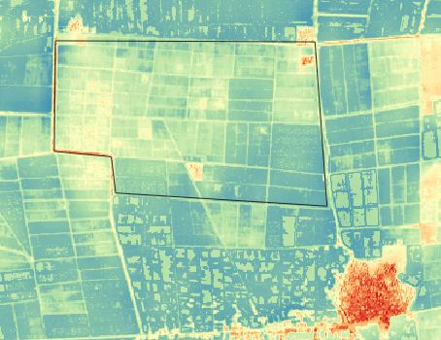

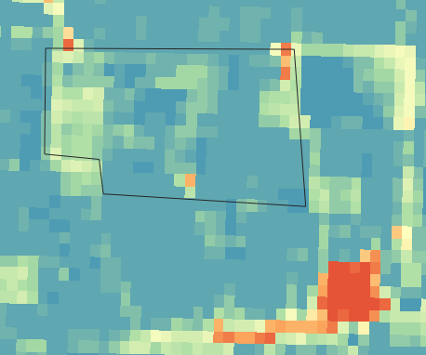
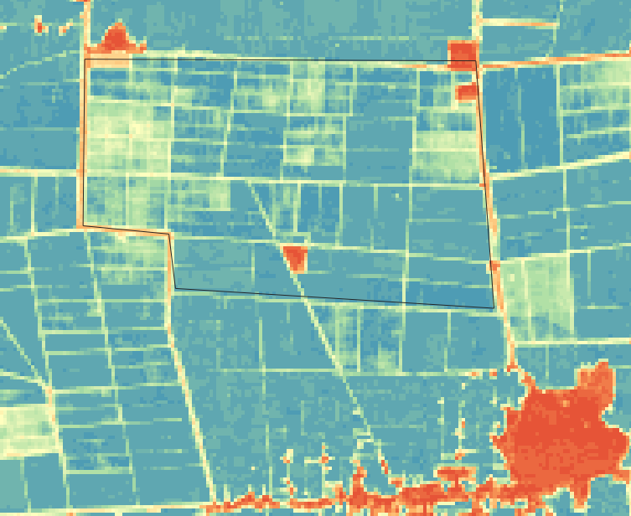
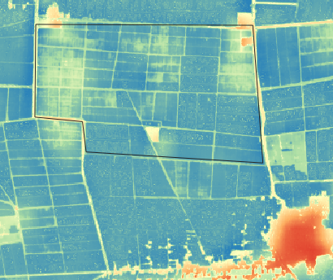

Downscaled WaPOR v3 AETI comparison
WaPOR v3 L2 100m
WaPOR v3 L3 20m
Downscaled 10m
01-01-2023
AETI [mm/day]
01-02-2023
AETI [mm/day]

Slide 5
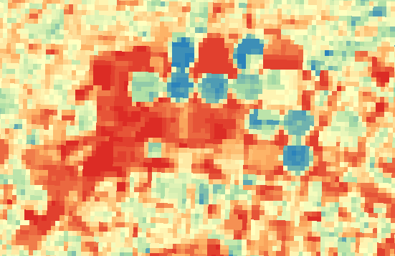
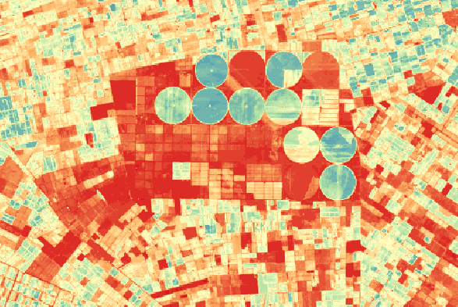
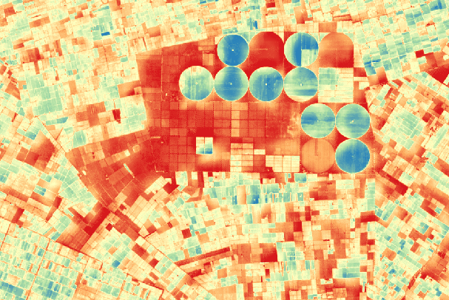

Downscaled WaPOR v3 AETI comparison
WaPOR v3 L2 100m
WaPOR v3 L3 20m
Downscaled 10m
01-11-2023
AETI [mm/day]

Slide 6
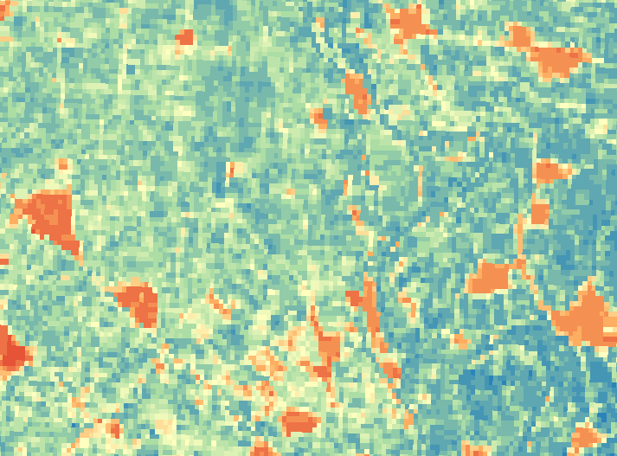
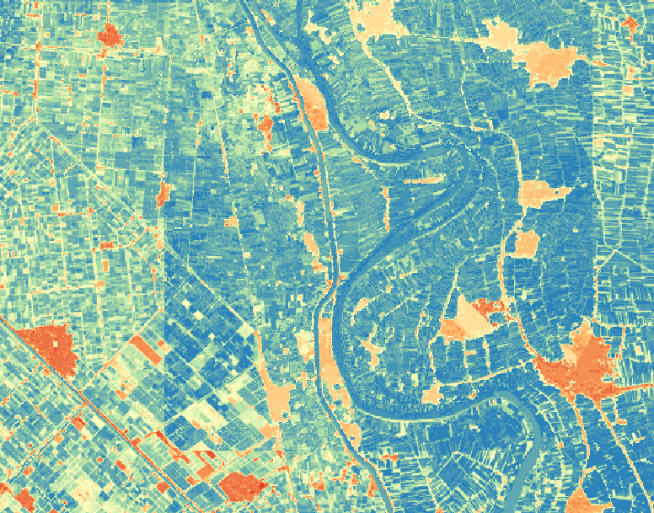
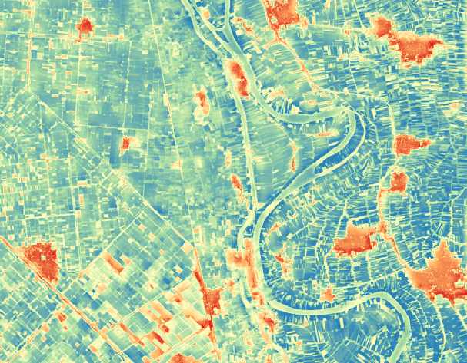
Downscaled WaPOR v3 AETI comparison
WaPOR v3 L2 100m
WaPOR v3 L3 20m
Downscaled 10m
01-01-2023
AETI [mm/day]

Slide 7
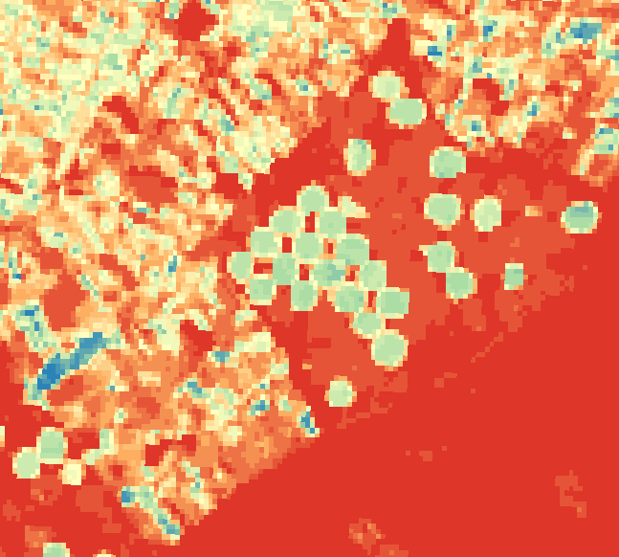
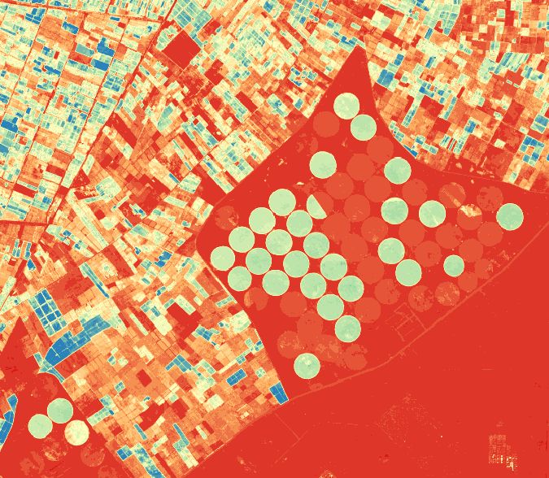
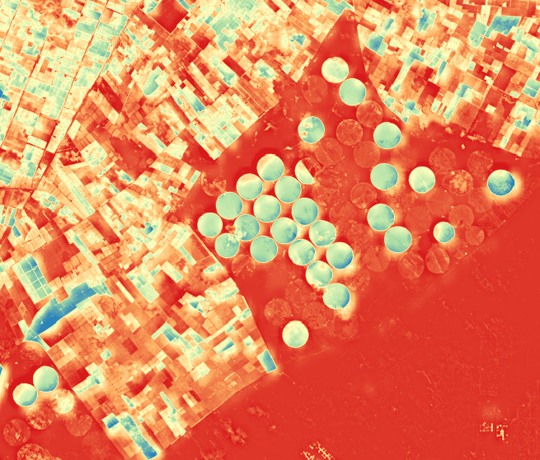
Downscaled WaPOR v3 AETI comparison
WaPOR v3 L2 100m
WaPOR v3 L3 20m
Downscaled 10m
01-01-2023
AETI [mm/day]

Slide 8
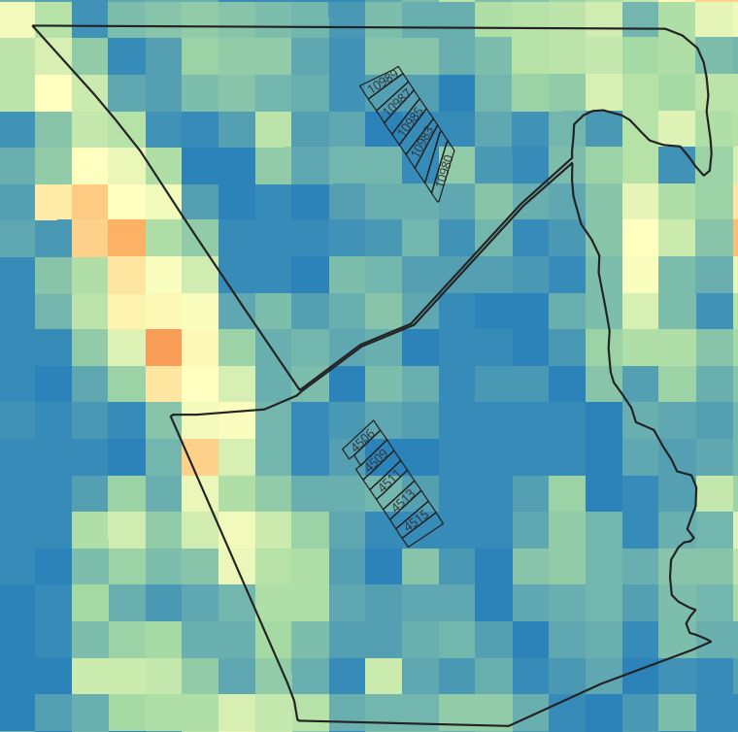
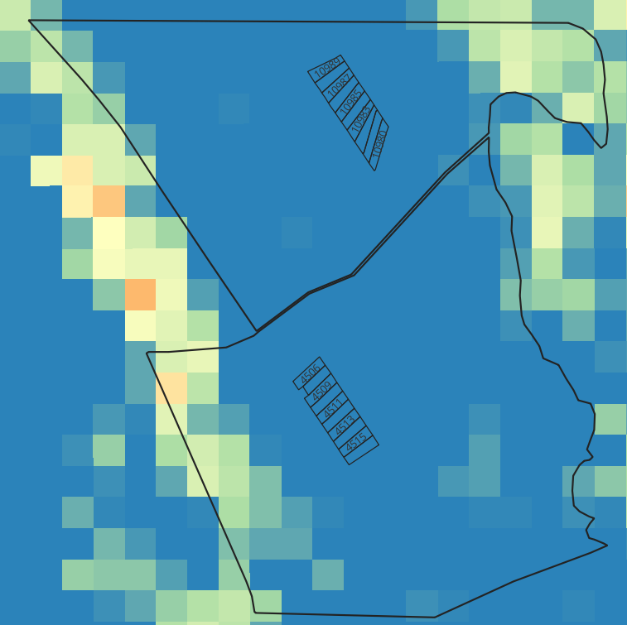
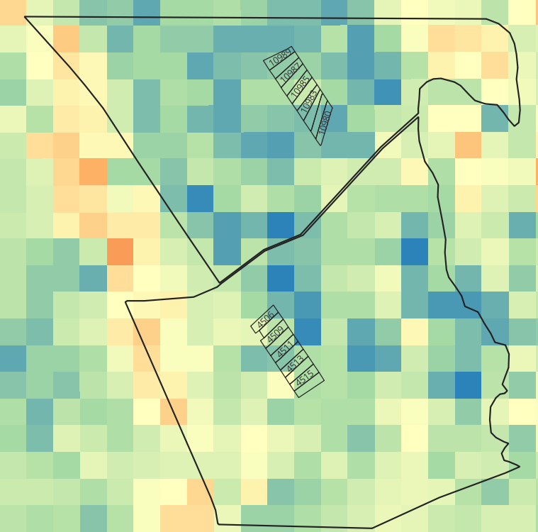
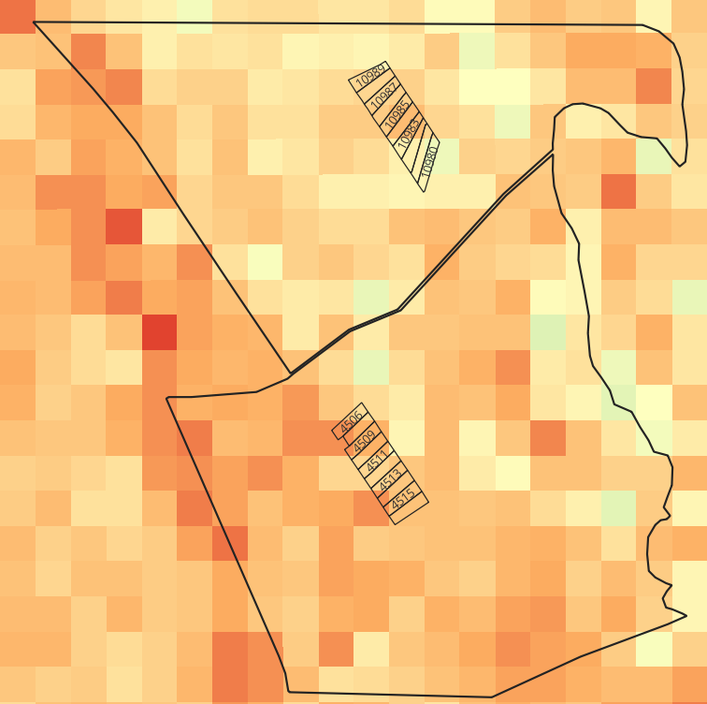
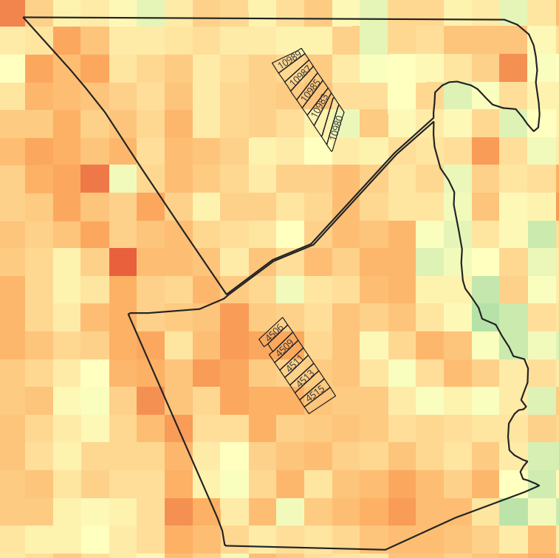
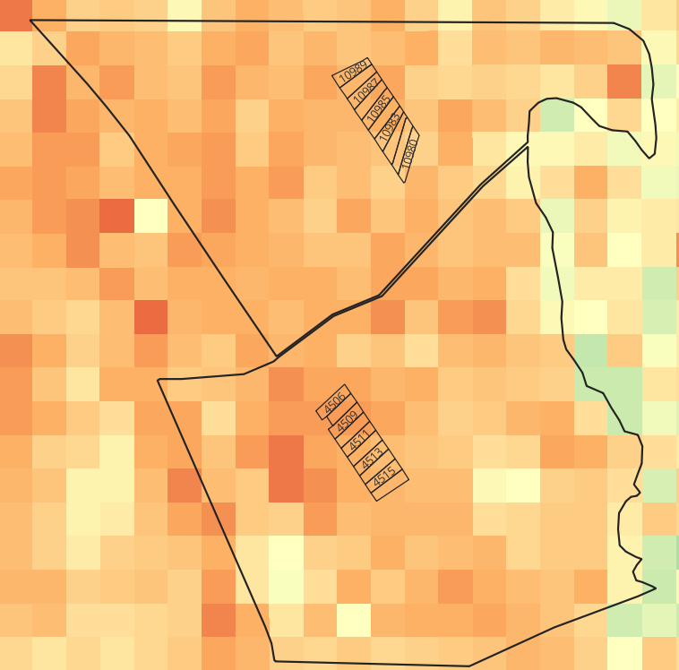
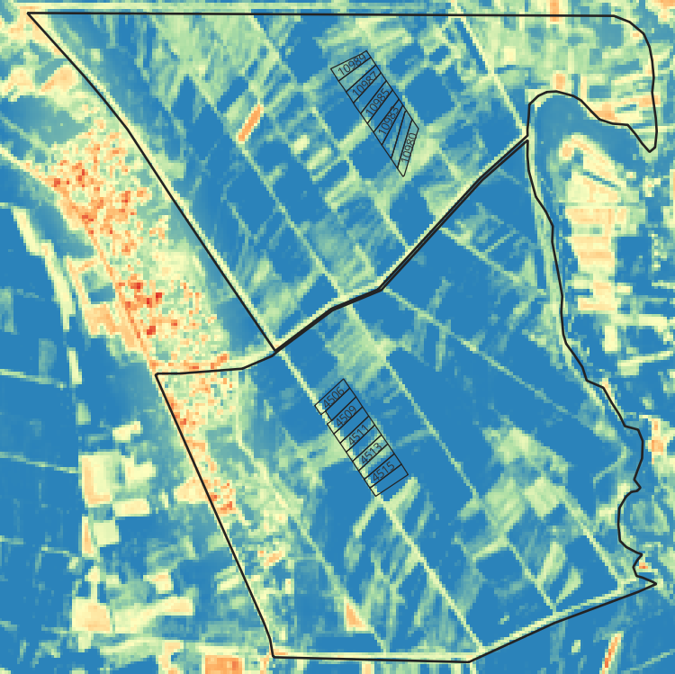
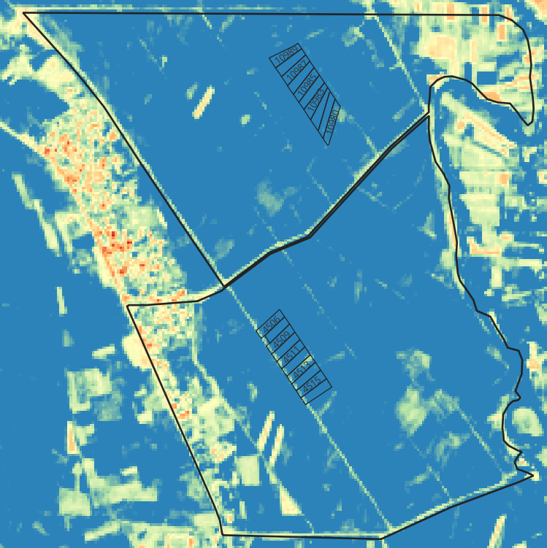
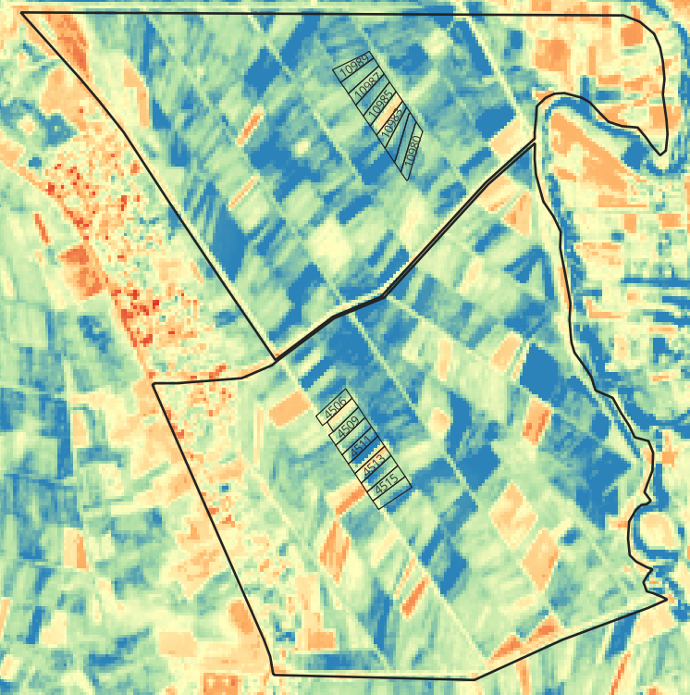
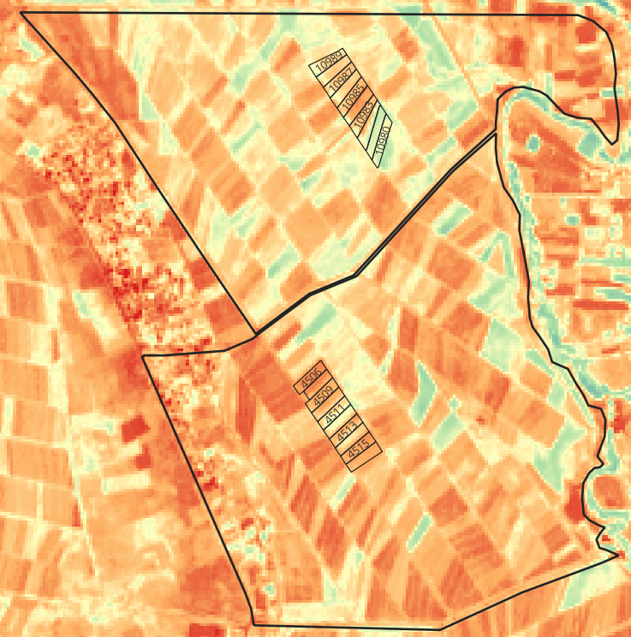
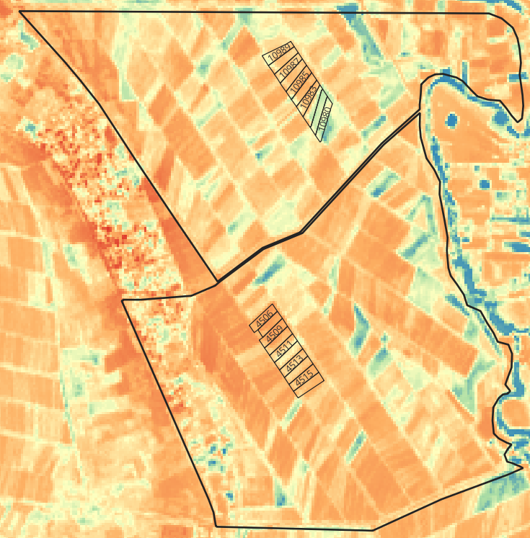
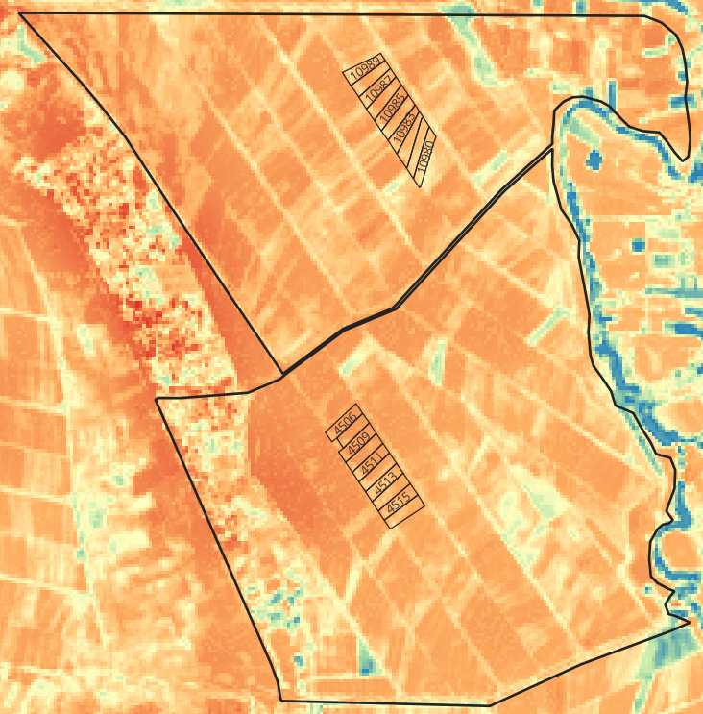

Downscaled WaPOR v2 L2 Actual Evapotranspiration data MWEA Irrigation scheme
22_02
22_03
22_05
22_06
22_07
22_08
100m_WaPOR AETI
10m_Sharpened AETI
AETI [mm/day]

Slide 9
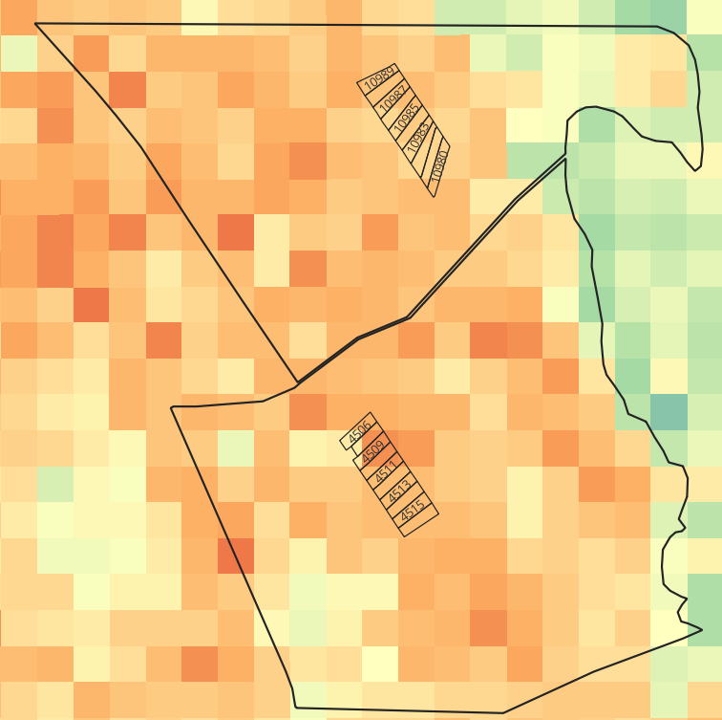
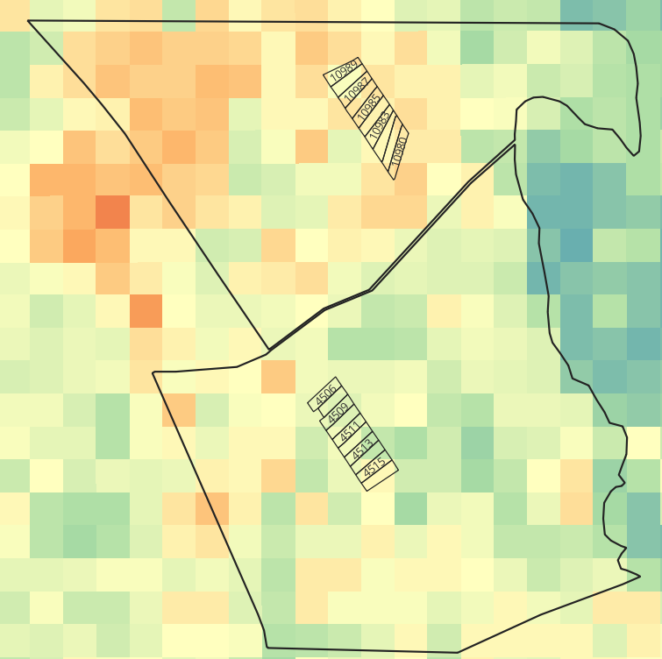
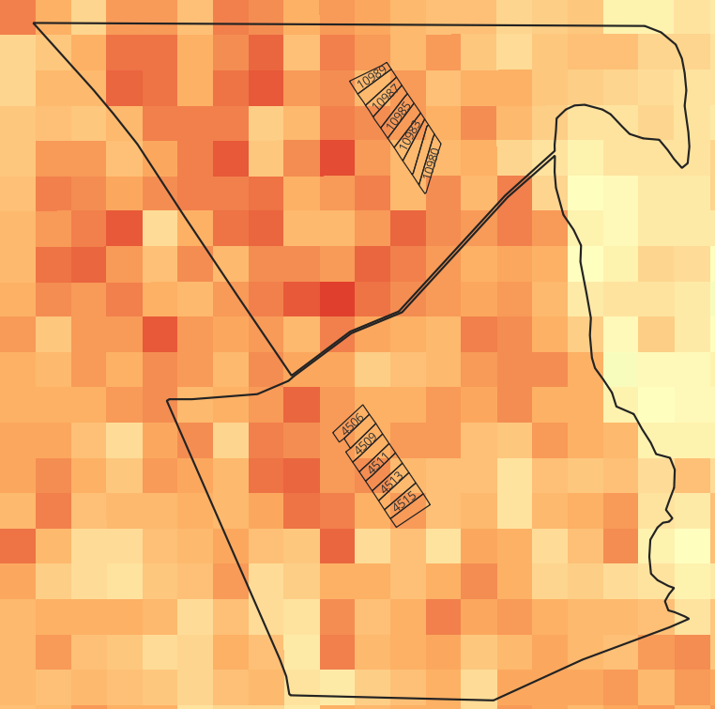
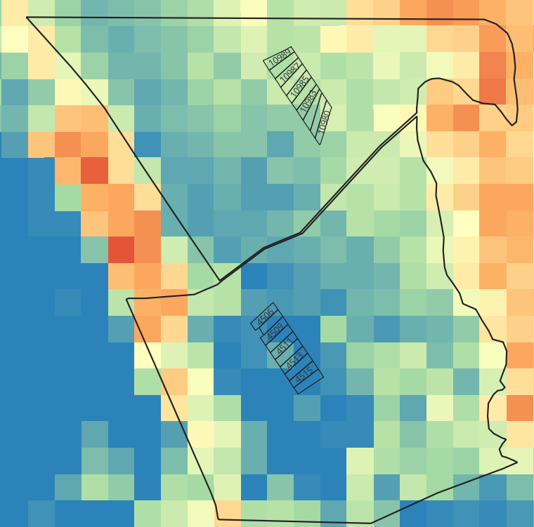
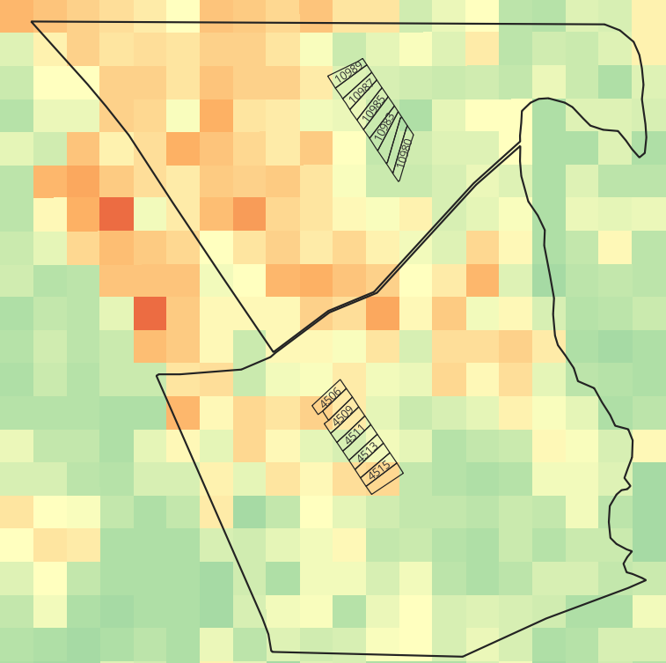
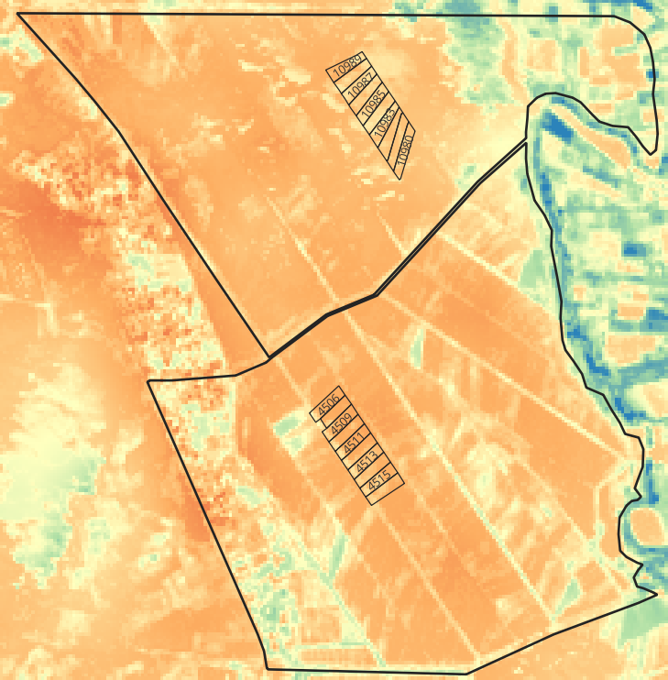
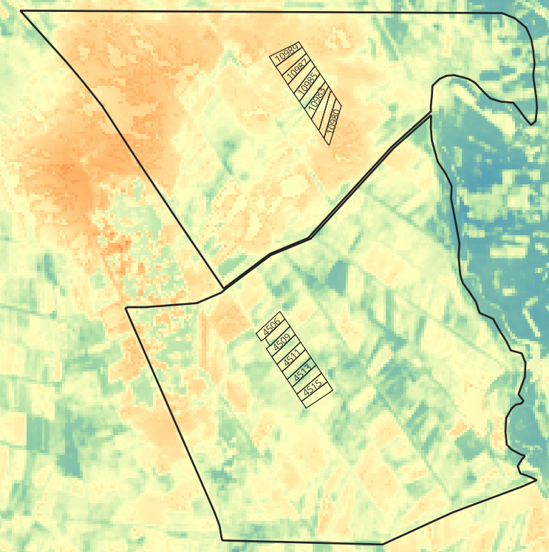
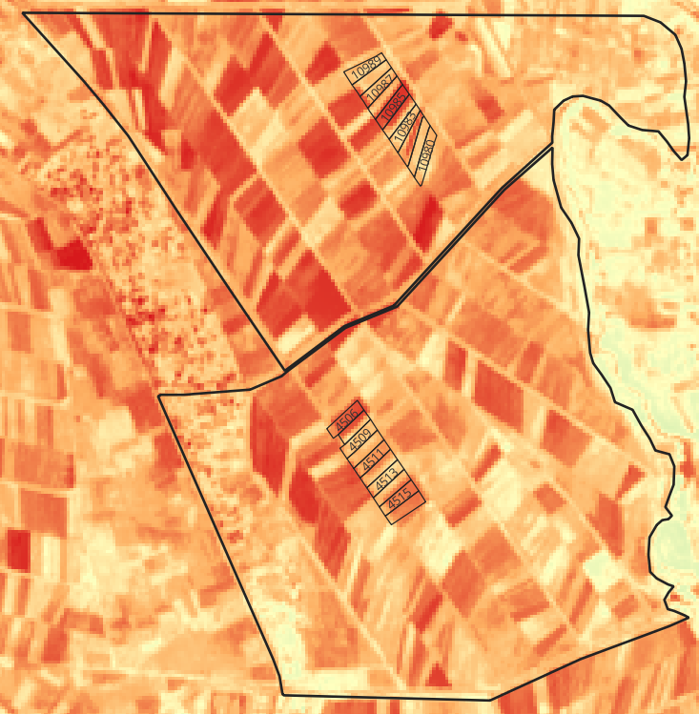
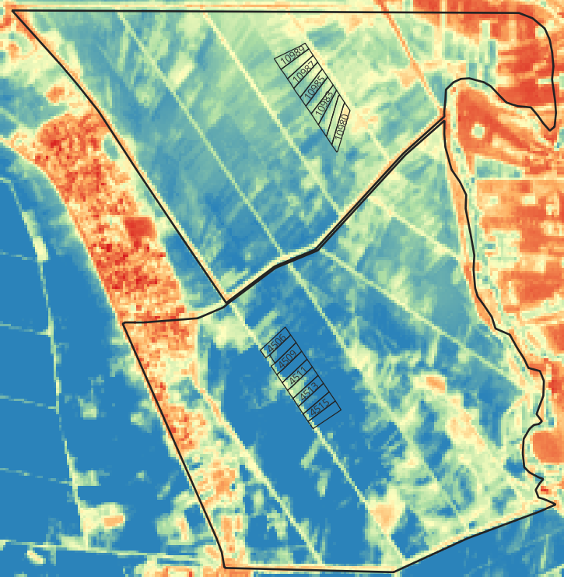
Downscaled WaPOR v2 L2 Actual Evapotranspiration data MWEA Irrigation scheme
22_11
22_14
22_15
22_29
22_34
100m_WaPOR AETI
10m_Sharpened AETI
AETI [mm/day]

Slide 10
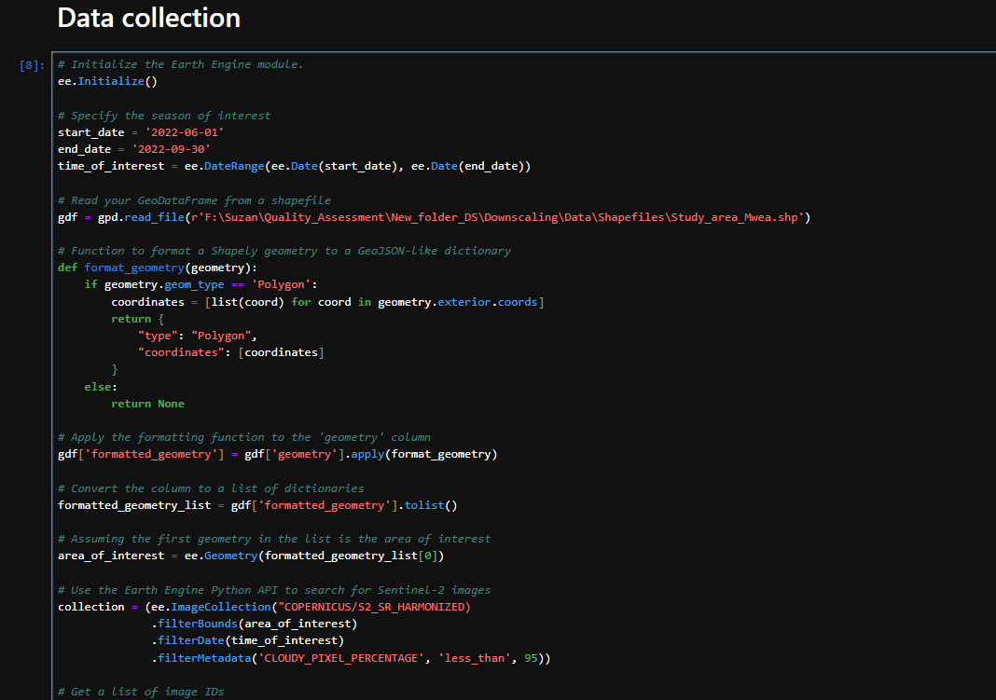
Notebook to Download Sentinel 2 NDVI

Slide 11
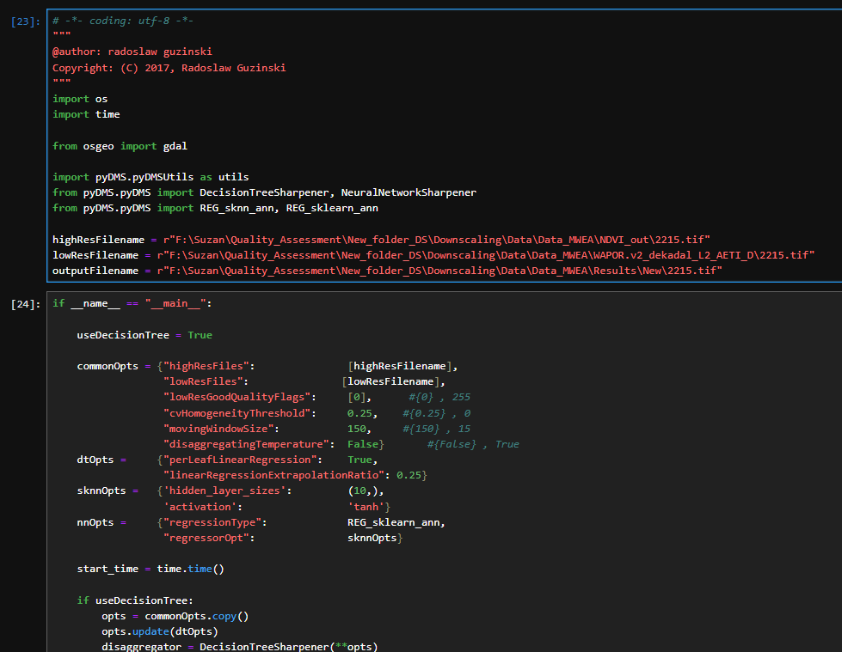
Notebook to run PyDMS

