Slide 1
#2 Exploring the WEF Nexus: Synergies & Trade-offs
Dr. Aidan Senzanje
University of KwaZulu-Natal
South Africa
(14th February 2025)

Slide 2
Content
01
Background
02
WEF Nexus
Water, energy & food resources
Definition, illustration, dimensions/dimensions, interconnections
03
WEF interconnections
04
Conclusion
Synergies, trade-offs and neutrality and their management (case studies)
Managing synergies and trade-offs by the nexus approach

Slide 3
Background: Water, energy & food resources
Water uses energy, energy uses water, agriculture needs both. Humankind and our increasingly urban societies need all three. However, the resources continue depleting.
Challenges, facts and figures:
  By 2030, 47% of the world's population will be living in areas of high-water stress, southern Africa will be the most affected.
By 2050, global population is expected to reach 9 billion. 70% more food will be needed.
Agriculture accounts for roughly 70% of water use (over 60% in South Africa, between 70 and 80% in Southern Africa).
Hydropower provides 20% of the world's electricity and is the main energy source in southern Africa.
By 2030 humankind will need 30% more water, 40% more energy and 10% of existing crop land for biofuels.

Slide 4
What is a nexus?
The word nexus:
            is from the Latin “nectere”, means “to connect”,
            has been used in philosophy, cell biology and economics,
            conveys the interactions (dependencies or interdependencies) between two or more elements.
According to the background paper of the Bonn 2011 Nexus Conference, the nexus approach is defined as:
            “an approach that integrates management and governance across sectors and scales”.

Slide 5
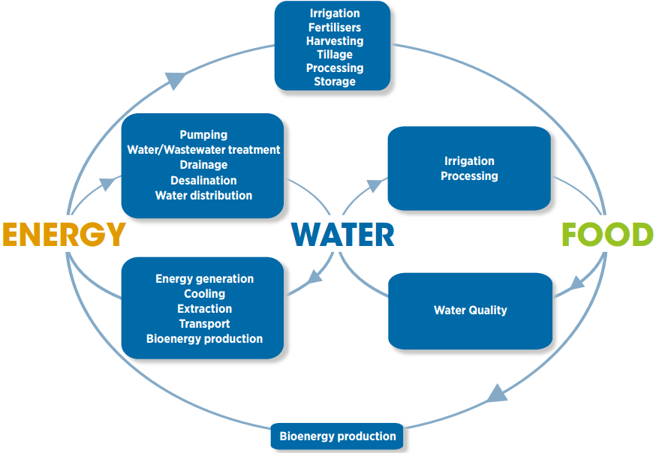
Schematic illustration of various elements of the water–energy–food (WEF) nexus
(IRENA, 2015) adapted from (Mohtar and Daher, 2012)
Notes:
IRENA. 2015. Renewable Energy in the Water, Energy and Food Nexus. International Renewable Energy Agency (IRENA), Abu Dhabi.
Mohtar, R and Daher, B. 2012. Water, energy, and food: The Ultimate Nexus. In: eds. Heldman, DR and Moraru, CI, Encyclopedia of Agricultural, Food, and Biological Engineering. Taylor and Francis, New York, USA.

Slide 6
Dimensions / domains of the WEF nexus
A concept and/or conceptual framework:
understanding of WEF linkages to promote coherence in policy-making and enhance sustainability, e.g., conceptual frameworks.
An analytical tool:
use of quantitative and/or qualitative methods to understand interactions among water, energy, and food systems.
A discourse or governance framework or boundary concept:
for problem framing and promoting cross-sectoral collaboration, e.g., policy dialogues.

Slide 7
WEF interconnections: Water for Energy
Hydropower generation√
Thermal power plant cooling√
(Bio)fuel feedstock production and processing: bioethanol, biodiesel
Fossil fuel: extracting, mining, processing, refining, and disposing fossil fuel residues - conventional and non-conventional
Renewables: cleaning, cooling and maintenance (wind turbines, solar photovoltaic)√
Floating solar: floatovoltaics
Wastewater to energy
Energy sector is the second biggest water user: accounts for about 8-15% of total global water withdrawals, 3% of total global water consumption, and 75% of industrial water withdrawals√
About 90% of global power generation is water-intensive√

Slide 8
WEF interconnections: Energy for Water
Extraction, lifting, moving, distributing, allocating and treating (waste)water√
Heating of water for domestic and industrial uses
Drinking water and wastewater management consumes approximately 4% of global electricity√
Highly energy intensive: groundwater exploitation, water transfers and non-conventional water sources, such as reclaimed wastewater or desalinated seawater√
Oil spills contaminate water sources
Warmer return flows from electric power stations cause thermal water pollution
Hydropower reservoirs can expose the stored water to significant evaporative losses

Slide 9
WEF interconnections: Water for Food
Agro-ecosystems use about 10% (irrigation uses about 2%, virtual water trade accounts for about 2.4%) of precipitation over land masses or 16% (virtual water trade 3.8%) of terrestrial evapotranspiration√
Global water consumption for food production, including crops and livestock, dominates and accounts for about 86% of the total water consumption and 70% of global water withdrawals√
An estimated 78% of the global water footprint of agriculture is contributed by green water and 22% by blue water (i.e., evapotranspiration of irrigation water) (D'Odorico et al., 2018).
Producing one calorie of food energy requires on average about one litre of water√
A water volume of 1,200 m³/year per person is consumptively used for food production√
Processing, preparation and consumption of food relies on reliable access to water
Irrigation contributes 40% of the global crop production and 60% of cereal production on only 20% of the global agricultural land√
Between a quarter and 40% of the global area equipped for irrigation relies on groundwater and approximately 11% of non-renewable groundwater use for irrigation is embedded in international food trade
Irrigation with wastewater contributes essential nutrients for crop production.

Slide 10
WEF interconnections: Food for Water
Surface and groundwater depletion
Human disruption of the water cycle.
Agriculture is the single-largest polluter (non-point- and point-source) of surface water and groundwater√
Land (soil) degradation: soil erosion, reduced infiltration and run-off, groundwater recharge, water (surface and ground) quality (e.g., eutrophication, contamination, salinity) and overall efficiency of water and land use for other ecosystem services.
Reduce oxygen levels (hypoxia) in water, water pollution and acidification.
Reduced soil water storage, siltation and reduced storage of water bodies.
Irrigated and rainfed agriculture collectively accounts for about 10% of global precipitation over land, with green water flows from agroecosystems contributing to roughly 16% of the global evapotranspiration from terrestrial ecosystems√
Food loss and waste stands at more than one-third of the produced food and almost one-fifth of all food available to consumers, and representing 24% of the estimated water used for agriculture globally√

Slide 11
WEF interconnections: Energy for Food
Agricultural mechanization and other modernization measures
Production of agrochemicals (e.g., fertilizers) is energy-intensive
Land preparation, irrigation (including water pumping), crop management, harvesting
Processing, packaging, transporting, storage and/or handling (refrigerating), food safety, and preparing of food.
Close correlation between crop and oil prices as evidenced during the 2007/2008 global food crisis
Food production and supply chain is responsible for around 30% of total global energy demand.
Irrigation is generally more energy intensive than rainfed agriculture
Pressurised irrigation is more energy intensive than flood irrigation
Irrigation pumping is responsible for the highest portion (1896 petajoules: 15-48%) of direct energy consumption allocated for crop production
Energy represents around 40% of the total water costs (around 40%)
Groundwater pumping for irrigation is energy-intensive and accounts for 89% of the total energy consumption in irrigation.

Slide 12
WEF interconnections: Food for energy
Agricultural products such as sugarcane and their residue and waste, such as cow dung, are used as feedstock in bioenergy production, including biofuels (e.g., ethanol, methanol, biodiesel) and biogas.
Agriculture biomass contributes more than 30% of global household energy for heating, cooking and lighting.
Mining for fossil fuels or deforestation for cultivation of biomasses (feedstock) for energy production (e.g., biofuels) by the energy sector reduces available land and water thus negatively impact food production (and other vital ecosystem services).
Production of biofuels is highly water and land-intensive depending on crop type, climate, soil conditions, and farm practices, using about 2 - 7% of global cropland and withdrawing 44 km3/year of water of which 16 km3/year is consumed.
On average, producing 1 litre of liquid biofuel and food for one person for one day uses about the same amount of water.
High demand for biofuels contribute to higher cereal prices on world markets.
Coal mining for energy production threatens food security through direct competition for land and water and degradation of these strategic resources.
Food loss and waste stands at more than one-third of the produced food and almost one-fifth of all food available to consumers, and with it about 38% of the energy consumed in the agrifood chain and an equivalent of nearly 30% of the world’s agricultural land.

Slide 13
WEF interconnections: Nature of relationships
Synergies/co-benefits (Greek word “synergos”) means to “work together” or “co-operate”:
➤ experienced when the policies or actions in one sector lead to more than additional or similar benefits in achieving the goals of another sector.
➤ an action that two or more actors take together whose coordinated effort potentially multiply benefits and reduces investment efforts than by acting separately.
Trade-offs (negative Interaction or externalities): ➤ experienced when the policies or actions in one sector reduce the chances of achieving the goals in another sector.
➤ a balance achieved between two desirable but incompatible features or a sacrifice made in one area to obtain benefits in another.
Neutrality:
experienced when the policies or actions in one sector have no significant influence on other sectors.

Slide 14
WEF interconnections: Synergies, trade-offs and neutral relationships …1
Action | Synergy | Trade-off | Cases
➤ Irrigation modernisation: from open-channel gravity-fed surface systems to pumped pressurised (drip and sprinkler) irrigation systems | ➤ Decrease in water use at the national level | ➤ Change to water-intensive crop rotations ➤ Increase in energy demand and consumption for pumping ➤ Increase in costs for amortisation, operation and maintenance ➤ Increased greenhouse gas emissions | ➤ Spain ➤ India ➤ Viet Nam ➤ Australia (Murray-Darling Basin) ➤ Mediterranean region ➤ China
➤ Monoculture production and use of biomass for bioenergy | ➤ Reduced greenhouse gas (GHG) emissions ➤ Energy security ➤ Economic development ➤ Import substitution ➤ Foreign exchange savings ➤ Improvement of ambient air quality | ➤ Land conversion and degradation ➤ Food insecurity (availability, affordability, crop substitution) ➤ Increased competition for and scarcity of land and water for food production | Sub Saharan Africa Brazil United States Southeast Asia

Slide 15
WEF interconnections: Synergies, trade-offs and neutral relationships …2
Action | Synergy | Trade-off | Cases
➤ Agricultural expansion and mechanisation | ➤ Increased agricultural production, yields and productivity ➤ National economic growth | ➤ High rates of deforestation leading to carbon emissions and biodiversity losses ➤ Groundwater pollution ➤ Land degradation | ➤ Brazil
➤ Subsidies for energy, water and other inputs ➤ Electrification | ➤ Increased agricultural production ➤ Increased in irrigation efficiency and flexibility ➤ Increased agricultural production ➤ Agricultural and economic development ➤ Increased income | ➤ Increased water and energy consumption ➤ Degradation of natural resources ➤ Increased greenhouse gas emissions (GHGs) ➤ Reduced nutritional security ➤ Unstable power grid due to over-usage ➤ Prevalence of waterborne diseases (human health) | ➤ Syria ➤ South Asia ➤ Indo-Gangetic Plain ➤ India (West Bengal, Punjab, Haryana, and Andhra Pradesh) ➤ Pakistan ➤ Nepal ➤ Bangladesh ➤ Morocco

Slide 16
Conclusion
WEF interconnections exist, e.g., between interconnected WEF resources/sectors, climate action, sustainable development (pillars/dimensions, themes, goals, and targets).
The WEF nexus approach seeks to:
unpack, uncover and understand interconnections between WEF resources and sectors through frameworks and tools/models,
balance trade-offs and synergies,
minimise trade-offs and maladaptation,
create and strengthen synergies,
integrate and harmonise policies and actions.

Slide 17

Thank You!
Do you have any questions?
senzanje@gmail.com

