Slide 1
Significance of WEF Nexus as an Analytical Tool: Introduction to WEF Nexus Modelling
Luxon Nhamo
Sylvester Mpandeli
Virtual WEF Nexus Masterclass
13-15 May 2025

Slide 2
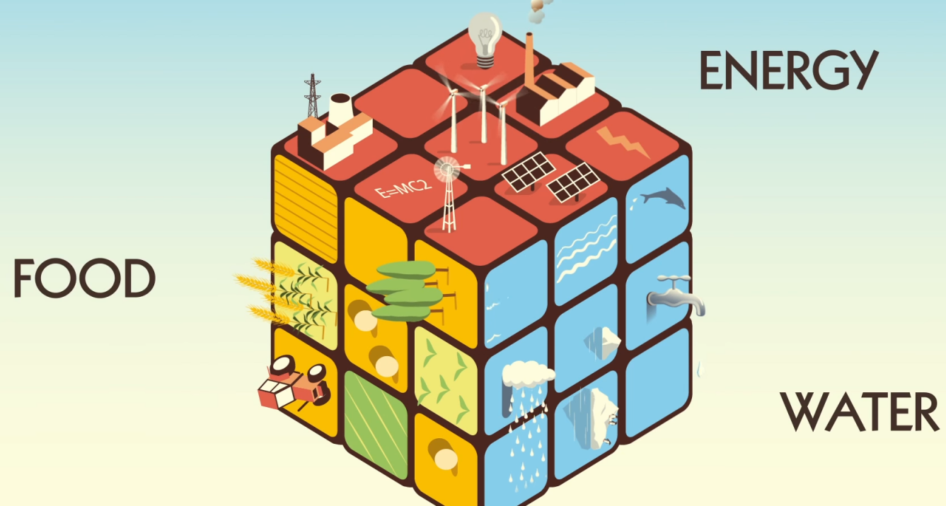
Contents
Defining nexus planning/thinking
Benefits of adopting nexus planning
Types of nexus planning
Linking SDGs with nexus planning
WEF nexus sustainability indicators
Nexus composite indices
Concluding remarks

Slide 3
The cross-cutting challenges require cross-sectoral interventions
DRIVERS OF CHANGE
RISK AND EXPOSURE
PREPAREDNESS AND RECOVERY
ADAPTATION AND RESILIENCE
Southern Africa will be able to provide only 13% of its food requirements by 2050
15% decrease in yields by 2050 if global temp increases by 2°C affecting 60% of pop in rural areas
Drivers of change
  Rapid urbanization
  Climate change
  Agriculture expansion
  Shrinking food basket
  Population growth
Risks to livelihoods, human and environmental health, and sustainable development
Transformative approaches
Water, energy and food security
Resilience and adaptation
Improved livelihoods and nutrition
  Nexus planning
  Scenario planning
  Circular economy
  Sustainable food systems
  Just Transition
75-250 million people in 2020 and 350-600 million in 2050 at risk of increased water stress
About 45% of people in Africa have no access to clean energy (about 600 million people)
SOCIETAL AND ENVIRONMENTAL FEEDBACKS

Slide 4
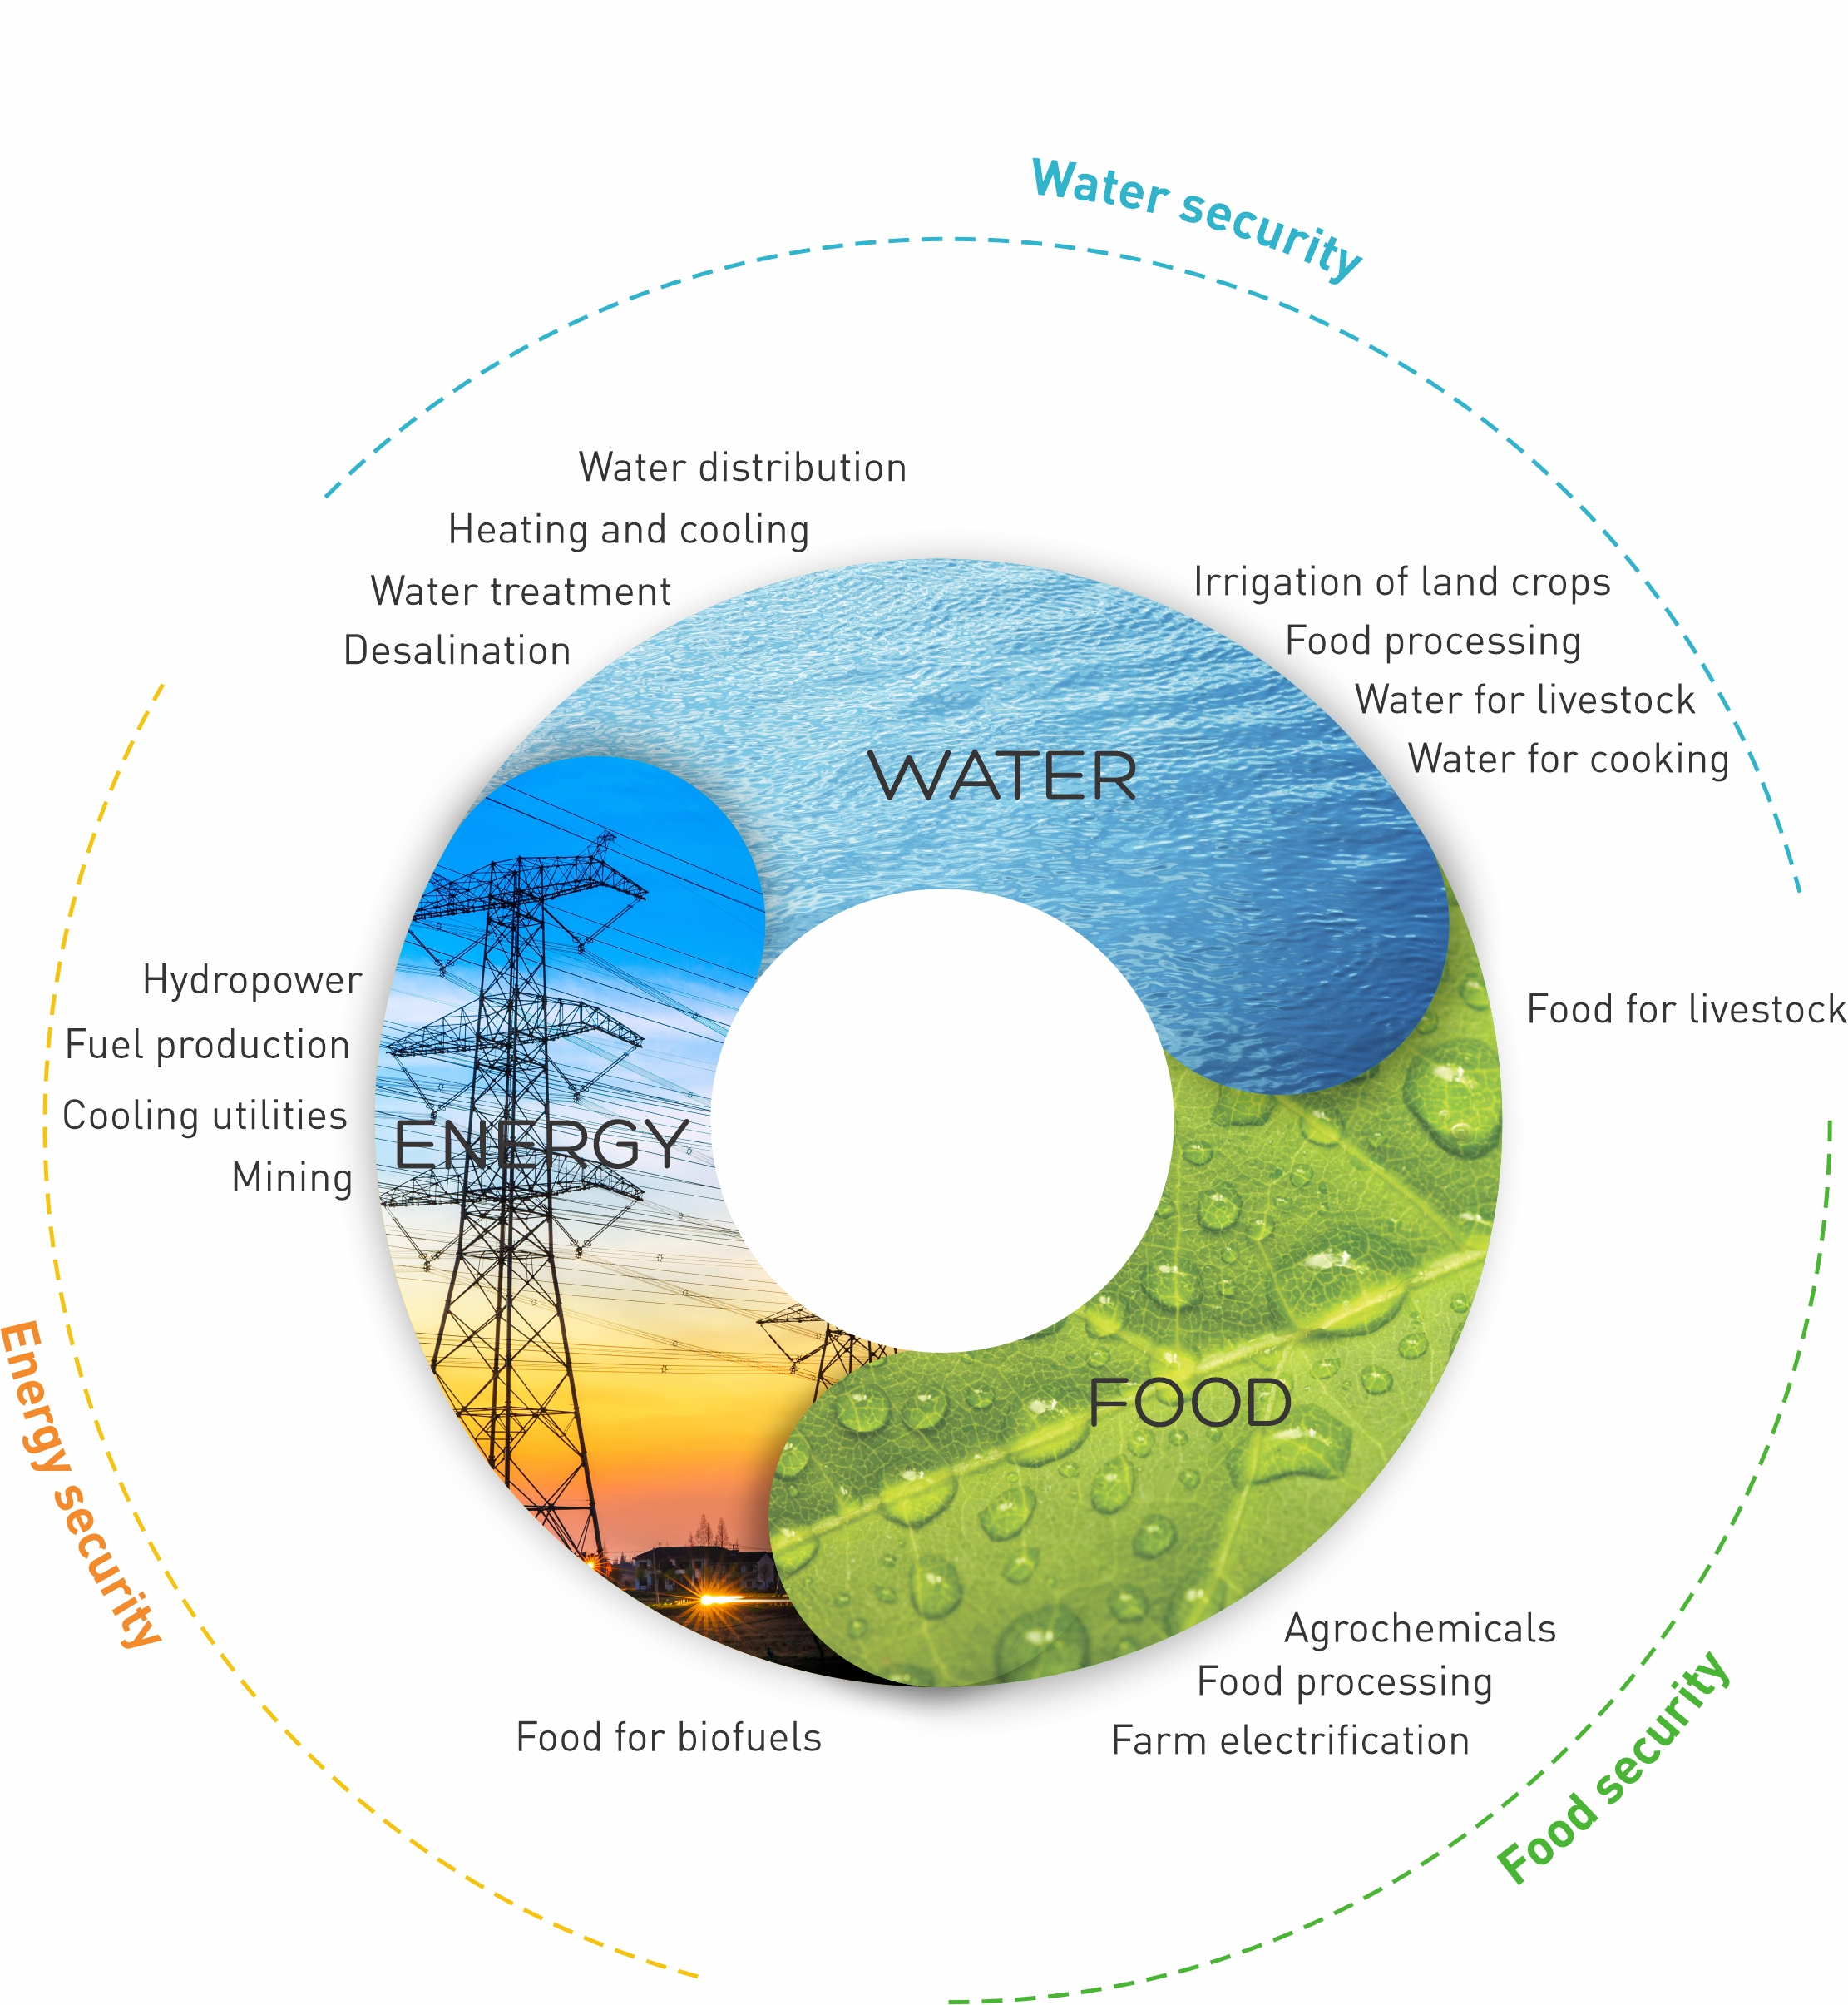
Why WEF Nexus: Its significance as a transformative approach
Water, Energy and Food (WEF) sectors are linked to each another. Any shock in any one of these sectors impacts the other two: e.g., irrigated area expansion
Most of natural resources on the continent are transboundary in nature:
  Population increase in downstream countries. Upstream countries may get reduced water supplies as downstream populations increase and use more water to meet their own needs (e.g. the Renaissance Dam in Ethiopia).

Slide 5
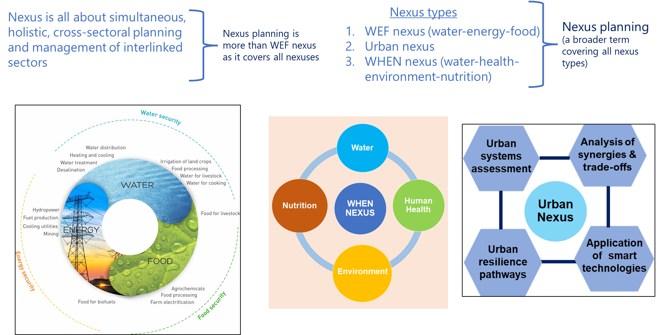
Defining WEF nexus or planning/thinking

Slide 6

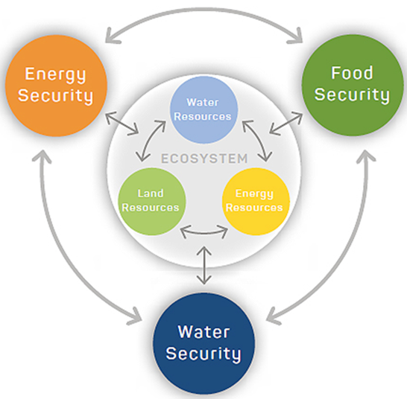

The WEF nexus and its complexity
The essence of the WEF nexus
Security of the intricately connected three resources.
Developments in one sector should only be implemented after considering the impacts on other sectors (trade-offs and synergies) (irrigated area expansion).
Cross-sectoral management of resources (break silos).
The concept is multi-faceted, transdisciplinary, multidimensional and polycentric, making it complex
Multi-criteria decision method (MCDM)
Attributes of WEF resources security
Availability
Accessibility
Self-sufficiency
Productivity

Slide 7
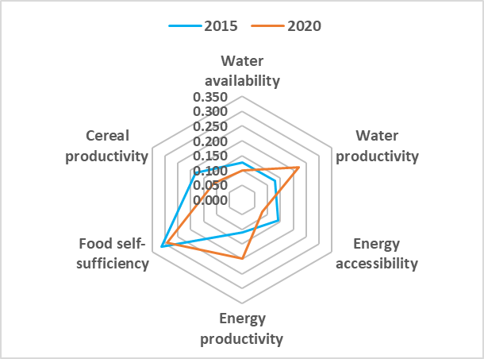
WEF nexus indicators and progress in South Africa between 2015 and 2020
Sector | Indicator | Units | Pillars
Water | Proportion of available freshwater resources per capita (availability) | m³/capita | Affordability Stability Safety
 | Proportion of crops produced per unit of water used (productivity) | $/m³
Energy | Proportion of the population with access to electricity (accessibility) | % | Reliability Sufficiency Energy type
 | Energy intensity measured in terms of primary energy and GDP (productivity) | MJ/GDP
Food | Prevalence of moderate or severe food insecurity in the population (self-sufficiency) | % | Accessibility Availability Affordability Stability
 | Proportion of sustainable agricultural production per unit area (cereal productivity) | kg/ha
Indicator | Composite indices
 | 2015 | 2020
Water availability | 0.126 | 0.099
Water productivity | 0.128 | 0.221
Energy accessibility | 0.141 | 0.079
Energy productivity | 0.111 | 0.199
Food self-sufficiency | 0.314 | 0.292
Cereal productivity | 0.180 | 0.111
WEF integrated index | 0.155 | 0.203

Slide 8
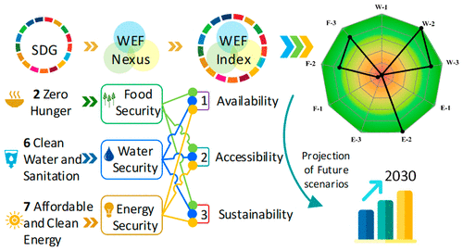
WEF nexus indicators and relationships with SDGs
Sector | WEF nexus Indicator | Pillars | Related SDG indicator
Water | Proportion of crops/energy produced per unit of water used (productivity) Proportion of available freshwater resources per capita (availability) | Affordability Stability Safety | 6.4.1: Change in water-use efficiency over time 6.4.2: Freshwater withdrawal as a proportion of available freshwater resources
Energy | Proportion of population with access to electricity (accessibility) Energy intensity measured in terms of primary energy and GDP (productivity) | Reliability Sufficiency Energy type | 7.1.1: Proportion of population with access to electricity 7.3.1: Energy intensity measured in terms of primary energy and GDP
Food | Prevalence of moderate or severe food insecurity in the population (self-sufficiency) Proportion of sustainable agricultural production per unit area (cereal productivity) | Accessibility Availability Affordability Stability | 2.1.2: Prevalence of moderate or severe food insecurity in the population 2.4.1: Proportion of agricultural area under productive and sustainable agriculture

Slide 9
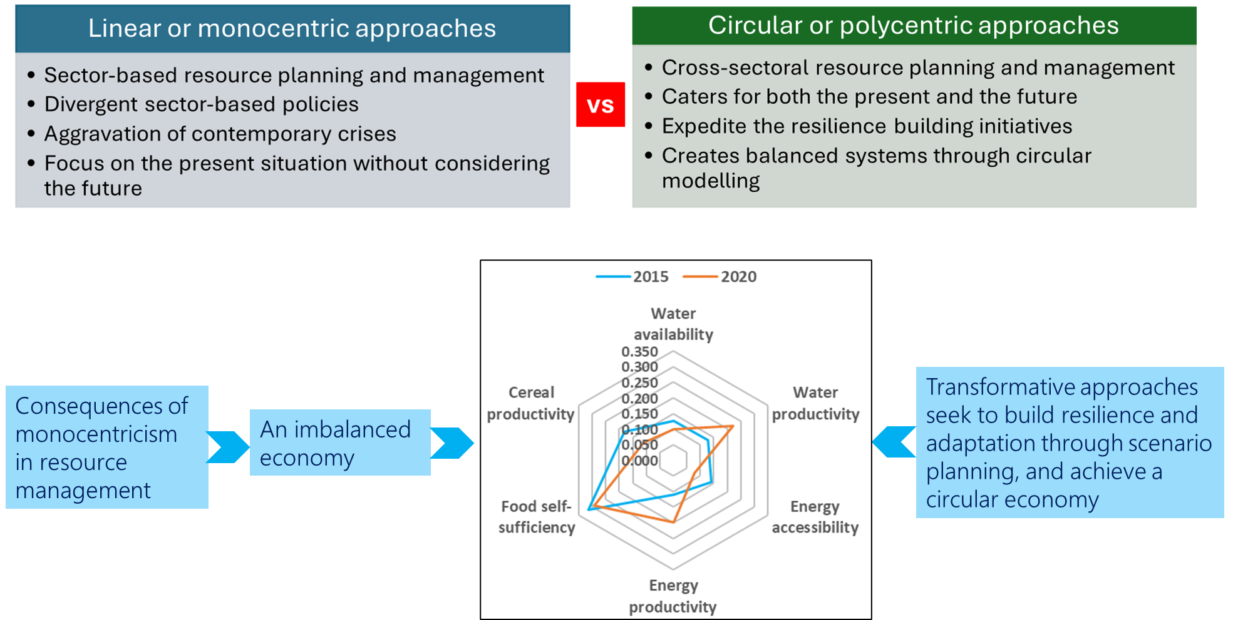
Linearity vs Circularity: Which path to follow

Slide 10
The WEF Nexus: A catalyst towards sustainability
The connections between the water, energy, food and ecosystems, together with the synergies, conflicts and trade-offs that arise from their management (e.g. water for food and food for water,….)
A multicentric lens for assessing integrated resources management and sustainable development

Slide 11
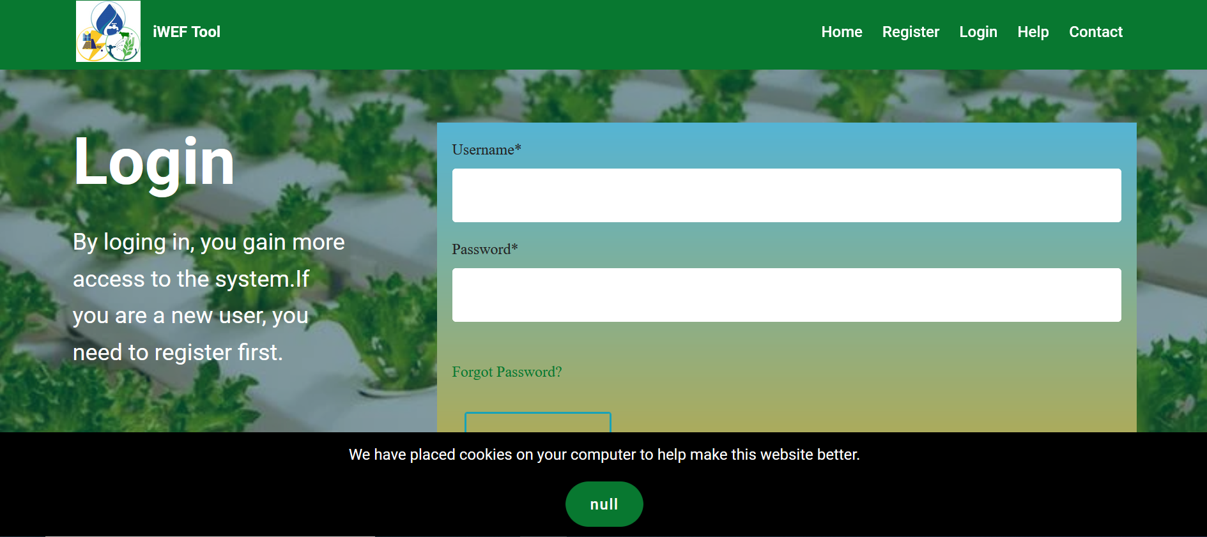
The iWEF online tool
https://www.iwef.app/login/

Slide 12
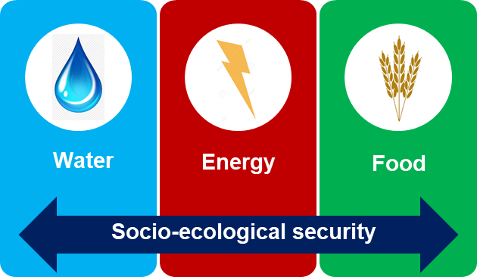
Concluding remarks
The WEF Nexus provide pathways towards sustainable development.
Today’s challenges are cross-cutting and therefore require cross sectoral interventions that guide the transformational agenda.
It is an important tool to assess progress towards SDGs.
Its use is enhanced by integrating other transformative approaches such as scenario planning, circular economy, just transition and horizon scanning.

Slide 13
THANK YOU

