Slide 1
Conceptual understanding of Water-Energy-Food (WEF) nexus
Sylvester Mpandeli & Luxon Nhamo
Virtual WEF Nexus Masterclass 2025
13-15 May 2024

Slide 2
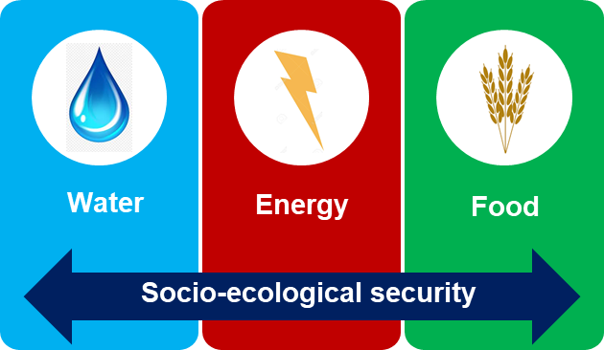
Presentation Outline
What is nexus ?
Nexus configurations
WEF nexus concept
WEF nexus research
Difference with other integrated methods
Criticisms of the WEF Nexus Concept
Conclusions

Slide 3

What is nexus ?
The word nexus, (from the Latin “nectare”), means “to connect”. It has been used in philosophy, cell biology and economics. This word conveys the interactions (dependencies or interdependencies) between two or more elements.
According to the background paper of the Bonn 2011 Nexus Conference, the nexus approach is defined as “an approach that integrates management and governance across sectors and scales”

Slide 4

Background
What is the WEF nexus?
Water uses energy, energy uses water, agriculture needs both. Humankind and our increasingly urban societies need all three. However, the resources continue depleting.
Challenges, facts and figures
In 2030, 47% of the world's population will be living in areas of high-water stress, southern Africa will be the most affected
By 2050, global population is expected to reach 9 billion. 70% more food will be needed
Agriculture accounts for roughly 70% of water use (over 60% in South Africa)
Hydropower provides 20% of the world's electricity and is the main energy source in southern Africa
By 2030 humankind will need 30% more water, 40% more energy and 10% of existing crop land for biofuels

Slide 5
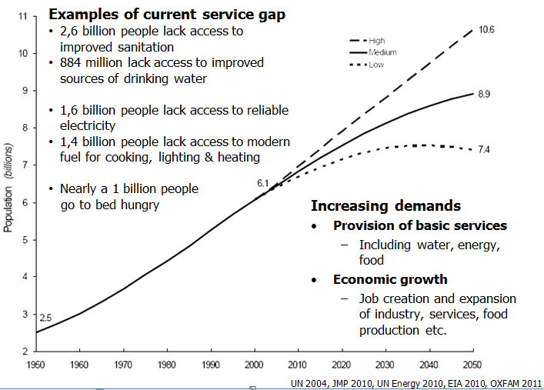
Background (cont.)

Slide 6

Benefits of Nexus Approaches
Uncover synergies
multi-sectoral systems analysis reveals that urine separation technology (UST), which requires less water than conventional methods, could lead to a 10% reduction in water needs, lowering the energy use in water supply by about 10% and wastewater treatment by nearly 25%
Detect trade-offs among sectors,
Trade-offs occur in drier regions where farmers choose between multiple types of crops that have different water and energy demands
Unveiling unexpected consequences
biofuels emissions were proposed as part of the solution to increased CO2 from burning fossil fuels, but unexpected side effects occurred (e.g. water scarcity as their production, processing and distribution)
Promote cooperation, coordination and policy coherence
A nexus approach has been incorporated into a hydro-economic systems model and scenario analysis to investigate resource security and allocation in a River Basin
Achieving the SDGs
The achievement of the SDGs requires all relevant stakeholders to work together and manage the synergies and trade-offs among different management or governance sectors (for example, food, health, water and energy)

Slide 7
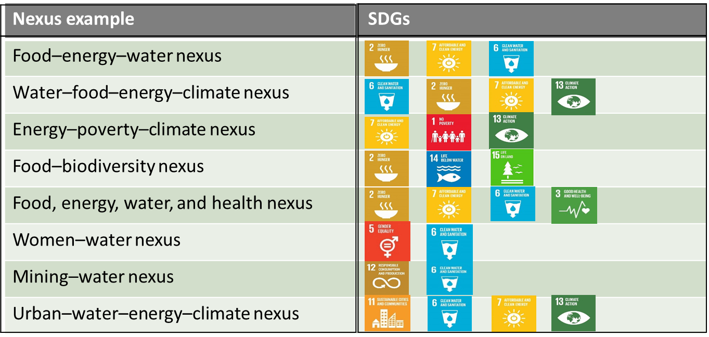
Nexus Configurations
They are several nexus configurations or examples (e.g. Women–water nexus, Food–energy nexus, etc).
  Most nexus studies focus on two sectors, such as energy and water, water and food, food and energy or food and biodiversity;
  Amongst the various nexus configurations, the water-energy-food (WEF) nexus has garnered particular interest.
      due to the finite and indispensable nature of each of these resources;
      ever-increasing demand for them due to population growth and changes in consumption patterns.

Slide 8
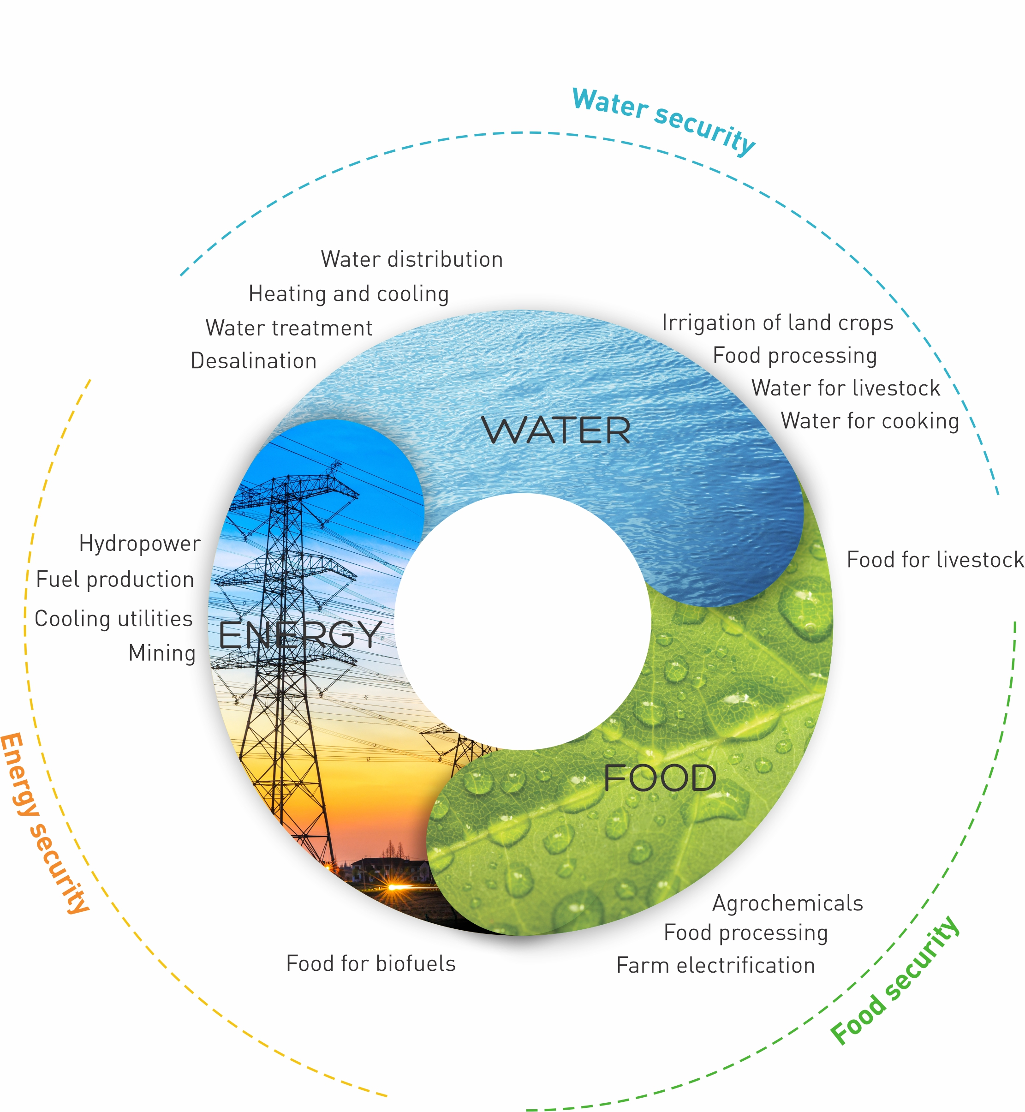
WEF Nexus Concept
The connections between the water, energy, food and ecosystems, together with the synergies, conflicts and trade-offs that arise from their management (e.g. water for food and food for water,….)
A multicentric lens for assessing integrated resources management and sustainable development in the past decade
It can be used as a:
  Conceptual framework
  Analytical tool
  Discourse

Slide 9
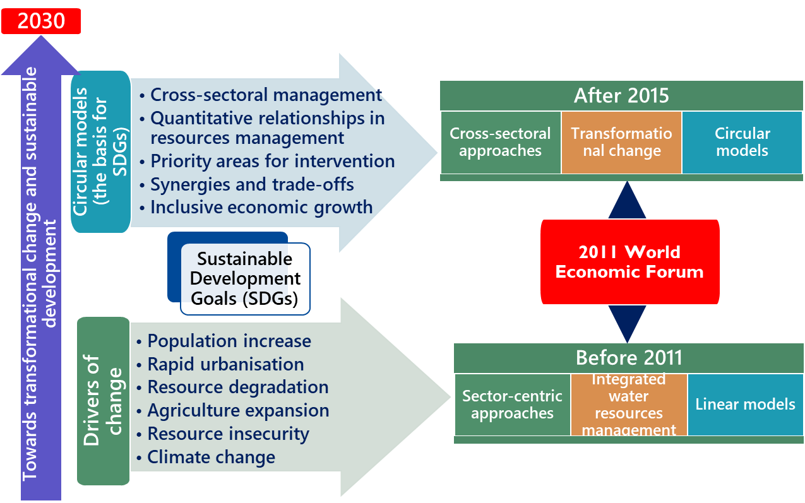
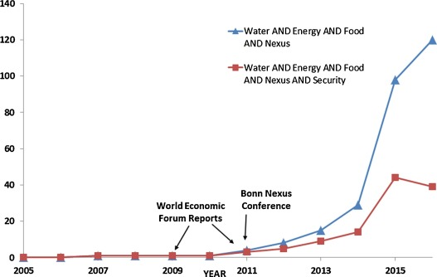
WEF Nexus Research: Its evolution

Slide 10
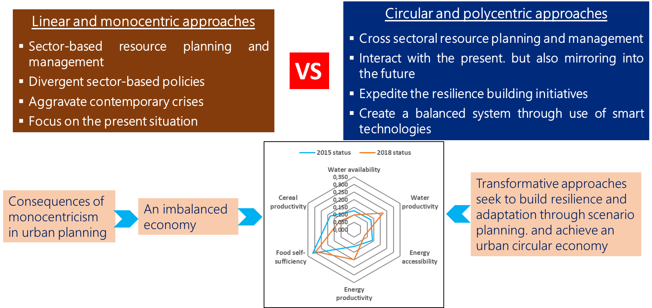
Difference with other integrated methods

Slide 11
Difference with other integrated methods (cont.)
Integrated Water Resources Management (IWRM), soft path, planetary boundaries
  being water-focused (e.g. IWRM)
  Failure to garner the necessary cross-sectoral support to move an integrated management concept beyond its core sector
  suffered from implementation problems
WEF nexus
  builds on many of these approaches
  multicentric, with each sector being treated with equal importance, removes the institutional“silos” that are so prevalent in governance and policy circles
  emphasizes on the importance of understanding linkages among sectors
  stronger demand for operationalization

Slide 12

Criticisms of the WEF nexus
The critiques are at the three levels: concept, application, and outcome/impact
At the concept level:
    not “new”
    still evolving and relatively immature
    narrative but not useful in applications
    lack of common definitions, methods, and frameworks
    not fully acknowledged on the ground and lacks publicity due to underrepresentation of private sectors and media in its activities

Slide 13
Concluding remarks
Nexus planning provides the pathways to sustainable development.
Today’s challenges are cross-cutting, and therefore require cross sectoral approaches that lead to transformational change.
As a transformative approach that assesses the spatio-temporal management of resource, it is an important tool to assess progress towards SDGs.
Its use is enhanced by integrating other transformative approaches such as scenario planning, circular economy and sustainable food systems.
WEF nexus is only one of the many nexuses that are available in literature.
Nexus planning is not a panacea of the many existing challenges, but it provides valuable information on resource management and sustainable development.

Slide 14
THANK YOU
2024

