Slide 1
Institutions as an enablers of the Water-Energy-Food Nexus
Institutional coordination for sustainable resource management

Slide 2
Introduction to the Water-Energy-Food Nexus
Water, energy, and food systems are highly interconnected.
Decisions in one sector affect outcomes in the others.
The nexus requires an integrated planning
The WEF Nexus approach can results in resource efficiency.

Slide 3
Governance Challenges in the WEF Nexus
Sectoral silos and weak coordination
Competing mandates and priorities
Limited data sharing
Inadequate financing and technical capacity
Weak enforcement of policies and regulations

Slide 4
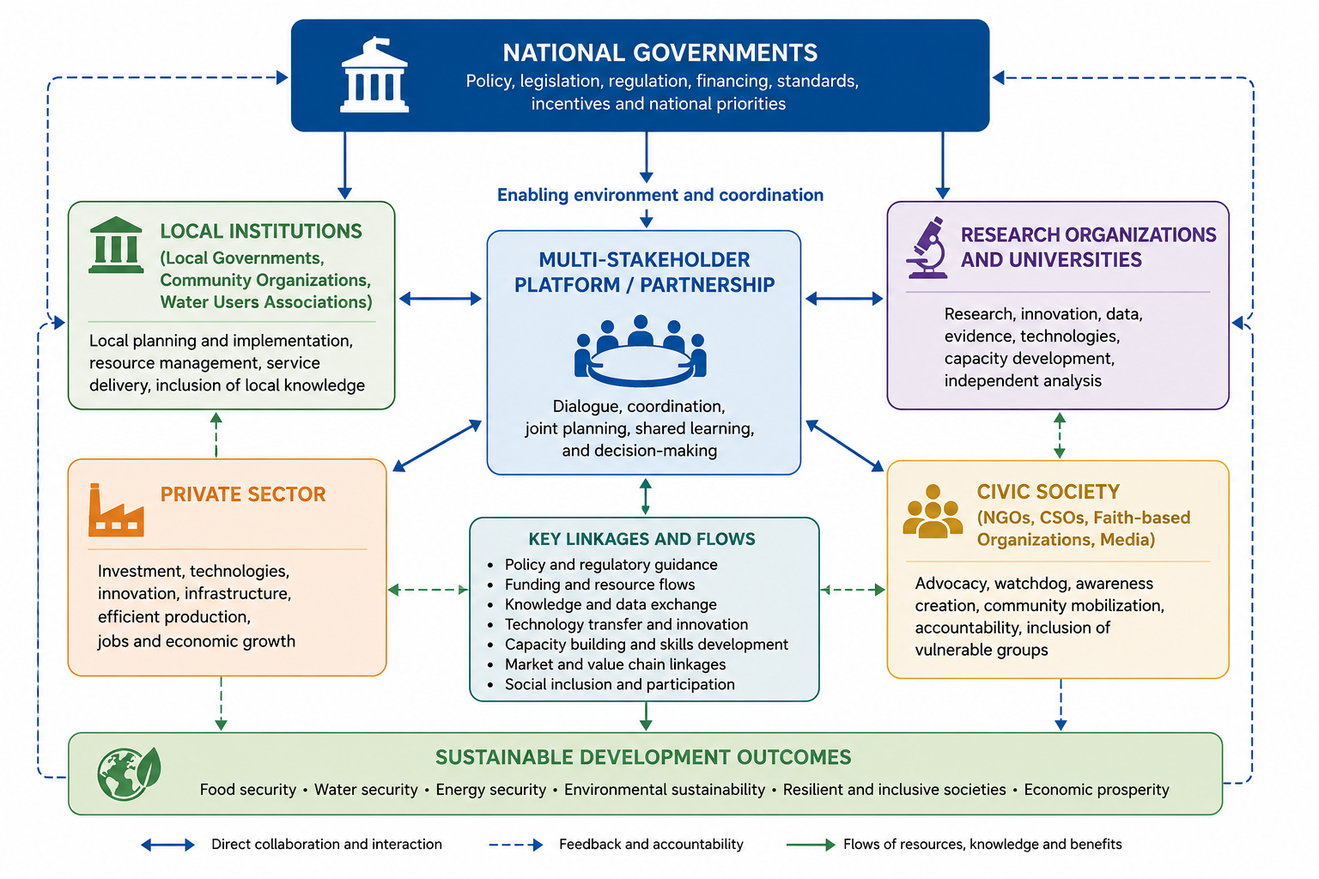

Slide 5

Why Institutions Matter in WEF
Institutions shape policies, regulations, incentives, and governance systems.
They coordinate actors across sectors and scales.
Strong institutions reduce fragmentation and improve resource allocation.

Slide 6
Key Institutional Functions
Policy formulation and implementation
Coordination across ministries and sectors
Resource regulation and monitoring
Conflict resolution and stakeholder engagement
Research, innovation, and capacity development

Slide 7
Case for Institutions in WEF
Water scarcity affects both energy generation and food production.
Climate variability intensifies resource competition.
Integrated institutions improve resilience and sustainability.

Slide 8
Institutional Enablers of the WEF Nexus
Clear policy frameworks
Cross-sector collaboration
Reliable data and information systems
Stakeholder participation
Capacity development and financing

Slide 9
Conclusion
Effective institutions are central to achieving WEF Nexus outcomes.
Integrated governance supports sustainability, resilience, and equity.
Collaboration across sectors is essential for long-term WEF nexus success.
Recommendations
Strengthen policy coherence across sectors
Invest in institutional capacity
Promote integrated planning tools
Enhance data sharing and monitoring
Support inclusive and participatory governance

