Slide 1

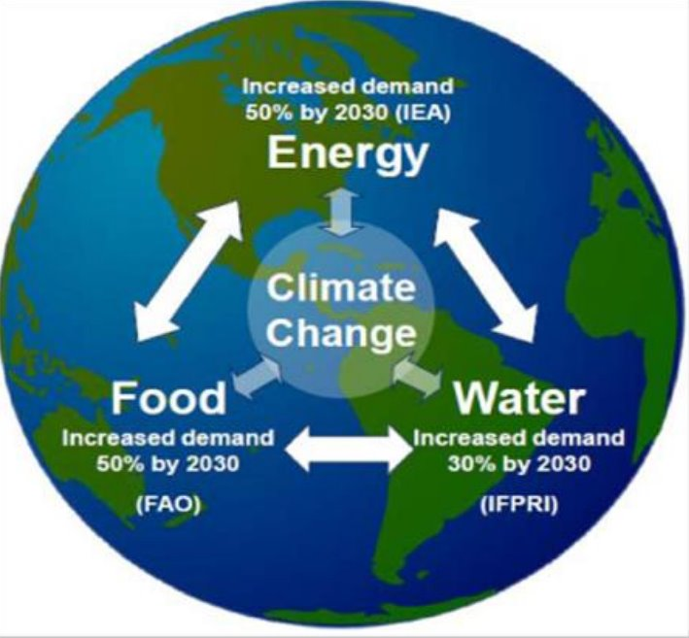
WEF Nexus Winter School Programme | 11–13 May 2026
Operationalizing the WEF Nexus in Transboundary Context
Lessons from the Cuvelai–Kunene (CUVKUN) GEF Project
Presented by Aune Amwaama, GWPSA-CUVKUN Project

Slide 2
Introduction & Context
The Cuvelai and Kunene River Basins, shared by Angola and Namibia, face interconnected environmental and development pressures:
• Frequent droughts and episodic flooding
• Growing water insecurity and ecosystem degradation
• Rural poverty and climate vulnerability
• Increasing pressure on water, food, and energy systems
The CUVKUN Project addresses these challenges through integrated and transboundary water resources management.

Slide 3
River Basin Characteristics
 | KUNENE | CUVELAI
Catchment Area | 106, 500 km², Angola 87% - Namibia 13% | 160, 000 km² Angola 40% - Namibia 60%
Rainfall | 1300 mm/a in headwaters near Huambo, almost 0-50 mm/a in lower reaches | 1000 mm/a upstream down to less than 500mm/a downstream
Evaporation | PE from 300mm/a in upper catchment to max 2000mm/a in lower reaches | 1,500 mm/a more than three times greater than average annual rainfall downstream.
Average flow | 5,500 Mm³/a (175 m³/s | Highly variable hydrological regime due to varying precipitation patterns, geology and soil Estimated runoff volumes vary; between 100 and 150 MM^{3/}a

Slide 4
Overview of the CUVKUN Project
Project Objective (2024–2029):
Enhance water security and community resilience in the Cuvelai and Kunene transboundary river basins.
Core Components:
• Improved management of water resources
• Flood and drought risk management
• Groundwater assessment and water harvesting
• Basin-wide environmental flow assessments
• Development of long-term IWRM Plans and investment programmes

Slide 5
CUVKUN as a WEF Nexus Case Study
The project demonstrates practical application of the Water-Energy-Food (WEF) Nexus through:
• Integrated planning across water, agriculture, and energy sectors
• Climate-resilient flood and drought management
• Livelihood-based basin management approaches
• Data-driven decision-making and regional cooperation
• Strengthening capacities of CUVECOM, PJTC, and local stakeholders

Slide 6
Practical Experiences & Lessons
Early Warning Systems
• Upgrading hydrometeorological stations at four pilot sites
• Combining hydrological modelling with community awareness
Groundwater Assessments
• Basin-wide groundwater studies with SADC-GMI support
• Solar-powered retrofitting of deep wells at demonstration sites
• Improving climate resilience for irrigation and rural water supply

Slide 7
Sustainable Land Management Pilots
Total of 13 Pilot interventions focus on:
Conservation agriculture and climate-smart horticulture
Replacing diesel pumps with solar-powered systems
Rainwater and floodwater harvesting infrastructure
Livestock watering systems and community stewardship
Nature-based solutions for water retention and contamination reduction

Slide 8
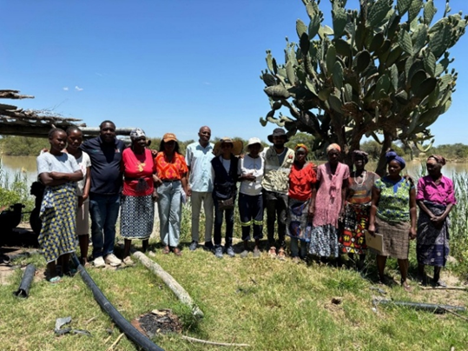
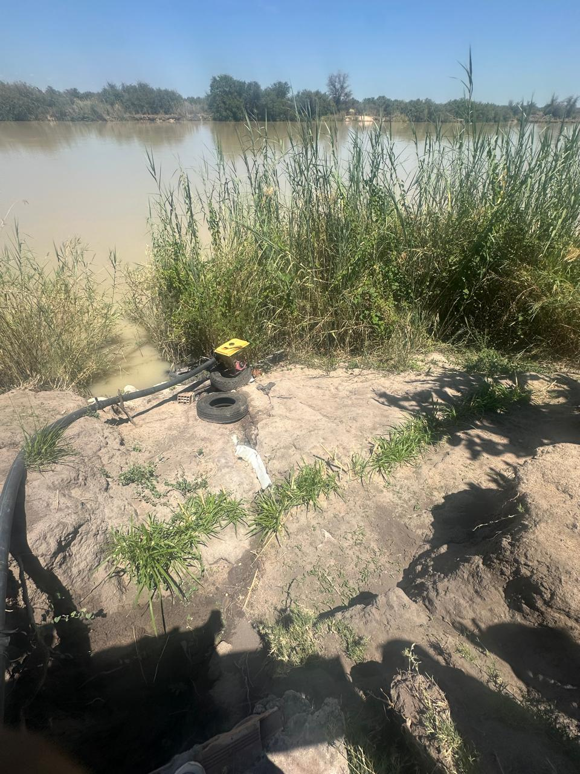
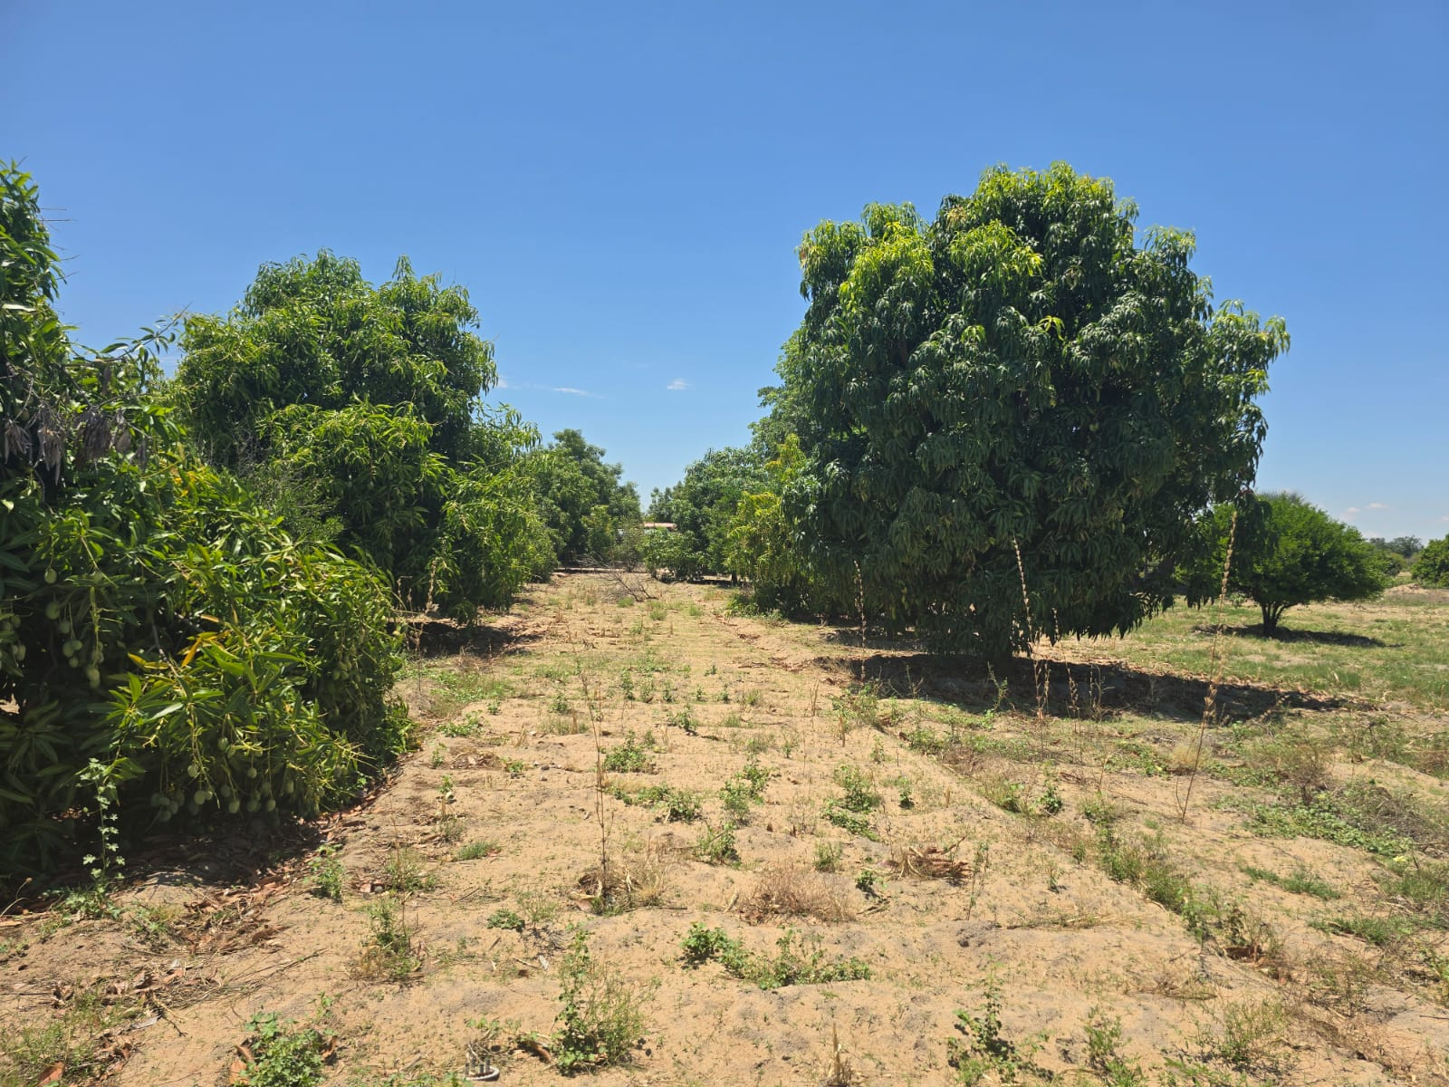
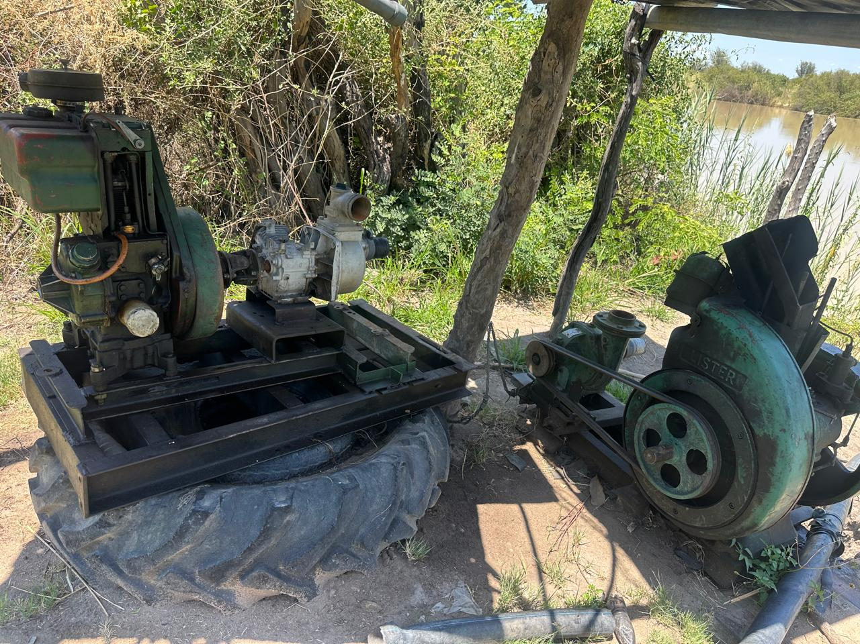
PumpingPump water to apond/alternative storage tanks.
Distribution to irrigated plots using drip irrigation to optimize water use
Soil moisture retention efforts

Slide 9
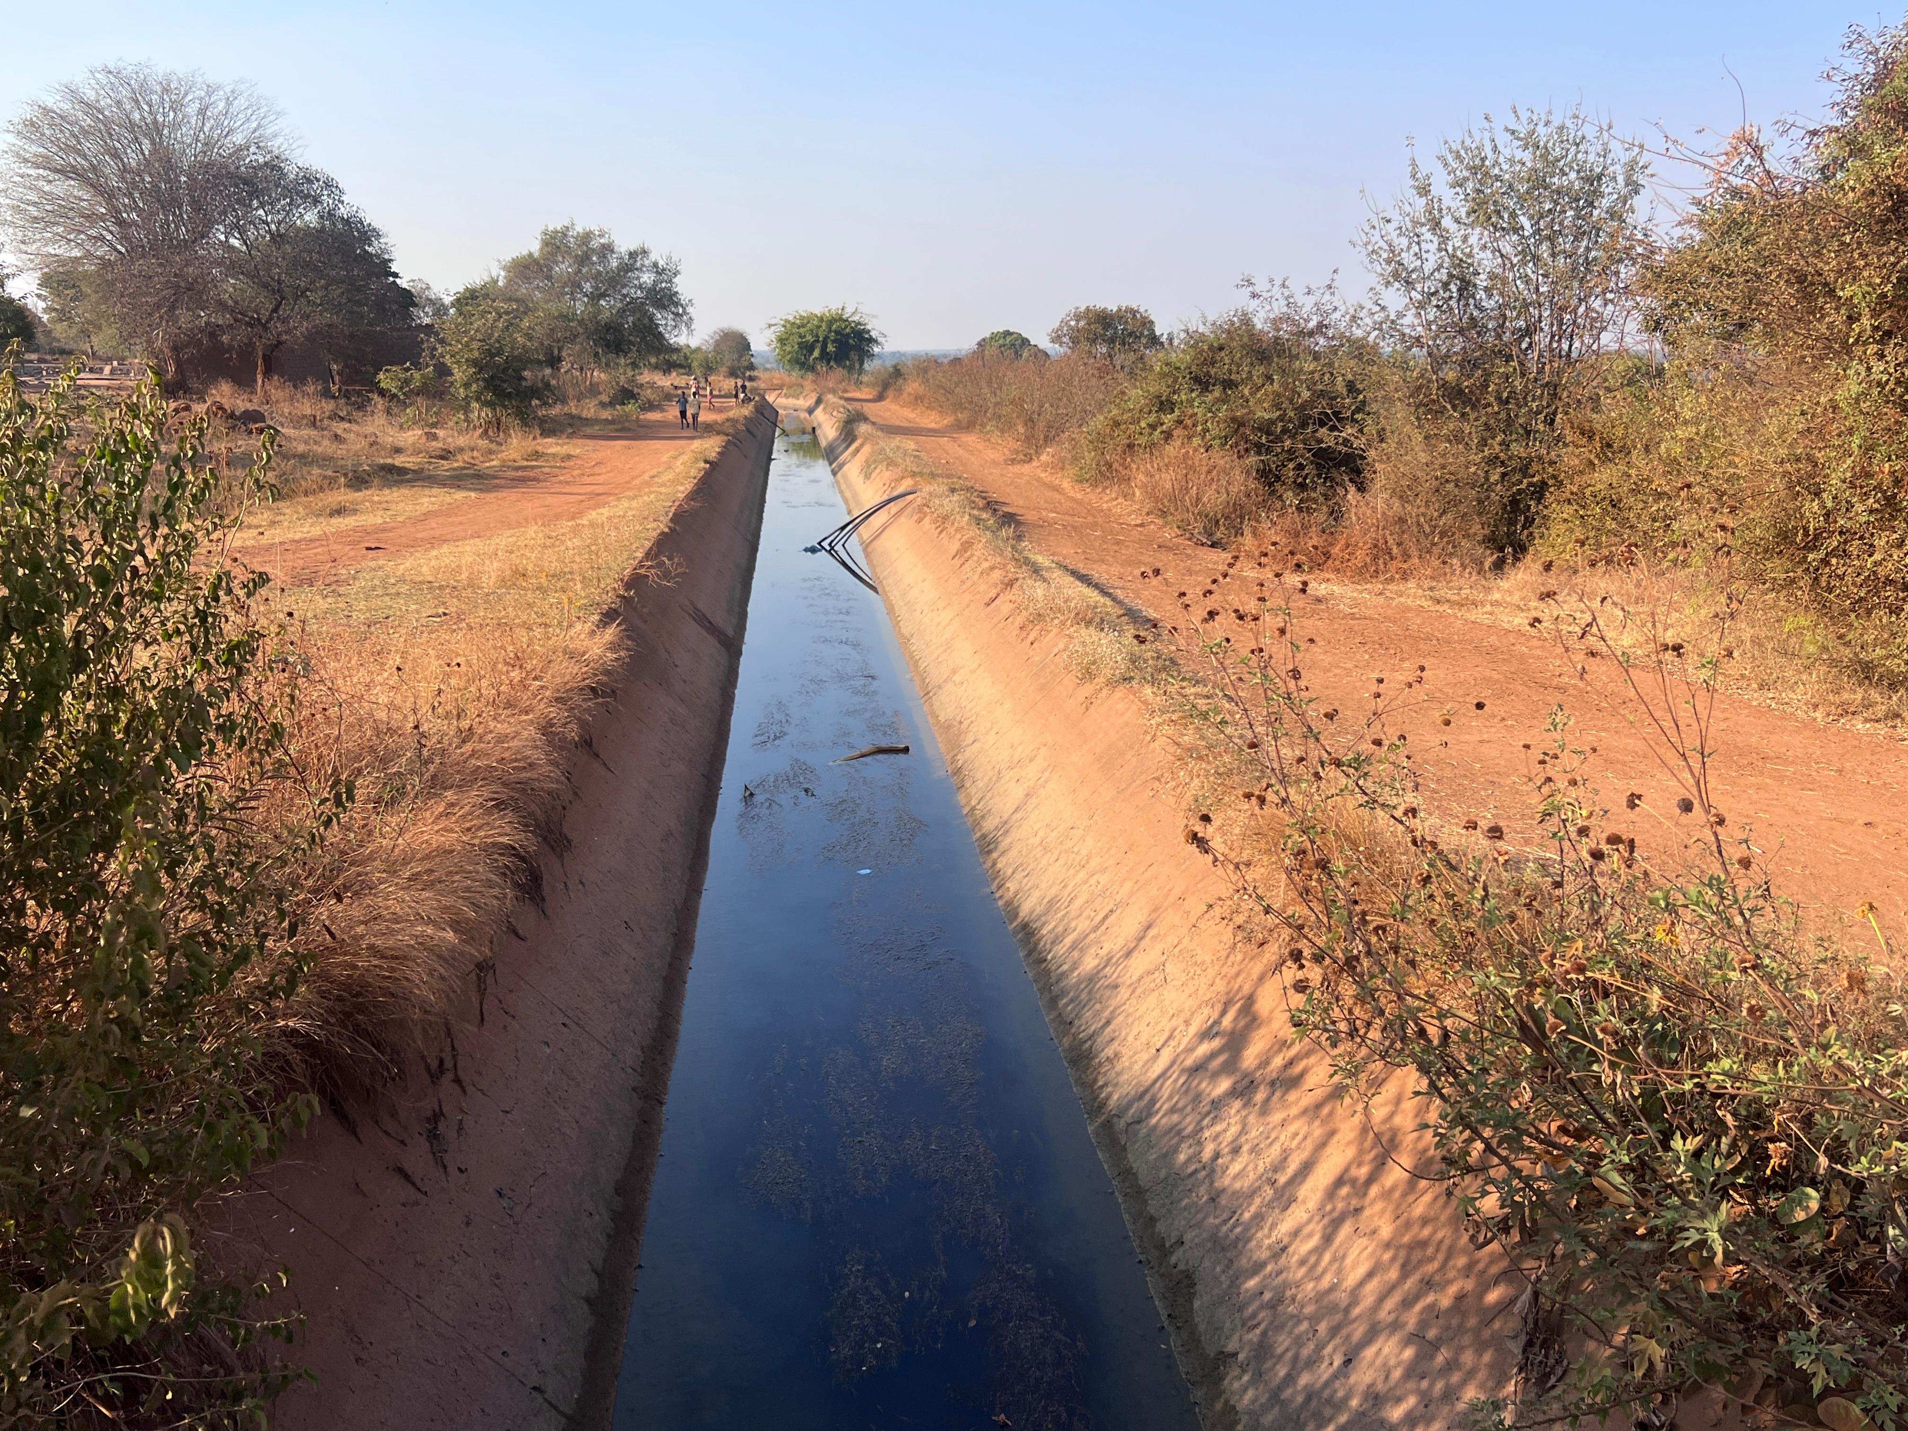
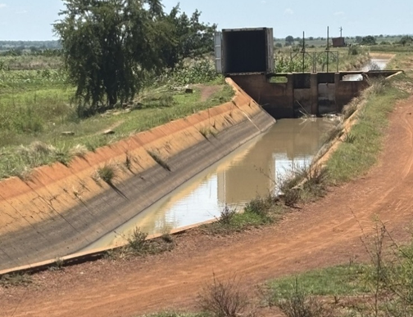
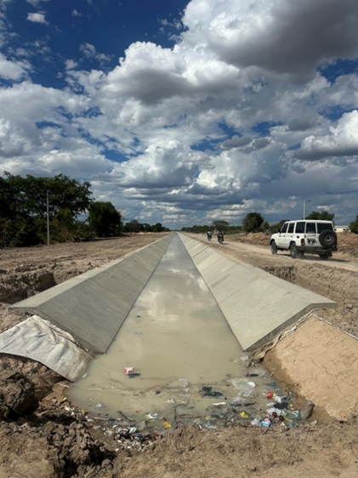
Repair and rehabilitation ofrehabilitate flood gates, sluices, and irrigation outlets.
Maintenance protocols to prevent future sedimentation or vandalism.
Revival of the “cantoneiro” patrol system: Youth monitors equipped with motorbikes inspect canal infrastructure, oversee sluice operations, and report issues
Institutional strengthening: Improved governance structures, conflict resolution mechanisms, and cooperative coordination.

Slide 10
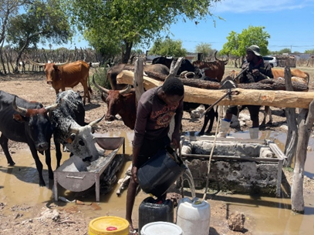
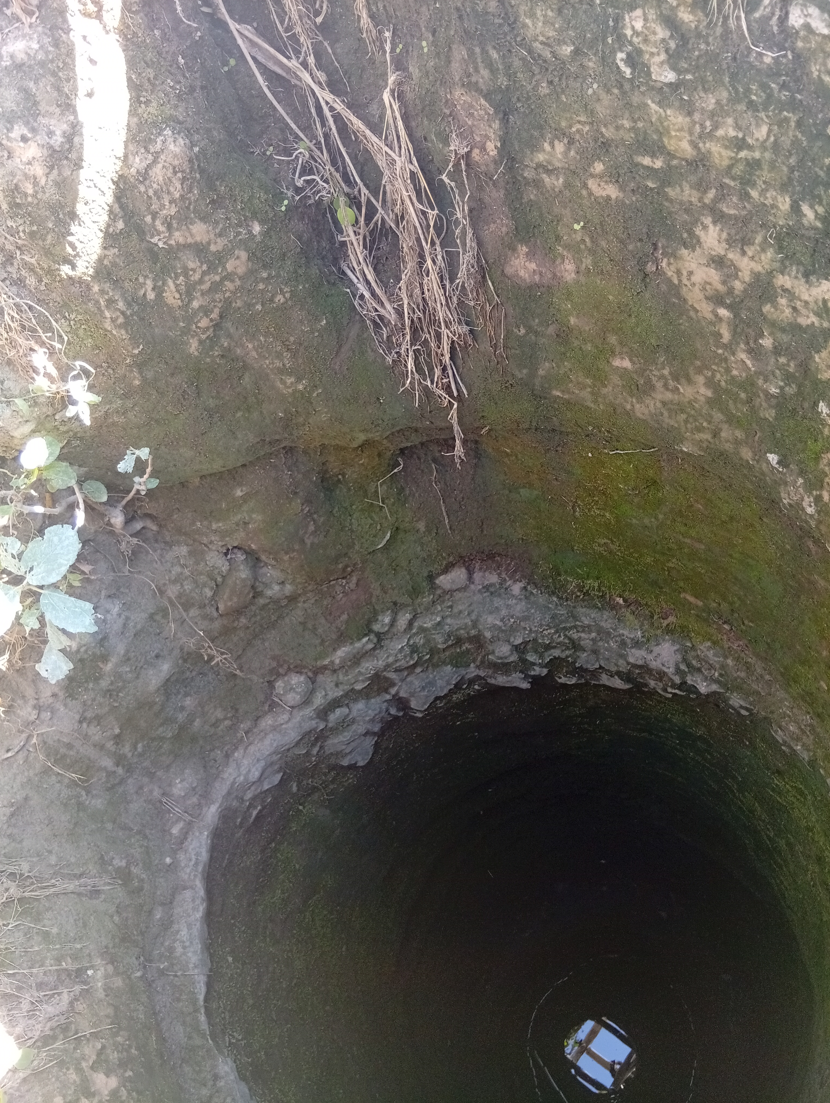
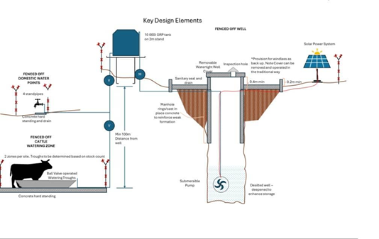
Modernizing/improving hand dug wells according to the design on the right

Slide 11
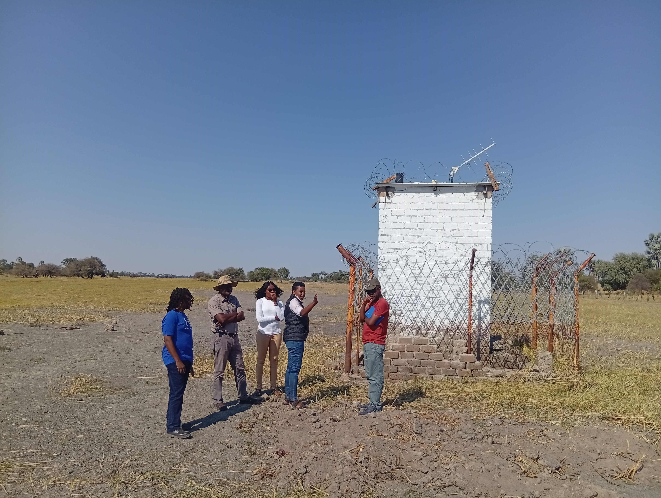
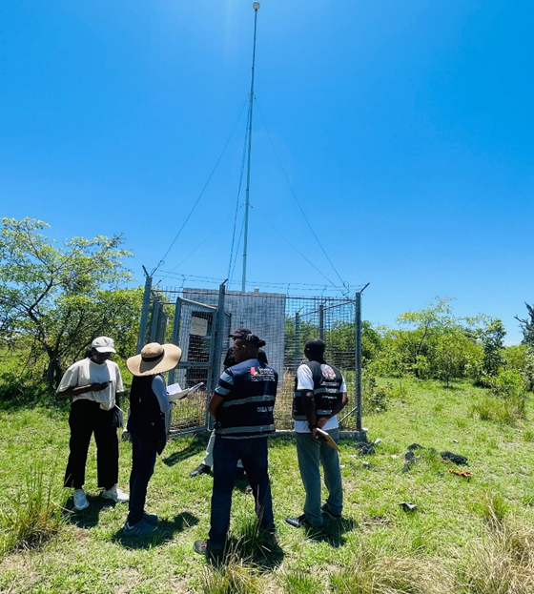
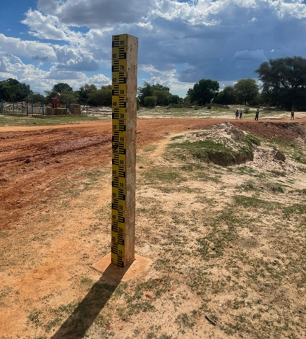
Plans:
Standardized system
Early warning communication pathways to support rapid evacuation of people, livestock, and property
Powered by solar energy

Slide 12
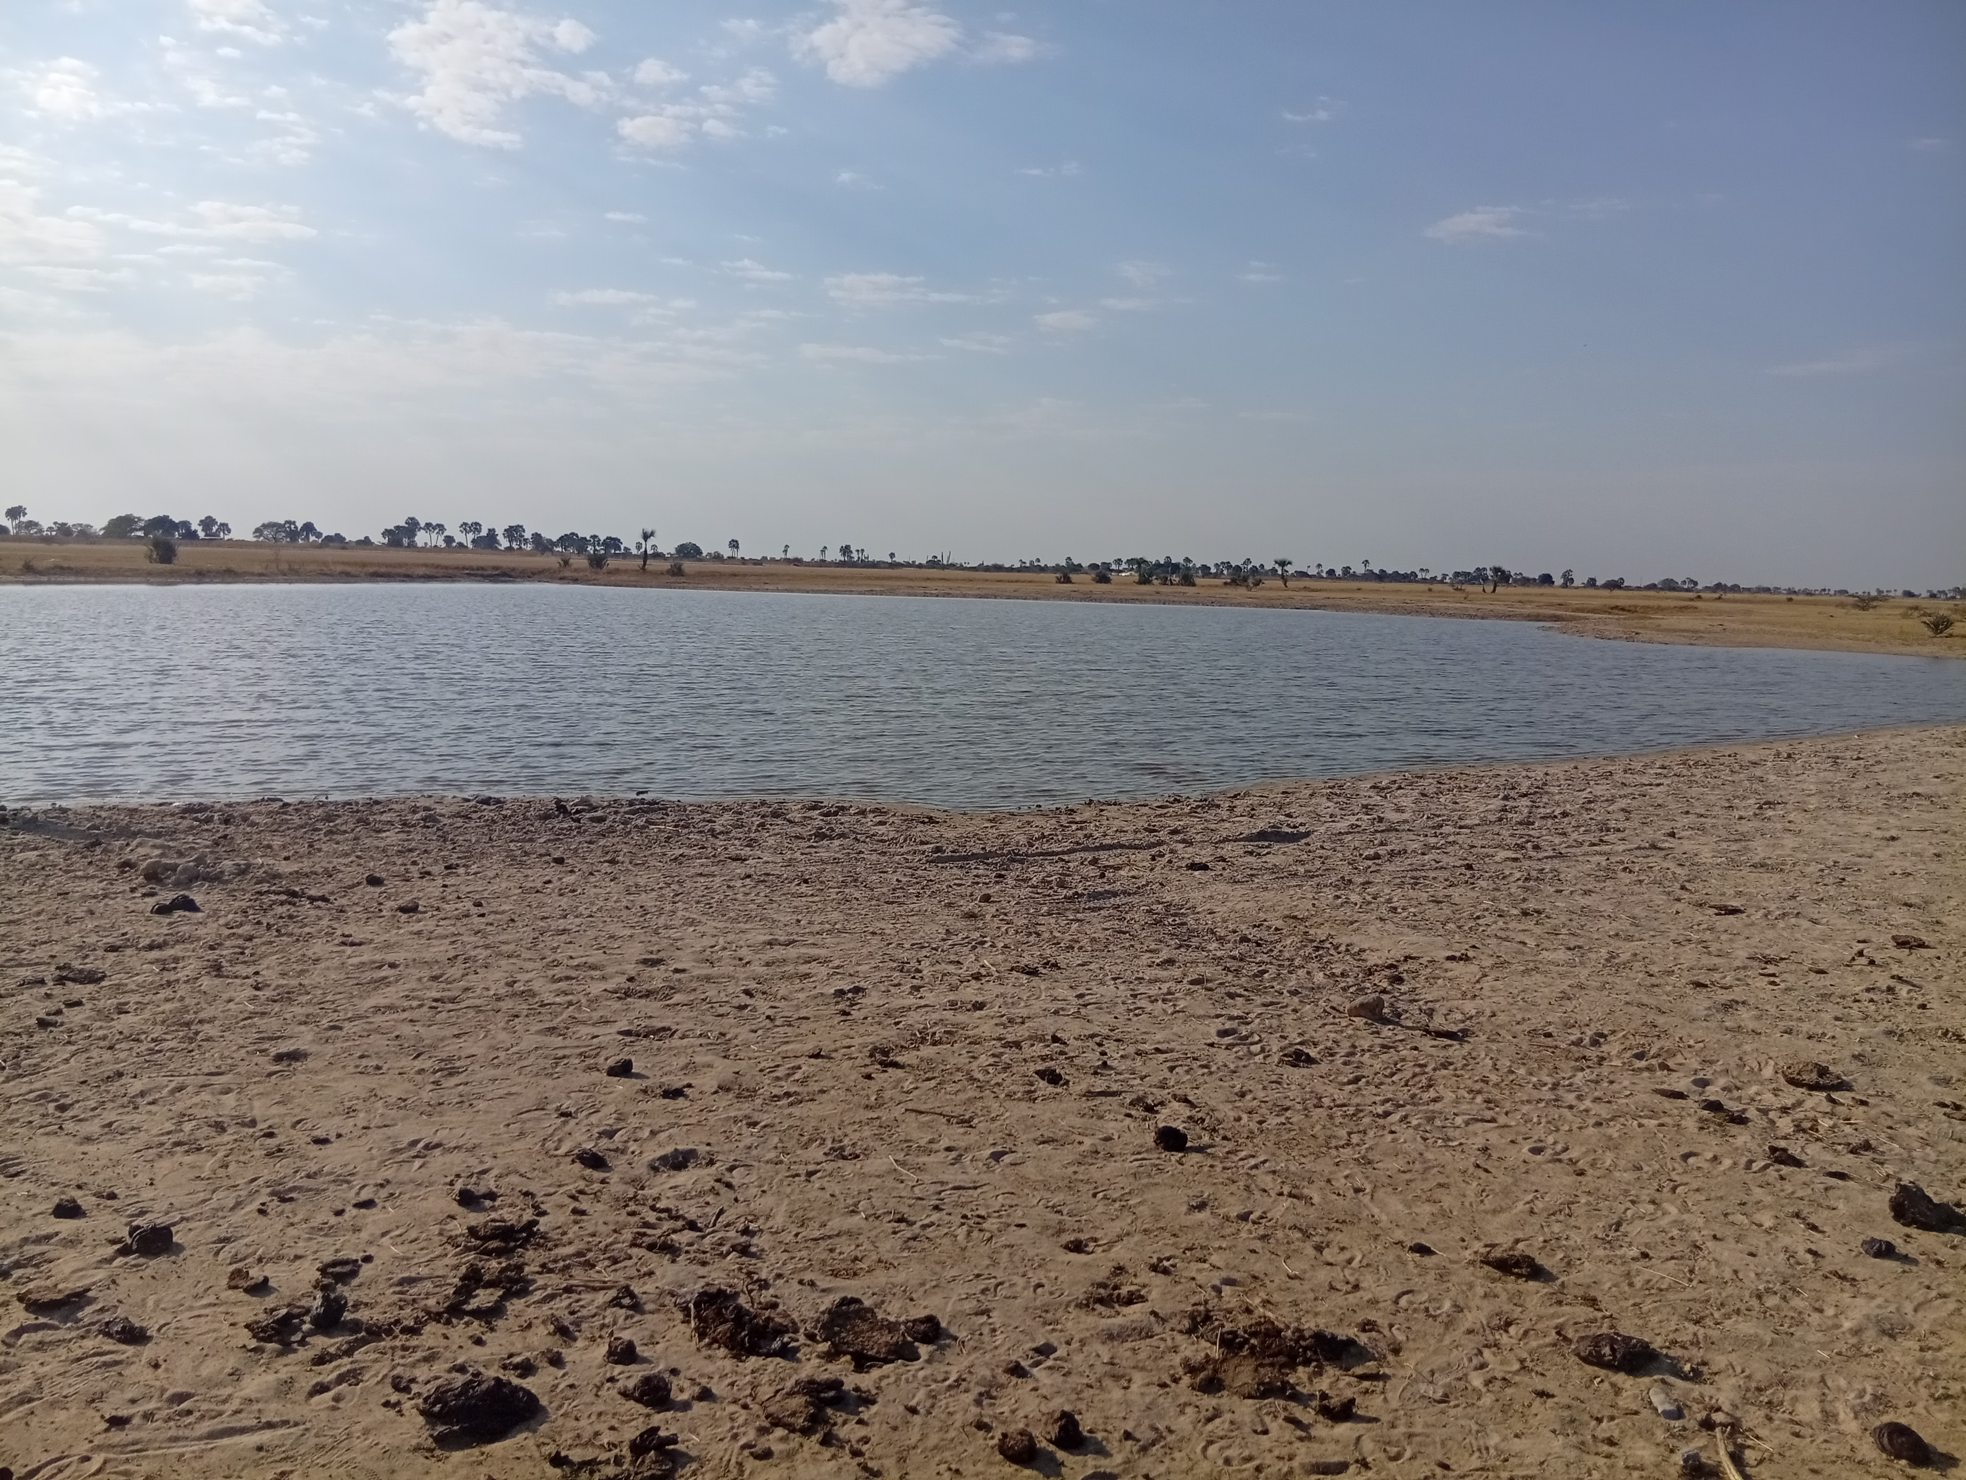
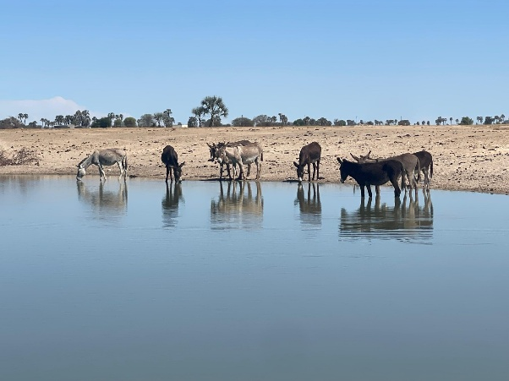
These earth ponds will be;
    re-excavated/deepened
    fenced off and
    installed with a pump to draw water to animal troughs and water collection points

Slide 13
Challenges Encountered
• Fragmented governance and sectoral silos
• Limited access to consistent transboundary datasets
• Institutional and technical capacity constraints
• Budget limitations and competing development priorities
• Delays in harmonizing regional coordination mechanisms

Slide 14
Opportunities & Emerging Innovations
• Integrated TDA/SAP processes for joint planning
• Shared data-sharing protocols and early warning systems
• Partnerships with universities for postgraduate training
• Green jobs and sustainable infrastructure investment
• Strengthened regional cooperation through knowledge exchange

Slide 15
Key Lessons Learned
• Transboundary cooperation is essential for climate resilience
• Data sharing strengthens evidence-based decision-making
• Community participation improves sustainability of interventions
• Integrated WEF approaches support balanced resource management
• Long-term institutional collaboration is critical for basin sustainability

Slide 16
Conclusion
The CUVKUN Project demonstrates how integrated and transboundary approaches can strengthen resilience, improve livelihoods, and support sustainable development in shared river basins.
The WEF Nexus provides a practical framework for balancing water, food, and energy needs while fostering regional cooperation.

Slide 17

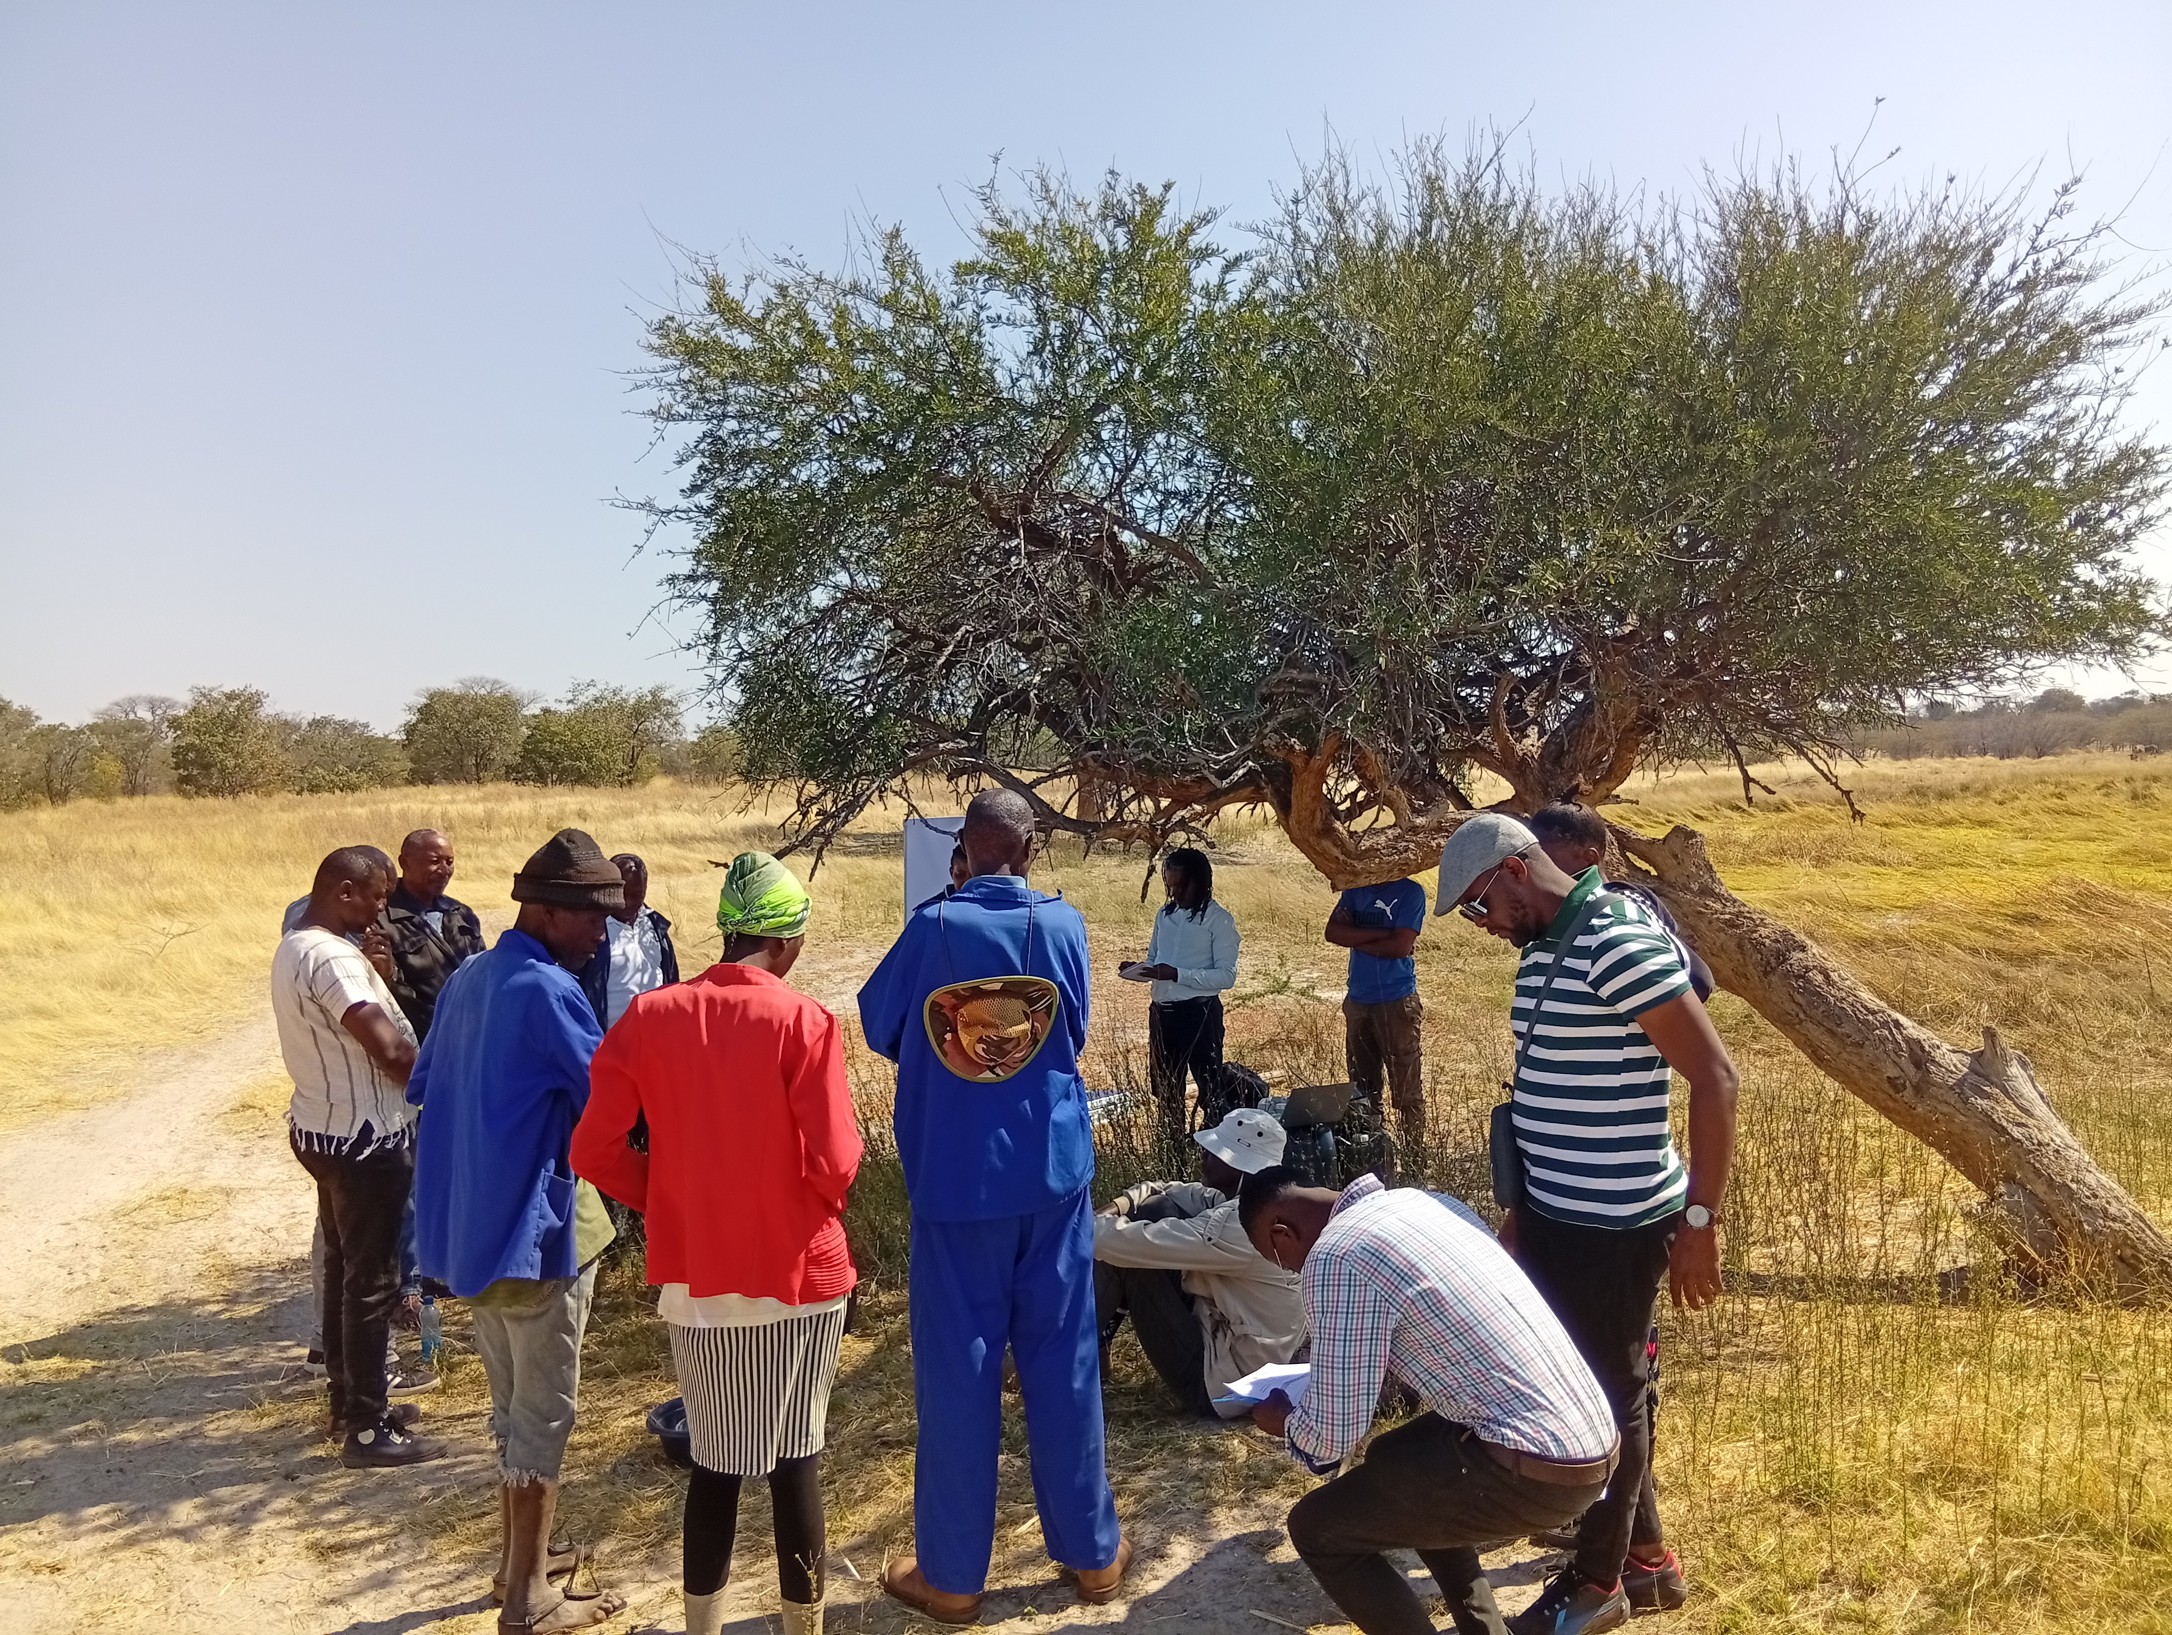
Thank You!
Questions & Discussion

