Slide 1

7. The WEF nexus in discourse: From Dialogue to Architecture
Presented by
Loreen Katiyo (PhD)
Senior Advisor: Programme Development & Technical Systems
Slides prepared by
Senior Advisor: Climate and Vulnerability
Global Water Partnership-Southern Africa
Continental Africa Water Investment Programme (AIP):
Judith Maryna Storie (PhD)

Slide 2
EXECUTIVE SUMMARY
This updated module responds directly to the latest Pan-African dialogue on water resources management, which brings together River Basin Organisations, climate finance institutions (GCF, GEF, AF, AfDB, even FRLD), AUDA-NEPAD, RECs such as SADC, ECOWAS, IGAD, Member States, private sector and civil society.
The latest dialogue and insights reveal that while the WEF nexus has matured significantly since 2011, the next frontier requires moving from conceptual discourse to systems architecture.
Three structural reform areas emerged with striking consensus:
Climate finance alignment between nationally-siloed access mechanisms and transboundary basin governance
Multi-country institutional coordination that enables cross-sectoral, transdisciplinary cooperation
Digital integration and data interoperability as foundational for investment credibility and climate risk modelling
This module positions the WEF nexus not merely as a dialogue framework, but as a coordination mechanism for implementation, investment readiness, and cooperative development across Africa's transboundary basins.

Slide 3
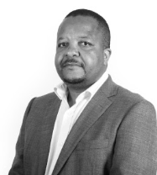
Presentation Outline
Setting the Scene: From Concept to Continental Imperative
Structural Reform Pillars
Key Achievements and Breakthroughs (2024-2025)
Case Studies from Southern Africa
Future Direction: From Dialogue to Architecture (2025-2030 Agenda)
“The African Union has declared 2026 the Year of “Assuring Sustainable Water Availability and Safe Sanitation Systems to Achieve the Goals of Agenda 2063.” This theme places water and sanitation firmly at the center of Africa’s development agenda, recognising their fundamental role in public health, food security, climate resilience, economic growth, and human dignity.”
Andrew Takawira
Interim Executive Secretary: GWPSA

Slide 4
What is the nexus?
The word nexus, (from the Latin verb “nectere”), means “to connect”, and is defined as “one or more connections linking two or more things”. It has been used in philosophy, cell biology and economics. This word conveys the interactions (dependencies or interdependencies) between two or more elements.
According to the background paper of the Bonn 2011 Nexus Conference, the nexus approach is defined as “an approach that integrates management and governance across sectors and scales”.
The nexus approach highlights the interconnections and interdependence of water, energy and food security (including nutrition and health) and the natural resources that underpin that security – water, soil and land.
Human resources managing these natural resources are key role players.
The interconnections can be synergistic (synergies) or adverse (trade-offs).

Slide 5

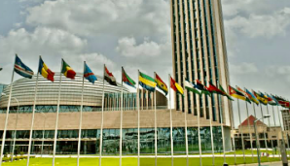

Presentation Outline
Setting the Scene: From Concept to Continental Imperative
Structural Reform Pillars
Key Achievements and Breakthroughs (2024-2025)
Case Studies from Southern Africa
Future Direction: From Dialogue to Architecture (2025-2030 Agenda)
“What emerged from Addis 2026 focuses everything”
Notes:
Good day. I'm recording this module immediately following the Pan-African dialogue on transboundary water governance held in Addis Ababa on February 17-18, 2026.

Slide 6
“What emerged from Addis 2026 focuses everything”
Why This Moment Matters:
The February 2026 Pan-African dialogue revealed that Africa stands at an
inflection point for transboundary WEF governance. What emerged strongly:
Theme | Consensus Statement
Finance | “Finance architecture must align with transboundary reality—basins don't respect national borders, but our funding windows do.“ – Funding and finance representatives
Governance | "We've spent a decade talking about integration. Now we need institutional mandates that enable it." — AU and Member States Water Divisions
Data and Infrastructure | "The technology exists. What's missing is interoperability standards, maintenance, financing, and political will." — Technical experts
Inclusion | "Youth and women must move from consultation to structural representation. This isn't optional—it's foundational." — Youth and Gender & GEDSI representatives
Notes:
Let me share what emerged from the dialogues: finance architecture is designed for national project approval, but basins are multi-country by nature. It was also highlighted that we have the technology—satellites, sensors, platforms—but we lack agreement on standards and sustained maintenance financing. The Pan-African Youth Water Parliament especially delivered a powerful message: inclusion must move from consultation to structural representation. These aren't technical disagreements—they're architectural gaps. And they're now explicitly identified with consensus on the path forward.

Slide 7
Dimensions/domains/roles of the WEF Nexus
A concept / conceptual framework:
understanding of WEF linkages to promote coherence in cross-sectoral and transboundary policy-making and enhance sustainability, e.g., conceptual frameworks.
An analytical tool:
use of quantitative and/or qualitative methods to understand interactions among water, energy, and food systems.
A discourse or governance framework or boundary concept:
problem framing, and
promoting cross-sectoral collaboration, e.g., policy dialogues, finance mobilisation, infrastructure maintenance, technical interoperability, GEDSI and youth

Slide 8
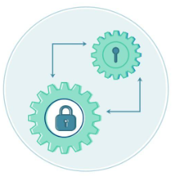
Africa Does Not Lack Knowledge:
"We have the science. We have the needs assessments. We have the technical capacity.
What we don't have is aligned systems."
Opportunities for alignment:
Dimension | Current Reality | Required Shift
Finance | Nationally-siloed finance windows (NDA-based) | Multi-country/transboundary, basin-aligned architecture
Governance | Sectoral ministries, national mandates | Cross-sectoral integration, RBO-NDA coordination
Data and Infrastructure | Multiple different hydrological standards across Africa and Infrastructure linkages and maintenance challenges | Harmonized protocols, sustained financing, interoperability, budget for maintenance
These aren't separate issues. They're one interconnected system that present opportunities.
Notes:
The opening plenary chair said something that resonated throughout both days: "We have the science. We have the needs assessments. We have the technical capacity. What we don't have is aligned systems." Think about that. We're not failing because we don't know what to do. We're failing because our systems aren't designed to work together. Fourteen different hydrological data standards across the continent. Nationally-siloed windows trying to fund transboundary basins. Sectoral ministries with no coordination mechanism. The revelation was that these aren't three separate problems—they're one interconnected systems failure. And fixing them requires architecture, not just dialogue.

Slide 9

Alignment Architecture: Connecting Continental Frameworks
Using the WEF Nexus as Coordination Logic for:
Framework | Alignment Points
Agenda 2063 | Aspiration 1 (Prosperity), 3 (Governance), 5 (Environment), 6 (People) all require transboundary cooperation
NDCs (nationally determined contributions) | African countries including nexus language—but basin/transboundary alignment is often lacking
SDGs (2, 6, 7, 13) | Interconnected implementation requires interconnected institutions; and linkage between Operations/Planning vs Budgeting/Finance
Paris Agreement Article 6 | Cooperative approaches need cooperative governance
AfCFTA | Infrastructure corridors depend on transboundary water-energy-food systems
"Alignment must move from voluntary to structural."
Notes:
The dialogue explicitly mapped how WEF nexus architecture connects to existing continental frameworks. Agenda 2063's aspirations can't be achieved without transboundary cooperation. NDC 3.0 submissions in 2025 indicated that at least 32 countries across Africa have nexus language included, but transboundary is often missing. The AfCFTA's infrastructure corridors depend on reliable water and energy systems that cross borders. The call is clear: alignment must move from voluntary to structural. Not hoping that coordination happens, but building systems that require it.

Slide 10

Presentation Outline
Setting the Scene: From Concept to Continental Imperative
Structural Reform Pillars
Key Achievements and Breakthroughs (2024-2025)
Case Studies from Southern Africa
Future Direction: From Dialogue to Architecture (2025-2030 Agenda)

Slide 11
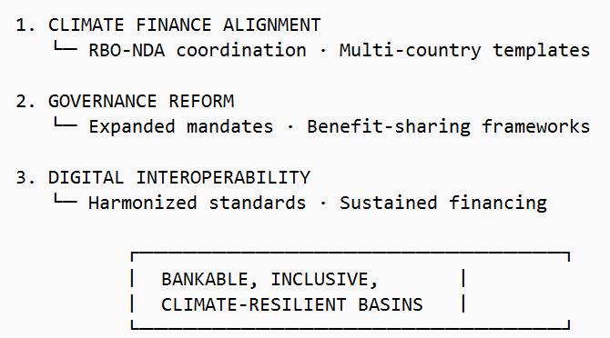
3 KEY STRUCTURAL REFORM PILLARS:
"We recognize that transformative progress in transboundary water governance requires structural reform in three interconnected domains: climate finance alignment, multi-country institutional coordination, and digital data interoperability."
Finance Architecture
AND TECHNICAL/INFRASTRUCTURE
Governance
Technical:
Data Systems
(Information and
Knowledge
Management); and
Infrastructure
Notes:
Three pillars. First, climate finance alignment—RBO-NDA coordination, multi-country templates. Second, governance reform—expanded institutional mandates, benefit-sharing frameworks. Third, digital interoperability—harmonized standards, sustained financing. Not as standalone initiatives, but as interconnected architecture. Together, they enable bankable, inclusive, climate-resilient basins. This is the framework. This is what we're building through WEF Nexus implementation – across sectors.

Slide 12
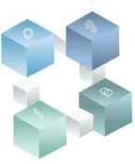
PILLAR 1: Finance Alignment – the Realisation
The Reality Check:
Current Reality: examples
"Multi-country proposals take 18-24 months for country-based no-objection; opposed to single-country no-objection on average taking 3-6 months"
"Only 3 of 25 major African basins are reported to have direct accreditation pathways"
"NDA mandates explicitly exclude transboundary processing"
"We have investment programmes—we don't have accreditation"
How do we become “credible”?
– INTEGRITY, TRANSPARENCY
& ACCOUNTABILITY:
FINANCIALLY SOUND & CLEAN AUDITS

Slide 13
PILLAR 1: Finance Alignment – the Realisation
The Reality Check:
Current Reality: examples
"Multi-country proposals take 18-24 months for country-based no-objection; opposed to single-country no-objection on average taking 3-6 months"
"Only 3 of 25 major African basins are reported to have direct accreditation pathways"
"NDA mandates explicitly exclude transboundary processing"
"We have investment programmes—we don't have accreditation"
What's Needed:
Reform
Formal RBO-NDA coordination platforms
Standardized multi-country/transboundary proposal templates
Direct accreditation pathways for e.g. RBOs / WEF Nexus actors
Blended finance structuring: Finance mobilization skills
Notes:
The consensus was clear: we need formal RBO-NDA coordination platforms, standardized templates, and direct accreditation pathways. Not pilots. Systems.

Slide 14
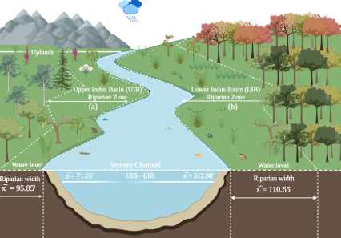
PILLAR 2: Multi-Country Institutional Coordination – the Breakthrough
The Reality Check:
Current Reality | Envisaged Future
NDAs: national mandates only | Expanded mandates for transboundary processing
No formal RBO-NDA coordination | Standing coordination mechanisms
Sectoral ministries operating in silos; Finance/Treasury budgeting is not aligned with Ministerial Programmes/Plans | Cross-sectoral platforms; Direct engagement between Ministry of Finance and Sectors/Ministries’ Programmes/Plans
Project-by-project endorsement | Programmatic, multi-country transboundary frameworks
The Innovation: Benefit-Sharing as Negotiation Logic
"The WEF nexus makes visible who benefits, who bears costs, and where compensation is needed. That visibility enables negotiation. That negotiation enables cooperation."
CASE STUDY: Limpopo Basin Water-Energy-Food Beneficial-Sharing Framework (launched Feb 2025) - first transboundary agreement explicitly using nexus logic to allocate benefits from multi-purpose infrastructure.

Slide 15
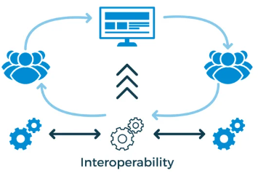
PILLAR 3: Digital Integration and Data Interoperability – the Headline
Findings: "The technology exists. The gap is institutional."
14+ different hydrological data standards across 48+ countries
60%+ of continental monitoring stations underfunded for maintenance; similar with infrastructure
Cross-border data agreements exist – reportedly for only 8 of 25 major basins
Interoperability gap costs +/- US$120M annually
Priorities in the Solution Framework:
Africa-wide Hydrological Data Harmonization Protocol / Interoperability
Infrastructure maintenance financing mechanism (0.5% of infrastructure budgets)
Continental open data portal
Cross-border data agreement template
Notes:
The solution framework is, however, clear. A harmonized set of protocols is ideal. The 0.5% maintenance financing mechanism—dedicating half a percent of infrastructure budgets to monitoring—is being piloted. Cross-border agreement templates are being drafted. The consensus was clear: interoperability is foundational, not optional.

Slide 16
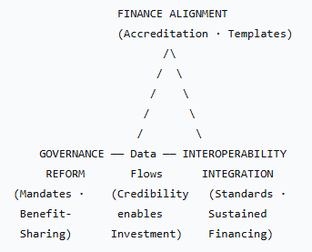
The Integration Framework: Three Pillars as One System, supporting the WEF Nexus operationalisation
"The three pillars are not separate workstreams. They are one integrated architecture. Finance flows through governance systems enabled by credible data and alignment between finance and ministries. You cannot reform one without the others."
Governance: Multi-level accountability mechanisms (continental to community)
Ministerial oversight through AMCOW
Alignment with AU Agenda 2063 and SDG 6
Reform (Investment Flows): AIP-PIDA Water Investment Scorecard, complementing WASSMO – see the AIP Pyramid and WASSMO discussion later on
Interoperability: Harmonization; Open data protocols; Integration between systems in and across sectors
AND TECHNICAL/INFRASTRUCTURE
Notes:
INTEROPERABILITY:
Harmonized indicators across 55 countries
Open data protocols enabling integration with other systems
Opportunity for WEF Nexus integration: WASSMO data interoperability with energy systems monitoring and agricultural/food security databases

Slide 17
The Integration Framework: Three Pillars as One System, supporting the WEF Nexus operationalisation
"The three pillars are not separate workstreams. They are one integrated architecture. Finance flows through governance systems enabled by credible data and alignment between finance and ministries. You cannot reform one without the others."
at the center: Bankable, Inclusive, Climate-Resilient River Basins and Transboundary Conservation and sustainable livelihoods
AND TECHNICAL/INFRASTRUCTURE
Notes:
The triangle isn't decorative—it's operational. Reform must be simultaneous and connected.

Slide 18
Presentation Outline
Setting the Scene: From Concept to Continental Imperative
Structural Reform Pillars
Key Achievements and Breakthroughs (2024-2025)
Case Studies from Southern Africa
Future Direction: From Dialogue to Architecture (2025-2030 Agenda)

Slide 19
Breakthroughs:
Achievement 1: WEF Nexus Mainstreamed in National Climate Frameworks
Achievement 2: Investment Readiness Strengthened
32 African countries included nexus language in NDC 3.0 drafts (as of Feb 2025)
8 Transboundary basins reference nexus in updated master plans
SADC Regional Water Policy revision (2025) explicitly adopts the WEF Nexus approach
Indicator | 2020 Baseline | 2025 Status
Bankable multi-country proposals | 2 | 16
RBOs with GCF readiness support | 3 | 12
Blended finance transactions closed | 0 | 5
Multi-country GCF concept notes submitted | 1 | 7
Achievement 3: Institutional Learning Accelerated
RBO-NDA coordination platforms established in 6 basins
WEF Nexus training integrated into 14 university curricula
Youth WEF Nexus fellows program launched
Notes:
Sixteen bankable multi-country proposals exist—up from two in 2020. Twelve River Basin Organisations now have reported GCF readiness support. Five blended finance transactions are reported to have closed, and at least seven multi-country GCF concept notes across Africa with submitted in the past year. These aren't small numbers—they represent systematic progress. At least fourteen universities are reported to have integrated nexus into curricula. The discourse has matured into tangible capability.

Slide 20
GEDSI and Youth: From Add-On to Structure:
Initiative | Commitment
Zambezi Youth Water Fellowship | Expanded to 50 fellows (2026-2028)
Limpopo Women in Digital Hydrology | Scale to 500 women trained by 2027
SADC Nexus Youth Council | Formal advisory status with secretariat support
Continental Youth in Water Platform | Launch 2026 (endorsed by AU)
The Breakthrough on Inclusion:
"We're done being consulted. We're here to co-govern." — Pan-African Youth Water Parliament
Indicator | 2020 | 2025 | Potential
RBOs with institutionalized youth seats | 0 | 4 | 15
Projects with mandatory GEDSI-disaggregated data | 15% | 45% | 100%
Tertiary partnerships for technical capacity | 8 | 27 | 50
Women in RBO technical leadership | 12% | 28% | 40%
National Framework | Basins with Alignment (Feb 2025) | Target (2026)
NDCs (Nationally Determined Contributions) | 12 basins mapped to NDC 3.0 | All 25 major basins
NAPs (National Adaptation Plans) | 8 basins with adaptation alignment | 18 basins
NDPs (National Development Plans) | 10 basins with development integration | 20 basins
National Investment Plans | 5 basins with investment coherence | 15 basins
Persistent Gaps Identified: Basin master plans not consistently aligned with national frameworks
"Demand-driven basin planning flowing from national strategies, not parallel to them."
Notes:
The Pan-African Youth Water Parliament delivered a powerful statement on the final day: "We're done being consulted. We're here to co-govern." That message landed. Four River Basin Organisations now have institutionalized youth seats—not consultation, but voting representation. Forty-five percent of projects require mandatory GEDSI-disaggregated data. Twenty-eight percent of RBO technical leadership positions are held by women, up from twelve percent in 2020. And the commitments made—expanded fellowships, scaled training, formal advisory status, a continental youth platform—show that inclusion is moving from add-on to structure. AUDA-NEPAD presented sobering findings on alignment. Only twelve basins are systematically mapped to NDCs. Eight have adaptation alignment with NAPs. Ten connect to national development plans. Five align with national investment plans. The diagnosis: basin plans have been developed parallel to national strategies, not flowing from them. The prescription: demand-driven planning—basin strategies responding to national priorities, aggregated upward, not imposed downward.

Slide 21
Presentation Outline
Setting the Scene: From Concept to Continental Imperative
Structural Reform Pillars
Key Achievements and Breakthroughs (2024-2025)
Case Studies from Southern Africa
Future Direction: From Dialogue to Architecture (2025-2030 Agenda)

Slide 22
Southern Africa: Progress in Achievement of SDGs
Country | SDG Index Score | SDG Index Rank | SDG 1 |  | SDG 2 |  | SDG 3 |  | SDG 4 |  | SDG 5 |  | SDG 6 |  | SDG 7 |  | SDG 8 |  | SDG 9 |  | SDG 10 |  | SDG 11 |  | SDG 12 |  | SDG 13 |  | SDG 14 |  | SDG 15 |  | SDG 16 |  | SDG 17
Mauritius | 70.3 | 76 | green | ↑ | red | → | orange | → | yellow | ➚ | red | → | yellow | ➚ | orange | ➚ | yellow | ↑ | orange | ➚ | orange |  | orange | ➚ | grey |  | yellow | → | red | → | red | → | orange | ↓ | orange | ➚
Namibia | 65.5 | 104 | red | → | red | → | red | ➚ | orange | ↑ | green | ➚ | red | ➚ | red | → | red | → | orange | ➚ | red |  | orange | ↓ | yellow | ➚ | yellow | ➚ | yellow | → | green | ➚ | red | ↓ | yellow | →
Botswana | 64.5 | 109 | red | → | red | → | red | ➚ | orange | ➚ | orange | ➚ | orange | ➚ | red | → | orange | → | red | ➚ | red |  | orange | → | yellow | → | orange | → | grey |  | red | → | orange | → | yellow | →
South Africa | 64.1 | 111 | red | → | red | → | red | → | yellow | → | green | ↑ | orange | ➚ | red | → | red | ➚ | orange | ➚ | red |  | red | ↓ | orange | ➚ | orange | ➚ | red | ➚ | red | → | red | ↓ | yellow | ↑
Tanzania | 57.7 | 135 | red | → | red | → | red | ➚ | red | → | orange | ➚ | red | ➚ | red | → | orange | → | red | → | red |  | red | ↓ | green | ➚ | green | ➚ | red | ↓ | red | → | red | → | red | →
Eswatini | 57.5 | 136 | red | → | red | → | red | ➚ | red |  | orange | ➚ | red | → | red | → | orange | ↓ | orange | ➚ | red |  | orange | → | grey |  | green | → | grey |  | red | → | red | ↓ | orange | ➚
Zimbabwe | 57.4 | 137 | red | ↓ | red | → | red | ➚ | red | ➚ | orange | ➚ | red | → | red | → | orange | → | red | → | red |  | red | ↓ | green | ↑ | green | ↑ | grey |  | orange | ➚ | red | ↓ | red | →
Malawi | 57.1 | 139 | red | ↓ | red | → | red | ➚ | red | → | orange | ➚ | red | ➚ | red | → | red | → | red | → | orange |  | red | → | green | ➚ | green | ➚ | grey |  | red | → | red | → | red | →
Lesotho | 55.6 | 143 | red | → | red | → | red | ➚ | red | → | yellow | → | red | ➚ | red | → | red | → | red | → | red |  | red | → | grey |  | green | → | grey |  | yellow | ➚ | red | ↓ | yellow | →
Zambia | 54.8 | 146 | red | → | red | → | red | → | orange |  | orange | → | red | ➚ | red | → | red | → | red | → | red | ➚ | red | ↓ | green | ➚ | green | ➚ | grey |  | red | → | red | ↓ | orange | →
Comoros | 54.7 | 148 | red | → | red | → | red | → | red | ↓ | red | → | red | → | red | → | grey |  | red | → | red |  | orange | → | grey |  | green | → | red | ↓ | red | → | grey |  | orange | →
Mozambique | 53.7 | 151 | red | → | red | ➚ | red | → | red | → | red | → | red | ➚ | red | → | red | ➚ | red | ↓ | red |  | red | → | green | → | yellow | ↑ | red | ➚ | red | → | red | ↓ | orange | ➚
Angola | 52.8 | 155 | red | ↓ | red | → | red | → | red | ➚ | red | → | red | ➚ | red | → | red | ➚ | red | → | red |  | red | → | green | ↑ | yellow | ↑ | orange | → | red | → | red | → | orange | →
Madagascar | 51.0 | 158 | red | → | red | → | red | → | red | → | orange | → | red | ➚ | red | → | red | → | red | → | red |  | red | → | green | ↑ | green | ➚ | red | → | red | → | red | → | red | →
Congo, Dem. Rep. | 48.2 | 162 | red | → | red | ↓ | red | → | red | ➚ | red | → | red | → | red | → | red | → | red | → | red |  | red | → | green | ➚ | green | → | yellow | → | red | → | red | ↓ | red | →
Seychelles |  |  | green | ↑ | red | → | orange | ➚ | green | → | yellow | → | yellow | ➚ | orange | ➚ | grey |  | orange | ➚ | yellow |  | green | ➚ | grey |  | yellow | → | yellow | ➚ | red | ➚ | grey |  | orange | ➚
World | 68.6 |  | orange | → | red | → | red | ➚ | orange | → | orange | ➚ | orange | → | orange | ➚ | orange | → | orange | ➚ | orange |  | red | → | orange | → | orange | → | red | → | red | → | red | → | orange | →
 | Goal Achievement
 | Challenges remain
 | Significant challenges
 | Major challenges
 | Insufficient data
↑ | On track or maintaining achievement
➚ | Moderately Increasing
→ | Stagnating
↓ | Decreasing
Notes:
The 2026 targets are ambitious but achievable with the architecture now being built.

Slide 23
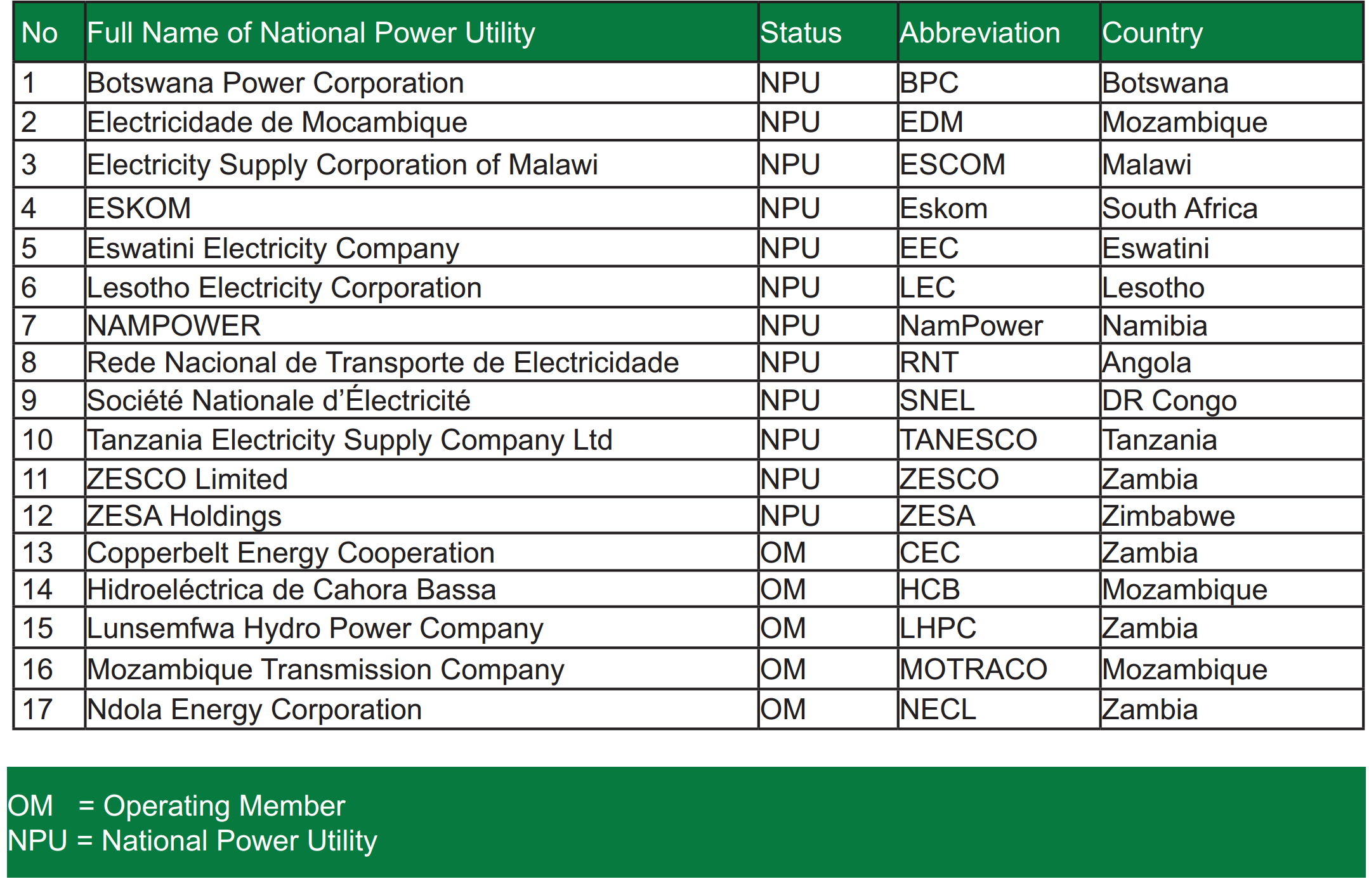
Southern African Power Pool (SAPP) – electricity is shared …1

Slide 24
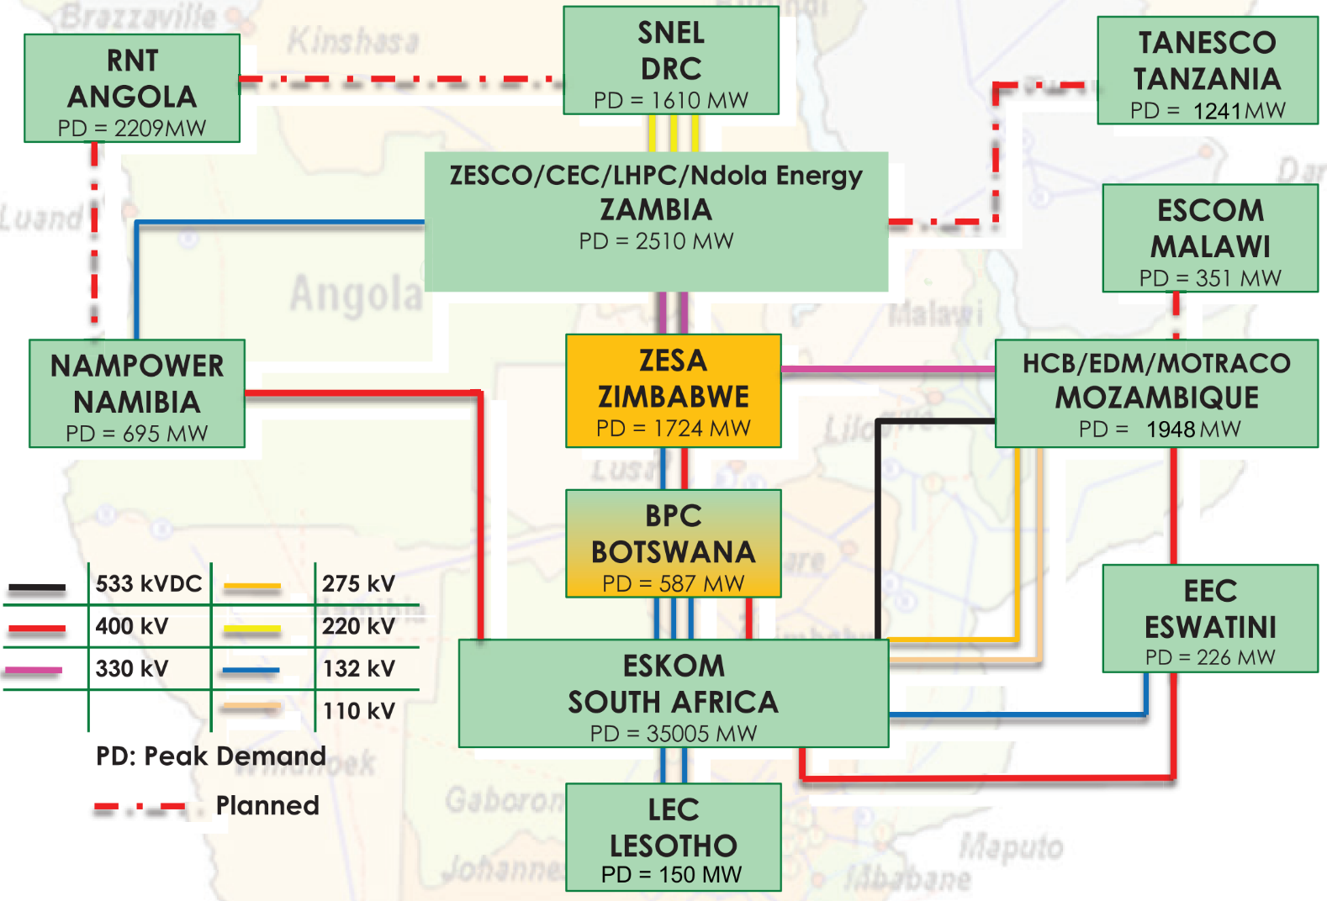
Southern African Power Pool (SAPP) – electricity is shared …2

Slide 25
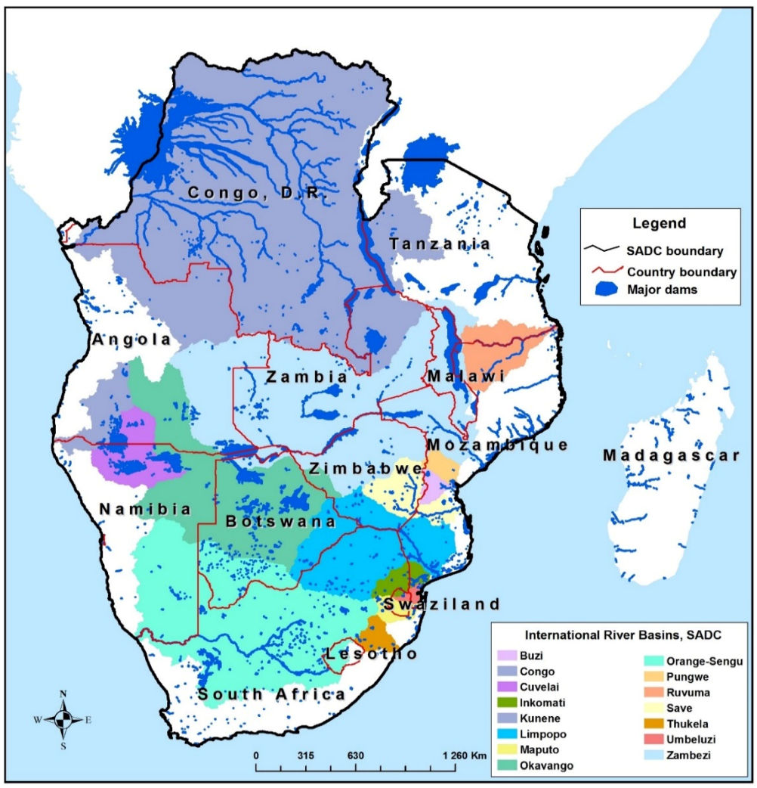
Southern Africa: Transboundary river basins – water is shared
River Basin | Sharing Riparian States
Buzi | Mozambique, Zimbabwe
Congo | Angola, Democratic Republic of Congo, Tanzania, Zambia
Cuvelai | Angola, Namibia
Incomati | Mozambique, South Africa, Eswatini
Kunene | Angola, Namibia
Limpopo | Botswana, Mozambique, South Africa, Zimbabwe
Maputo | Mozambique, South Africa, Eswatini
Nile | Democratic Republic of Congo, Tanzania
Okavango | Angola, Botswana, Namibia
Orange | Botswana, Lesotho, Namibia, South Africa
Pungwe | Mozambique, Zimbabwe
Ruvuma | Malawi, Mozambique, Tanzania
Save | Mozambique, Zimbabwe
Umbeluzi | Mozambique, Eswatini
Zambezi | Angola, Botswana, Malawi, Mozambique, Namibia, Tanzania, Zambia, Zimbabwe
* Only Southern African Member States for the River Basins are noted

Slide 26
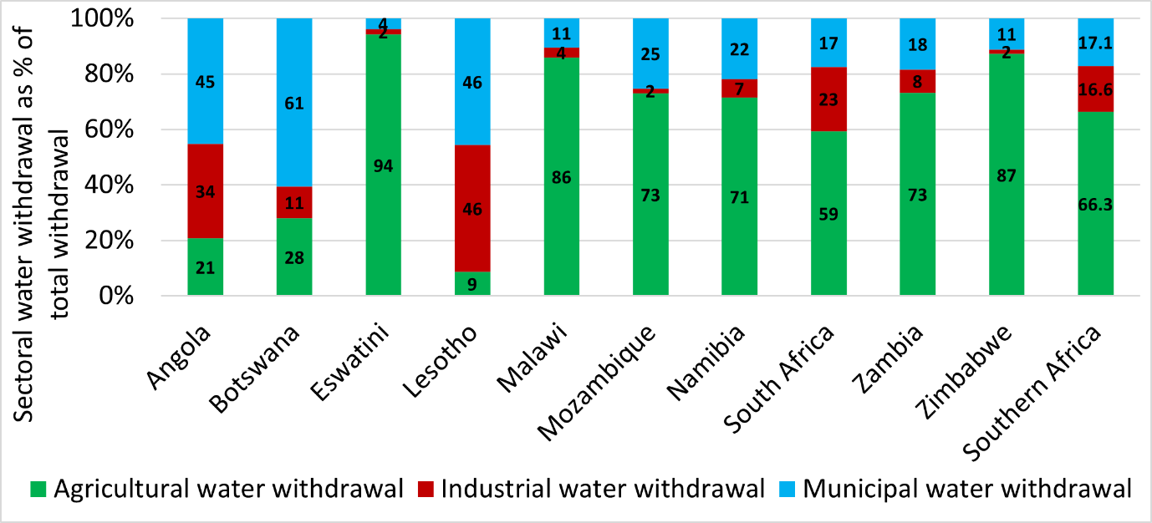
Southern Africa: Sectoral water withdrawal as % of total withdrawal

Slide 27
Basins Under Pressure: some examples
Basin | Challenge | Response
Zambezi | Record-low hydropower (40% capacity Feb 2025) | Solar-hybrid diversification (financial close announced)
Limpopo | Cyclone flooding (Jan 2025) + drought (Mar 2025) | Climate-resilient infrastructure; joint monitoring, Disaster response: “build back better”
Orange-Senqu | Irrigation-demand conflict (2025 growing season) | Benefit-sharing negotiation framework
Save & Limpopo | Transboundary pollution events | Joint monitoring (& WASSMO* opportunity)
The Paradox: Same region, same basins—facing floods AND droughts within months. Climate volatility is the new normal.
WEF Nexus is the coordination mechanism for navigating it.
* WASSMO: Water and Sanitation Sector Monitoring and Reporting System
Notes:
Southern Africa case study sessions at Addis showed the region as a microcosm of continental challenges. Zambezi hydropower at forty percent capacity in February—lowest in decades. Limpopo basin flooding especially in Mozambique in February 2026, and drought conditions shortly thereafter. The same basin, the same region, opposite extremes within weeks. The paradox is stark: we're facing compound, cascading, and simultaneous climate shocks. The WEF nexus isn't optional anymore—it's survival infrastructure. It's how we anticipate trade-offs, manage synergies, and build resilience when certainty is uncertain.

Slide 28
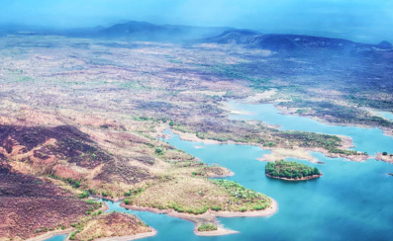
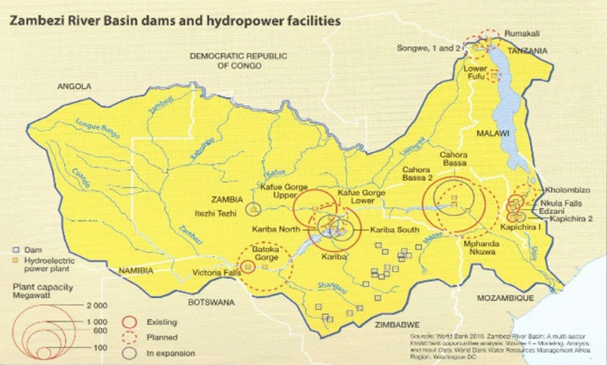
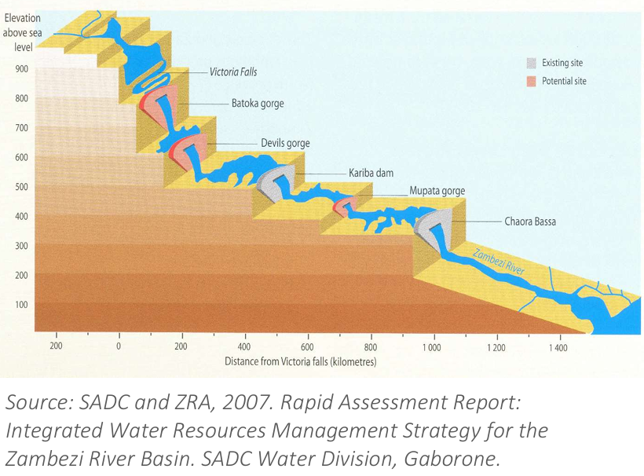
Investment Breakthroughs: Cases:
Case 1: Zambezi Hydropower-Solar Hybrid Facility

Slide 29
Investment Breakthroughs: Cases:
Case 1: Zambezi Hydropower-Solar Hybrid Facility
Metric | Detail
Total mobilization | US$420 million
Sources | GCF + AfDB + private (blended)
Countries | 8 Riparian states
Benefit-sharing | Multi-country framework using WEF Nexus analysis
Gender-responsive elements | 30% of contracts to women-owned enterprises
Youth inclusion | 25% of technical roles to age <35 professionals
Why was this intervention necessary?
Notes:
Need identified – solution identified: WEF Nexus

Slide 30
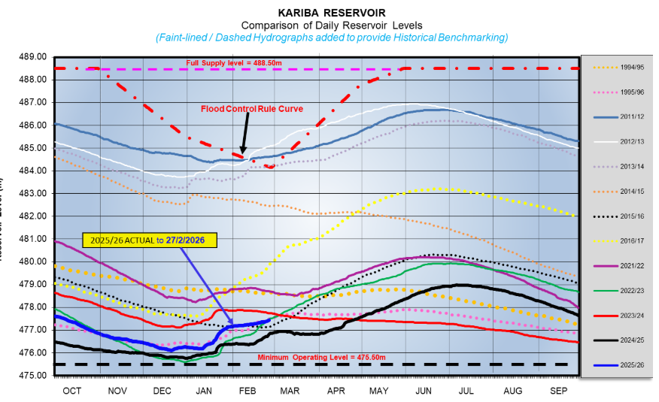
Investment Breakthroughs: Cases:
Case 1: Zambezi Hydropower-Solar Hybrid Facility, and the WEF Nexus response

Slide 31
Investment Breakthroughs: Cases:
Case 1: Zambezi Hydropower-Solar Hybrid Facility, and the WEF Nexus response
Metric | Historical Average | Feb 2025 Reality
Lake Kariba water level | 477m | 475.2m (minimum operating level)
Hydropower generation | 1,050 MW | 420 MW
Load-shedding impact | 4 hours/day | 12 hours/day w/out power (Zambia, Zimbabwe)
Economic loss | — | US$200M+ estimated (Q1 2025)

Slide 32

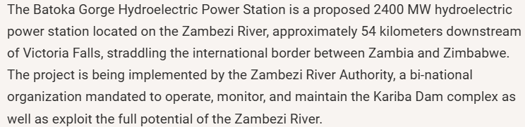
Investment Breakthroughs: Cases:
Case 1: Zambezi Hydropower-Solar Hybrid Facility, and the WEF Nexus response
Interventions:
Zambezi Solar-Hybrid Diversification
Batoka Gorge re-optimization study (assisted self-assessment: World Bank)
Regional power-sharing agreement
Drought early warning integration
Multi-country benefit-sharing framework

Slide 33
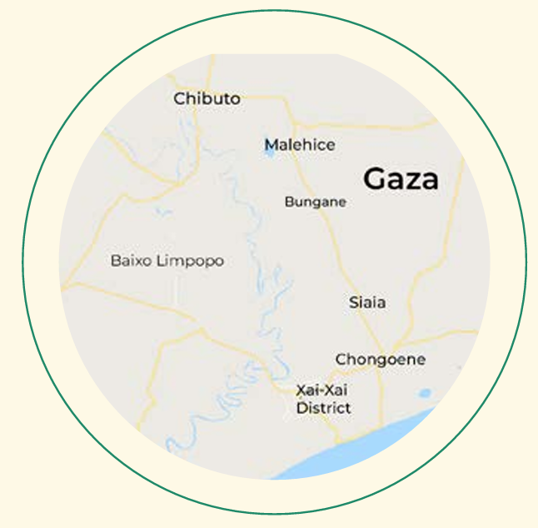
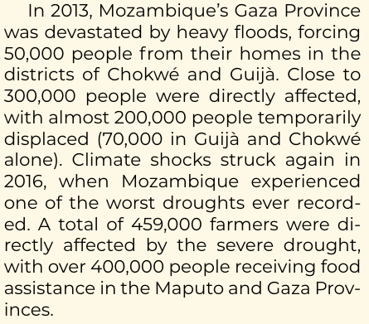
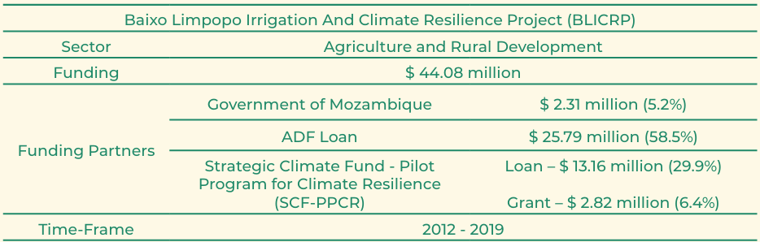
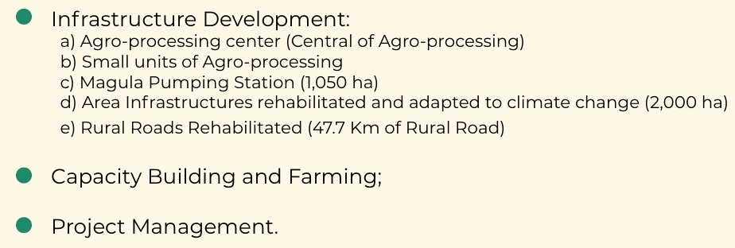
Investment Breakthroughs: Cases:
Case 2: Limpopo Climate-Resilient Irrigation Corridor
https://www.cif.org/sites/cif_enc/files/knowledge-documents/afdb_booklet_baixo_limpopo_irrigation_project.pdf
Notes:
How was it structured? – WEF Nexus written all over it

Slide 34
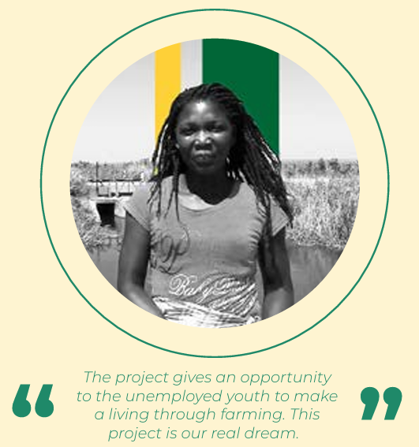
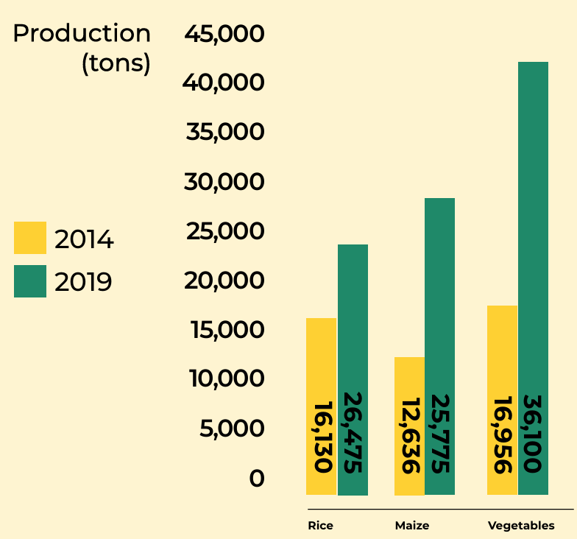
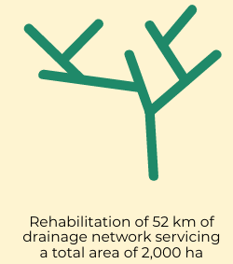
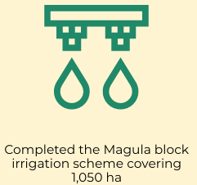
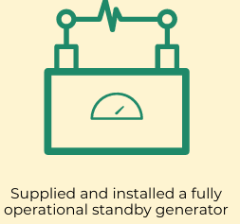
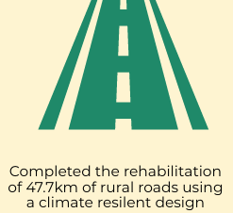

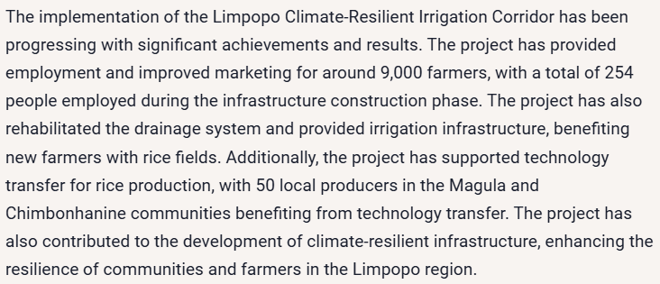
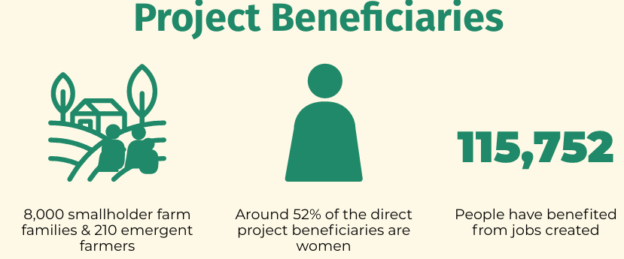
Investment Breakthroughs: Cases:
Case 2: Limpopo Climate-Resilient Irrigation Corridor
https://www.cif.org/sites/cif_enc/files/knowledge-documents/afdb_booklet_baixo_limpopo_irrigation_project.pdf
Notes:
How was it done?

Slide 35

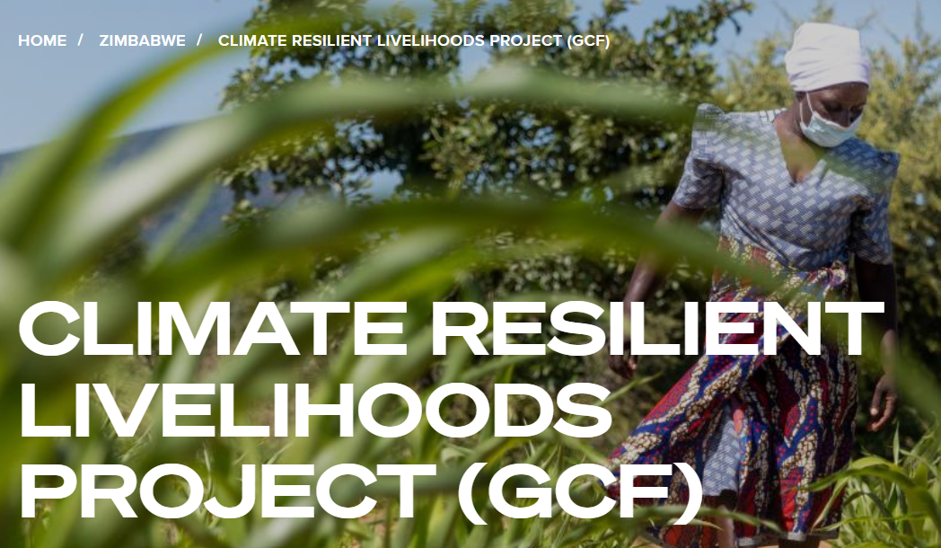
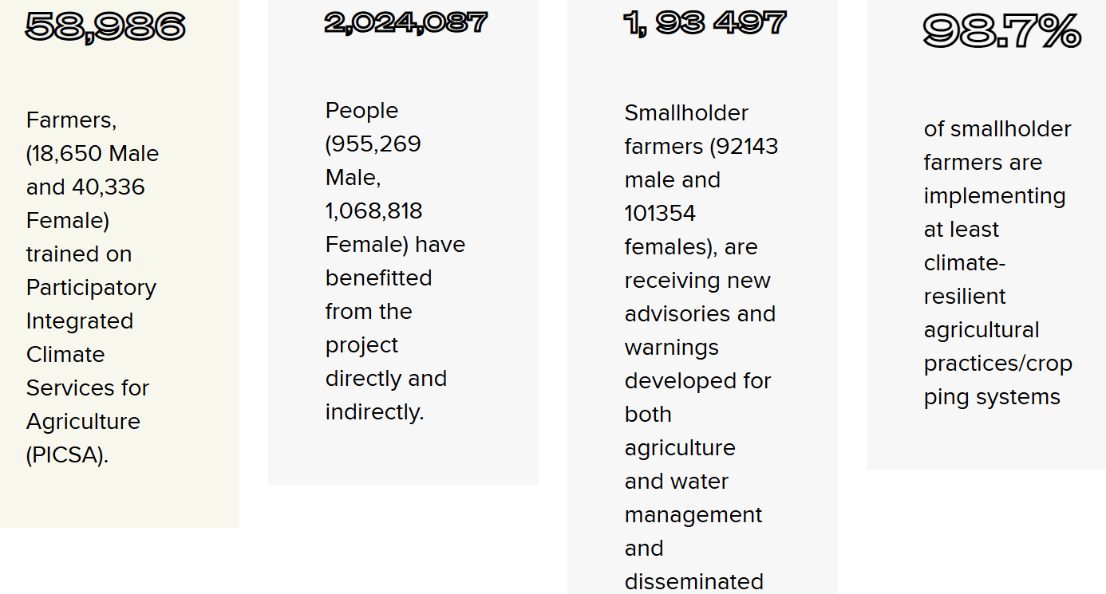
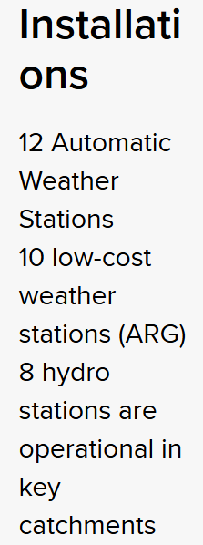
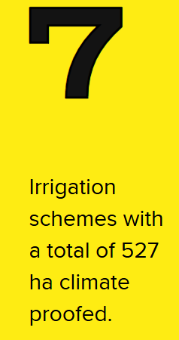
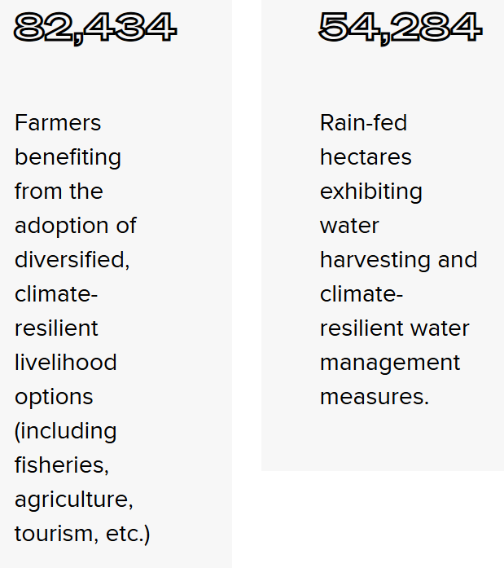
Investment Breakthroughs: Cases:
https://www.undp.org/zimbabwe/projects/building-climate-resilience-vulnerable-gcf
Case 2: Limpopo Climate-Resilience – continuing the legacy,
moving transboundary

Slide 36
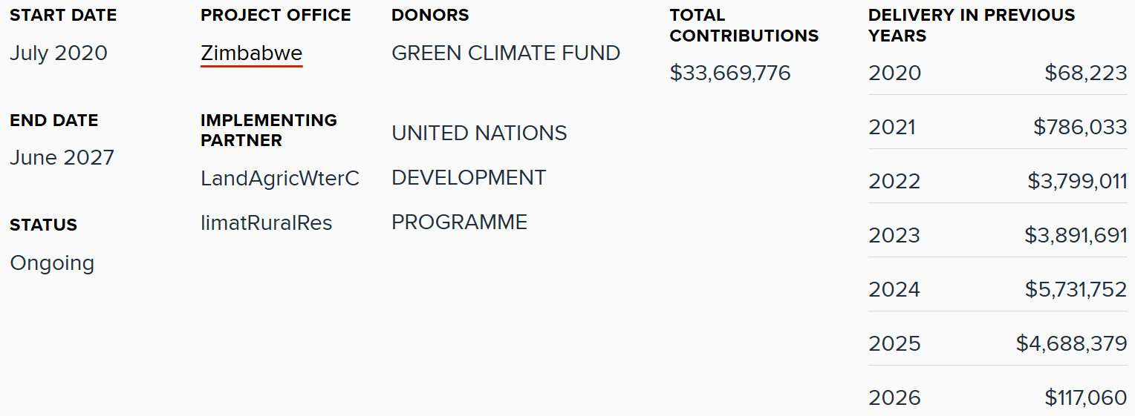
Investment Breakthroughs: Cases:
https://www.undp.org/zimbabwe/projects/building-climate-resilience-vulnerable-gcf
Case 2: Limpopo Climate-Resilience – continuing the legacy,
moving transboundary

Slide 37
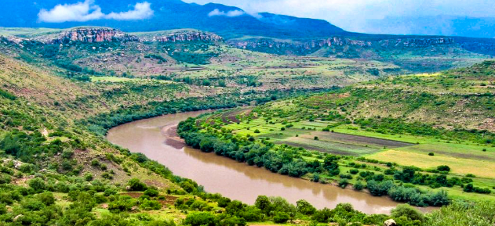
Investment Breakthroughs: Cases:
Case 3: The Orange-Senqu: Benefit-Sharing through WEF Nexus innovation
The Challenge:
Four riparian states (Lesotho, South Africa, Namibia, Botswana)
Competing demands between:
hydropower, irrigation, mining, urban supply, environment
Future Climate projections: 15% runoff reduction by 2030
Existing tensions:Avoiding potential tensions and ensuring equitable utilisation
ORASECOM IWRM plan update
Innovation | Description of the vision
Basin Model | Simulation of water-energy-food scenarios
Benefit-Sharing | Beyond water—hydropower revenue, carbon credits, biodiversity offsets
Youth Climate Corps | 200 young professionals in digital monitoring, modelling
Blended Finance Facility | GCF + AfDB + private for integrated projects
The solution:
Orange-Senqu Nexus
Innovation Corridor:
Notes:
The Innovation Corridor launching in 2026 reimagines transboundary cooperation. Digital twin technology simulating real-time scenarios—so policymakers see consequences before decisions. Benefit-Sharing 2.0 moving beyond water allocation to include hydropower revenues, carbon credits, biodiversity offsets. Youth Climate Corps deploying 200 young professionals. Blended finance facility structuring integrated investments. This isn't incremental—it's next-generation governance.

Slide 38
Investment Breakthroughs: Cases:
Case 3: The Orange-Senqu: Benefit-Sharing through WEF Nexus innovation
The Challenge:
Four riparian states (Lesotho, South Africa, Namibia, Botswana)
Competing demands between:
hydropower, irrigation, mining, urban supply, environment
Future Climate projections: 15% runoff reduction by 2030
Existing tensions:Avoiding potential tensions and ensuring equitable utilisation
ORASECOM IWRM plan update
Project examples some of which are currently being executed by ORASECOM on behalf of project owner countries e.g., Noordoewer/Vioolsdrift Bridging Feasibility Study to look at measures to mitigate impacts of upstream projects e.g., Phase II of Lesotho Highlands Water Project and for re-regulation of flow for the Orange-Senqu River Mouth.
Additional project
examples:
Notes:
The Orange-Senqu WEF Nexus innovation presents real excitement.

Slide 39
Case 4: The WASSMO Concept:
Water and Sanitation Sector Systems Monitoring and Reporting System
Tier | Scale
Tier 1: Continental | AMCOW coordination with AU Commission
Tier 2: Regional | RECs (Regional Economic Communities) integration and transboundary frameworks
Tier 3: National | National WASSMO focal points and institutional capacity building
WASSMO is AMCOW's flagship
continental monitoring platform,
developed in 2015 (UNEP),
now covering all 55 AU Member States.
Notes:
Data interoperability is key: the framework for Water and Sanitation Sector Systems Monitoring and Reporting System
is notable. Three tiers: continental standards, regional platforms, national integration.

Slide 40
Case 4: The WASSMO Concept:
Water and Sanitation Sector Systems Monitoring and Reporting System
Tier | Focus
Tier 1: Continental | Harmonized standards, open data protocols
Tier 2: Regional | Interoperable platforms, shared infrastructure
Tier 3: National | Integrated monitoring, capacity building
WASSMO tracks 7 Thematic areas:
creating WEF Nexus opportunity
Water infrastructure for growth
Managing and protecting water resources
Water supply, sanitation, hygiene and wastewater
Climate change and disaster risk reduction (DRR)
Governance and institutions
Financing
Information management and capacity development
Notes:
WASSMO currently tracks 7 thematic areas across water and sanitation. This architecture creates opportunities for cross-sectoral data integration – particularly linking water security data with energy (for water infrastructure operations) and food security (irrigation, agricultural water use).
Water infrastructure for growth
Managing and protecting water resources
Water supply, sanitation, hygiene and wastewater
Climate change and disaster risk reduction (DRR)
Governance and institutions
Financing
Information management and capacity development
These themes are associated with 28 sub-themes and 43 indicators, providing a comprehensive framework for monitoring progress in the water and sanitation sector in Africa.

Slide 41
Case 4: The WASSMO Concept:
Water and Sanitation Sector Systems Monitoring and Reporting System
Tier | Focus
Tier 1: Continental | Harmonized standards, open data protocols
Tier 2: Regional | Interoperable platforms, shared infrastructure
Tier 3: National | Integrated monitoring, capacity building
Current Gaps & Opportunities to Improve WASSMO:
Data completeness & timely reporting
Real-time data and continuous reporting
Cross-sectoral integration
Subnational granularity
Improvement Opportunities for WEF Nexus Applications
Integrate remote sensing
Develop cross-sectoral indicators
Enhance interoperability
Strengthen the WASSMO-Scorecard nexus
operationalisation
Notes:
Address the "Opportunities to Improve WASSMO Reporting Protocol"
Based on recent continental dialogues, here are concrete improvement areas:
Current Gaps:
Data completeness: Many Member States still face capacity constraints in timely reporting
Real-time data: The system relies on periodic reporting cycles rather than continuous monitoring
Cross-sectoral integration: WASSMO focuses on water/sanitation but lacks systematic linkages to energy and food security data systems
Subnational granularity: Limited capacity to capture basin-level or subnational variations
Improvement Opportunities for WEF Nexus Applications:
Integrate remote sensing (as shown in your "Core Components") to enable real-time monitoring and reduce reporting burden
Develop cross-sectoral indicators that capture WEF interlinkages (e.g., energy use in water infrastructure, water allocation for agriculture)
Enhance interoperability with other AU systems, particularly PIDA infrastructure monitoring and agricultural information systems
Strengthen the WASSMO-Scorecard nexus: Create automated data flows between WASSMO (monitoring outcomes) and the AIP-PIDA Scorecard (tracking investments and enabling environment)

Slide 42
Case 4: The WASSMO Concept:
Water and Sanitation Sector Systems Monitoring and Reporting System
Tier | Focus
Tier 1: Continental | Harmonized standards, open data protocols
Tier 2: Regional | Interoperable platforms, shared infrastructure
Tier 3: National | Integrated monitoring, capacity building
Evolutionary pathway:
IoT-based hydrological monitoring network
Remote sensing integration (satellite + drone)
Shared dashboards with real-time visualization
Cross-border data-sharing agreements (standardized template)
Maintenance financing mechanism (0.5% of infrastructure budgets)
Enhance WASSMO Capabilities
Evolutionary pathway:
IoT-based hydrological monitoring networks → reduces reporting burden, enables real-time tracking
Remote sensing integration → improves spatial coverage, transboundary monitoring
Shared dashboards with real-time visualization → enhances transparency, facilitates decision-making
Cross-border data-sharing agreements → critical for transboundary WEF Nexus governance
Maintenance financing mechanism → sustainability challenge for continental monitoring infrastructure
Notes:
Evolutionary pathway: Internet-of-Things for linking sensors to monitoring databases, satellite remote sensing, shared dashboards, cross-border data agreements, and infrastructure maintenance financing: which can be digitally tracked with AI features and semi or even fully automated, to enable improved monitoring.
The 0.5% mechanism in infrastructure maintenance and monitoring is important: —dedicating half a percent of infrastructure budgets to monitoring—addresses the sustainability gap that kills so many data systems. WASSMO transforms fragmented systems into integrated intelligence.
Current WASSMO Capabilities:
Web-based reporting platform with harmonized indicators
Covers all 55 AU Member States
Tracks progress on Sharm el-Sheikh Commitments, Africa Water Vision 2025, Agenda 2063, and SDG 6

Slide 43
Continental Water Monitoring Architecture – WASSMO & AIP-PIDA Scorecard
Case 4+:
A Model for Integrated WEF Nexus Governance, Finance, and Data Systems
Multi-tier Governance Architecture (Continental/Regional/National coordination)
Dual Monitoring Systems:
  WASSMO: Outcomes monitoring
  AIP-PIDA Scorecard: Investment tracking and governance assessment
Core Operational Components (IoT networks, remote sensing, dashboards, data-sharing protocols, financing mechanisms)
Interoperability and Reform Pathways:
  Standardized templates enabling cross-border coordination
  Investment accountability loops (monitoring → needs identification → investment tracking → performance assessment)
  Data integration opportunities for WEF Nexus applications
Lessons for WEF Nexus Governance:
  Harmonization at scale (55 countries)
  Multi-level accountability mechanisms
  Integration of monitoring and investment tracking
  Replicable model for cross-sectoral (water-energy-food) coordination
Notes:
Title: "Case Study: Continental Water Monitoring Architecture – WASSMO & AIP-PIDA Scorecard"
Subtitle: "A Model for Integrated WEF Nexus Governance, Finance, and Data Systems"
Content Framework:
Multi-tier Governance Architecture (Continental/Regional/National coordination)
Dual Monitoring Systems:
WASSMO: Outcomes monitoring
AIP-PIDA Scorecard: Investment tracking and governance assessment
Core Operational Components (IoT networks, remote sensing, dashboards, data-sharing protocols, financing mechanisms)
Interoperability and Reform Pathways:
Standardized templates enabling cross-border coordination
Investment accountability loops (monitoring → needs identification → investment tracking → performance assessment)
Data integration opportunities for WEF Nexus applications
Lessons for WEF Nexus Governance:
Harmonization at scale (55 countries)
Multi-level accountability mechanisms
Integration of monitoring and investment tracking
Replicable model for cross-sectoral (water-energy-food) coordination

Slide 44
Presentation Outline
Setting the Scene: From Concept to Continental Imperative
Structural Reform Pillars
Key Achievements and Breakthroughs (2024-2025)
Case Studies from Southern Africa
Future Direction: From Dialogue to Architecture (2025-2030 Agenda)

Slide 45
Persistent Challenges: The Reality check across Africa:
Challenge 1: NDA Mandate Rigidity
70% of NDAs still lack explicit transboundary processing authority
Multi-country proposals average 14 months longer than single-country
Solution: Model legislation for expanded mandates
Challenge 2: Monitoring System Sustainability
  60% of hydrological monitoring stations underfunded for maintenance
  Average station lifespan: 7 years vs. 15-year design life
  Solution: 0.5% + infrastructure budget set-aside: and harness the investment pyramid “bottom sections”
Challenge 3: Digital Standards Fragmentation / Infrastructure Maintenance
different hydrological data standards across countries
Interoperability gap costs
Solution: Harmonized Protocols
Challenge 4: Multi-Country Template Adoption / Transboundary
  Few major basins using standardized templates
  Majority of climate finance proposals still single-country
  Solution: Mandatory multi-country template for basin proposals
Notes:
Only ten of twenty-five basins reported to be using standardized templates. But solutions are in sight. Model legislation for expanded NDA mandates. Harmonized Protocol potential. Infrastructure maintenance approaches > enhancing regional appetite for investment. Multi-country finance templates. The challenges are structural. The solutions are architectural. The future is about implementation.

Slide 46
Considering WEF Nexus finance flows: the AU-AIP Investment Pyramid
As example: Water investment origins and flows

Slide 47
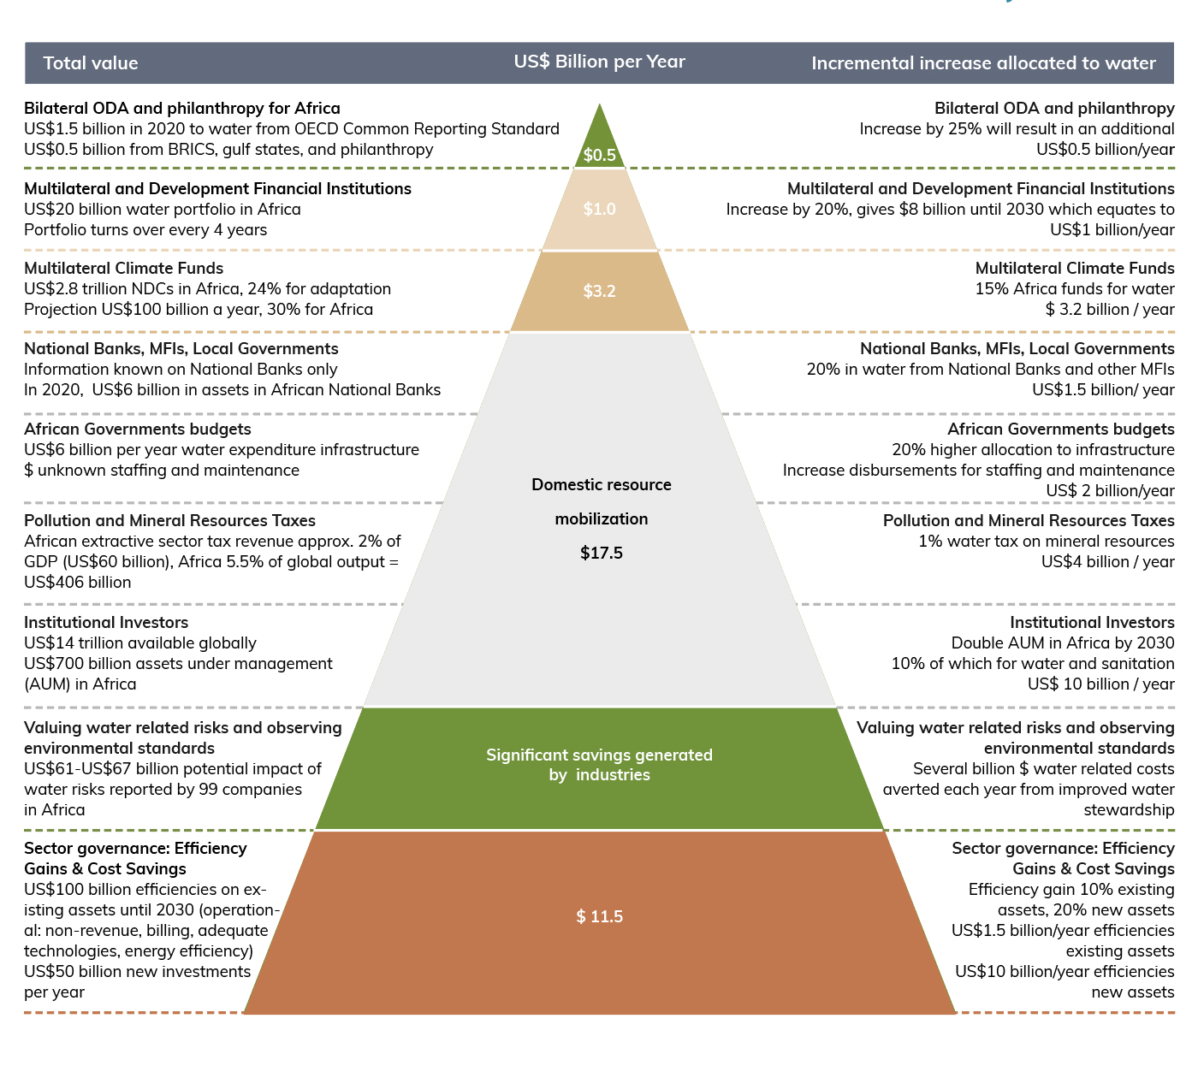
AU-AIP Pyramid of resource investment transformation towards $30billion/year

Slide 48
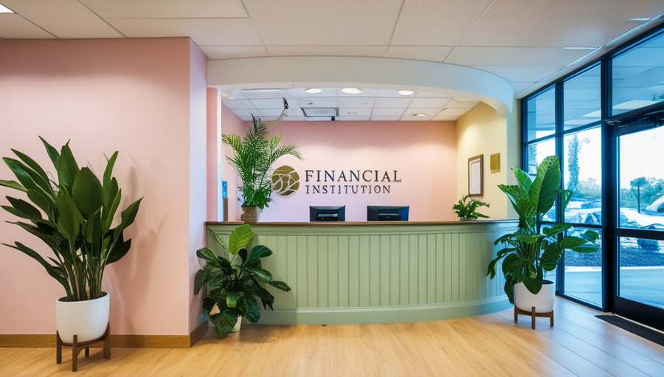


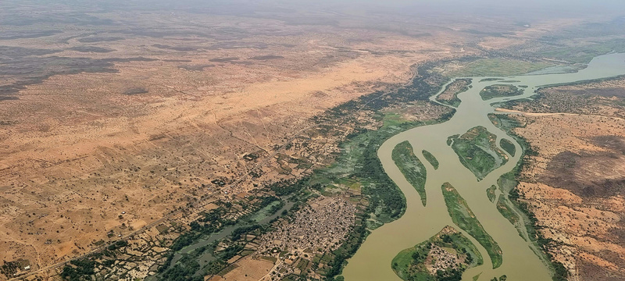


Investment Sources and Value
Key Actions Needed to Unlock Investment sources
  Renew eftectiveness &Donor coordination
  Leverage private and implement results-based financing
$0.5
Multilateral and Development Financial Institutions
• Improve national loan conditions (affordability of capital)
• Coordinate and strengthen national project facilities
• Leverage humanitarian and private finance and implement results-based financing revolving finance
Additional US$1b/year
Multilateral Climate Funds
Additional US$3.2 b/year
  Communicate evidence on water-climate linkages
  Integrate water into National Adaptation Plans and National-determined contributions
Key Focus: Coordinate
across sectors!

Slide 49
AU-AIP Pyramid of resource investment transformation towards $30billion/year

Slide 50
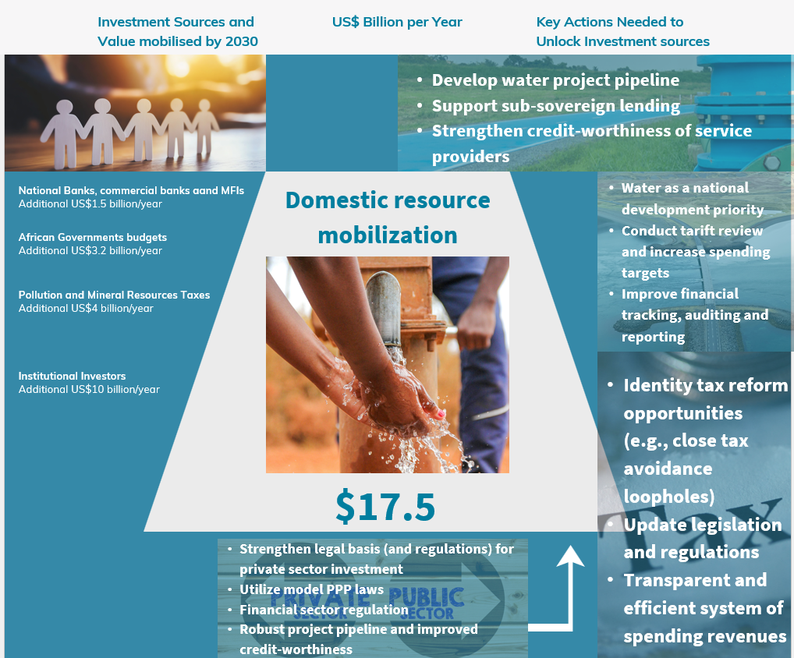
Non-Revenue Water Losses reduction!

Slide 51
AU-AIP Pyramid of resource investment transformation towards $30billion/year

Slide 52
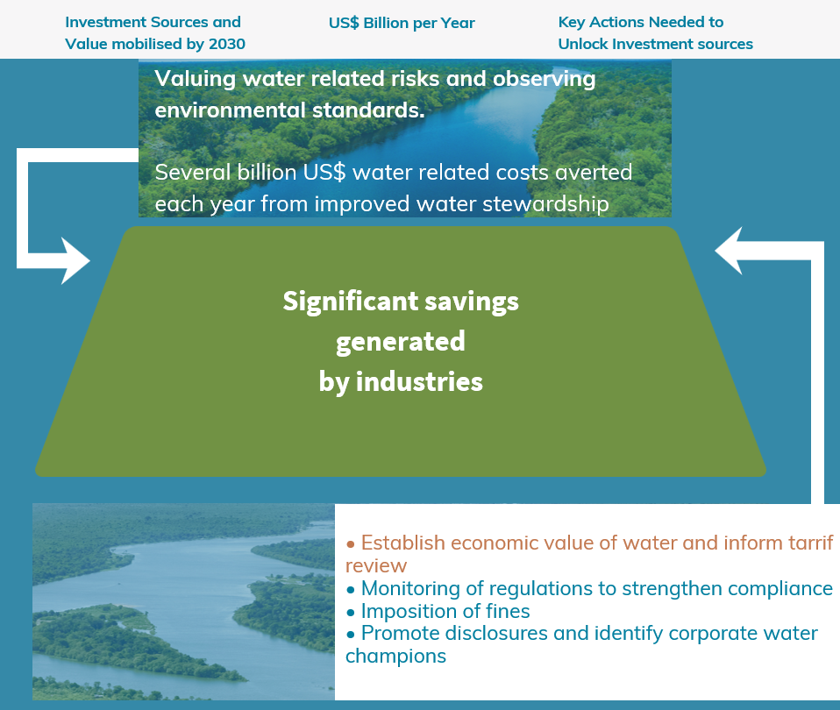
Valuing and recording loss and damage
Improve cross-sectoral stewardship
and SECTORS!
Promoting a “whole of society approach”

Slide 53
AU-AIP Pyramid of resource investment transformation towards $30billion/year

Slide 54
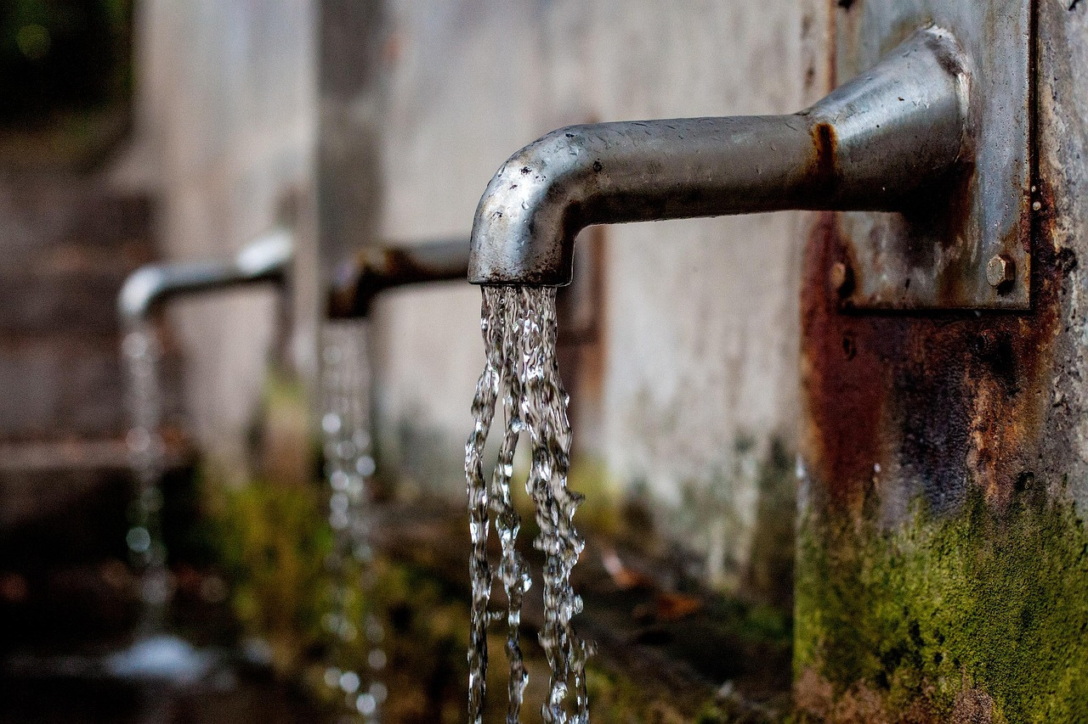
• Commit funds to strengthen enabling environment for resource investment
• Develop comprehensive, multi-sectoral, costed regional national investment programme
• Strengthen public financial management, cross-sectoral, and monitoring, evaluation, reporting and learning (MERL) systems
• Sector benchmarking & performance improvements
• Improve efficiencies. GEDSI and safeguarding & redress.
National spheres Governance: Efficiency Gains
& Cost Savings
US$1.5 bn/year efficiencies re: existing assets/processes
US$10 bn/year efficiencies re: new assets/processes
$ 11.5

Slide 55
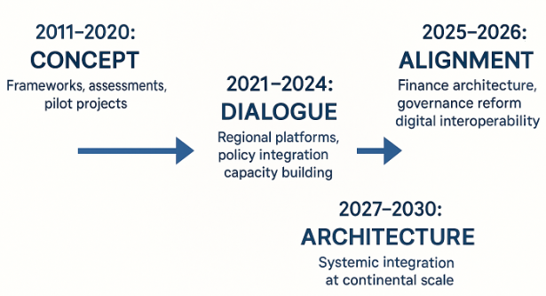

The WEF Nexus Evolution
Domain | Current Focus | Future Vision
Finance | RBO accreditation pathways, blended facilities | Direct access for all major basins
Governance | Expanded NDA mandates, benefit-sharing frameworks | Basin cooperation as default
Digital | WASMO, harmonized standards | Real-time continental intelligence
Infrastructure | Misalignment in Finance vs Planning and Operations | Align Ministry of Finance allocations with Ministry of Water Plans; % Maintenance
Inclusion | Structural representation: in RBOs, TFCAs, Projects | Intergenerational governance
Investment | Bankable multi-country proposals | Finance mobilized
Notes:
The transformation agenda is clear: direct climate finance access in a transboundary and WEF-nexus context, basin/catchment-wide approach and transboundary cooperation as default, real-time continental intelligence, intergenerational governance and finance mobilization. This isn't aspiration—it’s deliberate architecture.

Slide 56

Southern Africa Synthesis: From Dialogue to Architecture:
Dimension | 2020 Baseline | 2025 Reality | 2026 Trajectory
Dialogue | Occasional workshops | Permanent RBO-NDA platforms; TFCA’s | All SADC countries & basins
Data | Fragmented standards | WASSMO improvement, data sharing, systems interoperability | Full interoperability & automated monitor & reporting
Finance | Financing not speaking to Ministerial priorities Limited transboundary mobilisation | Blended facilities (Est 2 operational) Finance ministries becoming aware of Ministerial Plans and needs | 4(+) facilities Integrate budget allocation with plans
Governance | Sectoral silos | Benefit-sharing frameworks (transbndy) | All major basins
Inclusion | Consultation | Youth seats (in RBOs, TFCAs), GEDSI as standard inclusion | Structural across region
Investment | (2?) bankable proposals | Est 16 bankable proposals | 25(+) proposals
Dialogue → Data → Finance → Investment → Governance →
Infrastructure → Inclusion
Technical capacity exists. Dialogue is strong. Implementation alignment is the frontier.

Slide 57
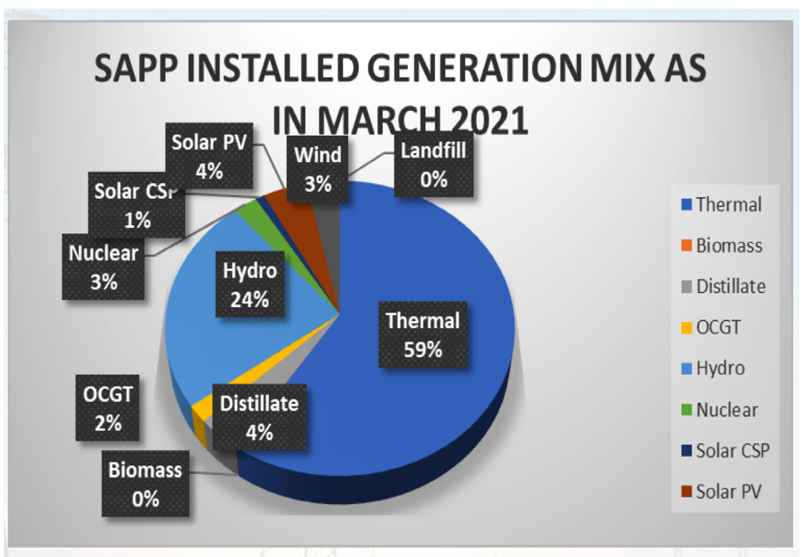
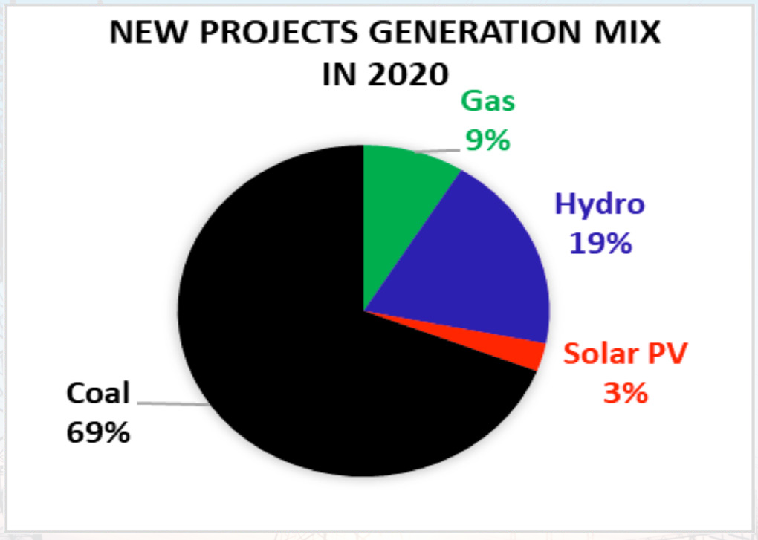
Southern Africa: Water for energy
SAPP installed generation mix as in March 2021
Generation mix for new generation capacity installed in 2020

Slide 58
Southern Africa: Reflecting on WEF-related institutions: Reduce the disconnect!
Sector | Regional Structures | Objectives/mandates
Food, Agriculture, Natural Resources | Food, Agriculture and Natural Resources (FANR) Directorate | Development, coordination and harmonisation of agricultural policies and programmes
Water, Energy | Infrastructure and Services Directorate | Development, coordination and harmonization of Energy, Transport and Communications, Trade, Tourism and Water policies, Disaster Risk Reduction, Regional strategies, protocols, programmes and projects. Coordination and promotion of integrated management of trans-boundary water (River Basin Organisations, Transfrontier Conservation areas, tourism, trade corridors, transport and communication and energy resources for regional integration and development.
 | Water Division SADC-RBOs | To oversee harmonisation of national water use policies, and moderate transboundary issues.
 | SADC Centre for Renewable Energy and Energy Efficiency (SACREEE) Southern African Power Pool (SAPP) Regional Energy Regulators Association (RERA)
Member State governments are typically structured in a functional and sectoral manner that tends to reinforce silos, rather than support collaboration, integration, and coordination. Ministries of Finance often allocate budgets without having sight of the Sector-specific Plans. Transboundary organisations including RBOs, TFCA,s and International Development Partner mandates and processes lend itself to improved WEF Nexus interactions and integration.

Slide 59
Southern Africa: Integrated governance mechanisms –
From WEF Nexus regional dialogues
SADC embraced integrated mechanisms for governing and managing WEF-related resources, including:
  integrated water resources management (IWRM)
  WEF nexus approach for:
    facilitate integrated planning and implementation of initiatives that will drive water, energy, and food security;
    ensuring simultaneous achievement of water, energy, and food security in the region through optimization of investments; and
    improving sustainable use and management of natural resources underpinning regional development.
Some SADC countries have embraced IWRM and the WEF nexus; RBO’s and TFCA’s also

Slide 60
Southern Africa: Water-related policy framework
The SADC Declaration and Treaty (1992)
The SADC Regional Indicative Strategic Development Plan (2003, 2007, 2015, And 2020-30)
The SADC Revised Protocol on Shared Watercourses (2000)
The Southern African Vision for Water, Life and the Environment in the 21st Century (2000)
The SADC Regional Water Policy (RWP) (2005)
The SADC Regional Water Strategy (2006)
The SADC Regional Awareness and Communication Strategy for the Water Sector (2009)
The SADC Regional Strategic Action Plans (RSAPs): I, II, III, IV, and V
The SADC Guidelines for Strengthening River Basin Organisations (2010)
Climate Change Adaptation in SADC: Strategy for the Water Sector (2011)
The SADC Regional Infrastructure Development Master Plan (2012)
The SADC Industrialisation Strategy and Road Map (2015-2063)
UN Sustainable Development Goal on Water (SDG6)

Slide 61
Southern Africa: Energy-related policy framework
The SADC Declaration and Treaty (1993)
SADC Energy Protocol (1996)
The SADC Energy Cooperation Policy and Strategy (1996)
The SADC Energy Action Plan (1997) And (2000)
The SADC Regional Indicative Strategic Development Plan (2003, 2007, 2015)
The SADC Regional Energy Access Strategy and Action Plan (2010)
The SADC Regional Infrastructure Development Master Plan (2012)
The SADC Renewable Energy and Energy Efficiency Strategy and Action Plan (REEESAP) (2017)
SAPP Plans
The SADC Industrialisation Strategy and Road Map (2015-2063)
RERA Instruments
UN Sustainable Development Goal on Energy (SDG7)

Slide 62
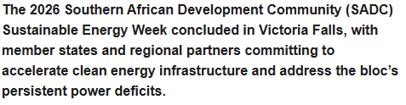
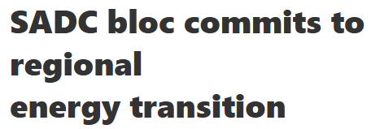
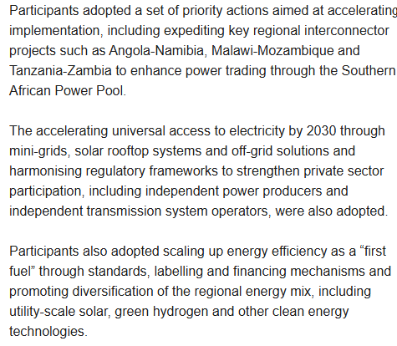
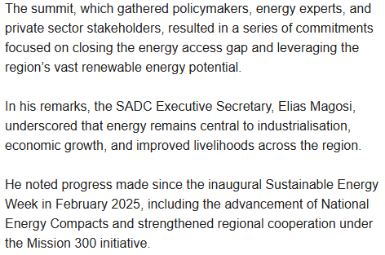
2026 SADC Sustainable Energy Week:
https://climatebrief.co.zw/
Hosted by Zimbabwe through the Ministry of Energy and Power Development from 23-27 February 2026, the Conference was held under the theme “Driving Regional Economic Growth Through Clean Energy and Energy Efficiency.”

Slide 63
Southern Africa: Food-related policy framework
The SADC Declaration and Treaty (1993)
SADC Protocol on Wildlife Conservation and Law Enforcement (1999)
SADC Protocol on Fisheries (2001)
Dar-es-Salaam Declaration on Agriculture and Food Security in the SADC Region (2004)
The SADC Regional Indicative Strategic Development Plan (RISDP) (2003, 2007, 2015)
Charter Establishing the Centre for Coordination of Agricultural Research and Development (CCARDESA) (2010)
The SADC Regional Infrastructure Development Master Plan (RIDMP) (2012)
SADC Regional Agriculture Policy (2014)
The SADC Industrialisation Strategy and Road Map (2015-2063)
SADC Control Strategy for Peste de Petit Ruminants (PPR) (2010)
UN Sustainable Development Goal on Hunger (SDG2)

Slide 64
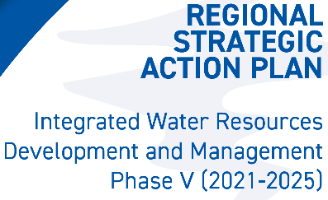

Southern Africa: The nexus and IWRM in WEF-related policy –
From nexus regional dialogues

Slide 65

Southern Africa: The nexus in WEF-related institutions –
From nexus regional dialogues
SADC’s Regional WEF Nexus Governance Framework has the WEF Nexus:
  Working Group,
  Joint Technical Committee, and
  Joint Ministers’ Committee.

Slide 66

Southern Africa: Coherence of WEF-related policy frameworks –
From WEF Nexus regional dialogues

Slide 67

Extending the Nexus
On 6 March 2026 at the Global Leaders Dialogue during the International Conference on ESG Transversality for the Sustainable Water–Energy–Health–Environment Nexus in New Delhi, India, Mr. Alex Simalabwi, CEO of the Global Water Partnership Organisation and Executive Secretary of GWP, shared two reflections on the future of global water leadership.
1. If water connects everything, then water cooperation and investments must connect everyone.
2. If the twentieth century was defined by competition for natural resources, the twenty-first century must be defined by investments in water and cooperation for sustainable water security.

Slide 68

Continental Africa: Reframing Africa’s WEF Nexus as an Engine of Integration
Reframing the Transboundary WEF Nexus:
From: | To:
Sources of tension > | Economic corridors
Climate vulnerability > | Climate buffers
Sectoral competition > | Food-energy-water systems
Biodiversity hotspots > | Ecosystem infrastructure
Border disputes > | Peacebuilding platforms
Institutional disconnect > Integration of National
Plans with Fiscal /
Annual budgeting
https://www.scirp.org/journal/paperinformation?paperid=116535
Notes:
Lets zoom Back to Africa as continent, knowing now the Southern Africa cases in point: How we frame transboundary WEF-matters is important. If we see WEF Nexus components as sources of tension, we manage conflict. If we see them as part of economic corridors, we build prosperity. These aren't just water-energy-food projects—they're regional integration platforms. Shared waters transform from risk into opportunity when governance, finance, and data systems align.

Slide 69

Continental Africa: The call to action – it starts with each of us
Africa Has Technical Capacity. What Must Be Strengthened:
✓ Coordinated implementation
✓ Institutional alignment
✓ Structured follow-through
✓ Sustained financing for systems
✓ Intergenerational governance
The WEF Nexus Is No Longer Just Discourse.: It Is Infrastructure Governance. The Question for Each of Us:
"In your country, your institution, your sector—which reform will you champion to unlock transboundary implementation?"
Climate finance alignment?
Multi-country governance mandates?
Digital data interoperability?
Structural inclusion?
Sustained financing?
Notes:
Africa has the technical capacity. We have the hydrologists, climate scientists, engineers, economists, and digital experts. What we need now is coordinated implementation, institutional alignment, structured follow-through, sustained financing for systems, and intergenerational governance. The WEF nexus is no longer just discourse—it's infrastructure governance. The question for each of us: in your basin, your country, your institution, your sector—which reform will you champion to unlock transboundary implementation? Climate finance alignment? Multi-country governance mandates? Digital interoperability? Structural inclusion? Sustained financing? Choose one. Start there. It starts with how we frame research papers, how we frame proposals, how we compile reports, how we collect and analyse data and how we present it – whether it is in research, academia, development or governance to civil society.

Slide 70
maryna.storie@gwpsaf.org
loreen.katiyo@gwpsaf.org
tafadzwanashe.mabhaudhi@unu.edu

