Slide 1

Open source
Nexus modelling tools for Planning sustainable Energy
Transition in Africa
WEFE Nexus Masterclass
15th May 2025

Slide 2
WEF Nexus Integration in Transboundary Policies and Instruments
Aim: To deepen understanding of how the WEF Nexus can be operationalised within transboundary policies and governance frameworks to drive sustainable development and climate resilience in Africa.
Focus: Integration of the WEF Nexus into international and regional agreements, with emphasis on governance, institutional architecture, and cross-sectoral collaboration.
Scope: Explores both policy-level and practical mechanisms - such as joint decision-making, harmonised regulations, and shared data systems - that support adaptive, inclusive, and investment-ready systems.
Systems Perspective: Emphasises systems thinking to address the interdependencies across water, energy, food, and environmental sectors, reinforcing the importance of coherence, feedback loops, and resilience.
Geographical Relevance: Anchored in African transboundary contexts, using global frameworks and regional case studies (e.g. BRIDGE, SDG 6.5.2) to illustrate real-world integration pathways.
Takeaway: Integration is not a choice but a necessity—effective transboundary governance enables equitable development, secures ecosystems, and unlocks sustainable investment.

Slide 3
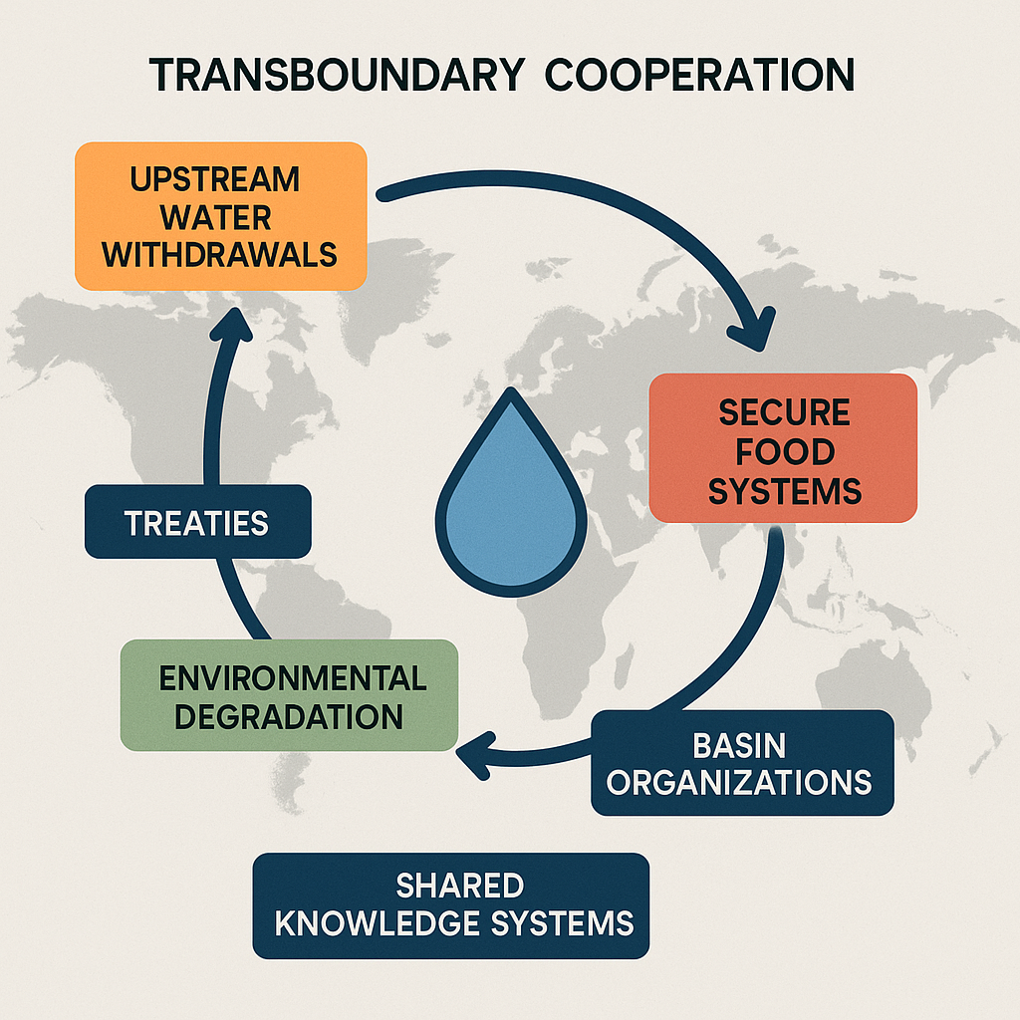
WEF Nexus Integration in Transboundary Policies and Instruments
WEF systems are regionally shared: upstream actions like water withdrawals or land degradation directly affect downstream energy, ecosystems, and food security across borders.
Secure food systems depend on cooperation: without regional alignment, export bans, irrigation pressures, or trade disruptions can destabilise supply chains and trigger price shocks.
Integration requires governance infrastructure: treaties, conventions, basin organisations etc and shared data platforms are essential to manage interdependencies and prevent conflict.
The goal is shared development, not sovereign isolation: moving from fragmented national actions to coordinated regional strategies ensures resilience and investment viability.

Slide 4
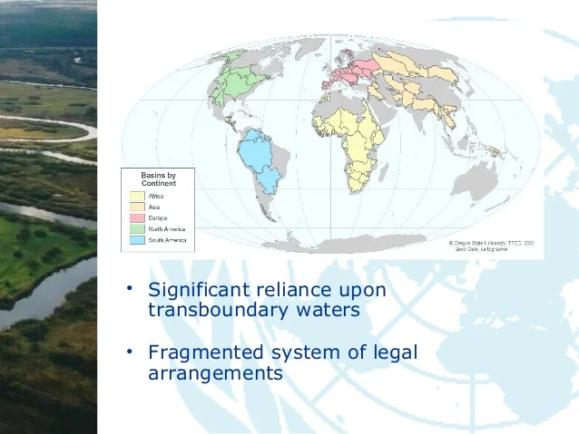
Global Transboundary Agreements
This Source: IUCN BRIDGE

Slide 5
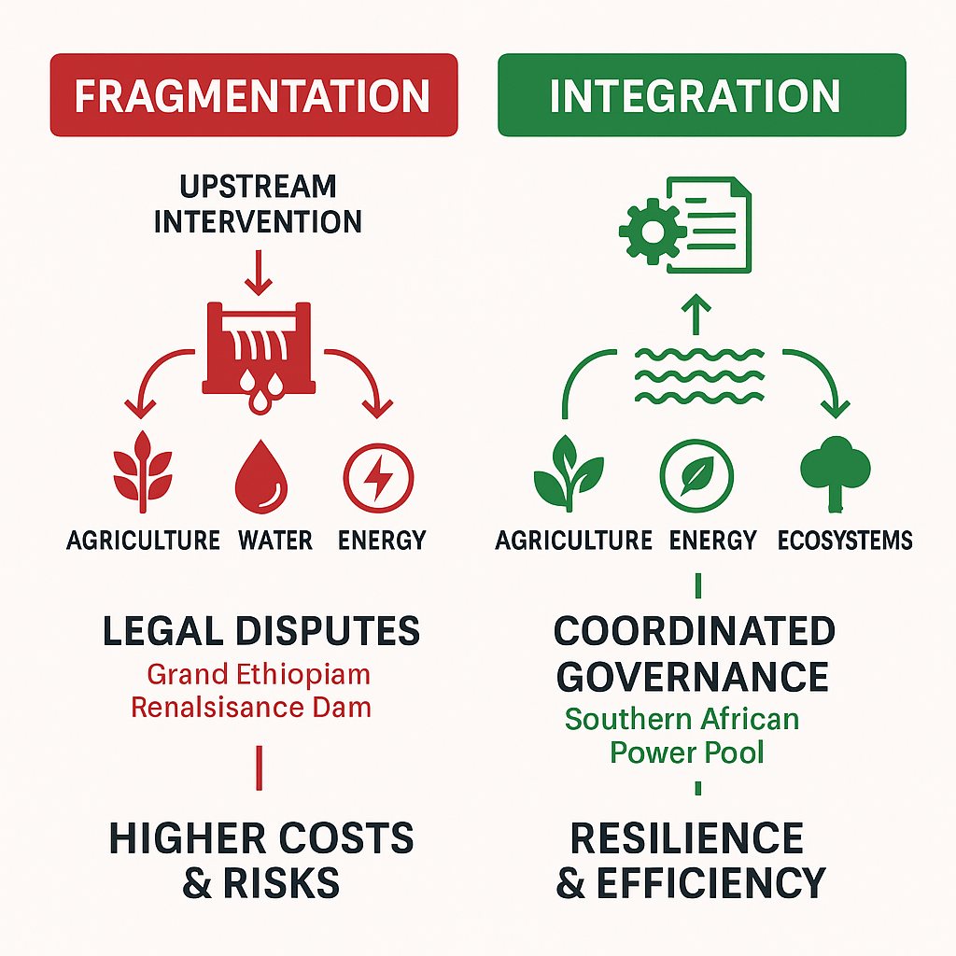
WEF Nexus Integration in Transboundary Policies and Instruments
Why Transboundary Integration Matters
Fragmentation disrupts complex systems and amplifies cascading risks
Integration restores feedback loops and systemic coherence
Transboundary institutions stabilise socio-political complexity
Integration advances equitable development and ecosystem integrity
Integrated systems are adaptive, investment-ready, and future-fit

Slide 6
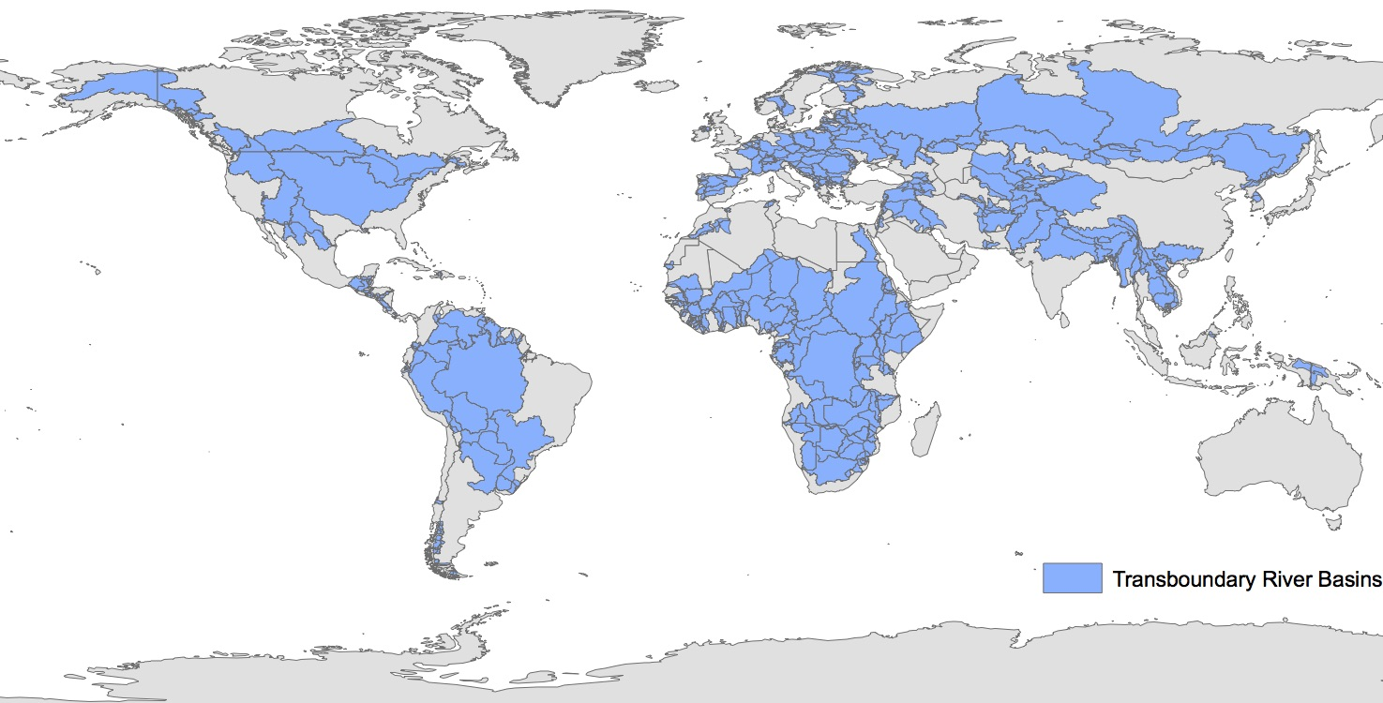
Global Transboundary Agreements
IUCN

Slide 7
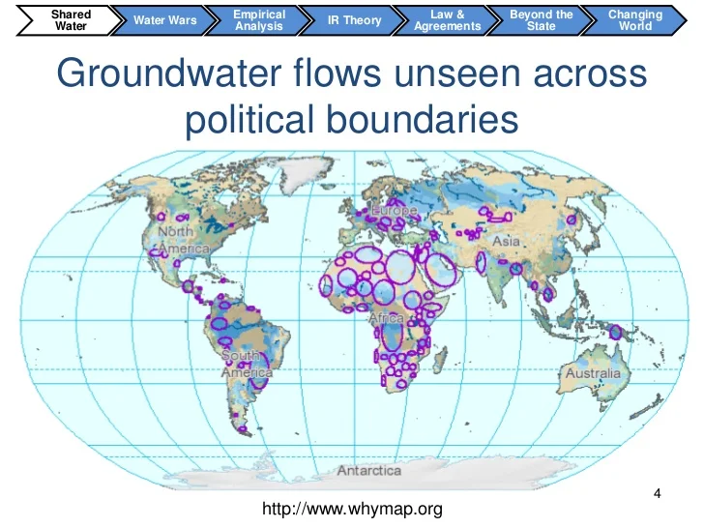
Global Transboundary Agreements
IUCN

Slide 8
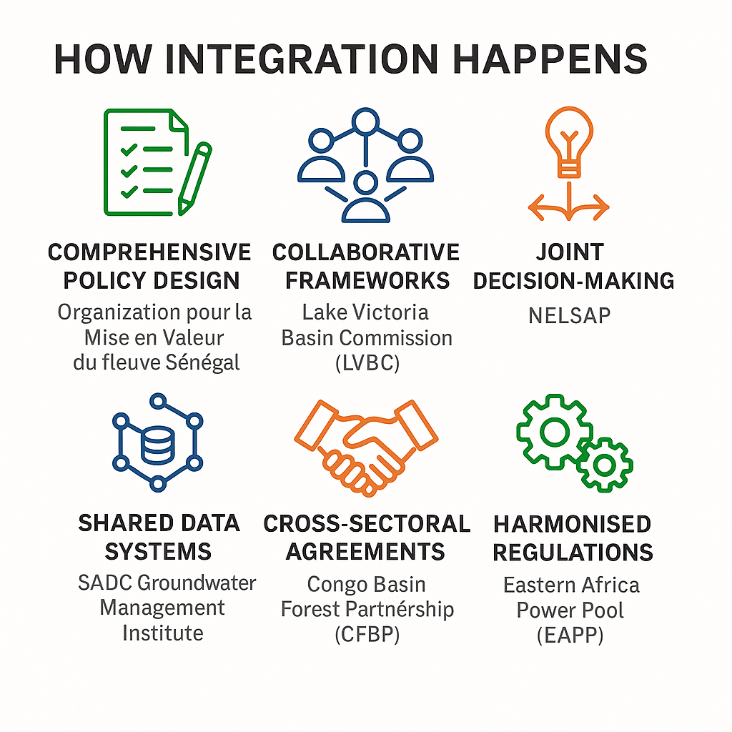
WEF Nexus Integration in Transboundary Policies and Instruments
How Integration Happens
Comprehensive Policy Design: Co-owned systems internalise trade-offs and distribute benefits, reducing asymmetries and creating systemic stability.
Collaborative Frameworks: Collaborative frameworks allow for adaptive learning, decentralised feedback, and continual course correction.
Joint Decision-Making Mechanisms: Distributed decision-making prevents unilateralism, enhances collective foresight, and builds institutional trust.
Shared Data and Knowledge Systems: Common information baselines enable shared situational awareness and reduce epistemic conflict.
Croos-Sectoral Agreements: Cross-sector agreements prevent optimisation of one subsystem at the expense of others (e.g., energy vs biodiversity).
Harmonised Regulations: Harmonised rules create a frictionless interface between subsystems, enabling efficient resource exchange and scalability.

Slide 9
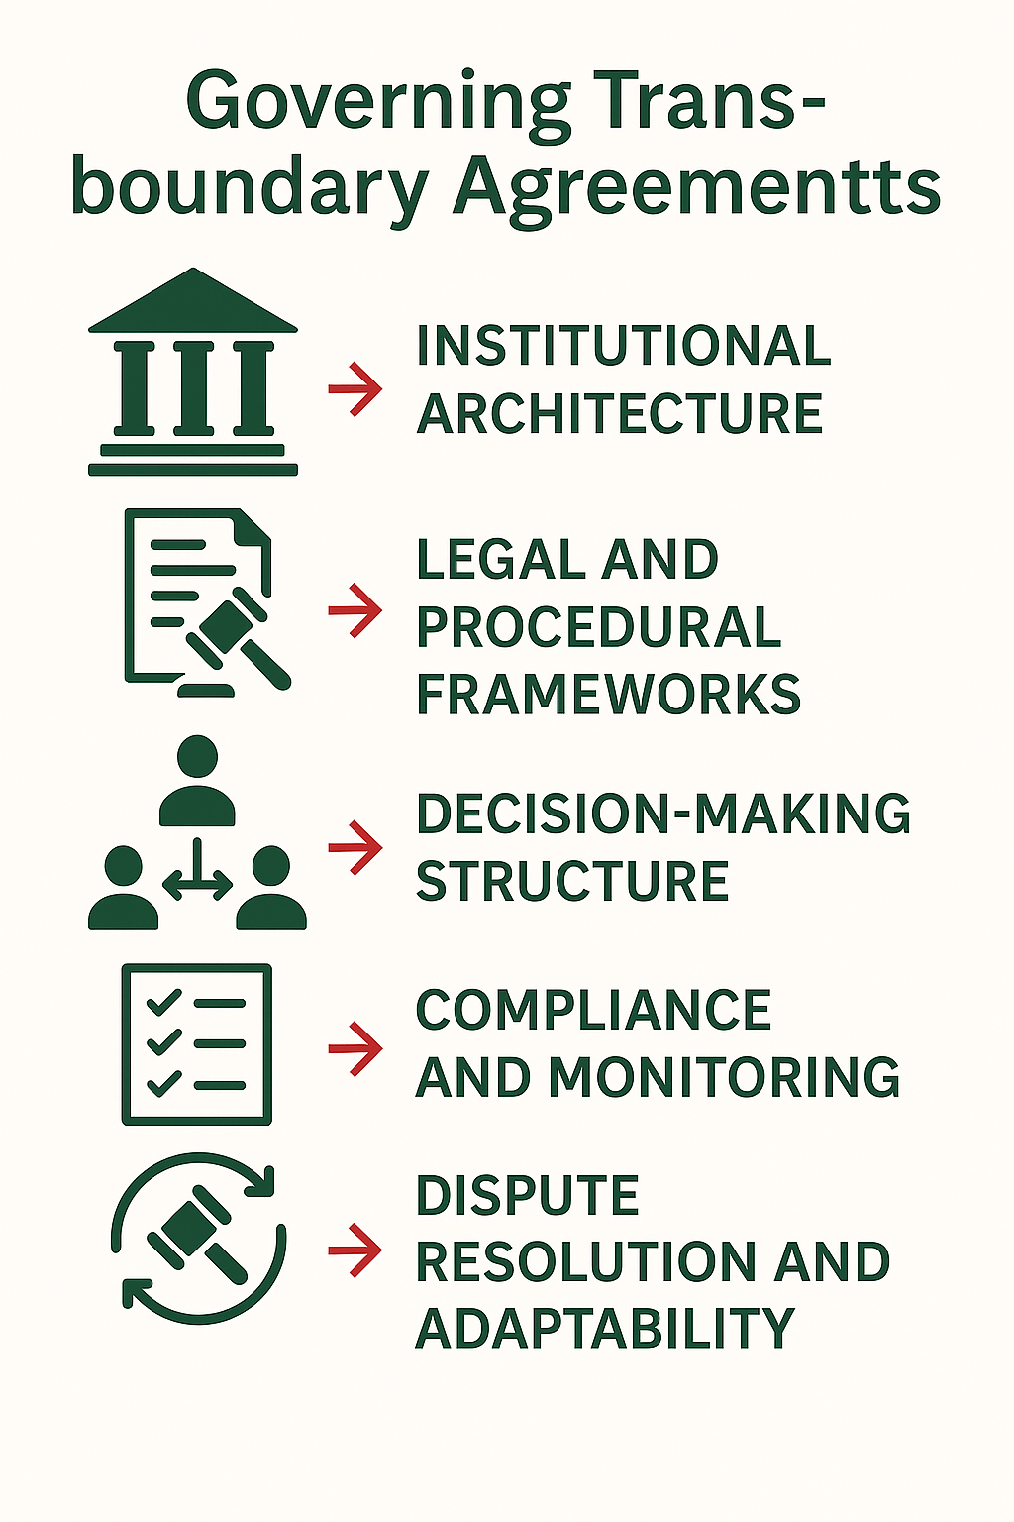
WEF Nexus Integration in Transboundary Policies and Instruments
Governing Transboundary Agreements
Institutional Architecture – Building the structural backbone of cooperationLack of Political Will and Leadership: Institutions in complex systems function as stabilisers and learning anchors. They provide continuity amid political volatility, enabling governance over time, not just in moments.
Legal and Procedural Frameworks – Encoding system-wide principles into lawLegal and Regulatory Barriers: In adaptive systems, rule-based order fosters predictability and fairness, allowing multiple actors to coordinate without central command.
Decision-Making Architecture – Distributed, multi-layered governance: Complex systems require subsidiarity—decisions should be made at the lowest appropriate level with upward coherence and downward legitimacy.Scaling and Adaptability Issues
Compliance and Monitoring – Closing feedback loops for accountability: Feedback loops must be timely, transparent, and trusted to support adaptive governance and collective course correction.Climate Change and Environmental Uncertainty
Dispute Resolution and Adaptive Capacity – Designing for resilience and evolution: Resilient systems don’t avoid stress—they learn from it. Adaptability and embedded conflict management are essential for long-term system viability

Slide 10
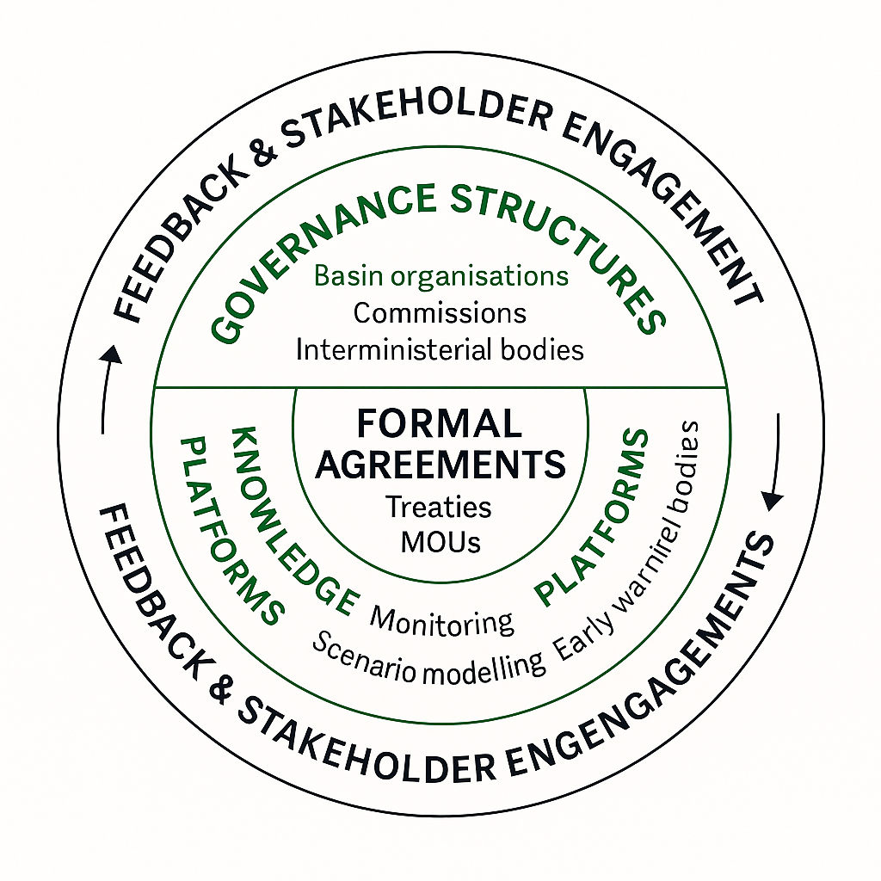
WEF Nexus Integration in Transboundary Policies and Instruments
Governance Diagram
Formal Agreements – Codifying intent to coordinate across systems: Agreements act as structural anchors that stabilise interactions in otherwise fluid, contested, or politicised transboundary systems.
Governance Structures – Sustaining institutional memory and coordination: Institutions are mediators of complexity. They translate ecological feedback into policy and hold space for negotiation, learning, and adaptation.
Knowledge Systems – Feedback infrastructure for adaptive governance: Resilient governance depends on timely, trusted, and co-owned knowledge that facilitates decentralised sense-making and responsive action.
Feedback & Stakeholder Engagement – Embedding legitimacy and learning: Complex adaptive systems require distributed legitimacy and pluralistic inputs. Feedback from diverse actors ensures that the system learns, evolves, and maintains social buy-in.

Slide 11
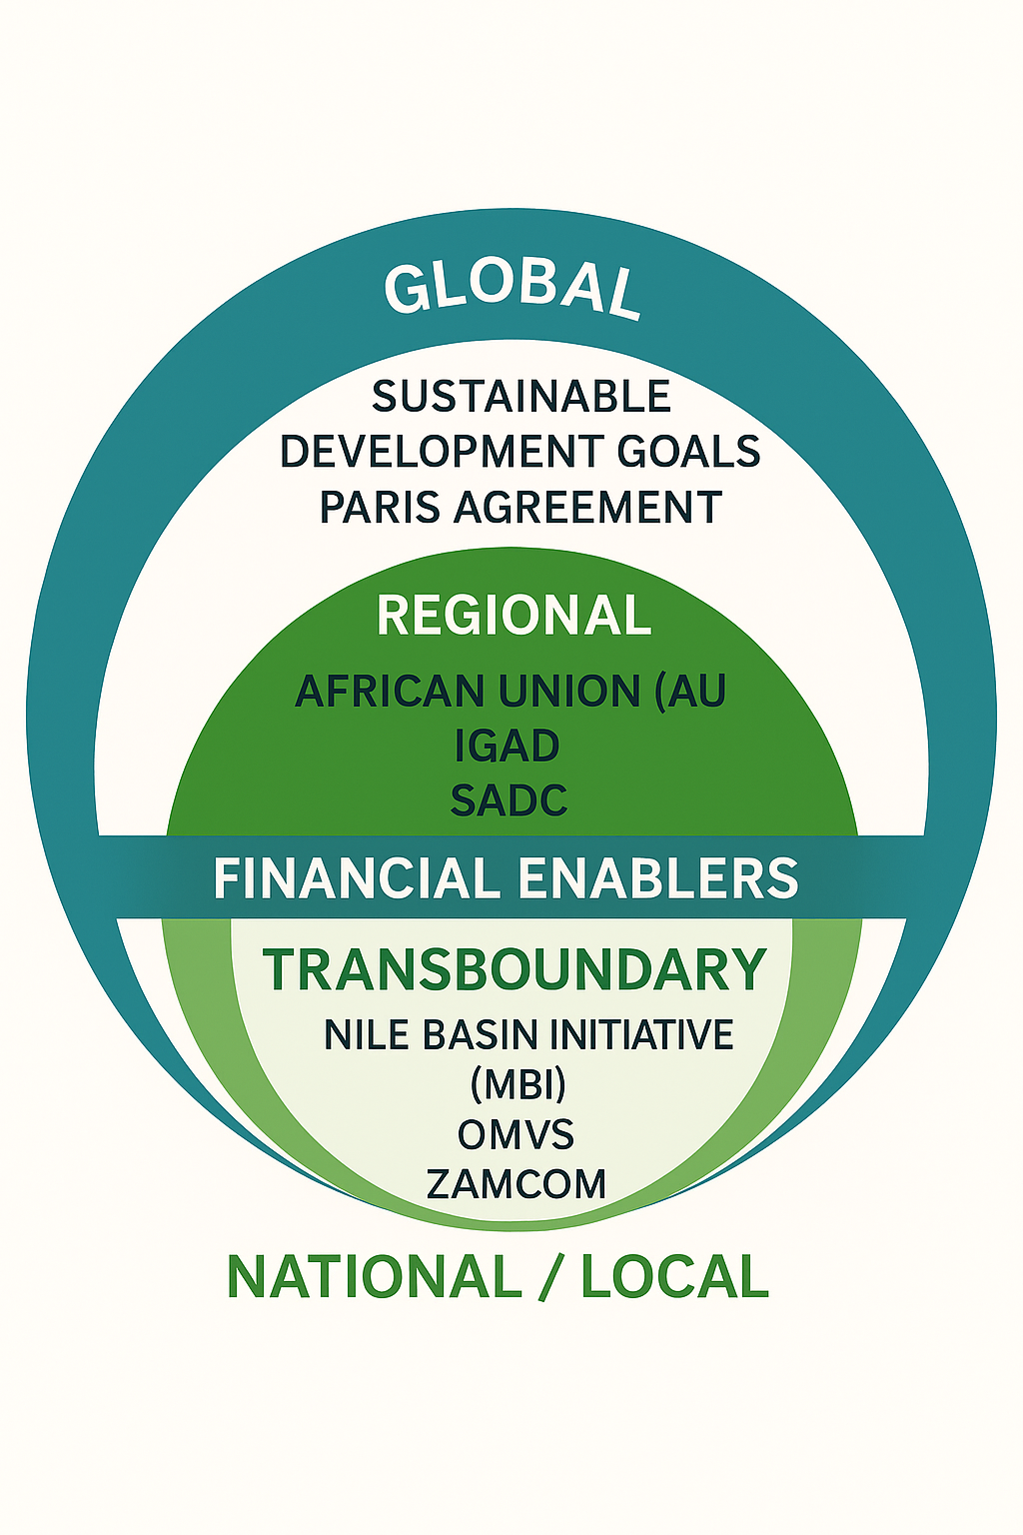
WEF Nexus Integration in Transboundary Policies and Instruments
Multi-Level Governance Frameworks
Global Level – Setting norms and guiding systemic convergence: Global frameworks shape the boundary conditions for action in nested systems. They generate convergence around normative baselines while accommodating national diversity.
Regional Level – Translating ambition into aligned continental strategies: Regional layers are essential in systems with polycentric governance. They buffer scale mismatches, enable cross-border alignment, and mobilise regional political capital.
Transboundary Level – Operationalising integration within ecological realities: This is where integration becomes tangible. These institutions act as “systems integrators”—managing cross-sectoral trade-offs, multi-scale feedback, and ecological limits.
Enabling Mechanisms – Fueling adaptive capacity and inter-scale learning: Complex systems need resources to evolve. Enablers embed resilience by linking finance to governance capacity and by promoting innovation across silos and scales.

Slide 12
WEF Nexus Integration in Transboundary Policies and Instruments
Total Number of Transboundary Water Agreements
  More than 3,600 bilateral or multilateral water treaties have been signed historically.
  However, only about 286 international agreements specifically pertain to transboundary rivers, lakes, and aquifers that are currently in effect, covering 153 countries.
Global Transboundary Water Context (Key Figures)
  310 international river and lake basins exist across the world.
  468 transboundary aquifers have been identified.
  153 countries share at least one transboundary water body.
Only 24 countries report having operational arrangements for all their shared basins (per UNECE/UN-Water 2021).
Example Status in Africa:
  Africa has 63 transboundary river basins, but fewer than one-third are governed by comprehensive agreements with clear implementation mechanisms.
Reference
UNECE Water Convention (1992) – Promotes transboundary water cooperation; open to all UN member states since 2016.
UN Watercourses Convention (1997) – Legal framework for equitable and reasonable utilisation of international watercourses.

Slide 13
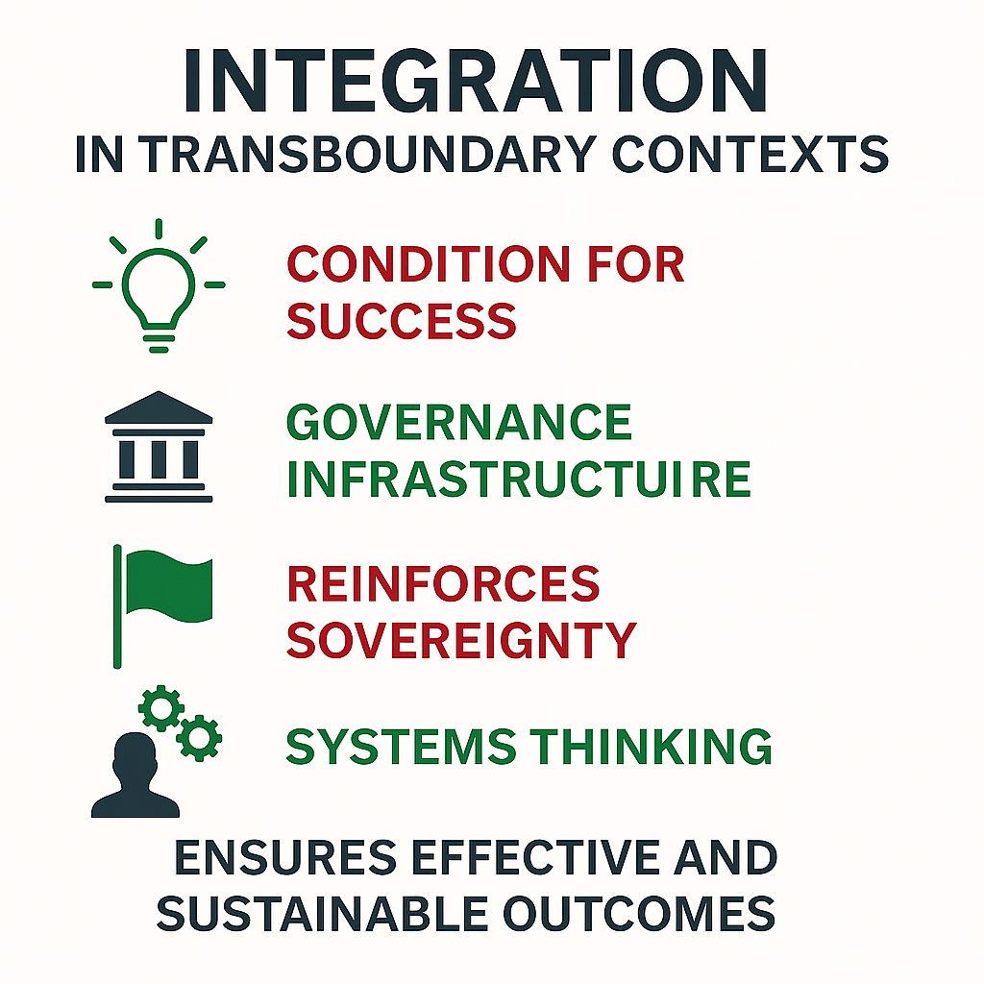
WEF Nexus Integration in Transboundary Policies and Instruments
Takeaways:
Integration is foundational, not optional: Integration aligns distributed subsystems (water, food, energy, ecosystems) into a cohesive investment environment.
Governance is the infrastructure behind infrastructure: Well-governed systems attract and protect capital. Governance reduces uncertainty, enhances accountability, and sustains system value over time.
Integration does not undermine sovereignty — it enhances it: Sovereignty is reinforced, not diminished, when nested within stable, rules-based regional systems.
Systems thinking shifts the investment horizon: Systems-aware governance future-proofs investments by embedding flexibility, coherence, and resilience.
Next step: From architecture to outcomes: In complex systems, outcomes emerge not from structure alone, but from how effectively the system enables interaction, learning, and adaptive response.
“You cannot invest where you cannot govern. Integration turns ambition into action—but only with robust governance behind it.” - We Mean Business Coalition's Call to Action for Ambitious and Investible Nationally Determined Contributions (NDCs).

Slide 14
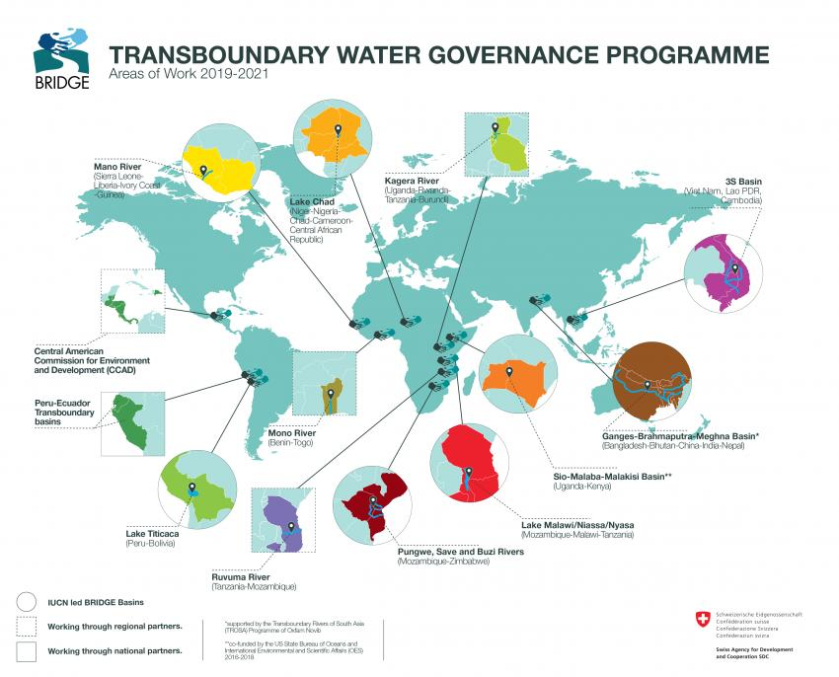
Global Transboundary Agreements
This map highlights priority transboundary river basins and regions where BRIDGE worked between 2019 and 2021 to strengthen cooperation, institutional capacity, and inclusive water governance. Source: IUCN BRIDGE

Slide 15
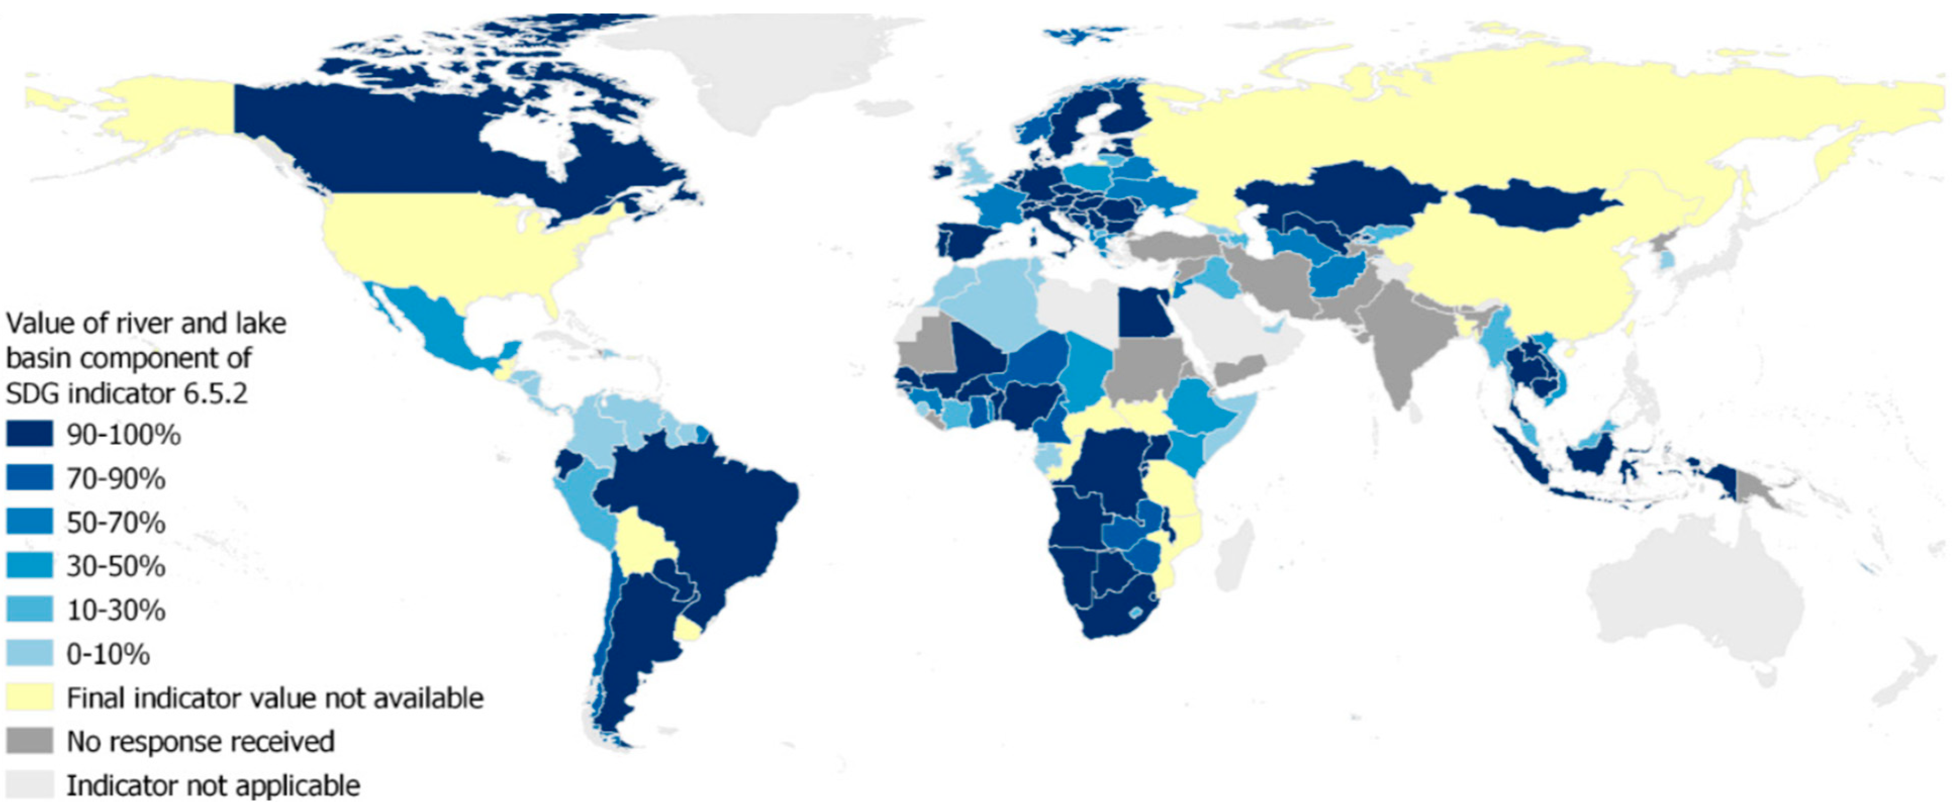
Global Transboundary Agreements
This map presents the global status of transboundary water cooperation based on the river and lake basin component of SDG Indicator 6.5.2. It shows the proportion of a country’s transboundary basin area that is covered by operational arrangements for water cooperation, a key measure under Sustainable Development Goal 6.5: "By 2030, implement integrated water resources management at all levels, including through transboundary cooperation as appropriate.":
IUCN

Slide 16
Thank you!
Do you have any questions?
Email
podhiambo@strathmore.edu

