Slide 1
WEF Nexus Masterclass 2025: Day 3
Introduction to WEF Investments
Global Water Partnership
Dr J Maryna Storie (PrGISc, GISP, PrDM)

Slide 2
Focus of the sessions during the day
WEF Investment and finance mobilisation, focussing on opportunities related to gender, disability and social equity; and climate finance
Integration of Transboundary Policies and Instruments (Peter Odhiambo)
Linking Investment and Governance with Practical outcomes
CuvKun Case Study (Aune Amwaama)
Limpopo river basin Case Study
Capacity Building for the Operationalisation and Implementation of the WEF Nexus (Prof Jean-Marie Kileshye Onema)

Slide 3
Focus of the sessions during the day
WEF Investment and finance mobilisation, focussing on opportunities related to gender, disability and social equity; and climate finance

Slide 4
Investing in Transformation — Mobilising Finance for Inclusive WEF Security
Why Focus on Finance Mobilisation?
The scale of transformation required to achieve integrated WEF security under climate stress is immense and capital-intensive.
Traditional finance flows are insufficient and poorly aligned with inclusive, just, and climate-resilient development objectives.
Effective blended finance, climate finance, and social impact investing are emerging as critical tools to close the WEF infrastructure and services gap.
Climate change, water stress, energy and food insecurity intensifying
WEF Nexus approach supports systems thinking & integration
Inclusive, coordinated responses needed more than ever

Slide 5
Investing in Transformation — Mobilising Finance for Inclusive WEF Security
The Equity Imperative
WEF challenges are deeply entangled with social inequities:
  Women and girls bear disproportionate WEF-related burdens (e.g., time poverty, exposure to unsafe energy, travelling).
  Persons with disabilities are often excluded from WEF systems due to design or institutional barriers.
  Indigenous and rural populations and in some cases some cultural groups or migrant communities face structural exclusion from decision-making and investment targeting.

Slide 6
Investing in Transformation — Mobilising Finance for Inclusive WEF Security
Opportunity Areas
Mobilising climate and loss & damage finance
Gender-Responsive Climate Finance:
  Targeted funds from entities like the Green Climate Fund (GCF), Adaptation Fund, and Climate Investment Funds support gender-transformative projects.
Disability-Inclusive WEF Innovation:
  Universal design and adaptive technologies (e.g., accessible water points, smart irrigation apps) are investable innovations.
Social Equity Bonds & Results-Based Financing:
  Instruments linking financial return to measurable social impacts (e.g., women's income, improved WASH access for Persons With Disabilities (PWDs)).
Community-Owned Infrastructure Models:
  Mobilising local capital and capacity (e.g., water user associations, off-grid solar cooperatives, farmer cooperatives) with public-private support.

Slide 7
Investing in Transformation — Mobilising Finance for Inclusive WEF Security
Investment & Governance Alignment
Mobilising finance requires strong institutions, clear governance frameworks, and stakeholder trust.
  Align national investment plans with GEDSI and climate policies.
  Improve capacity for project preparation, bankability assessments, and cross-sector coordination.
  Integrate GEDSI metrics into investment criteria, monitoring, and accountability systems.

Slide 8
Investing in Transformation — Mobilising Finance for Inclusive WEF Security
Key Messages
Mobilising WEF finance is not only a technical challenge, but a social and institutional one.
Transformative impact is possible only when investments are inclusive, participatory, and climate-aligned.
Overcoming implementation barriers (policy, institutional, capacity, finance) requires integrated approaches
The next frontier of WEF security lies in financing models that value people, planet, and partnerships equally.

Slide 9
Deep-dive: Why GEDSI matters in the WEF Nexus Context
Why it matters:
Promotes equity, participation, and resilience
Improves sustainability
Strengthens long-term development impacts
How to do it:
Apply intersectional lens (gender, disability, marginalisation)
Include GEDSI from project feasibility and design through implementation, and MEL

Slide 10
Deep-dive: Why GEDSI matters in the WEF Nexus Context
Equity: Ensuring fair access to water, energy, and food resources across all social groups, especially historically marginalized communities (e.g., women, Indigenous peoples, persons with disabilities).
Access: Addressing structural barriers to accessing and benefiting from WEF systems — such as discriminatory land tenure laws, lack of financing for women-led agricultural projects, or gendered time poverty affecting access to water.
Why it matters:
Promotes equity, participation, and resilience
Improves sustainability
Strengthens long-term development impacts
How to do it:
Apply intersectional lens (gender, disability, marginalisation)
Include GEDSI from project feasibility and design through implementation, and MEL
Representation: Promoting inclusive decision-making processes where diverse voices (especially those most affected) have influence over WEF governance and resource allocation.
Resilience: Strengthening the adaptive capacity of diverse social groups by ensuring that WEF interventions respond to differentiated vulnerabilities and build long-term, intersectional resilience to climate and economic shocks.

Slide 11
Deep-dive: GEDSI Tracking in the WEF Nexus Context
Symbolic/Absent: GEDSI is not mentioned in policies or practices; no efforts to involve underrepresented groups.
Intentional but Limited: Acknowledgement of GEDSI concerns; presence of gender language but limited action (e.g., invitations to women’s groups without decision-making authority).
Partial Integration: GEDSI considerations are embedded in some parts of project design or policy but not systematically applied across all levels.
Full Integration: GEDSI is mainstreamed throughout planning, budgeting, implementation, monitoring, and evaluation; intersectionality and power dynamics explicitly addressed.

Slide 12
Deep-dive: Examples of GEDSI-Sensitive Nexus Interventions
Water Access and Time Use:
  Introduction of community-managed water kiosks in rural Kenya reduced women’s daily water collection time by 3 hours, allowing greater participation in economic activities.
Energy and Entrepreneurship:
  Women-led solar irrigation cooperatives in Senegal increased agricultural yields and created income opportunities for women farmers.
Climate-Resilient Agriculture:
  Drought-tolerant seed banks run by women in Nepal ensured food security during climate shocks, while empowering women in agricultural governance.
Inclusive Governance Mechanisms:
  Participatory WEF planning bodies in Peru with gender quotas and capacity building for women ensured their meaningful involvement in basin-level decisions.

Slide 13
Deep-dive: GEDSI Key Messages
GEDSI is not an “add-on”; it is foundational to achieving sustainable WEF security.
WEF interventions that ignore GEDSI risk reinforcing inequalities and undermining long-term outcomes.
GEDSI-sensitive investments yield better development, climate resilience, and peacebuilding outcomes.

Slide 14
Deep-dive: Climate Finance & Loss & Damage Funding
Why it matters:
Nexus projects align well with NDC/NAP priorities
L&D finance offers new entry points for vulnerable regions
How to do it:
Access climate finance - navigate the process
Nexus investments need to be “bankable” and inclusive

Slide 15
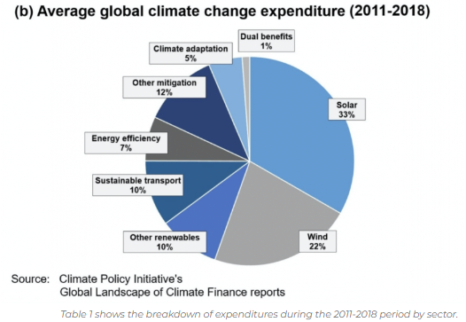
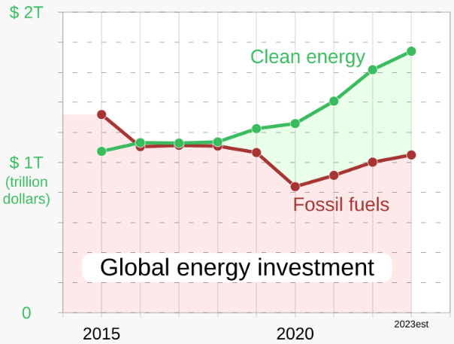
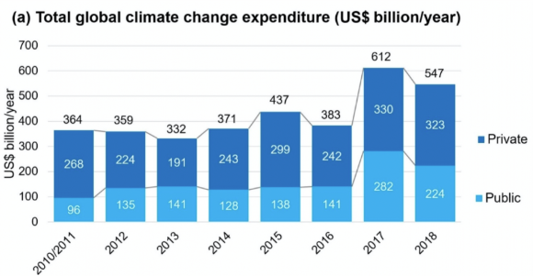
Deep-dive: Climate Finance & Loss & Damage Funding
Why it matters:
Nexus projects align well with NDC/NAP priorities
L&D finance offers new entry points for vulnerable regions
How to do it:
Access climate finance - navigate the process
Nexus investments need to be “bankable” and inclusive
Global Landscape of Climate Finance 2017 - Climate investment analysis
Cash in on Climate | Friends of Science
Interactive: How climate finance ‘flows’ around the world - Carbon Brief

Slide 16
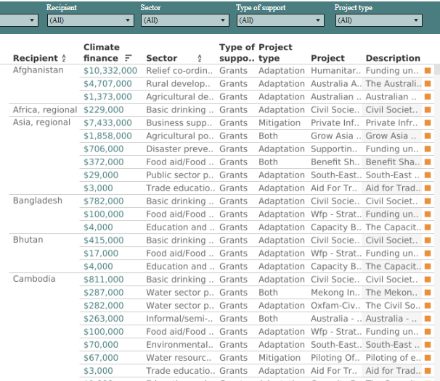
Deep-dive: Climate Finance & Loss & Damage Funding
Interactive: How climate finance ‘flows’ around the world - Carbon Brief

Slide 17
Deep-dive: Climate Finance & Loss & Damage Funding
What is the Loss and Damage Fund (L&D Fund)?
A new global climate finance mechanism established under the UNFCCC/Paris Agreement process.
Aims to provide financial support to vulnerable developing countries facing irreversible losses and unrecoverable damages from climate change.
Officially operationalized at COP28 (2023) with the World Bank as interim trustee.

Slide 18
Deep-dive: Climate Finance & Loss & Damage Funding
Why Loss and Damage?
Loss = Lives lost, livelihoods disrupted, ecosystems degraded.
Damage = Infrastructure destroyed, cultural heritage lost, economic dislocation.
Not addressed by traditional mitigation (cutting emissions) or adaptation (adjusting to impacts).
💸 How is the Fund Financed?
Initial pledges at COP28 totalled over $700 million – far short of actual needs.
Key contributors: UAE ($100m), Germany ($100m), EU, UK, USA, Japan, others.
Designed to mobilize new, additional, predictable, and adequate funding.
Still under discussion: innovative sources (e.g., fossil fuel levies, aviation taxes).
What is the Loss and Damage Fund (L&D Fund)?
A new global climate finance mechanism established under the UNFCCC/Paris Agreement process.
Aims to provide financial support to vulnerable developing countries facing irreversible losses and unrecoverable damages from climate change.
Officially operationalized at COP28 (2023) with the World Bank as interim trustee.
How Does It Work?
Governed by a Board with equitable representation (Global South-led).
Prioritizes countries most vulnerable to climate impacts (e.g., SIDS, LDCs, African nations).
Focus areas include:
  Rapid-onset events (storms, floods, wildfires)
  Slow-onset events (sea-level rise, desertification)
  Non-economic losses (cultural, health, displacement)
Implementation modalities are evolving: grants, insurance, technical assistance.
Equity, Justice & GEDSI Considerations
Recognizes historical responsibility and climate justice.
Must center gender equality, disability, social inclusion, and Indigenous rights.
Requires transparent, inclusive access frameworks to avoid reinforcing power imbalances.

Slide 19
Deep-dive: Climate and L&D Finance Key Messages
1. Climate finance is not an “add-on”; it is foundational to achieving sustainable WEF security.
Just as water, energy, and food systems are interdependent, securing them under climate stress requires dedicated and accessible climate finance. It underpins adaptive capacity and long-term sustainability.
2. WEF interventions that ignore climate finance risk underperformance, lock-in of vulnerability, and missed opportunities for resilience.
Without integrating climate finance into planning and implementation, WEF solutions may remain underfunded, reactive, or inequitable—exacerbating existing climate risks, gender inequity and social divides.
3. Climate and L&D finance–aligned investments yield better development, resilience, and transformational outcomes.
Targeted, transparent, and inclusive climate finance unlocks co-benefits—spurring innovation, empowering vulnerable groups, and supporting low-carbon, climate-resilient growth in WEF systems.

Slide 20
Focus of the sessions during the day
Integration of Transboundary Policies and Instruments (Peter Odhiambo)

Slide 21
Focus of the sessions during the day
Linking Investment and Governance with Practical outcomes

Slide 22
Real-world Barriers
Institutional silos between water, energy, agriculture, environment, planning, health, climate and other ministries
Poor recording or collation of data and information, with subsequent challenges in knowledge sharing > duplication of efforts and repeating mistakes/pitfalls
Limited potential to design and coordinate cross-sectoral projects – “it is up to us” – not always popular
Fragmented financing mechanisms: Scaling up finance to meet trillions in estimated needs: “finance begets finance”
Ensuring accessibility to communities and countries without complex barriers.
Operational clarity: How funds are mobilised, triggered, managed, disbursed, monitored and reported on.
Sustaining political will and institutional legitimacy.
Segmentation in MEL and reporting systems for GEDSI and climate resilience

Slide 23
What works to overcome barriers to Nexus Implementation?
1. Political Ownership & Inter-Ministerial Coordination
High-level commitment ensures alignment across water, energy, food, and climate ministries.
Clear roles and mandates help reduce siloed decision-making and budget fragmentation.
2. Demonstration Projects with Tangible Community Benefits
Pilot initiatives that improve daily lives build trust and momentum.
Focus on visibility, inclusivity, and scalability—start small, think big.
3. Institutional Champions & Regional Peer Learning
Empower reform-minded leaders within institutions to drive change.
Leverage south-south learning to share success stories and failures across borders.
4. Auditable Outcomes
Transparent, results-based approaches increase public accountability: “integrity and anti-corruption”.
Enables stakeholders to track value for money and build case for further investment.
5. Monitoring, Evaluation & Learning (MEL) with Reporting
Continual learning loops drive adaptation and improvement.
Investors and donors want to see progress, impact, and lessons learned.

Slide 24
What works to overcome barriers to Nexus Implementation?
“What Do Investors Want?”
Think of an investor like when a friend asks you to fund their overseas studies...
You ask:
Are you committed? → Political leadership & coordination
Do you have a plan with clear returns/pay-back? → Demonstration projects, Case studies, Outcomes, Tracking targets and milestones
How will you contain costs (accommodation, transport, food) → Budget
Do you have references/support? → Champions & peer learning
Will you show me your results? → Auditable outcomes & MEL
🔑 Bottom line: Investors fund vision, credibility, and accountability.

Slide 25
Practical Strategies for Implementation of GEDSI & finance mobilisation
Mainstream GEDSI, ESS and ESG: Include in policies, budgets, MEL, not just a “section in a report” – integrate throughout
Mobilise Finance: Design with NDC/NAP alignment, focus on vulnerability, start thinking like the investor
Bridge Silos: Create cross-sector task teams, joint KPIs, Activism and “marketing” - be the change, and be the salesperson
Build Capacity: Target training on finance access, project prep, GEDSI, ESS/ESG
Transparency, Monitoring and Reporting throughout

Slide 26
Be the change, be the salesperson:
Apply GEDSI, ESS, ESG & financial prowess in project design and implementation
Push for interdepartmental collaboration
Record and support transparency, ethics, data capture and knowledge sharing platforms/data sharing operating processes
Link initiatives, build on successes
Advocate for inclusive frameworks

Slide 27
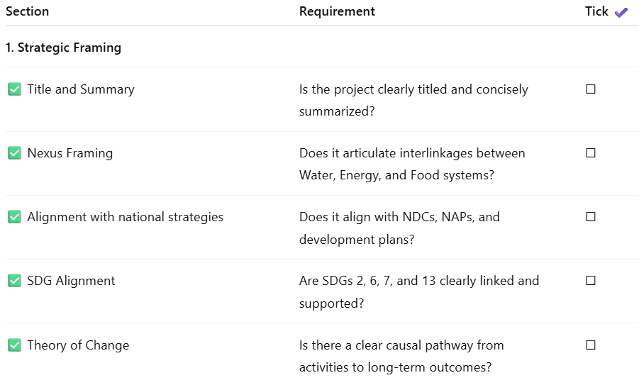
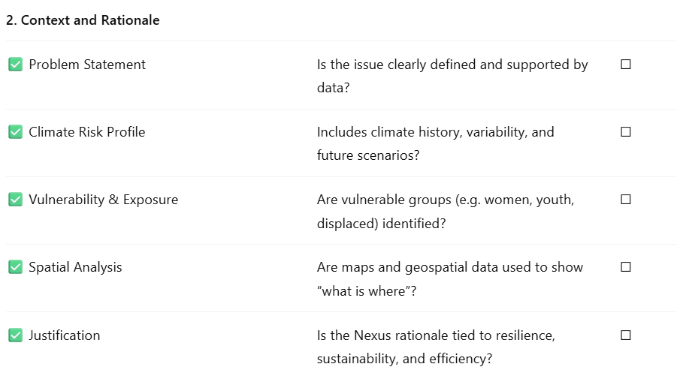
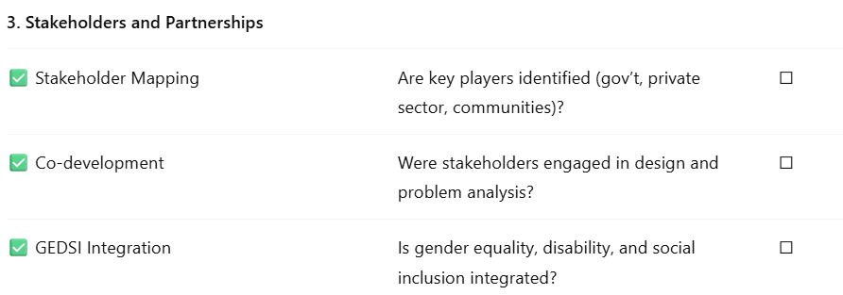
WEF Nexus investment pitch essentials checklist:
Use this checklist to structure your WEF Nexus investment proposal. Each item reflects a critical element funders seek in bankable, climate-aligned, cross-sectoral projects.

Slide 28
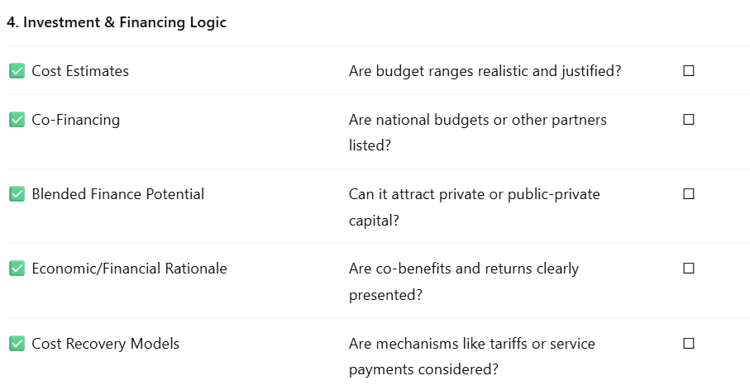
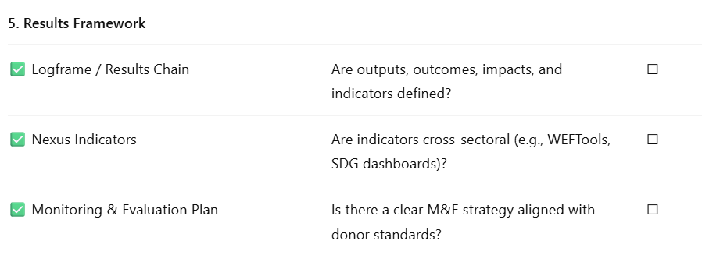
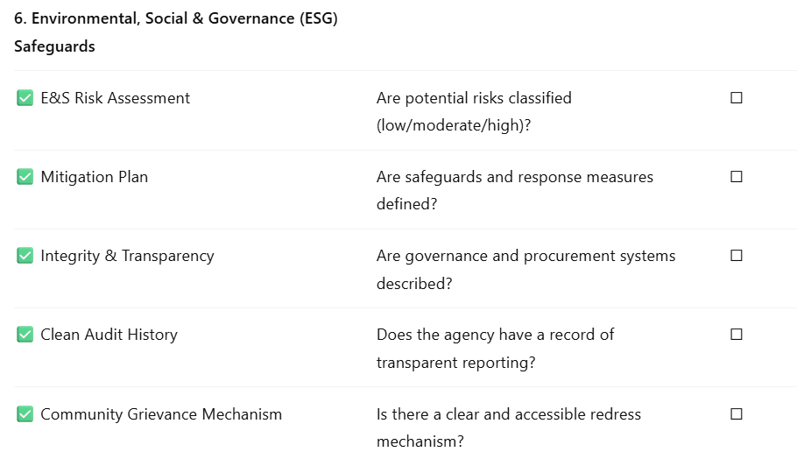
WEF Nexus investment pitch essentials checklist:
Use this checklist to structure your WEF Nexus investment proposal. Each item reflects a critical element funders seek in bankable, climate-aligned, cross-sectoral projects.

Slide 29
Case studies:

Slide 30
Focus of the sessions during the day
CuvKun Case Study (Aune Amwaama)

Slide 31
Focus of the sessions during the day
Limpopo river basin Case Study

Slide 32
Focus of the sessions during the day
Capacity Building for the Operationalisation and Implementation of the WEF Nexus (Prof Jean-Marie Kileshye Onema)

Slide 33



|Thank you
maryna.storie@gwpsaf.org

