Slide 1
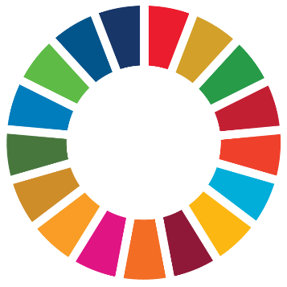

Accelerating Progress on the water-energy-food-ecosystem (WEFE) Nexus in Sub-Saharan Africa
WEF Nexus Masterclass
May 13, 2026
Sara Castro Hallgren
United Nations Office for Sustainable Development (UNOSD),
Division for SDGs,
UN DESA

Slide 2
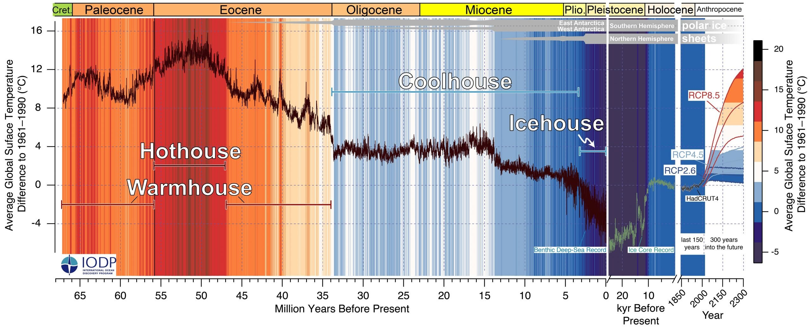
Climate Change = long term changes in average temp. + weather
Start of Human population ~300,000 years ago.
Start of Human agriculture ~12-14,000 years ago.
Source: van den Bergh, J. C. J. M. (2018). Prehistory Until the Rise of Agriculture. In Human Evolution beyond Biology and Culture: Evolutionary Social, Environmental and Policy Sciences (pp. 321–363). Cambridge University Press.
Image: Westerhold et al. (2020) doi: 10.1126/science.aba6853
Notes:
Climate Change: Long-term shifts in temperatures and weather patterns driven mainly by human activities (anthropogenic) altering ecosystems that support life on the planet.
“The IPCC projections for 2300 in the ‘business-as-usual’ scenario will potentially bring the global temperature to a level the planet has not seen in 50 million years”
Start of the human population on Earth is considered to be around 200,000 to 300,000 years ago when modern humans, Homo sapiens, first emerged in Africa

Slide 3
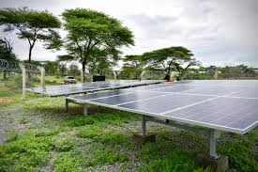
  Climate State
  2015 Paris Agreement: NDCs to keep long-term global average surface temperature well below 2°C above pre-industrial levels and pursue efforts to limit it to 1.5°C by the end of this century
  Global average surface air temperature has already risen to 1.54°C above
  pre-industrial level.
Source: Africa Minigrids Program

Slide 4
Multi-Level Governance = Vertical + Horizontal Coordination
Horizontal (e.g. across ministries)
Integrative Environmental Governance (IEG) is an umbrella term for concepts sharing a focus on the relationships between governance instruments and governance systems in an era of complex, fragmented environmental governance that requires engaging multiple actors (Visseren-Hamakers, 2015)
Vertical (e.g. National to local)
Ideal v. Reality

Slide 5



The Three Governance Gaps
Why the nexus literature is disconnected from the decision-making processes it seeks to influence?
Gap 1 Coordination Mechanisms
Is there a shared understanding of the nexus issue?
Are nexus concerns weighted in policy?
Are contradictions between sectoral policies reduced in practice?
Gap 2 Multi-Level Governance
How do higher-level decisions constrain nexus governance?
Are local stakeholders' rights and knowledge respected?
Does coherent policy lead to coherent implementation?
Gap 3 Barriers, Incentives & Reform
Whose interests do policy instruments support or hinder?
Are decision-makers' mindsets shifting over time?
Are power imbalances between actors addressed?
Source: Weitz, N., Strambo, C., Kemp-Benedict, E. & Nilsson, M. (2017). Global Environmental Change, 45, 165–173. doi:10.1016/j.gloenvcha.2017.06.006

Slide 6
WEF: Mechanisms for Public Governance & Institutional Coordination
Best practice: Regional/Transboundary bodies with enforcement mechanisms can deliver stronger policy harmonisation than purely advisory platforms (ECOWAS West Africa or European Union)
Information Sharing
Inter-Agency
Committees
Joint Planning
Platforms
Cross-Sectoral
Task Forces
Statutory Nexus
Body / Council
Joint data portals, inter-ministerial working groups, regular policy briefings
Standing bodies with representation from water, energy, agriculture & environment ministries; regular mandate
Shared planning cycles, integrated investment frameworks, co-authored national strategies
Time-bound, outcome-focused units mandated to deliver nexus solutions with budget authority – can have shared budgets
Legal mandate to coordinate WEFE governance; reporting to head of government; binding decisions
COORDINATION SPECTRUM — Informal to Institutionalized
Low formality
Medium
Medium-High
High
Highest

Slide 7
What is the Climate-Water-Energy-Food Nexus?
The “Water-Energy-Food Nexus” approach emerged in the late 2000s, as a way of framing cross-sector and cross-scale interactions in a context marked by growing concerns about the global economic and food security crisis (Allouche et al., 2014).
Climate link adds resilience and adaptation angle.
The way Water-Energy-Food resources and systems are governed depends on institutions.
Barriers to scaling solutions:
    Siloed ministries,
    Fragmented mandates,
    Uncoordinated financing

Slide 8
Context: The Resource Security Crisis in Sub-Saharan Africa
~565M
22.3%
31.3%
70-80%
people lack access to electricity (665 globally)
of the population faces chronic undernourishment
1 in 5 (Our World in Data)
only have access to safely managed drinking water (SDG 6.1.1)
freshwater withdrawals for agriculture, competing demand from energy ++
Potential vs. Investment Imbalances
Hydropower provides 40% of Africa’s electricity supply, yet nearly 90% of its potential remains untapped
Africa holds 60% of the world's solar resources, yet has attracted only 2% of global renewable energy investment over the past two decades.

Slide 9
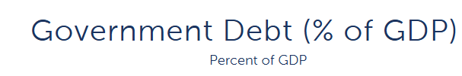
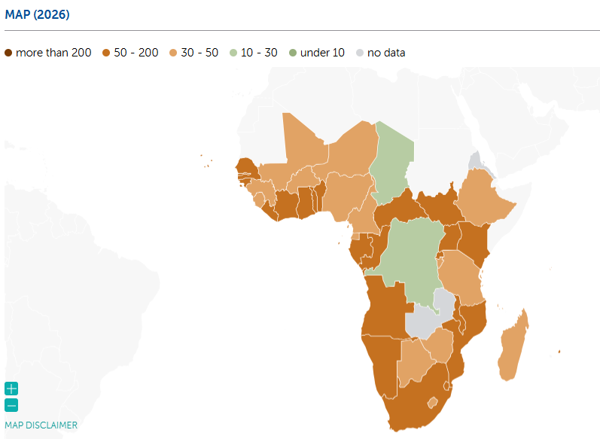
  Context: High Climate Vulnerability, Debt & Tight Fiscal Space
  African nations need USD ~1.3T/yr for NDCs
  Countries have high recurrent expenditure (e.g. debt interest) compared to development expenditure (e.g. infrastructure)
  20% of countries spending +25% of revenue on interest.
  In limited fiscal space context WEFE Nexus = efficiencies in finance and impact
Sub-Saharan Africa Average is 56.05% (IMF,2026)
Notes:
IMF, 2026: https://www.imf.org/external/datamapper/GGXWDG_GDP@AFRREO/SSQ

Slide 10
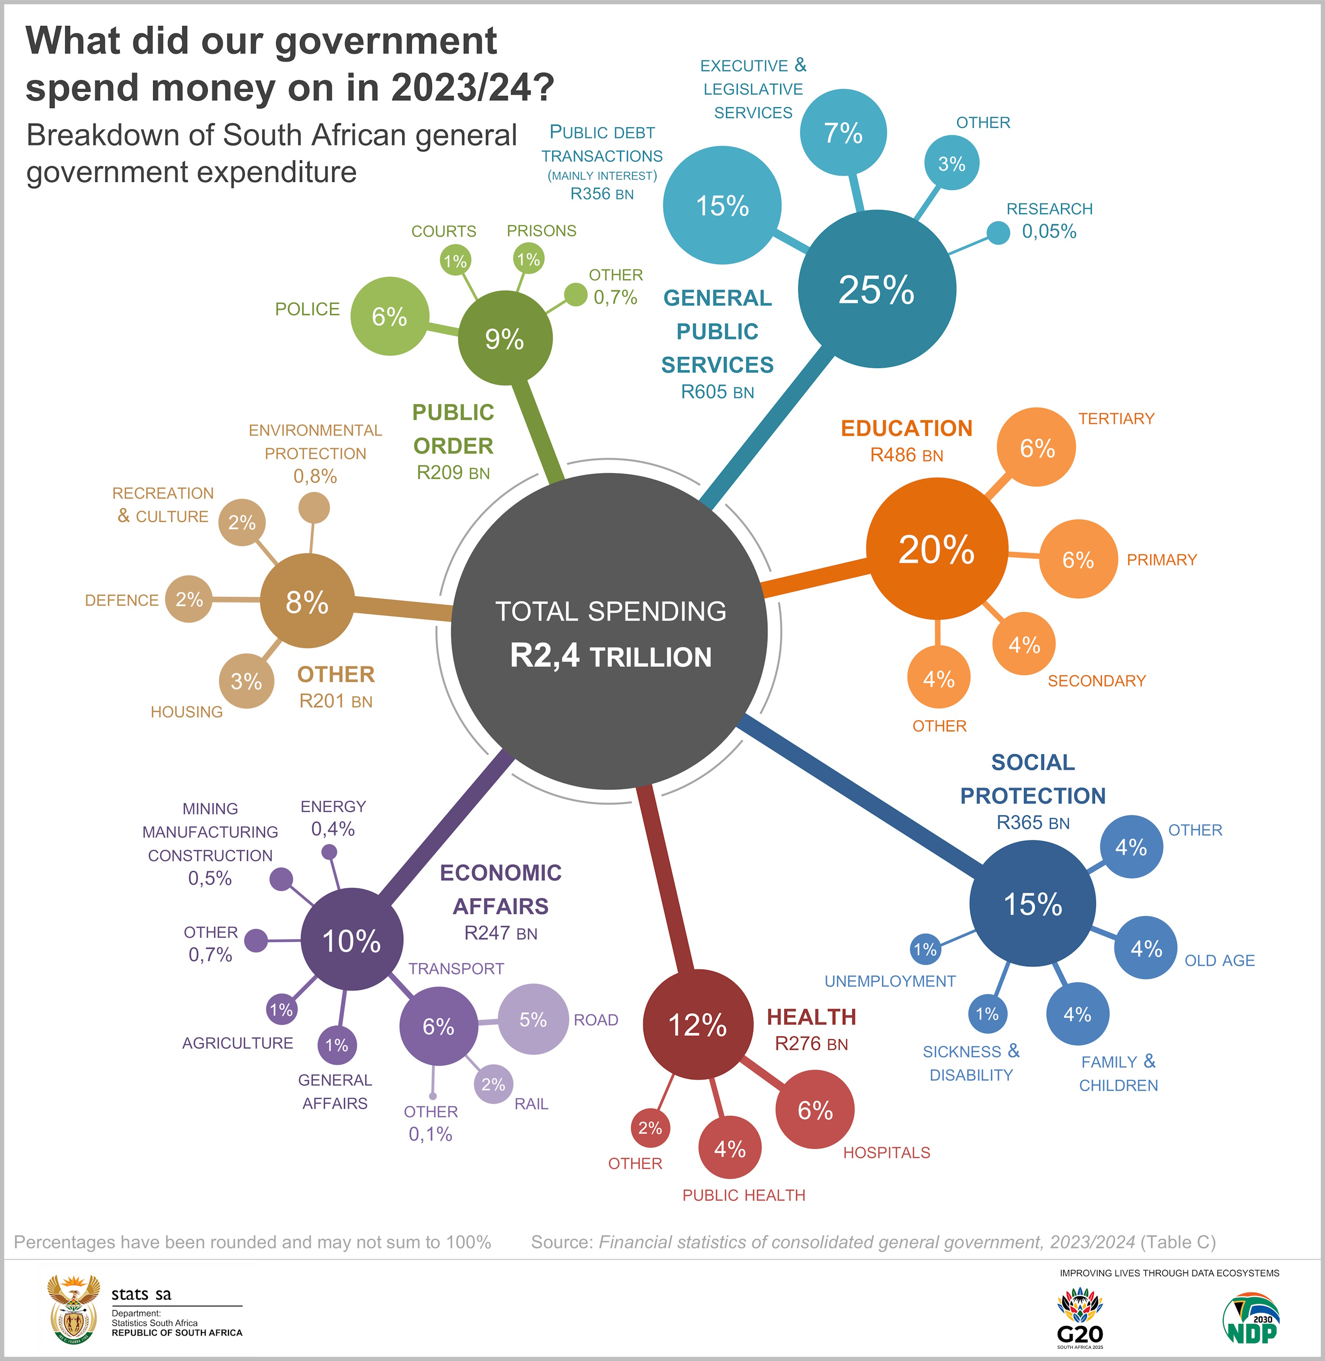
  South Africa: 15% of public budget expenditure for debt servicing in 2023/2024 v. 12% for health
  (e.g. R356 billion debt service v. R276 billion for health).
  Several sub-Saharan African countries now spend more on debt service than health or education
  (e.g. Ghana, Zambia, and Kenya)
  Budgetary consolidation recommended.
  Assess budget vs. expenditure
  WEFE Nexus solutions can help!
  Optimize resources, break silos.
Notes:
South Africa reference and source: A closer inspection of general public services reveals public debt transactions as the significant cost driver. According to the National Treasury, the South African government held R5,3 trillion in gross loan debt in 2023/24.³ The costs related to servicing debt, which mainly includes interest payments on borrowings, amounted to R356 billion, or 15% of total spending (or to be more precise, 14,9%). Compared with other government priorities, the category of public debt transactions exceeded the amount allocated to health (R276 billion) and was almost on par with social protection (R365 billion). Source: Statistics South Africa: https://www.statssa.gov.za/?p=19013#:~:text=The%20debt%2Dservicing%20bill%20was,23%20to%2014%2C9%25.

Slide 11
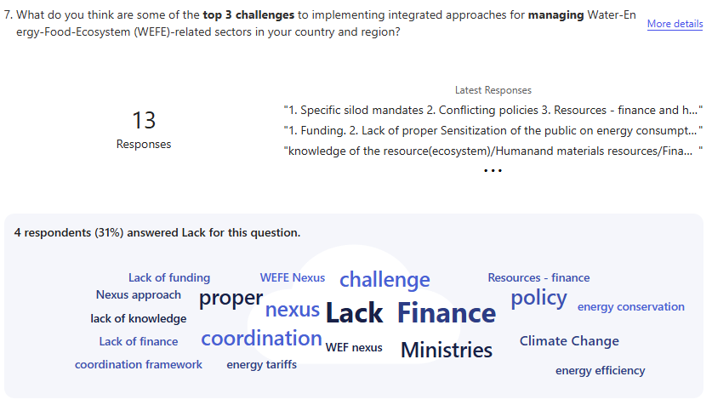
Source: UN WEFE Nexus State of Play — SSA, March 2025 https://unosd.un.org/sites/default/files/2026-04/wefe_nexus_state_of_play_in_ssa_-_guidebook.pdf

Slide 12
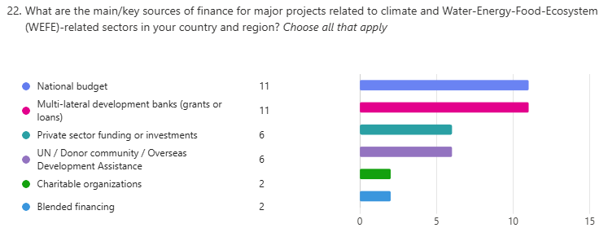
Source: UN WEFE Nexus State of Play — SSA, March 2025 https://unosd.un.org/sites/default/files/2026-04/wefe_nexus_state_of_play_in_ssa_-_guidebook.pdf

Slide 13
The Climate Finance Landscape: Flows, Gaps, and Inequities
NDCs and Finance Inequity Highlights
NDC 3.0: Currently, 28 African countries (13 from West and Central and 13 from East and Southern)
USD ~1.3T/yr needed for submitted NDCs
Sub-Saharan Africa receives just 23% of its NDC investment needs despite high climate vulnerability.
Top 10 recipients capture 46% of all Africa climate finance
10 most-vulnerable countries receive 11%.
KEY POINT: The WEFE Nexus offers a pathway to greater efficiency, integrating investments to maximize impact per dollar spent and ease pressure on overstretched budgets.

Slide 14
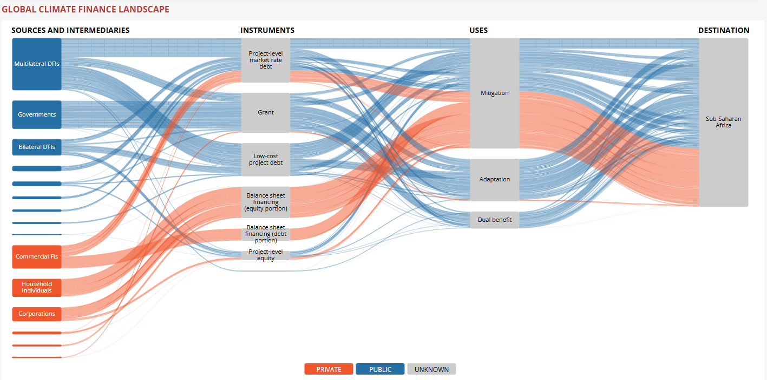
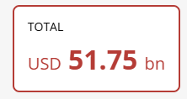
Figure 1. Increase in climate finance by region (2023)
Source: Climate Policy Initiative, 2024

Slide 15
Evidence from Sub-Saharan Africa Ministerial Integration Mapping
KEY FINDINGS
Food–Ecosystem pairing is most common integration (36% of combinations)
Water–Energy pairing next most common (28%)
Several countries lack explicit water or energy ministries
Duplicated mandates (e.g. water in 2+ ministries) creates conflict, not coordination
Only 4 countries have Water–Food–Ecosystems trios: CAR, Djibouti, Namibia, Zimbabwe
Why we train inter-ministerial delegations!
Implication for Governance Design: Data confirms institutional fragmentation, not lack of political will alone, is primary governance barrier.
Capacity-building must target cross-ministerial coordination, not just individual sector knowledge.
Source: UN WEFE Nexus State of Play — SSA, March 2025 https://unosd.un.org/sites/default/files/2026-04/wefe_nexus_state_of_play_in_ssa_-_guidebook.pdf

Slide 16
Solution: Regional governance context
Water
Energy
Food
The Continental Africa Water Investment Programme (AIP) raise US$30 billion annually by 2030 for water security and sustainable sanitation
African Continental Master Plan (CMP) collaborative strategy for single connected African electricity market
AU 10-year CAADP Strategy and Action Plan (2026–2035) adopted 2025 Kampala Summit for agrifood systems
Climate and Ecosystems
Opportunities for efficiency?
Synergistic investments?
AU Biodiversity Strategy and Action Plan (ABSAP) 2023-2030
AU Climate Change and Resilient Development Strategy and Action Plan (2022-2032).

Slide 17
Governance context …
PLANNING BASIS
OVERLAPPING COMPETENCIES
HARMONISATION OPPORTUNITIES
National Development Plans (NDPs) as primary integration vehicle
Sector strategies must reference cross-cutting SDG linkages (SDG 6, 7, 2, 13, 15)
NDC 3.0 provides an entry point for joint water–energy–food planning
Integrated River Basin / Watershed Management plans bridge sectors
Complementary or clashing: Water ministries can oversee irrigation; but energy ministries may own hydro policy
Agricultural ministry sets land-use policy affecting ecosystems under another mandate
Climate finance often governed by separate environment or finance ministry
Formal policy coherence reviews before sector legislation is adopted
Shared data infrastructure and joint indicator frameworks
Combining intra-sectoral mandates (e.g. agriculture + livestock + fisheries)
Explicit nexus clauses in ministerial mandates and cabinet resolutions
NDC harmonization

Slide 18
NDCs as Vehicles for WEF Finance: Country Evidence (from policy brief)
Country | NDC WEF Integration | Key Nexus Commitments | Finance Status | Priority Gaps
Ethiopia | HIGH | Dam construction, solar irrigation, watershed management | USD 50M FP243 Safe Water RE nexus pilot; USD 463M Urban WSS project | Cross-border water finance; equity in rural access
Kenya | MODERATE | Safe water access for 50% by 2030; geothermal expansion | M-KOPA off-grid solar; Menengai Geothermal; USD 10M Upper Athi Water Security | WEFE integration in NDC planning; smallholder finance
Rwanda | HIGH | 52% grid / 48% off-grid; solar cold chain | ACES solar cold chain active; strong policy environment | Ecosystem services finance; watershed investment
South Africa | HIGH | Just Energy Transition; water recycling; conservation agriculture | JETP USD 8.5B; USD 1.5B FP209 SA Water Reuse Programme | Adaptation finance; just transition equity; water-energy integration
Nigeria | HIGH | Renewable energy expansion; water infrastructure; Em-Hydro pilot | USD 495M P123112 Transforming Irrigation (IWRM) | Private sector mobilisation; community-level WEFE finance
Niger | HIGH | Solar irrigation, water harvesting, agrivoltaics pilot | RETO-DOSSO pilot demonstrates proof of concept | Scale-up capital; governance and risk frameworks
Senegal | HIGH | Renewable energy; sustainable agriculture; integrated resource management | GCF/BOAD FP138: off-grid solar to 1,000 villages | Domestic capital mobilisation; food system investment
Source: CPI Landscape of Climate Finance in Africa 2024; UNDP; country NDC submissions; UNOSD analysis; GCF; World Bank; GEF.

Slide 19

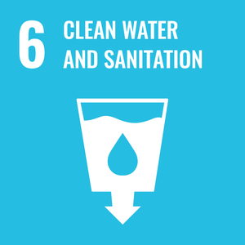
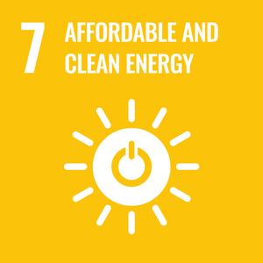
SDG 6 & 7 progress and finance split
Progress vs. finance in 48 Sub-Saharan African countries | Latest available year | 2015–2024
Source: UN SDG Global Data Portal | Chronic = absent across multiple years/cycles
Table 1: Top Sub-Saharan African Countries Progressing by SDG 6 & 7 Indicator Rankings^{[1]}
Source: Author's analysis based on data from the UN SDG Global Data Portal (SDG 6 and 7), not adjusted for population and data: unstats.un.org/sdgs/dataportal.
Note: Rwanda: reported 6.1.1 data is urban-only; reported 6.2.1a data is rural-only.
 |  | Top-5 Classification (count) |  | SDG split |  | ODA & finance flows (latest, USD M)
No. | Country | Progress (2015-2024) | Latest Rank | SDG 6 | SDG 7 | 6.a.1 (water) | 7.a.1 (energy)
1 | Rwanda* | 7 | 7 | 11 | 3 | 86.0 | 315
2 | South Africa | 5 | 9 | 10 | 4 | 9.2 | 935
3 | Benin | 8 | 4 | 9 | 3 | 66.4 | 23.4
4 | Mauritius | 3 | 9 | 7 | 5 | 66.2 | 3.7
5 | Tanzania | 7 | 4 | 8 | 3 | 297 | 558
Notes:
3

Slide 20






SDG 6.a.1 & 7.a.1 Financing Progress
(baseline to latest year e.g. 2024)
Source: UN SDG Global Data Portal | Chronic = absent across multiple years/cycles
6.a.1 Water and sanitation ODA:
The proportion of total water and sanitation-related ODA disbursements that are included in the government budget. Covers all SDG 6 target areas including WASH, wastewater, water efficiency, water resources management, and ecosystems.
1. Seychelles: $0.08M → $0.21M (+13.3%/yr)
2. Equatorial Guinea: ~$0 → $0.07M
3. Mauritius: $5.8M → $66.2M (+35.6%/yr in final year)
7.a.1 International clean-energy finance:
All official loans, grants and equity investments received by countries. Covers OECD/DAC CRS sector codes: 23210–23280 (RE generation by tech.), 23410 (hybrid plants), 23631 (isolated mini-grid transmission), 23182 (energy R&D).
1. Nigeria: $68.7M → $828.8M (+$760.1M abs)
2. Tanzania: $40.4M → $558.2M (+$517.8M abs)
3. Rwanda: ~$0M → $314.5M (+$314.5M abs)
Notes:
3

Slide 21
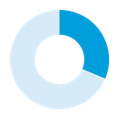
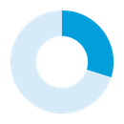
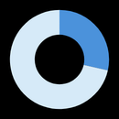
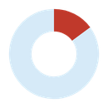
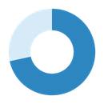
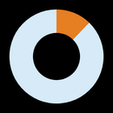
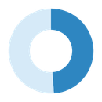
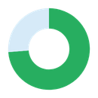
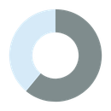
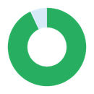
SDG 6: Clean Water & Sanitation
Sub-Saharan Africa | 48 Countries | 12 Indicators | Regional Averages | 2015–2024
Source: UN SDG Global Data Portal, World Bank, WHO, UNICEF | Unweighted country averages | ▲ = Progress Leaders | ▼ = Challenges
REGIONAL AVERAGES
6.1.1 Safely Managed
Drinking Water
6.2.1a Safely Managed
Sanitation
6.2.1b Basic
Handwashing
6.3.1 Wastewater
Safely Treated
31.8%
30.1%
28.1%
14.4%
+2.9 pp since 2015
+4.9 pp since 2015
+5.9 pp since 2015
−1.3 pp (declining)
▲ Ghana +12.1pp, Rwanda +10.8pp, Tanzania +10.3pp
▲ South Africa +16.5pp (#1 all ranks), Malawi +14.5pp, Rwanda +12.4pp
▲ Kenya +42.3pp (largest any indicator), Lesotho +17.2pp, Comoros +14.5pp
▲ Zimbabwe +32.3pp (doubled), Mauritius +13.6pp, Tanzania +1.7pp
▼ Botswana -5.4pp (continuous), Zambia -2.8pp, Zimbabwe -1.7pp
▼ Gambia -4.2pp (worst), Zimbabwe -2.5pp, Mauritius -2.3pp
▼ Somalia -13.7pp (continuous), Mauritania -10.7pp, Ethiopia -2.9pp
▼ South Africa -39.7pp (most severe in dataset), Nigeria -7.6pp
6.3.2 Water Bodies
Good Quality
$26.8
6.4.1 Water-Use
Efficiency
6.4.2 Water
Stress
6.5.1 IWRM
Implementation
72.7%
12.2%
48.9%
+8.6 pp since 2017
USD/m³
+$2.3/m³ since 2015
+1.4 pp (worsening)
+8.5 pp since 2017
Lower = better
▲ Sierra Leone +28.3pp, South Africa +23.8pp, Lesotho +23.0pp
▲ Guinea-Bissau +$2.36, Ethiopia +$2.30, DRC +$19.63 (high + growth)
▲ Namibia -0.19pp (only genuine stress reduction in region)
▲ Rwanda +33pp (#1 progress + level), Angola +25pp, Somalia +24pp
▼ Burkina Faso -88.7pp (extreme), Ethiopia -24.1pp, Kenya -49.4pp
▼ Congo -$35.65, Angola -$15.76; oil economies declining
▼ Cabo Verde +22.4pp, Zimbabwe +14.2pp, South Africa +7.8pp
▼ South Africa -5pp (regression), Uganda -2pp; pace halved
6.5.2 Transboundary
Cooperation
$54.7M
6.a.1 ODA for
Water & Sanitation
6.b.1a Community
Participation Level
6.b.1b Participation
Defined in Law
71.6%
1.87/3
9.33/10
+17.0 pp since 2017
avg/country
+$1.6M (flat in real terms)
Plateaued since 2019
+0.26 (recovered)
Scale 0–3
Most at score 10
▲ Sierra Leone +93pp (to 100%), Senegal +65pp, Guinea-Bissau +57pp
▲ Ethiopia $337M, Tanzania $297M, Kenya $154M (top 3, 2023)
▲ Botswana, Comoros, Lesotho, Senegal: Low to High (1→3)
▲ Cameroon, Comoros, DRC, Seychelles, S. Africa: rose to 10
▼ Cameroon -16pp, Chad -5.6pp; 3 countries still at 0%
▼ Nigeria/Ghana/DRC halved; regional avg flat since 2015
▼ Congo, Liberia, Ethiopia, S. Sudan: High to Low (3→1)
▼ Congo, Gabon, Senegal: 10→5; Côte d'Ivoire dropped to 0
KEY FINDINGS:
  Progress is uneven across SDG 6: governance indicators improved faster than infrastructure and service access.
  Regional averages are dependent on data coverage and may be biased upward where many low-capacity countries are missing.
  Drinking water, sanitation, and handwashing improved, but current levels remain far below universal access.
  Wastewater and water stress show that environmental outcomes are not improving uniformly.
Notes:
1

Slide 22
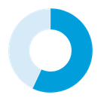
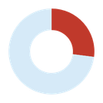
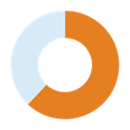
SDG 7: Affordable & Clean Energy
Sub-Saharan Africa | 48 Countries | 6 Indicators | Regional Averages | 2015–2023
Source: World Bank, IEA, IRENA, WHO, UN Stats Division | Unweighted averages | ▲ = Progress Leaders | ▼ = Challenges
REGIONAL AVERAGES
56.5%
7.1.1 Access to
Electricity
25.6%
7.1.2 Clean Fuels
for Cooking
59.3%
7.2.1 Renewable
Energy Share
+12.9 pp since 2015
+4.3 pp since 2015
−2.8 pp (declining)
▲ Rwanda +41.1pp (on track), Kenya +34.6pp, Uganda +33.0pp
▲ Nigeria +20.5pp (5.7→26.2%), Kenya +19.0pp, Côte d'Ivoire +18.2pp
▲ Djibouti +11.8pp (genuine solar/wind), Gabon +9.0pp
▼ Somalia -0.9pp (only decliner), S. Sudan 5.4% (lowest)
▼ Zambia -4.8pp (consistent), S. Sudan at 0% all years
▼ Comoros -27.8pp, Mali -14.0pp (may reflect modernisation)
4.74
7.3.1 Energy
Intensity
$97.5M
7.a.1 Int'l Financial
Flows (Clean Energy)
48.9
7.b.1 Installed
Renewable Capacity
MJ/USD
−0.06 (slight improvement)
avg/country
Highly volatile year-to-year
W/cap
+14.2 W/cap (+12.4% CAGR)
▲ Ethiopia -2.34 MJ/USD (largest gain), Guinea-Bissau -1.27, Tanzania -1.27
▲ Nigeria +$760M (to $829M), Tanzania +$518M, Rwanda +$315M
▲ Seychelles +111 W/cap, South Africa +107.6, Mauritius +79.1
▼ Liberia +1.89 (worst, worsening), Congo +1.71, Eq Guinea +1.62
▼ Uganda -$1,395M (spike distortion), Liberia -$283M
▼ Gabon -28.9, Eq Guinea -17.6; Chad at 0.25 W/cap
KEY FINDINGS:
  Progress is uneven across SDG 7: electrification and renewable capacity improved faster than energy efficiency.
  Electricity access improved.
  The falling renewable share partly reflects modernization away from traditional biomass.
  Finance and capacity averages are volatile and can be skewed by a few countries.
Notes:
2

Slide 23
Solution: Budgetary Coordination & Pooled Financing for Cross-Sectoral Investment
Nexus governance = nexus finance. Institutional coordination mechanisms must be matched by
fiscal instruments that incentivise integrated investment and break siloed budget lines.
Joint Budget Lines
NDC-Linked Climate Finance
Multi-ministry appropriations requiring co-signature; common in integrated watershed programmes
COP29 commitments to triple public finance for vulnerability; WEFE nexus investments eligible under GCF, GEF, AF, LDCF
Pooled Funding Mechanisms
Results-Based Financing
Common fund managed by a coordinating body (e.g. national climate fund drawing on water + energy + agriculture allocations)
Payment for verified co-benefits (e.g. water savings + GHG reduction + food productivity); REIPPPP: 130M kl saved
Blended Finance Structures
Development Bank Co-financing w priority valuation for WEF solutions
Public anchor investment de-risks private co-financing for nexus projects (infrastructure, solar irrigation, mini-grids)
World Bank, ADB, EIB multi-sector lending windows; IDA window for nexus-aligned national programmes

Slide 24
SDG 6 & 7: Sub-Saharan Africa - Water & Energy Projects
Key climate adaptation, WASH infrastructure & renewable energy funded projects | GCF, World Bank, AfDB, GEF funded
Source: GCF Project Portfolio, World Bank, AfDB, GEF | Funding = total approved (may include co-financing)
WASH & WATER RESOURCE MANAGEMENT
ENERGY ACCESS & MITIGATION
Project | Country | Focus | USD | Status
SA Water Reuse (FP209) | South Africa | Wastewater treatment & reuse | 235M | est. completion Oct. 2033
Irrigation Reform (P123112) | Nigeria | Irrigation, drainage, IWRM | 409M | Closed (30 Jun 2025)
Urban WSS (P156433) | Ethiopia | Urban water supply & sanitation | 445M | Under implementation est. completion 30 June 2027
Simiyu Climate (FP041) | Tanzania | WASH, resilient water, CSA | 203M | Under implementation; est. completion Aug 2025
Rural WSS (P164262) | Senegal | Rural WASH, WRM capacity | 130M | Closed (2024)
Drought Resilience (FP058) | Ethiopia | Drinking water, small irrigation | 50M | Under implementation
Project | Country | Focus | USD | Status
Solar Mini-grids (FP102) | Mali | Off-grid PV 4.83MW, 50 communities | 82M | Under implementation; est. completion 2027
Solar + Storage (FP096) | DRC | ~30MW solar capacity, 3 towns | 60M | Under implementation, est. completion 11 Aug 2027
Off-grid Solar (FP138) | Senegal | 1,000 villages off-grid solar | 77M | Under implementation
REPP 2 Facility | Multi-country | Blended finance, 7.7M people | 250M | est. completion 2044
Climate-Friendly Cooking | Kenya/Senegal | Improved cookstoves, 11.2M benef. | 65.8M | Under implementation
Menengai Geothermal | Kenya | 500K households, 300K businesses | Geothermal power (35MW plant) | Construction / under implementation
WATER-ENERGY NEXUS PILOT ETHIOPIA
HYDROMET & EARLY WARNING SYSTEMS
FP243 Safe Water Powered by Renewable Energy (Ethiopia, USD 50M, 2024 approved)
Solar-powered water pumping for drinking water and irrigation.
Reduces diesel dependence + improving water access, irrigation efficiency, and resilience.
Pilot and potential Model for integrated nexus programming.
Malawi: Flood warning systems
Mali: Hydromet modernization
Burkina Faso: Early warning systems and climate services
Volta Basin: Cross-border flood and drought management
Wider shift toward climate-information services and institutional resilience alongside infrastructure investment.
Notes:
3

Slide 25
Analytical Tool: Nexus Governance Assessment Framework
Can be applied to national or subnational governance context as a diagnostic and planning tool
1. Mandate Mapping
2. Coordination Audit
3. Planning Coherence
Who governs each nexus sector? Where do mandates overlap or conflict?
What formal and informal mechanisms exist for cross-sector coordination?
Are NDPs, sector strategies and NDCs aligned on nexus priorities?
Ministerial inventory matrix (as per SSA study)
Coordination spectrum assessment (from ad hoc to statutory)
Policy coherence scoring rubric; SDG interlinkage analysis
4. Finance Alignment
5. Stakeholder Inclusion
6. Monitoring & Accountability
Are budget lines and financing instruments designed for integrated investment?
Are marginalised groups (women, youth, indigenous) meaningfully engaged?
Are nexus outcomes tracked across sectors with shared indicators?
Nexus investment screening tool (SADC model); TOSSD tagging
Participation quality index; FPIC compliance review
Joint monitoring framework; CLEWs scenario modelling for baselines

Slide 26
Discussion Questions & Module Assignment
DISCUSSION QUESTIONS
APPLYING KNOWLEDGE: MODULE ASSIGNMENT
OPTIONAL ASSIGNMENT
Select a country of your choice. Using the 6-dimension Nexus Governance Assessment Framework from Slide 13:
(1) Map ministerial mandates across WEF sectors
(2) Identify any coordination mechanism in use
(3) Assess one gap and propose a concrete institutional reform – how would you reduce ministerial overlaps?
Why does public governance matter for Water-Energy-Food systems and resource security?
Which coordination mechanism is most appropriate for your country context, and what are the enabling conditions for establishing it?
For some countries the WEF Nexus is essential for rural development and access to water-energy-food security. If you were a minister of water or energy, how would you design a stakeholder engagement process for a nexus initiative that includes meaningful participation from women farmers, rural decisionmakers, and youth entrepreneurs?
If you were a minister of water in a least developed country with 40% of the national budget comprised of development assistance, how would you finance progress on water-energy-food applying the nexus governance and points in the module?

Slide 27
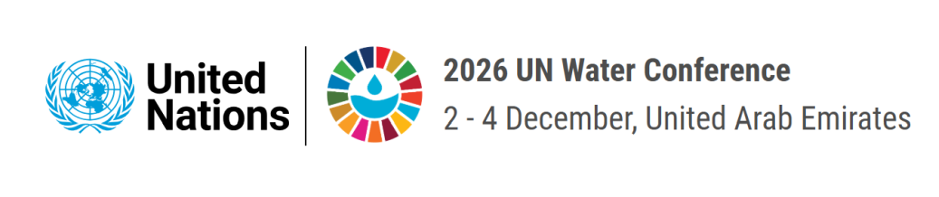
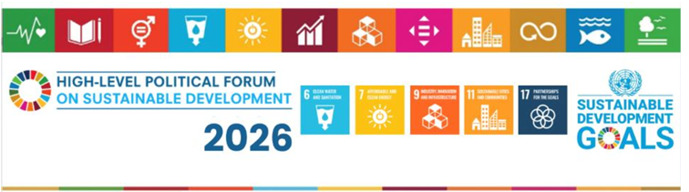
Key messages
①
Break the silos in climate and public finance.
②
To maximize impact ensure localized focus.
Direct to needs essential with targeting women, youth, smallholders or vulnerable areas.
Africa receives only 23% of its NDC investment needs. Finance flows to water, energy, and food sectors in isolation, forfeiting critical multiplier effects. Expenditure can be optimized through nexus.
Climate finance must reach women, youth and smallholder farmers, both primary resource managers and primary climate victims and yield greatest impacts across SDGs
③
Blended finance and results-based mechanisms are essential.
④
At regional level – bridge Continental plans and finance on water, energy, food
Green bonds, payment-for-ecosystem-services, and PPPs must be scaled specifically for nexus projects, with standardised multi-sector valuation frameworks – working across ministries bridging budget silos
- The Continental Africa Water Investment Programme (AIP) raise US$30 billion annually by 2030 for water security and sustainable sanitation
- African Continental Master Plan (CMP) collaborative strategy for single connected African electricity market
- AU 10-year CAADP Strategy and Action Plan (2026–2035) adopted 2025 Kampala Summit for agrifood systems
⑤
Ensure regional voice calls for more efficient/integrated WEF nexus finance in global agendas

Slide 28
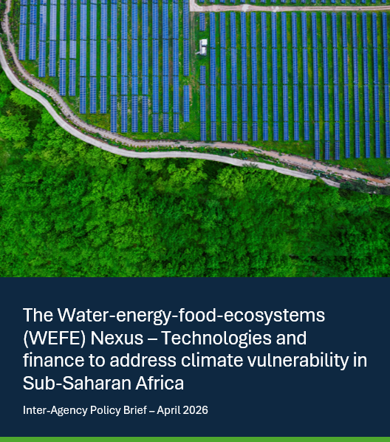



Thank you.
https://unosd.un.org/
sara.castrohallgren@un.org / https://kr.linkedin.com/in/scastrohallgren

