Slide 1
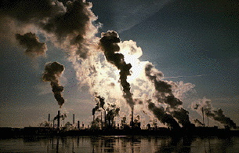
Cleaner Production and Industrial Resource Management
Maarten A. Siebel
UNESCO - IHE, Delft, The Netherlands

Slide 2
Contents
Trend-setting intro
Theoretical concept of Eco-efficiency
What is Cleaner Production, how it is achieved?
Financial benefits of Cleaner Production
Future developments
In this unit
Notes:
Just very fine. Although, should we repeat the word ‘contents’ here (and on the subsequent sheets)?

Slide 3
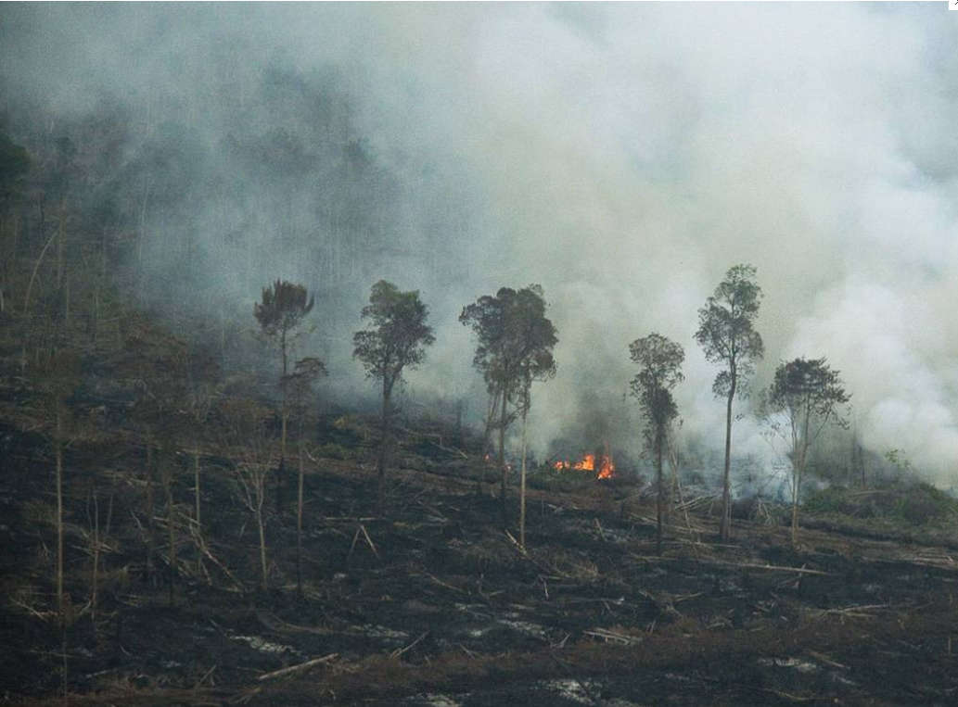
Recent Headlines (1)
Burned forest giants - remembrance of rainforest (Java, 2012)
Notes:
Fine although the formatting of the text isn’t very nice I feel.

Slide 4
Recent Headlines (2)
Greenhouse effect unavoidable with continued CO2 production
Click to watch video: An Inconvenient truth from Al Gore (2006)
(Right click on the link below and click ‘open hyperlink’ to watch the video)
Notes:
Fine.

Slide 5
Recent Headlines (3)
The Disappearing Rainforests
Rainforests once covered 14% of the earth's land surface; now just 6%.
Experts estimate remaining rainforests consumed in less than 40 years.
6000 m² of rainforest lost every second; tragic consequences for both developing and industrial countries.
Nearly half of the world's species of plants, animals and microorganisms destroyed or severely threatened over next quarter century due to rainforest deforestation.
Estimates suggest the loss of 137 plant, animal and insect species every day due to rainforest deforestation (50,000 per year).
Currently, 121 prescription drugs sold worldwide come from plant-derived sources. 25% of pharmaceuticals are derived from rainforest ingredients but less that 1% of this rainforest potential has been tested.
There were an estimated ten million Indians living in the Amazonian Rainforest five centuries ago. Today there are less than 200,000.
(http://www.rain-tree.com/facts.htm)
Notes:
As opposed to the previous sheet where the picture could be related to both entries, this poor tree picture only relates to the second entry. It would be nice if we could find a picture related to the mother milk issue (an solid waste incineration plant, near a field where milk-producing cows are running around) so that this picture could solely related to the acid rain issue.

Slide 6
Global environmental problems (1)
Causing factors
  Growth of the size of the population
Notes:
The population explosion graph of sheet 10 should come here.

Slide 7
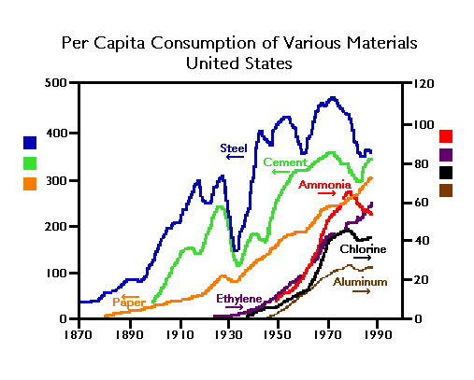
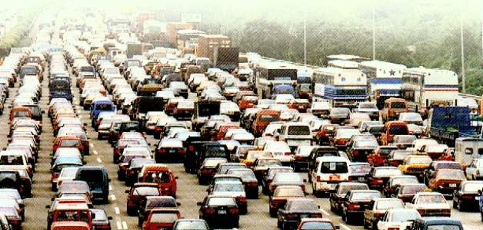
Global environmental problems (2)
Causing factors
  Increasing global per capita material demand
(Source: Ross, M., Larson, E.D., and Williams, R.H. 1987. “Energy Demand and Materials Flows in the Economy.” Energy 12(10/11):953-967.)
Notes:
Fine

Slide 8
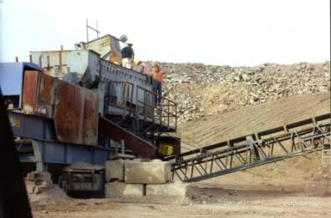
Global environmental problems (3)
Causing factors
  Industrial material and energy inefficiency
  http://www.youtube.com/watch?v=kpVICwyiVxU
(Right click on the link below and click ‘open hyperlink’ to watch the video)
Notes:
Fine

Slide 9
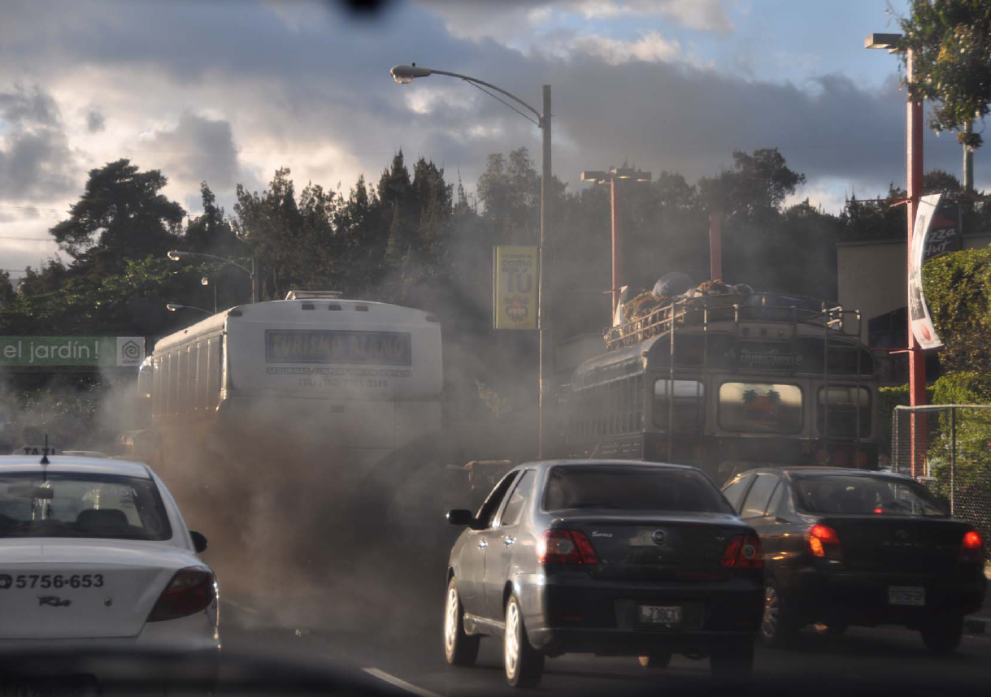
Eco-responsibility (1)
Global warming - How business is involved?
  By burning fossil fuels in power stations and heating systems.
  By allowing the evaporation or release of certain chlorinated solvents and CFC’s.
  By poor maintenance: inefficient vehicles, processes, machinery
Notes:
I would prefer to have smaller margins so that each entry has at most two lines, as done in the next sheet.
In next 6 sheets we have only text. A picture of a smoking power plant could be fine here.

Slide 10
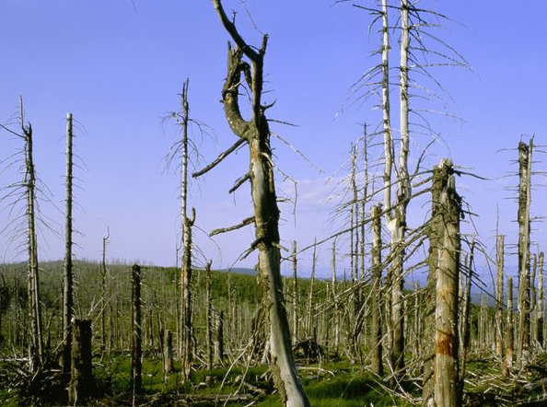
Eco-responsibility (2)
Acid Rain - How business is involved?
  By using electricity generated from sulphur-richt fossil fuels and resisting the active support for renewable energy sources.
  By burning fossil fuels in factories and heating systems.
  By its dependence upon road transport.

Slide 11
Eco-responsibility (3)
Waste - How business is involved?
  By concentrating on cures and treatments for waste (“end of pipe” solutions) rather than preventing its creation.
  By not investigating methods for recycling and re-use of waste, for example paper, cans, glass, construction side materials.
  By failing to investigate waste-exchange schemes.

Slide 12
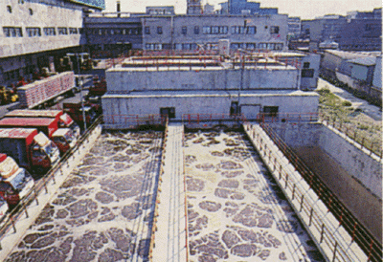
Eco-responsibility (4)
Waste?
  Conventional wisdom => waste treatment
Notes:
Fine

Slide 13
Eco-responsibility (5)
Waste treatment - How business and governments responded?
  In 1992 the US spent US$ 100 billion, the EU US$ 30 billion on ‘end-of-pipe’ treatment.
  HOWEVER: There is very little direct financial return to the industries that incur this expenditure
  Ecological Sustainable Industrial Development, UNIDO, 1994
Notes:
Fine

Slide 14

Eco-responsibility (6)
Is end-of-pipe treatment effective?
  Depletion of resources:
  Dilution of resources:
  Pollution of resources:
  Damage to resources:
  Not effective
  Not effective
  Effective
  Not effective
, sort of
Notes:
Fine

Slide 15

Eco-responsibility (7)
To waste or not to waste -
that's the question
Notes:
Can we had here a background picture of Shakespeare or another old and wise guy? I already tried with the picture of a good friend of mine which I happen to have on the computer.

Slide 16
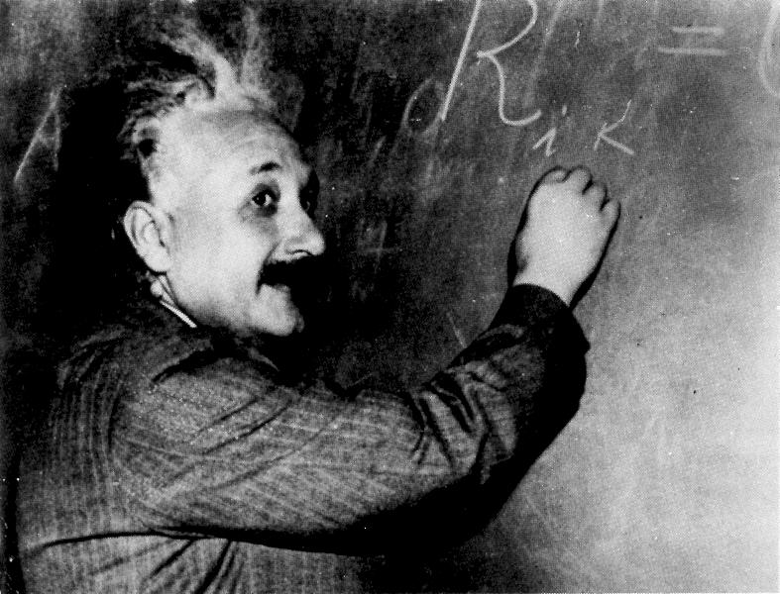
Contents
The inefficiency of producing waste
- theoretical considerations
Notes:
Just very fine. Although, should we repeat the word ‘contents’ here (and on the subsequent sheets)?

Slide 17
Eco-efficiency (1)
improving material use efficiency
raw
materials
products
products
products
products
waste
waste
waste
zero waste?
Notes:
Fine. May be the neta + line can be made to stick out a little more to the right and left. I changed that already.
Moreover, in presentation mode the taller characters are all cut off horizontally. I’m not sure why, it wasn’t before.

Slide 18
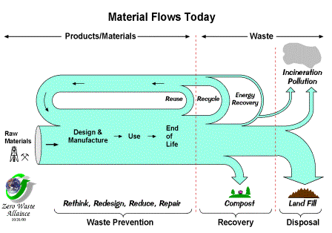
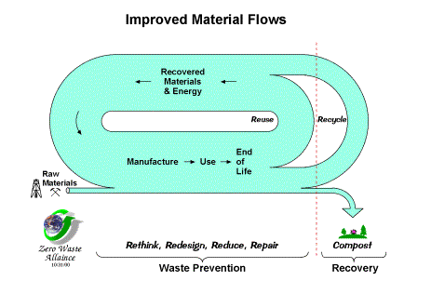
Eco-efficiency (2)
improving material use efficiency
Notes:
Fine. May be the neta + line can be made to stick out a little more to the right and left. I changed that already.
Moreover, in presentation mode the taller characters are all cut off horizontally. I’m not sure why, it wasn’t before.

Slide 19
Eco-efficiency (3)
Contemporary thinking:
To increase eco-logical efficiency,
improve management.
This is mostly also good for the
eco-nomical efficiency because …...
wasting resources is expensive
Notes:
Position of frame is a little changed

Slide 20

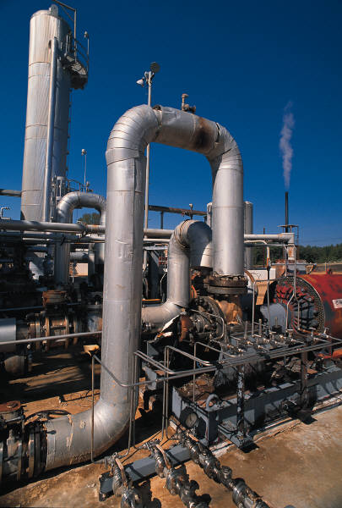
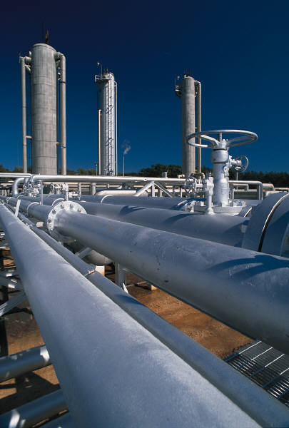
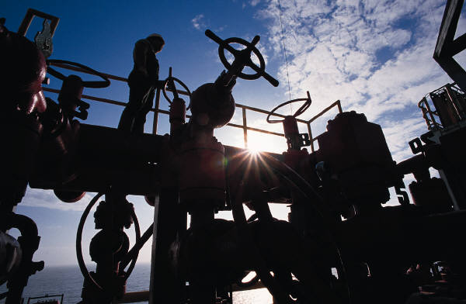
Eco-efficiency (4)
Improving management means improving knowledge about the precise process conditions.
This relates to knowing:
  Material quantities and flows
  Energy consumption
  Process details
  Temperatures,
  Pressures,
  Mixing conditions,
  Procedures,
  Etc.
Notes:
Fine

Slide 21
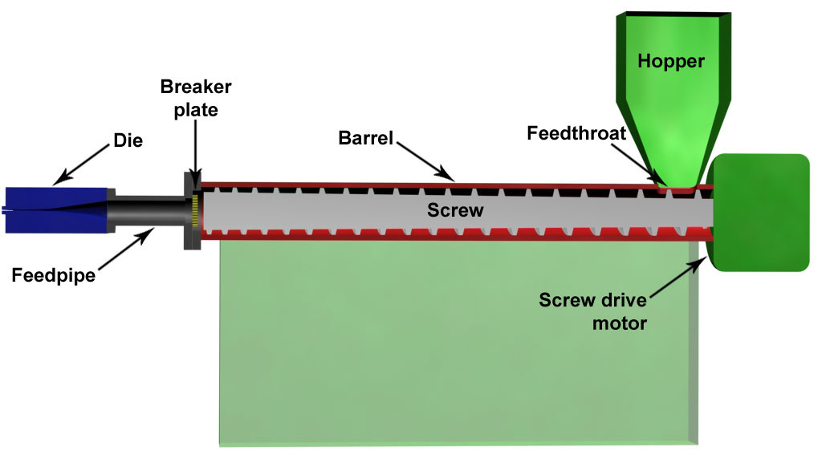
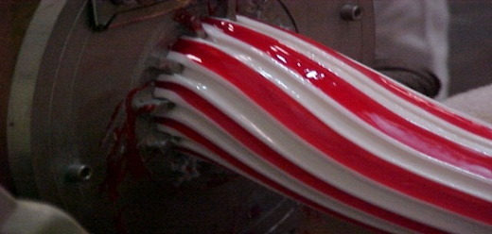
Eco-efficiency (5)
example
raw
materials
An extruder is a device that squeezes a plastic in molten form under pressures through a mould to deliver a material of the shape of the mold.
ENERGY
product leaving extrusion process
extruder
inputs
Notes:
Fine

Slide 22


Eco-efficiency (2)
example cont’d
Measurement of electrical energy consumption
energy
Notes:
I extended the dividing line. Also here the taller characters are cut off.

Slide 23
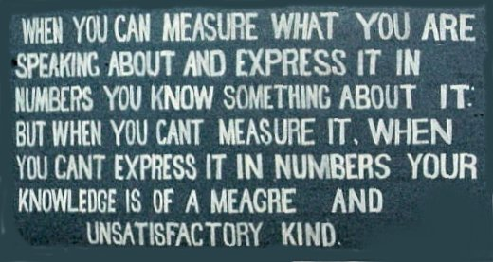
Eco-efficiency (6)
How can an industrial process work eco-optimally if information on important operational details is missing?
Notes:
Fine

Slide 24
Eco-efficiency (7)
First understand the process-technological details of your enterprise. Then improve the eco-efficiency of it
=
CLEANER PRODUCTION
Notes:
Fine

